Slide 1
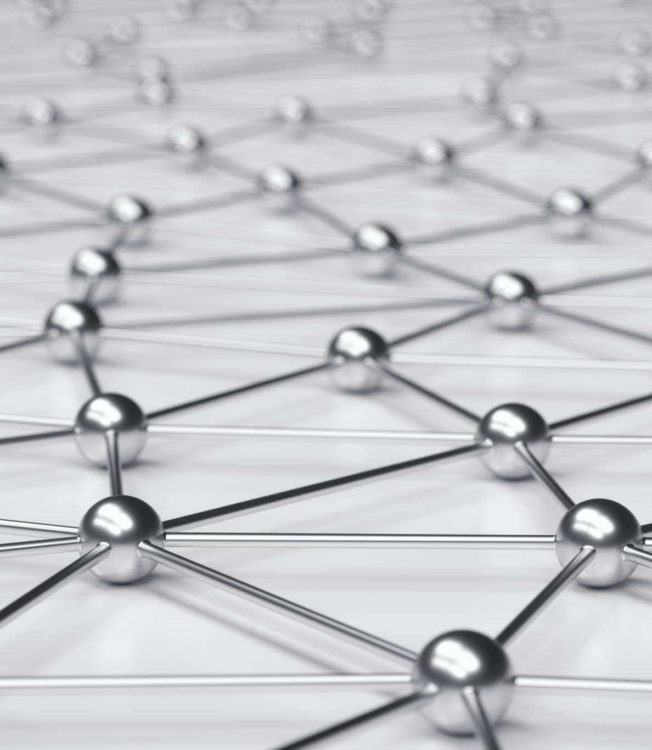
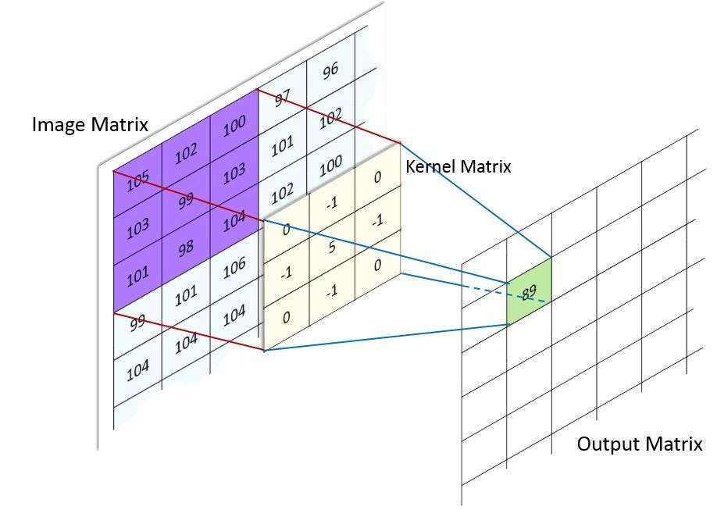
Convolutional Neural Networks

Slide 2
Convolutional Neural Networks
Convolution is a mathematical operation on two functions (let’s call them F₁and F₂) that produces a third function F₃
F₁ F₂ = F₃

Slide 3
Convolutional Neural Networks
For Convolutional Neural Networks, which focuses on image processing, it is often implemented as a matrix multiplication. Multiplying a large matrix (representing the image), by a smaller filter matrix (called the kernel) to enhance some of the features in the image.

Slide 5
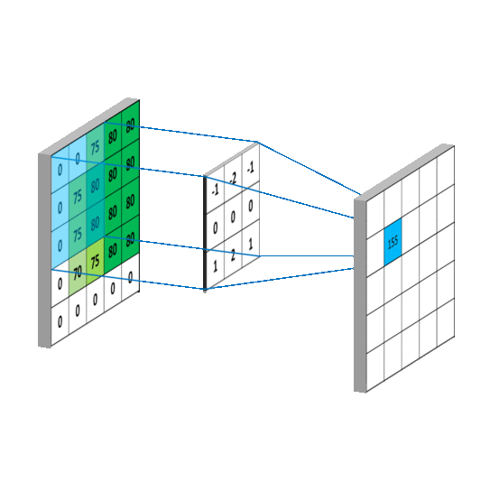

Slide 6
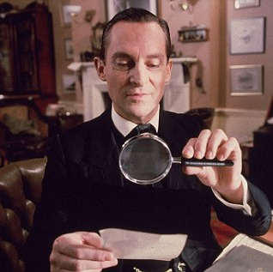
Convolutional Neural Networks
It’s like using a magnifying glass to examine small sections of the image instead of trying to understand the whole picture at once.

Slide 7
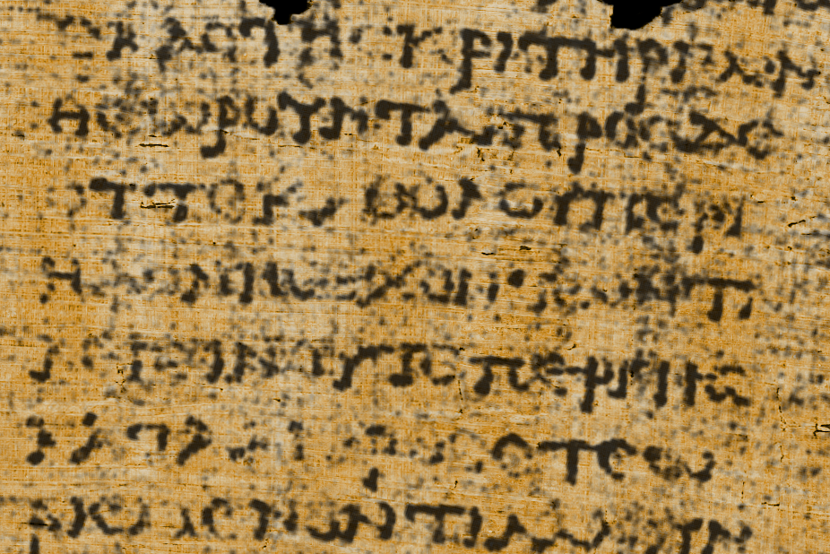

Slide 9
Convolutional Neural Networks
So the fours stages are:
Scanning Small Areas (Convolution Layer)
Finding Important Details (Feature Extraction)
Combining the Details (Pooling Layer)
Making a Decision (Fully Connected Layer)

Slide 10
Convolutional Neural Networks
Scanning Small Areas (Convolution Layer): Just like your magnifying glass moves over different parts of the image, a CNN slides a kernel over the image to detect patterns. At first, it might detect simple things like edges and corners.
Finding Important Details (Feature Extraction): As the CNN scans more areas, it starts to recognize shapes like circles, lines, or textures.
Combining the Details (Pooling Layer): You don’t need to remember every single tiny detail, just the important ones! A CNN does the same thing using Pooling, where it keeps the strongest signals and ignores unnecessary details (like shadows or background noise).
Making a Decision (Fully Connected Layer): After scanning the whole image, the CNN puts together everything it found.

Slide 11
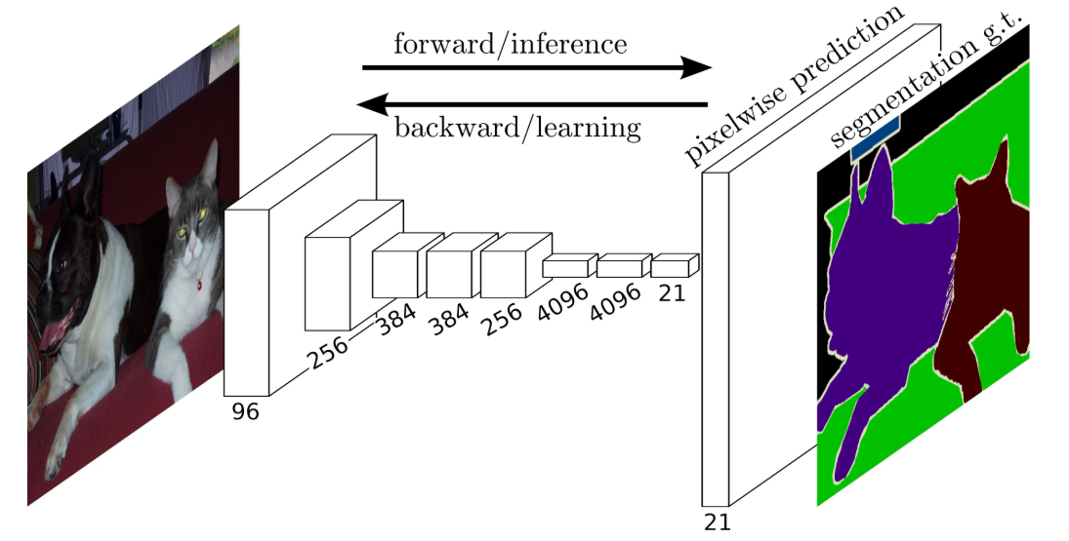

Slide 12
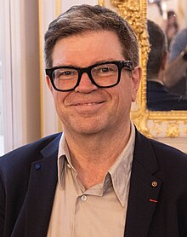
Convolutional Neural Networks
Yann LeCun
Born: 8 July 1960
Soisy-sous-Montmorency, France
A French-American computer scientist working primarily in the fields of machine learning, computer vision, mobile robotics and computational neuroscience. He is known for his work on CNNs.

Slide 13
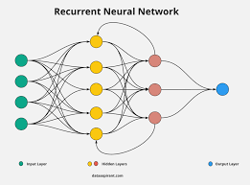
Recurrent Neural Networks

Slide 14
Recurrent Neural Networks
A Recurrent Neural Network (RNN) is a type of artificial neural network designed for sequential data.
Unlike traditional feedforward neural networks, RNNs have loops that allow information to persist, making them well-suited for tasks where previous inputs influence future outputs.

Slide 15
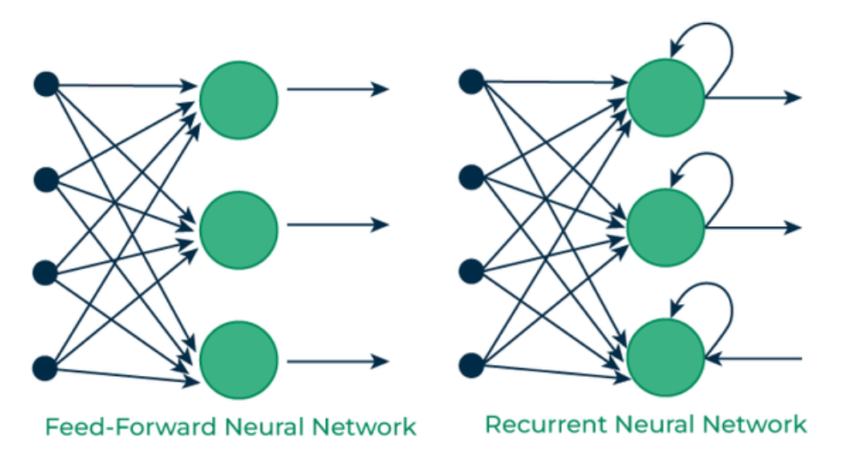

Slide 16
Recurrent Neural Networks
Key Features of RNNs:
Memory of Past Inputs: RNNs have connections that allow information from previous time steps to be used in the current time step.
Shared Weights: The same weights are used across different time steps, reducing the number of parameters compared to fully connected networks.
Sequential Processing: RNNs process input data step by step, making them ideal for time series, speech recognition, and natural language processing.

Slide 17
Recurrent Neural Networks
Applications of RNNs:
Natural Language Processing (NLP): Text generation, machine translation, sentiment analysis.
Speech Recognition: Transcribing spoken language into text.
Time Series Forecasting: Stock market prediction, weather forecasting.
Music Generation: Creating sequences of musical notes.

Slide 18
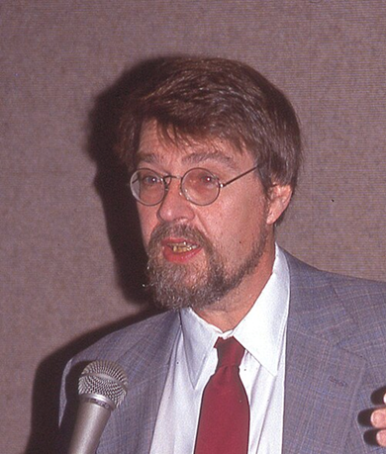
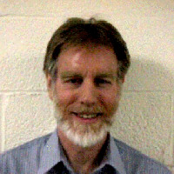
Recurrent Neural Networks
Recurrent Neural Networks (RNNs) were introduced by David Rumelhart and Ronald J. Williams in the 1980s. They developed the Backpropagation Through Time (BPTT) algorithm, which is used to train RNNs by adjusting weights based on past inputs.

Slide 19
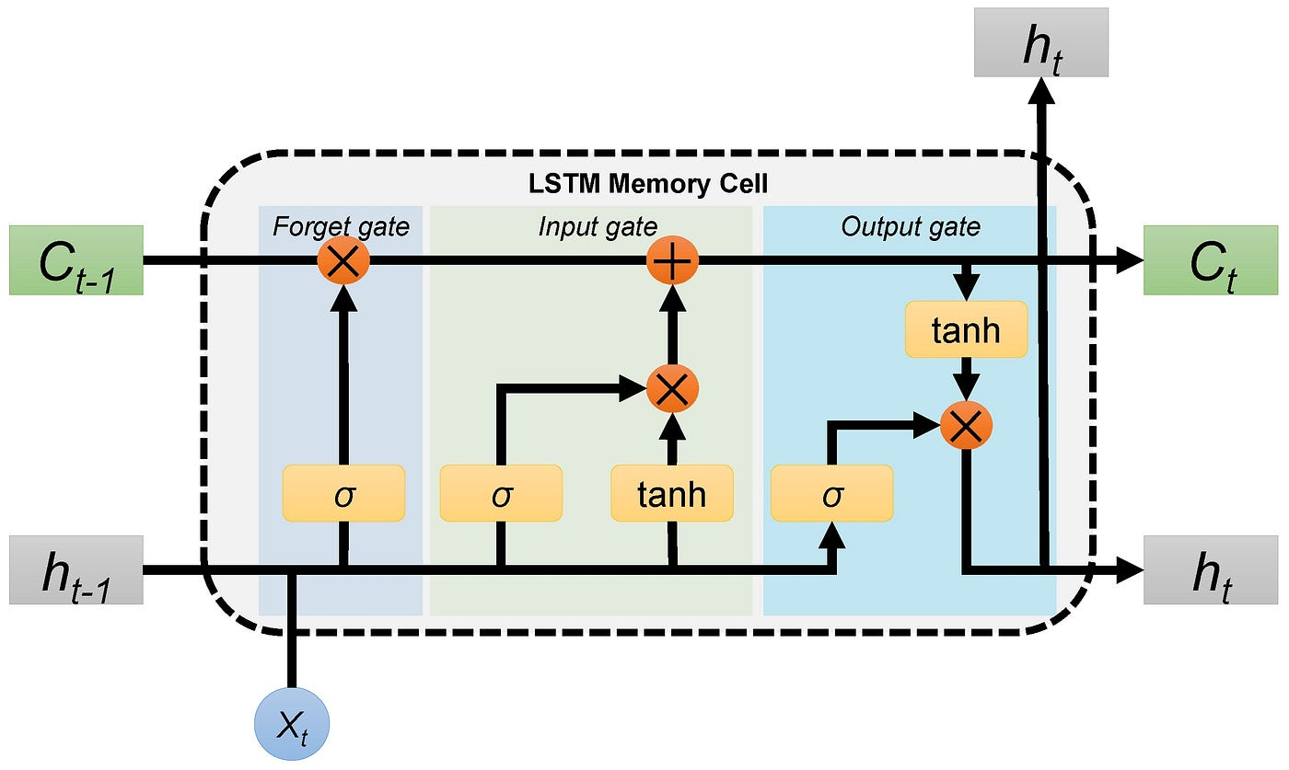
Long Short-Term Memory Networks

Slide 20
Long Short-Term Memory Networks
Long short-term memory (LSTM) is a specific type of recurrent neural network (RNN) aimed at mitigating the issue when a neural network forgets things from earlier steps because the learning signals become too weak.

Slide 21
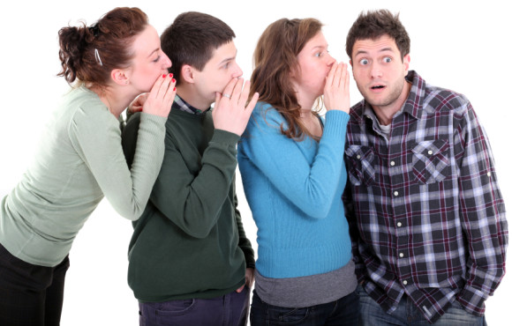
Long Short-Term Memory Networks
Think of it like passing a message through a long line of people. If each person whispers too softly, by the time the message reaches the last person, it’s almost gone or completely lost. In a neural network, this means the early layers stop learning because they don’t get enough updates.

Slide 22
Long Short-Term Memory Networks
Think of LSTM like a notepad:
It erases old notes that are no longer needed.
It adds new important notes when necessary.
It remembers useful notes from earlier.
LSTMs do this using three gates:
Forget Gate – Decides what information to erase.
Input Gate – Decides what new information to store.
Output Gate – Decides what part of the stored information to use for the output.

Slide 23
Long Short-Term Memory Networks
Candidate
The candidate is the potential new information that could be added to the memory (cell state). It is generated based on the current input and previous hidden state using a tanh activation.

Slide 24
Long Short-Term Memory Networks
New Cell State
The new cell state is the actual updated memory of the LSTM. It is formed by combining:
The old cell state (some parts are kept or forgotten via the forget gate).
The candidate (some parts are added via the input gate).

Slide 25
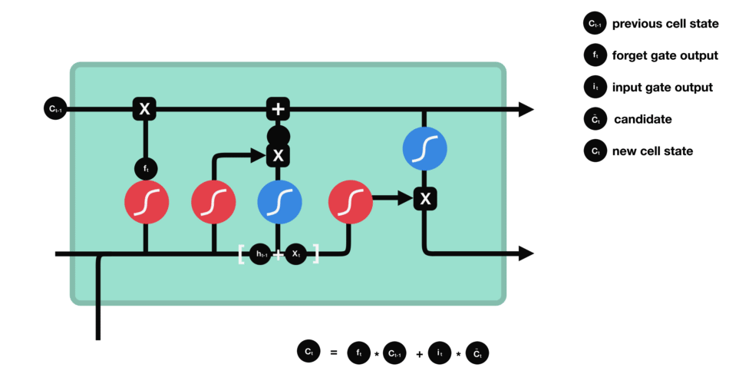

Slide 26
Long Short-Term Memory Networks
Example Use Cases
Predicting text (like autocomplete on your phone)
Speech recognition (turning speech into text)
Time-series forecasting (stock prices, weather predictions)

Slide 27
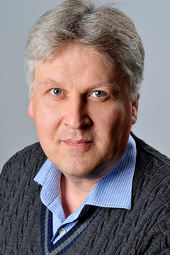
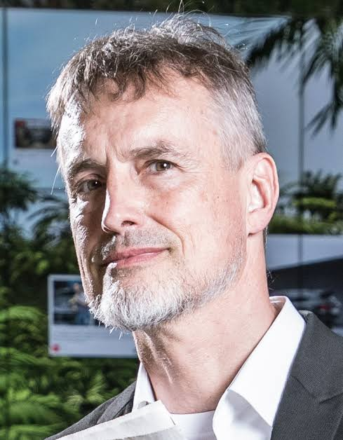
Long Short-Term Memory Networks
in 1997, Sepp Hochreiter and Jürgen Schmidhuber developed the Long Short-Term Memory (LSTM) network, which addressed the vanishing gradient problem in standard RNNs, making them more effective for long-sequence learning.

Slide 28
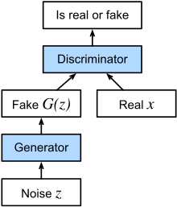
Generative Adversarial Networks

Slide 29
Generative Adversarial Networks
Generative Adversarial Networks (GANs) are a type of artificial intelligence model used to create new data that looks similar to real data.
They are widely used in image generation, deepfake creation, art generation, and data augmentation.

Slide 30
Generative Adversarial Networks
GANs have two parts that compete with each other:
Generator: Tries to create fake data (e.g., images that look like real photos). It learns to generate data that resembles real-world examples.
Discriminator: Tries to detect fake data and distinguish it from real data. This helps the generator improve by providing feedback.

Slide 31
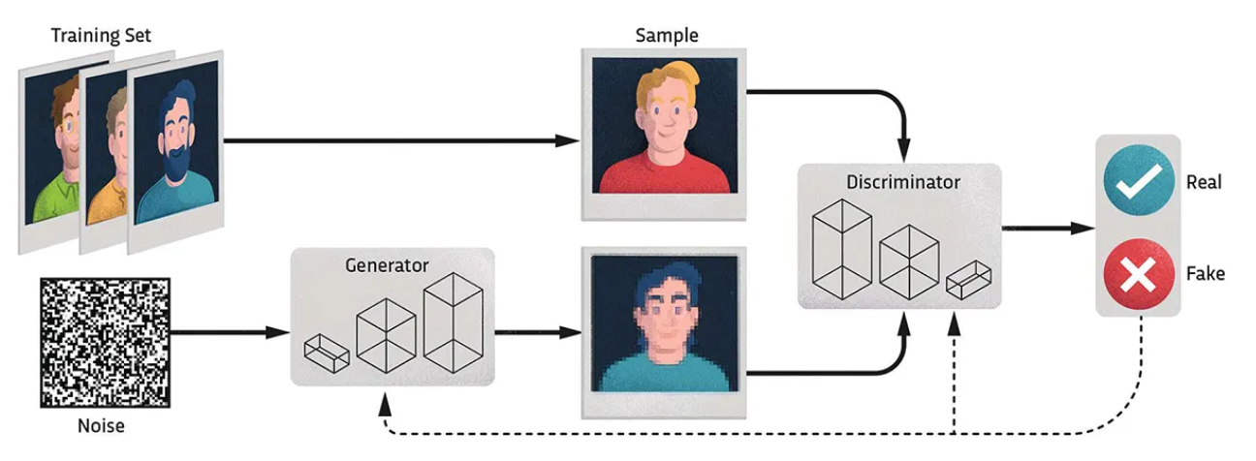

Slide 32
Generative Adversarial Networks
GANs have been used for transfer learning to enforce the alignment of the latent feature space, such as in deep reinforcement learning.
This works by feeding the embeddings of the source and target task to the discriminator which tries to guess the context.
The resulting loss is then (inversely) backpropagated through the encoder.

Slide 33
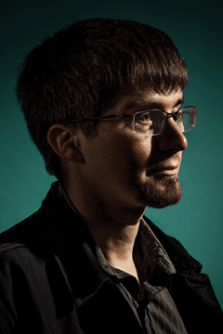
Generative Adversarial Networks
Ian Goodfellow
Born: 1987
An American computer scientist, most noted for his work on artificial neural networks. He is a research scientist at Google DeepMind. He is best known for inventing generative adversarial networks (GAN).

