Slide 1
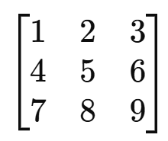
Matrix Operations
Damian Gordon

Slide 2
Matrix Operations
What is a Matrix?

Slide 3
Matrix Operations
What is a Matrix?
A Matrix is simple, it’s just a grid of numbers.

Slide 4
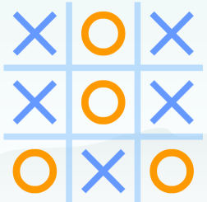
Matrix Operations
What is a Matrix?
It’s like a game of X’s and O’s, but with numbers.

Slide 5
Matrix Operations
What is a Matrix?
Working with matrices is like playing a game, you have to follow the rules of the game.

Slide 6
Matrix Operations
Why do we use Matrices?

Slide 7
Matrix Operations
Why do we use Matrices?
To solve simultaneous equations !!!

Slide 8
Matrix Operations
Simultaneous equations:
5x - 2y = 16
7x + 6y = -4

Slide 9
Matrix Operations
Simultaneous equations:
5x - 2y = 16
7x + 6y = -4
5 -2
7 6
x
y
16
-4
=

Slide 10
Matrix Addition

Slide 11
Matrix Addition
a b
c d
e f
g h
a+e b+f
c+g d+h
+
=

Slide 12
Matrix Addition
a b
c d
e f
g h
a+e b+f
c+g d+h
+
=
5 2
11 6
4 6
3 5
9 8
14 9
=
+

Slide 13
Matrix Subtraction

Slide 14
Matrix Subtraction
a b
c d
e f
g h
a-e b-f
c-g d-h
_
=

Slide 15
Matrix Subtraction
a b
c d
e f
g h
a-e b-f
c-g d-h
_
=
5 2
11 6
_
4 6
3 5
1 -4
8 1
=

Slide 16
Matrix Convolution

Slide 17
Matrix Convolution
a b
c d
e f
g h

Slide 18
Matrix Convolution
a b
c d
e f
g h
axe bxf
cxg dxh
=

Slide 19
Matrix Convolution
a b
c d
e f
g h
axe + bxf
+
cxg + dxh
axe bxf
cxg dxh
=

Slide 20
Matrix Convolution
a b
c d
e f
g h
axe + bxf
+
cxg + dxh
axe bxf
cxg dxh
=
5 2
11 6
4 6
3 5
20 12
33 30
=
95

Slide 21
Matrix Convolution
a b
c d
e f
g h
axe + bxf
+
cxg + dxh
axe bxf
cxg dxh
=
5 2
11 6
0 0
1 0
0 0
11 0
=
11

Slide 22
Matrix Convolution
a b
c d
e f
g h
axe + bxf
+
cxg + dxh
axe bxf
cxg dxh
=
5 2
11 6
0 0
1 1
0 0
11 6
=
17

Slide 23
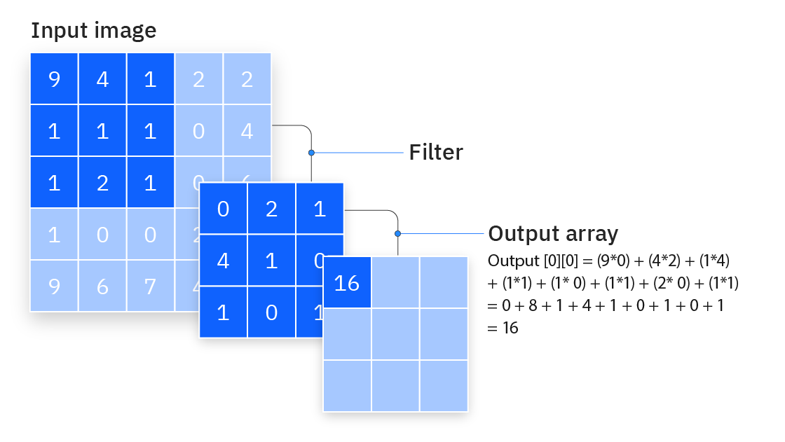

Slide 24
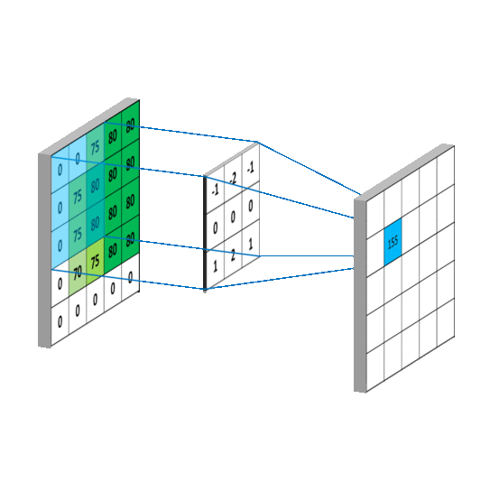

Slide 25
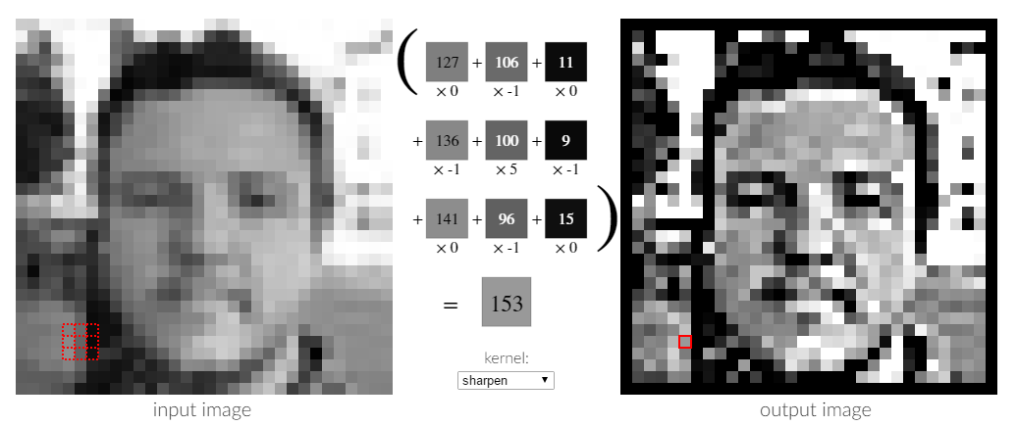

Slide 26
Matrix Multiplication

Slide 27
Matrix Multiplication
a b
c d
e f
g h
??? ???
??? ???
=
X

Slide 28
Matrix Multiplication
a b
c d
e f
g h
??? ???
??? ???
=
X

Slide 29
Matrix Multiplication
a b
c d
e f
g h
??? ???
??? ???
=
X

Slide 30
Matrix Multiplication
a b
c d
e f
g h
??? ???
??? ???
=
X

Slide 31
Matrix Multiplication
a b
c d
e f
g h
??? ???
??? ???
=
X

Slide 32
Matrix Multiplication
a b
c d
e f
g h
(axe) ???
??? ???
=
X

Slide 33
Matrix Multiplication
a b
c d
e f
g h
(axe)+(bxg) ???
??? ???
=
X

Slide 34
Matrix Multiplication
a b
c d
e f
g h
(axe)+(bxg) ???
??? ???
=
X

Slide 35
Matrix Multiplication
a b
c d
e f
g h
(axe)+(bxg) ???
??? ???
=
X

Slide 36
Matrix Multiplication
a b
c d
e f
g h
(axe)+(bxg) ???
??? ???
=
X

Slide 37
Matrix Multiplication
a b
c d
e f
g h
(axe)+(bxg) ???
??? ???
=
X

Slide 38
Matrix Multiplication
a b
c d
e f
g h
(axe)+(bxg) ???
??? ???
=
X

Slide 39
Matrix Multiplication
a b
c d
e f
g h
(axe)+(bxg) (axf)
??? ???
=
X

Slide 40
Matrix Multiplication
a b
c d
e f
g h
(axe)+(bxg) (axf)+(bxh)
??? ???
=
X

Slide 41
Matrix Multiplication
a b
c d
e f
g h
(axe)+(bxg) (axf)+(bxh)
??? ???
=
X

Slide 42
Matrix Multiplication
a b
c d
e f
g h
(axe)+(bxg) (axf)+(bxh)
??? ???
=
X

Slide 43
Matrix Multiplication
a b
c d
e f
g h
(axe)+(bxg) (axf)+(bxh)
??? ???
=
X

Slide 44
Matrix Multiplication
a b
c d
e f
g h
(axe)+(bxg) (axf)+(bxh)
??? ???
=
X

Slide 45
Matrix Multiplication
a b
c d
e f
g h
(axe)+(bxg) (axf)+(bxh)
??? ???
=
X

Slide 46
Matrix Multiplication
a b
c d
e f
g h
(axe)+(bxg) (axf)+(bxh)
(cxe) ???
=
X

Slide 47
Matrix Multiplication
a b
c d
e f
g h
(axe)+(bxg) (axf)+(bxh)
(cxe)+(dxg) ???
=
X

Slide 48
Matrix Multiplication
a b
c d
e f
g h
(axe)+(bxg) (axf)+(bxh)
(cxe)+(dxg) ???
=
X

Slide 49
Matrix Multiplication
a b
c d
e f
g h
(axe)+(bxg) (axf)+(bxh)
(cxe)+(dxg) ???
=
X

Slide 50
Matrix Multiplication
a b
c d
e f
g h
(axe)+(bxg) (axf)+(bxh)
(cxe)+(dxg) ???
=
X

Slide 51
Matrix Multiplication
a b
c d
e f
g h
(axe)+(bxg) (axf)+(bxh)
(cxe)+(dxg) ???
=
X

Slide 52
Matrix Multiplication
a b
c d
e f
g h
(axe)+(bxg) (axf)+(bxh)
(cxe)+(dxg) ???
=
X

Slide 53
Matrix Multiplication
a b
c d
e f
g h
(axe)+(bxg) (axf)+(bxh)
(cxe)+(dxg) (cxf)
=
X

Slide 54
Matrix Multiplication
a b
c d
e f
g h
(axe)+(bxg) (axf)+(bxh)
(cxe)+(dxg) (cxf)+(dxh)
=
X

Slide 55
Matrix Multiplication
a b
c d
e f
g h
(axe)+(bxg) (axf)+(bxh)
(cxe)+(dxg) (cxf)+(dxh)
=
X

Slide 56
Matrix Multiplication
a b
c d
e f
g h
(axe)+(bxg) (axf)+(bxh)
(cxe)+(dxg) (cxf)+(dxh)
=
X
5 2
11 6
4 6
3 5
X

Slide 57
Matrix Multiplication
a b
c d
e f
g h
(axe)+(bxg) (axf)+(bxh)
(cxe)+(dxg) (cxf)+(dxh)
=
X
5 2
11 6
4 6
3 5
5x4+2x3 5x6+2x5
11x4+6x3 11x6+6x5
=
X

Slide 58
Matrix Multiplication
a b
c d
e f
g h
(axe)+(bxg) (axf)+(bxh)
(cxe)+(dxg) (cxf)+(dxh)
=
X
5 2
11 6
4 6
3 5
20+6 30+10
44+18 66+30
=
X

Slide 59
Matrix Multiplication
a b
c d
e f
g h
(axe)+(bxg) (axf)+(bxh)
(cxe)+(dxg) (cxf)+(dxh)
=
X
5 2
11 6
4 6
3 5
26 40
62 96
=
X

