Slide 1
Introduction to Image Processing
Damian Gordon

Slide 2
Image Processing
Image processing involves analyzing, enhancing, and manipulating images using algorithms and mathematical techniques.

Slide 3
Image Processing
It is widely used in applications such as medical imaging, computer vision, and machine learning to extract meaningful information from visual data.

Slide 4
Image Processing
With advancements in artificial intelligence and deep learning, modern image processing techniques enable tasks like object recognition, image restoration, and real-time video analysis.

Slide 5
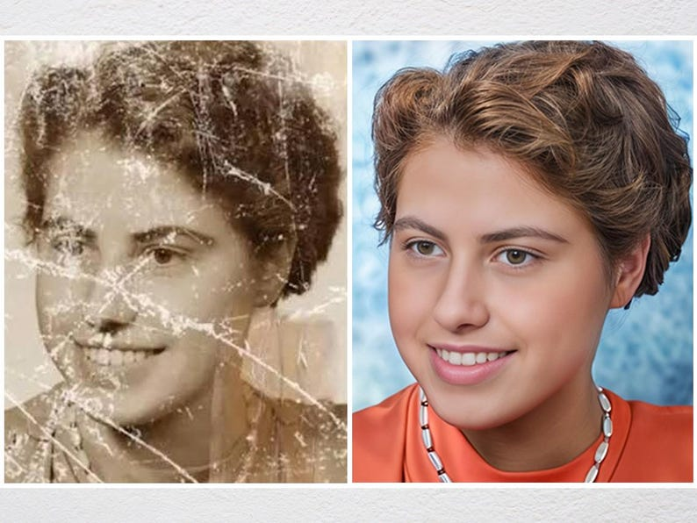

Slide 6
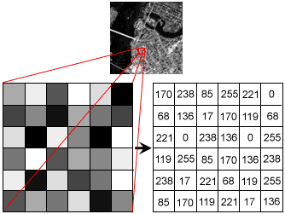

Slide 7
What is Pixels?
A pixel (“picture element”) is the basic unit of programmable content on a computer display or in a computer image.
Up to millions of pixels make up an image or video on a device's screen.

Slide 8
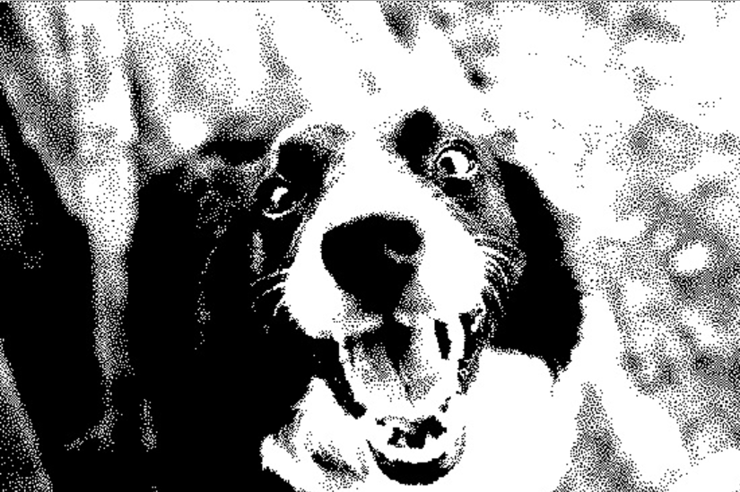
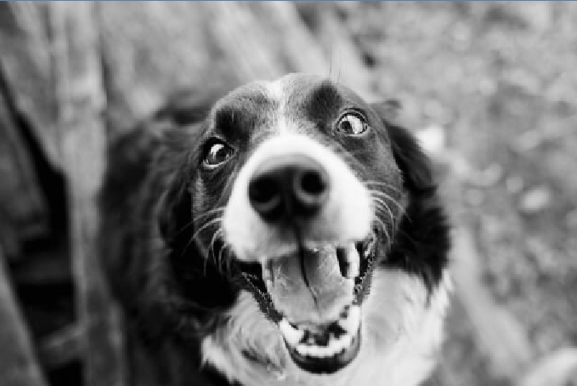
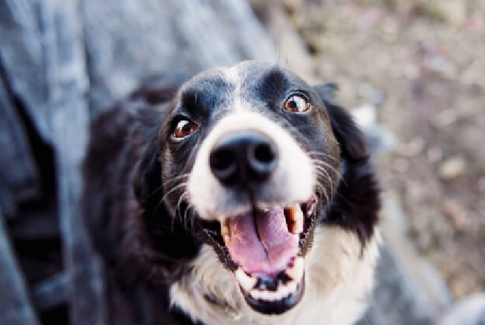
B & W Image
Greyscale Image
Colour Image

Slide 9
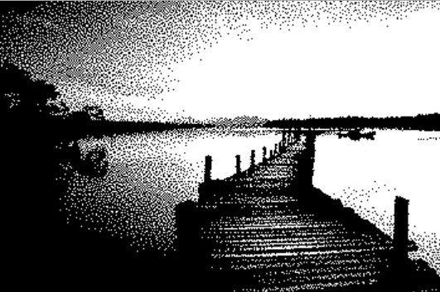
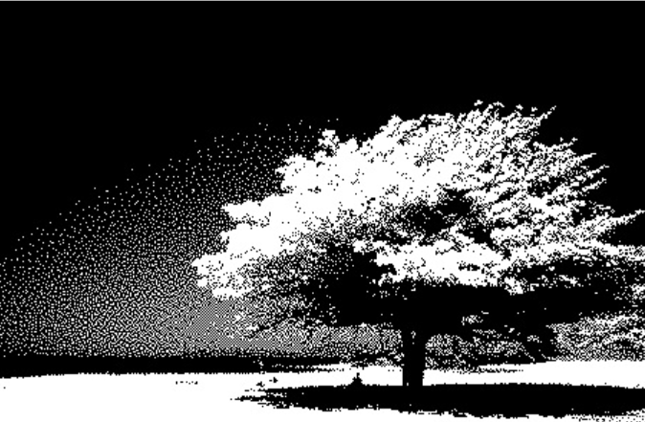
B & W Images

Slide 10
Image Processing
If we think about an image that has just black or white pixels, we can represent those colours as follows:
Black is 0 (the complete absence of light).
White is 1 (the maximum intensity of light).

Slide 11
Image Processing
1 | 1 | 1 | 1 | 1 | 0 | 0 | 0 | 0 | 0
1 | 1 | 1 | 1 | 1 | 0 | 0 | 0 | 0 | 0
1 | 1 | 1 | 1 | 1 | 0 | 0 | 0 | 0 | 0
1 | 1 | 1 | 1 | 1 | 0 | 0 | 0 | 0 | 0
1 | 1 | 1 | 1 | 1 | 0 | 0 | 0 | 0 | 0
1 | 1 | 1 | 1 | 1 | 0 | 0 | 0 | 0 | 0
1 | 1 | 1 | 1 | 1 | 0 | 0 | 0 | 0 | 0
1 | 1 | 1 | 1 | 1 | 0 | 0 | 0 | 0 | 0
1 | 1 | 1 | 1 | 1 | 0 | 0 | 0 | 0 | 0
1 | 1 | 1 | 1 | 1 | 0 | 0 | 0 | 0 | 0

Slide 12
Image Processing
0 | 0 | 0 | 1 | 1 | 0 | 0 | 0 | 0 | 0
0 | 0 | 0 | 1 | 1 | 0 | 0 | 0 | 0 | 0
0 | 0 | 0 | 1 | 1 | 0 | 0 | 0 | 0 | 0
0 | 0 | 0 | 1 | 1 | 0 | 0 | 0 | 0 | 0
0 | 0 | 0 | 1 | 1 | 0 | 0 | 0 | 0 | 0
0 | 0 | 0 | 1 | 1 | 0 | 0 | 0 | 0 | 0
0 | 0 | 0 | 1 | 1 | 0 | 0 | 0 | 0 | 0
0 | 0 | 0 | 1 | 1 | 0 | 0 | 0 | 0 | 0
0 | 0 | 0 | 1 | 1 | 0 | 0 | 0 | 0 | 0
0 | 0 | 0 | 1 | 1 | 0 | 0 | 0 | 0 | 0

Slide 13
Image Processing
1 | 1 | 1 | 1 | 1 | 1 | 1 | 1 | 1 | 1
1 | 1 | 1 | 1 | 1 | 1 | 1 | 1 | 1 | 1
1 | 1 | 1 | 1 | 1 | 1 | 1 | 1 | 1 | 1
1 | 1 | 1 | 1 | 1 | 1 | 1 | 1 | 1 | 1
0 | 0 | 0 | 1 | 1 | 0 | 0 | 0 | 0 | 0
0 | 0 | 0 | 1 | 1 | 0 | 0 | 0 | 0 | 0
0 | 0 | 0 | 1 | 1 | 0 | 0 | 0 | 0 | 0
0 | 0 | 0 | 1 | 1 | 0 | 0 | 0 | 0 | 0
0 | 0 | 0 | 1 | 1 | 0 | 0 | 0 | 0 | 0
0 | 0 | 0 | 1 | 1 | 0 | 0 | 0 | 0 | 0

Slide 14
Image Processing
1 | 1 | 0 | 0 | 0 | 0 | 0 | 1 | 1 | 1
1 | 1 | 0 | 1 | 1 | 1 | 1 | 0 | 1 | 1
1 | 1 | 0 | 1 | 1 | 1 | 1 | 1 | 0 | 1
1 | 1 | 0 | 1 | 1 | 1 | 1 | 1 | 0 | 1
1 | 1 | 0 | 1 | 1 | 1 | 1 | 0 | 1 | 1
1 | 1 | 0 | 0 | 0 | 0 | 0 | 1 | 1 | 1
1 | 1 | 0 | 1 | 1 | 0 | 1 | 1 | 1 | 1
1 | 1 | 0 | 1 | 1 | 1 | 0 | 1 | 1 | 1
1 | 1 | 0 | 1 | 1 | 1 | 1 | 0 | 1 | 1
1 | 1 | 0 | 1 | 1 | 1 | 1 | 1 | 0 | 1

Slide 15
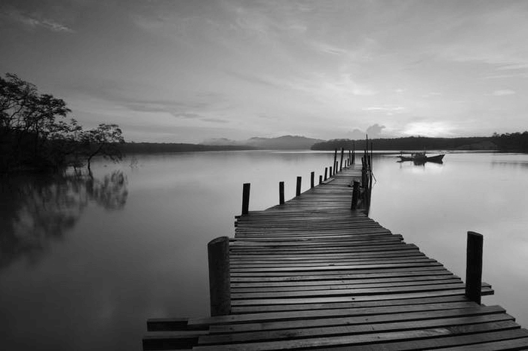
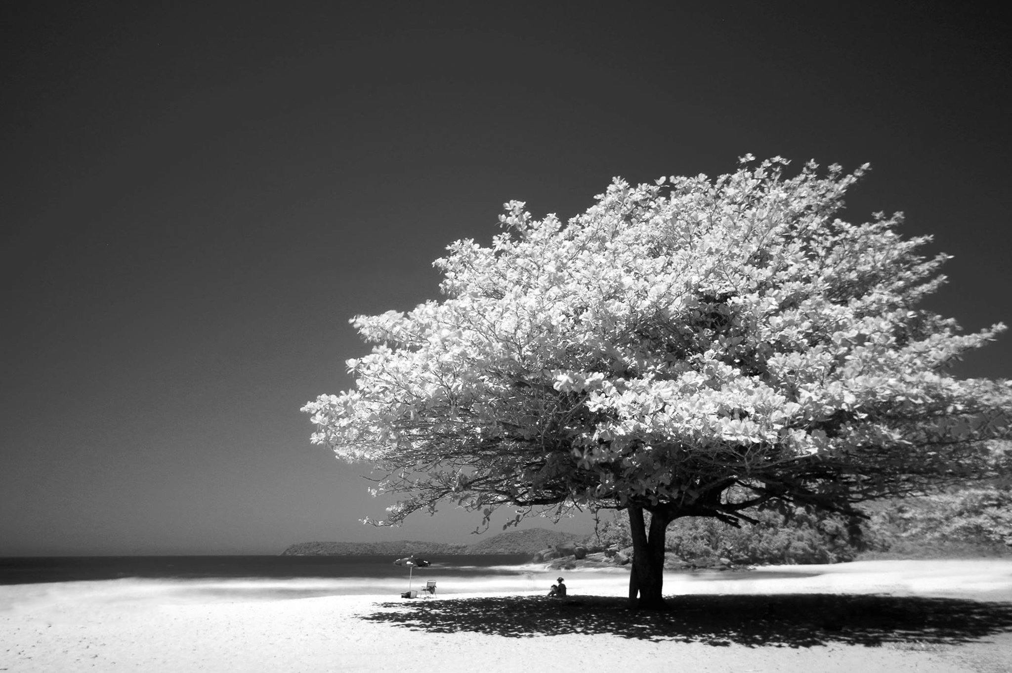
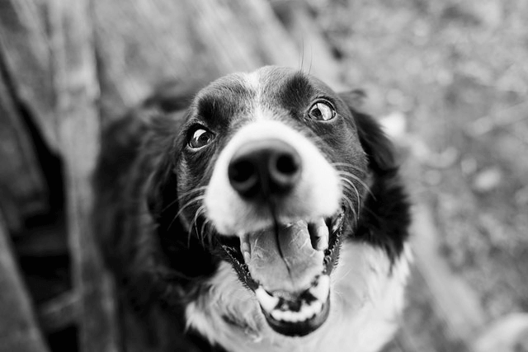
Greyscale Images

Slide 16
Image Processing
If we think about an image that has pixels with all the shades of grey, we can represent those colours as follows:
Black is 0 (the complete absence of light).
White is 255 (the maximum intensity of light).

Slide 17
Image Processing
255 | 255 | 255 | 255 | 255 | 0 | 0 | 0 | 0 | 0
255 | 255 | 255 | 255 | 255 | 0 | 0 | 0 | 0 | 0
255 | 255 | 255 | 255 | 255 | 0 | 0 | 0 | 0 | 0
255 | 255 | 255 | 255 | 255 | 0 | 0 | 0 | 0 | 0
255 | 255 | 255 | 255 | 255 | 0 | 0 | 0 | 0 | 0
255 | 255 | 255 | 255 | 255 | 0 | 0 | 0 | 0 | 0
255 | 255 | 255 | 255 | 255 | 0 | 0 | 0 | 0 | 0
255 | 255 | 255 | 255 | 255 | 0 | 0 | 0 | 0 | 0
255 | 255 | 255 | 255 | 255 | 0 | 0 | 0 | 0 | 0
255 | 255 | 255 | 255 | 255 | 0 | 0 | 0 | 0 | 0

Slide 18
Image Processing
0 | 0 | 0 | 255 | 255 | 0 | 0 | 0 | 0 | 0
0 | 0 | 0 | 255 | 255 | 0 | 0 | 0 | 0 | 0
0 | 0 | 0 | 255 | 255 | 0 | 0 | 0 | 0 | 0
0 | 0 | 0 | 255 | 255 | 0 | 0 | 0 | 0 | 0
0 | 0 | 0 | 255 | 255 | 0 | 0 | 0 | 0 | 0
0 | 0 | 0 | 255 | 255 | 0 | 0 | 0 | 0 | 0
0 | 0 | 0 | 255 | 255 | 0 | 0 | 0 | 0 | 0
0 | 0 | 0 | 255 | 255 | 0 | 0 | 0 | 0 | 0
0 | 0 | 0 | 255 | 255 | 0 | 0 | 0 | 0 | 0
0 | 0 | 0 | 255 | 255 | 0 | 0 | 0 | 0 | 0

Slide 19
Image Processing
255 | 255 | 255 | 255 | 255 | 255 | 255 | 255 | 255 | 255
255 | 255 | 255 | 255 | 255 | 255 | 255 | 255 | 255 | 255
255 | 255 | 255 | 255 | 255 | 255 | 255 | 255 | 255 | 255
255 | 255 | 255 | 255 | 255 | 255 | 255 | 255 | 255 | 255
0 | 0 | 0 | 255 | 255 | 0 | 0 | 0 | 0 | 0
0 | 0 | 0 | 255 | 255 | 0 | 0 | 0 | 0 | 0
0 | 0 | 0 | 255 | 255 | 0 | 0 | 0 | 0 | 0
0 | 0 | 0 | 255 | 255 | 0 | 0 | 0 | 0 | 0
0 | 0 | 0 | 255 | 255 | 0 | 0 | 0 | 0 | 0
0 | 0 | 0 | 255 | 255 | 0 | 0 | 0 | 0 | 0

Slide 20
Image Processing
128 | 128 | 128 | 128 | 128 | 128 | 128 | 128 | 128 | 128
128 | 128 | 128 | 128 | 128 | 128 | 128 | 128 | 128 | 128
128 | 128 | 128 | 128 | 128 | 128 | 128 | 128 | 128 | 128
128 | 128 | 128 | 128 | 128 | 128 | 128 | 128 | 128 | 128
0 | 0 | 0 | 255 | 255 | 0 | 0 | 0 | 0 | 0
0 | 0 | 0 | 255 | 255 | 0 | 0 | 0 | 0 | 0
0 | 0 | 0 | 255 | 255 | 0 | 0 | 0 | 0 | 0
0 | 0 | 0 | 255 | 255 | 0 | 0 | 0 | 0 | 0
0 | 0 | 0 | 255 | 255 | 0 | 0 | 0 | 0 | 0
0 | 0 | 0 | 255 | 255 | 0 | 0 | 0 | 0 | 0

Slide 21
Image Processing
128 | 128 | 128 | 128 | 128 | 128 | 128 | 128 | 128 | 128
128 | 128 | 128 | 128 | 128 | 128 | 128 | 128 | 128 | 128
128 | 128 | 128 | 128 | 128 | 128 | 128 | 128 | 128 | 128
128 | 128 | 128 | 128 | 128 | 128 | 128 | 128 | 128 | 128
75 | 75 | 75 | 75 | 75 | 75 | 75 | 75 | 75 | 75
75 | 75 | 75 | 75 | 75 | 75 | 75 | 75 | 75 | 75
75 | 75 | 75 | 75 | 75 | 75 | 75 | 75 | 75 | 75
75 | 75 | 75 | 75 | 75 | 75 | 75 | 75 | 75 | 75
75 | 75 | 75 | 75 | 75 | 75 | 75 | 75 | 75 | 75
0 | 0 | 0 | 0 | 0 | 0 | 0 | 0 | 0 | 0

Slide 22
Image Processing
255 | 255 | 0 | 0 | 0 | 0 | 0 | 255 | 255 | 255
255 | 255 | 0 | 255 | 255 | 255 | 255 | 0 | 255 | 255
255 | 255 | 0 | 255 | 255 | 255 | 255 | 255 | 0 | 255
255 | 255 | 0 | 255 | 255 | 255 | 255 | 255 | 0 | 255
255 | 255 | 0 | 255 | 255 | 255 | 255 | 0 | 255 | 255
255 | 255 | 0 | 0 | 0 | 0 | 0 | 255 | 255 | 255
255 | 255 | 0 | 255 | 255 | 0 | 255 | 255 | 255 | 255
255 | 255 | 0 | 255 | 255 | 255 | 0 | 255 | 255 | 255
255 | 255 | 0 | 255 | 255 | 255 | 255 | 0 | 255 | 255
255 | 255 | 0 | 255 | 255 | 255 | 255 | 255 | 0 | 255

Slide 23
Image Processing
128 | 128 | 0 | 0 | 0 | 0 | 0 | 128 | 128 | 128
128 | 128 | 0 | 128 | 128 | 128 | 128 | 0 | 128 | 128
128 | 128 | 0 | 128 | 128 | 128 | 128 | 128 | 0 | 128
128 | 128 | 0 | 128 | 128 | 128 | 128 | 128 | 0 | 128
128 | 128 | 0 | 128 | 128 | 128 | 128 | 0 | 128 | 128
128 | 128 | 0 | 0 | 0 | 0 | 0 | 128 | 128 | 128
128 | 128 | 0 | 128 | 128 | 0 | 128 | 128 | 128 | 128
128 | 128 | 0 | 128 | 128 | 128 | 0 | 128 | 128 | 128
128 | 128 | 0 | 128 | 128 | 128 | 128 | 0 | 128 | 128
128 | 128 | 0 | 128 | 128 | 128 | 128 | 128 | 0 | 128

Slide 24
Image Processing
EDGE DETECTION
To help computers detect objects in images, edge detection is used to identify the boundaries of objects in an image.
It helps computers recognize shapes by detecting areas where the colour or brightness changes suddenly.

Slide 25
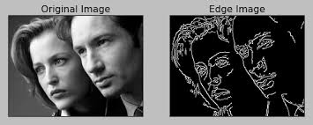
Image Processing
EDGE DETECTION

Slide 26
Image Processing
128 | 128 | 128 | 128 | 128 | 128 | 128 | 128 | 128 | 128
128 | 128 | 128 | 128 | 128 | 128 | 128 | 128 | 128 | 128
128 | 128 | 128 | 128 | 128 | 128 | 128 | 128 | 128 | 128
128 | 128 | 128 | 0 | 0 | 0 | 0 | 128 | 128 | 128
128 | 128 | 128 | 0 | 0 | 0 | 0 | 128 | 128 | 128
128 | 128 | 128 | 0 | 0 | 0 | 0 | 128 | 128 | 128
128 | 128 | 128 | 0 | 0 | 0 | 0 | 128 | 128 | 128
128 | 128 | 128 | 128 | 128 | 128 | 128 | 128 | 128 | 128
128 | 128 | 128 | 128 | 128 | 128 | 128 | 128 | 128 | 128
128 | 128 | 128 | 128 | 128 | 128 | 128 | 128 | 128 | 128

Slide 27
Image Processing
EDGE DETECTION
Let’s image we have this image that has a grey background, and a black box in the foreground, and we want to edge detect.

Slide 28
Image Processing
EDGE DETECTION
We could write a computer program to scan the image, and (for example) get the difference between each pixel and the next one, and if the difference is less then 100 we write a “0” into a new matrix, and if it’s more than 100 write a “1”, one row at a time.

Slide 29
128 | 128 | 128 | 128 | 128 | 128 | 128 | 128 | 128 | 128
128 | 128 | 128 | 128 | 128 | 128 | 128 | 128 | 128 | 128
128 | 128 | 128 | 128 | 128 | 128 | 128 | 128 | 128 | 128
128 | 128 | 128 | 0 | 0 | 0 | 0 | 128 | 128 | 128
128 | 128 | 128 | 0 | 0 | 0 | 0 | 128 | 128 | 128
128 | 128 | 128 | 0 | 0 | 0 | 0 | 128 | 128 | 128
128 | 128 | 128 | 0 | 0 | 0 | 0 | 128 | 128 | 128
128 | 128 | 128 | 128 | 128 | 128 | 128 | 128 | 128 | 128
128 | 128 | 128 | 128 | 128 | 128 | 128 | 128 | 128 | 128
128 | 128 | 128 | 128 | 128 | 128 | 128 | 128 | 128 | 128

Slide 30
128 | 128 | 128 | 128 | 128 | 128 | 128 | 128 | 128 | 128
128 | 128 | 128 | 128 | 128 | 128 | 128 | 128 | 128 | 128
128 | 128 | 128 | 128 | 128 | 128 | 128 | 128 | 128 | 128
128 | 128 | 128 | 0 | 0 | 0 | 0 | 128 | 128 | 128
128 | 128 | 128 | 0 | 0 | 0 | 0 | 128 | 128 | 128
128 | 128 | 128 | 0 | 0 | 0 | 0 | 128 | 128 | 128
128 | 128 | 128 | 0 | 0 | 0 | 0 | 128 | 128 | 128
128 | 128 | 128 | 128 | 128 | 128 | 128 | 128 | 128 | 128
128 | 128 | 128 | 128 | 128 | 128 | 128 | 128 | 128 | 128
128 | 128 | 128 | 128 | 128 | 128 | 128 | 128 | 128 | 128
0 | 0 | 0 | 0 | 0 | 0 | 0 | 0 | 0 | 0
0 | 0 | 0 | 0 | 0 | 0 | 0 | 0 | 0 | 0
0 | 0 | 0 | 0 | 0 | 0 | 0 | 0 | 0 | 0
0 | 0 | 1 | 0 | 0 | 0 | 1 | 0 | 0 | 0
0 | 0 | 1 | 0 | 0 | 0 | 1 | 0 | 0 | 0
0 | 0 | 1 | 0 | 0 | 0 | 1 | 0 | 0 | 0
0 | 0 | 1 | 0 | 0 | 0 | 1 | 0 | 0 | 0
0 | 0 | 0 | 0 | 0 | 0 | 0 | 0 | 0 | 0
0 | 0 | 0 | 0 | 0 | 0 | 0 | 0 | 0 | 0
0 | 0 | 0 | 0 | 0 | 0 | 0 | 0 | 0 | 0

Slide 31
Image Processing
EDGE DETECTION
Now let’s do the same thing, but one column at a time, instead of rows.

Slide 32
128 | 128 | 128 | 128 | 128 | 128 | 128 | 128 | 128 | 128
128 | 128 | 128 | 128 | 128 | 128 | 128 | 128 | 128 | 128
128 | 128 | 128 | 128 | 128 | 128 | 128 | 128 | 128 | 128
128 | 128 | 128 | 0 | 0 | 0 | 0 | 128 | 128 | 128
128 | 128 | 128 | 0 | 0 | 0 | 0 | 128 | 128 | 128
128 | 128 | 128 | 0 | 0 | 0 | 0 | 128 | 128 | 128
128 | 128 | 128 | 0 | 0 | 0 | 0 | 128 | 128 | 128
128 | 128 | 128 | 128 | 128 | 128 | 128 | 128 | 128 | 128
128 | 128 | 128 | 128 | 128 | 128 | 128 | 128 | 128 | 128
128 | 128 | 128 | 128 | 128 | 128 | 128 | 128 | 128 | 128
0 | 0 | 0 | 0 | 0 | 0 | 0 | 0 | 0 | 0
0 | 0 | 0 | 0 | 0 | 0 | 0 | 0 | 0 | 0
0 | 0 | 0 | 1 | 1 | 1 | 1 | 0 | 0 | 0
0 | 0 | 0 | 0 | 0 | 0 | 0 | 0 | 0 | 0
0 | 0 | 0 | 0 | 0 | 0 | 0 | 0 | 0 | 0
0 | 0 | 0 | 0 | 0 | 0 | 0 | 0 | 0 | 0
0 | 0 | 0 | 1 | 1 | 1 | 1 | 0 | 0 | 0
0 | 0 | 0 | 0 | 0 | 0 | 0 | 0 | 0 | 0
0 | 0 | 0 | 0 | 0 | 0 | 0 | 0 | 0 | 0
0 | 0 | 0 | 0 | 0 | 0 | 0 | 0 | 0 | 0

Slide 33
Image Processing
EDGE DETECTION
And if we put these two together, we don’t get a perfect edge, but we get a good rough outline.

Slide 34
128 | 128 | 128 | 128 | 128 | 128 | 128 | 128 | 128 | 128
128 | 128 | 128 | 128 | 128 | 128 | 128 | 128 | 128 | 128
128 | 128 | 128 | 128 | 128 | 128 | 128 | 128 | 128 | 128
128 | 128 | 128 | 0 | 0 | 0 | 0 | 128 | 128 | 128
128 | 128 | 128 | 0 | 0 | 0 | 0 | 128 | 128 | 128
128 | 128 | 128 | 0 | 0 | 0 | 0 | 128 | 128 | 128
128 | 128 | 128 | 0 | 0 | 0 | 0 | 128 | 128 | 128
128 | 128 | 128 | 128 | 128 | 128 | 128 | 128 | 128 | 128
128 | 128 | 128 | 128 | 128 | 128 | 128 | 128 | 128 | 128
128 | 128 | 128 | 128 | 128 | 128 | 128 | 128 | 128 | 128
0 | 0 | 0 | 0 | 0 | 0 | 0 | 0 | 0 | 0
0 | 0 | 0 | 0 | 0 | 0 | 0 | 0 | 0 | 0
0 | 0 | 0 | 1 | 1 | 1 | 1 | 0 | 0 | 0
0 | 0 | 1 | 0 | 0 | 0 | 1 | 0 | 0 | 0
0 | 0 | 1 | 0 | 0 | 0 | 1 | 0 | 0 | 0
0 | 0 | 1 | 0 | 0 | 0 | 1 | 0 | 0 | 0
0 | 0 | 1 | 1 | 1 | 1 | 1 | 0 | 0 | 0
0 | 0 | 0 | 0 | 0 | 0 | 0 | 0 | 0 | 0
0 | 0 | 0 | 0 | 0 | 0 | 0 | 0 | 0 | 0
0 | 0 | 0 | 0 | 0 | 0 | 0 | 0 | 0 | 0

Slide 37
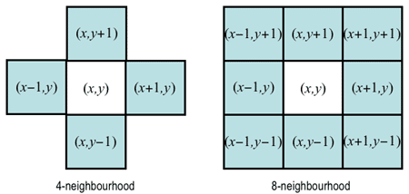
4-Connected
8-Connected

Slide 38
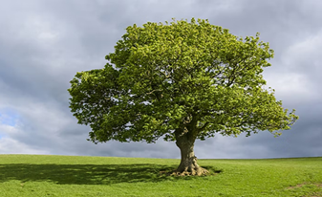
Colour Images

Slide 39
Image Processing
For colour images, every pixel in a display is composed of red, green and blue (RGB) subpixels that light up at different intensities to create different colors.

Slide 40
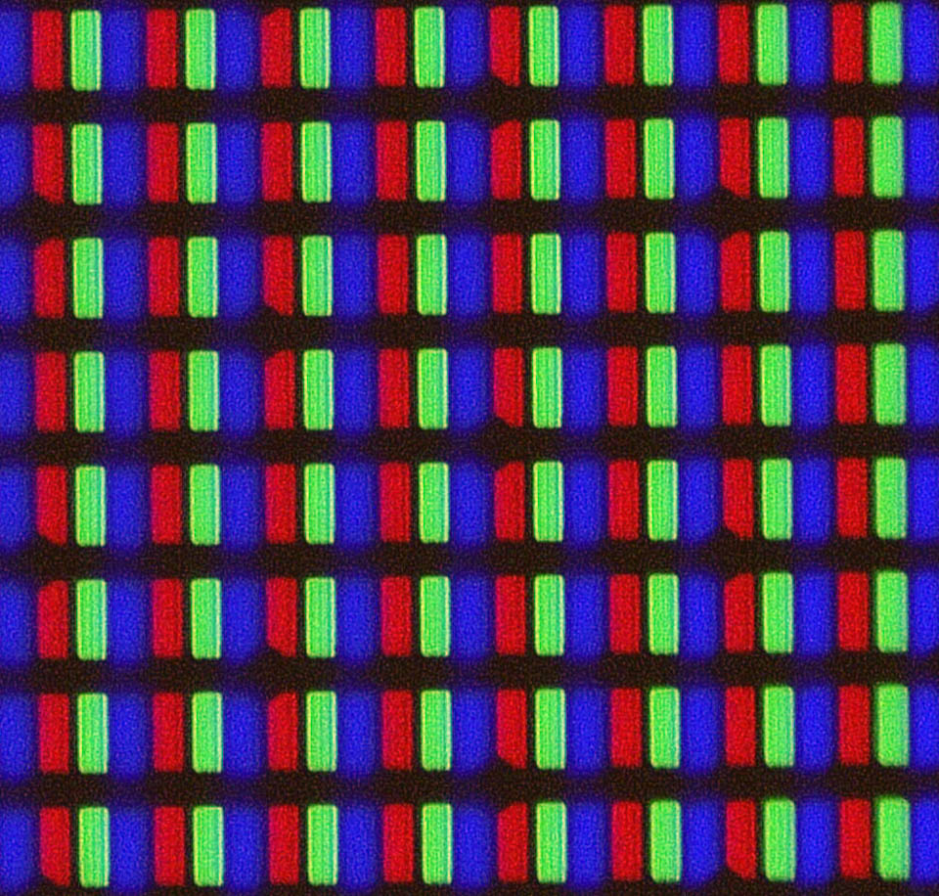

Slide 41
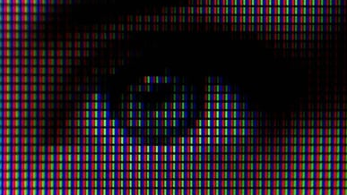

Slide 42
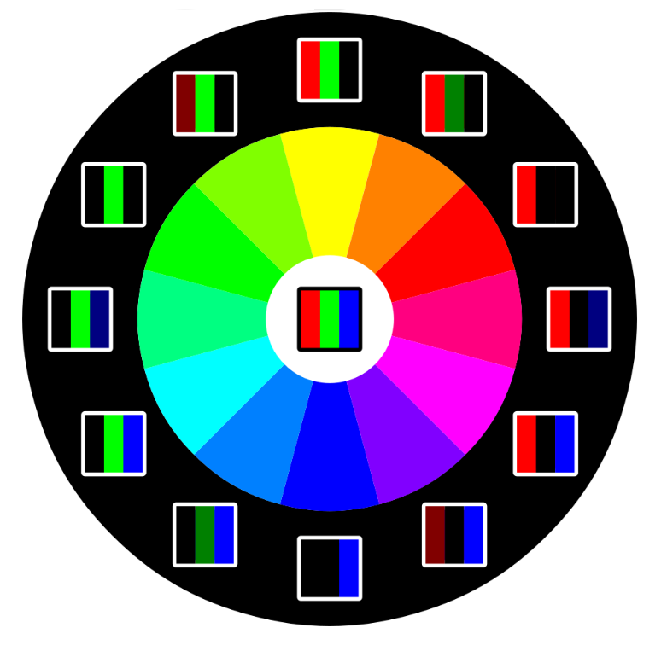

Slide 43
Image Processing
255, 0, 0 | 255, 0, 0 | 255, 0, 0 | 255, 0, 0 | 255, 0, 0
255, 0, 0 | 255, 0, 0 | 255, 0, 0 | 255, 0, 0 | 255, 0, 0
255, 0, 0 | 255, 0, 0 | 255, 0, 0 | 255, 0, 0 | 255, 0, 0
255, 0, 0 | 255, 0, 0 | 255, 0, 0 | 255, 0, 0 | 255, 0, 0
255, 0, 0 | 255, 0, 0 | 255, 0, 0 | 255, 0, 0 | 255, 0, 0

Slide 44
Image Processing
0, 255, 0 | 0, 255, 0 | 0, 255, 0 | 0, 255, 0 | 0, 255, 0
0, 255, 0 | 0, 255, 0 | 0, 255, 0 | 0, 255, 0 | 0, 255, 0
0, 255, 0 | 0, 255, 0 | 0, 255, 0 | 0, 255, 0 | 0, 255, 0
0, 255, 0 | 0, 255, 0 | 0, 255, 0 | 0, 255, 0 | 0, 255, 0
0, 255, 0 | 0, 255, 0 | 0, 255, 0 | 0, 255, 0 | 0, 255, 0

Slide 45
Image Processing
0, 0, 255 | 0, 0, 255 | 0, 0, 255 | 0, 0, 255 | 0, 0, 255
0, 0, 255 | 0, 0, 255 | 0, 0, 255 | 0, 0, 255 | 0, 0, 255
0, 0, 255 | 0, 0, 255 | 0, 0, 255 | 0, 0, 255 | 0, 0, 255
0, 0, 255 | 0, 0, 255 | 0, 0, 255 | 0, 0, 255 | 0, 0, 255
0, 0, 255 | 0, 0, 255 | 0, 0, 255 | 0, 0, 255 | 0, 0, 255

Slide 46
Image Processing
255, 0, 0 | 255, 0, 0 | 0, 255, 0 | 0, 255, 0 | 0, 255, 0
255, 0, 0 | 255, 0, 0 | 0, 255, 0 | 0, 255, 0 | 0, 255, 0
255, 0, 0 | 255, 0, 0 | 0, 255, 0 | 0, 255, 0 | 0, 255, 0
255, 0, 0 | 255, 0, 0 | 0, 255, 0 | 0, 255, 0 | 0, 255, 0
255, 0, 0 | 255, 0, 0 | 0, 255, 0 | 0, 255, 0 | 0, 255, 0

Slide 47
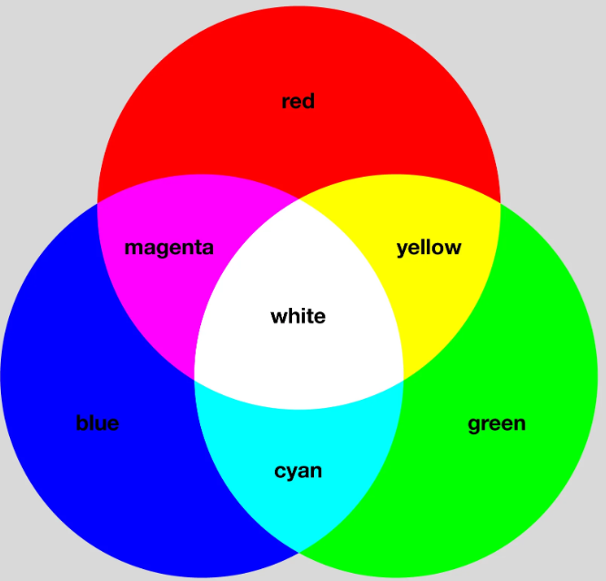

Slide 48
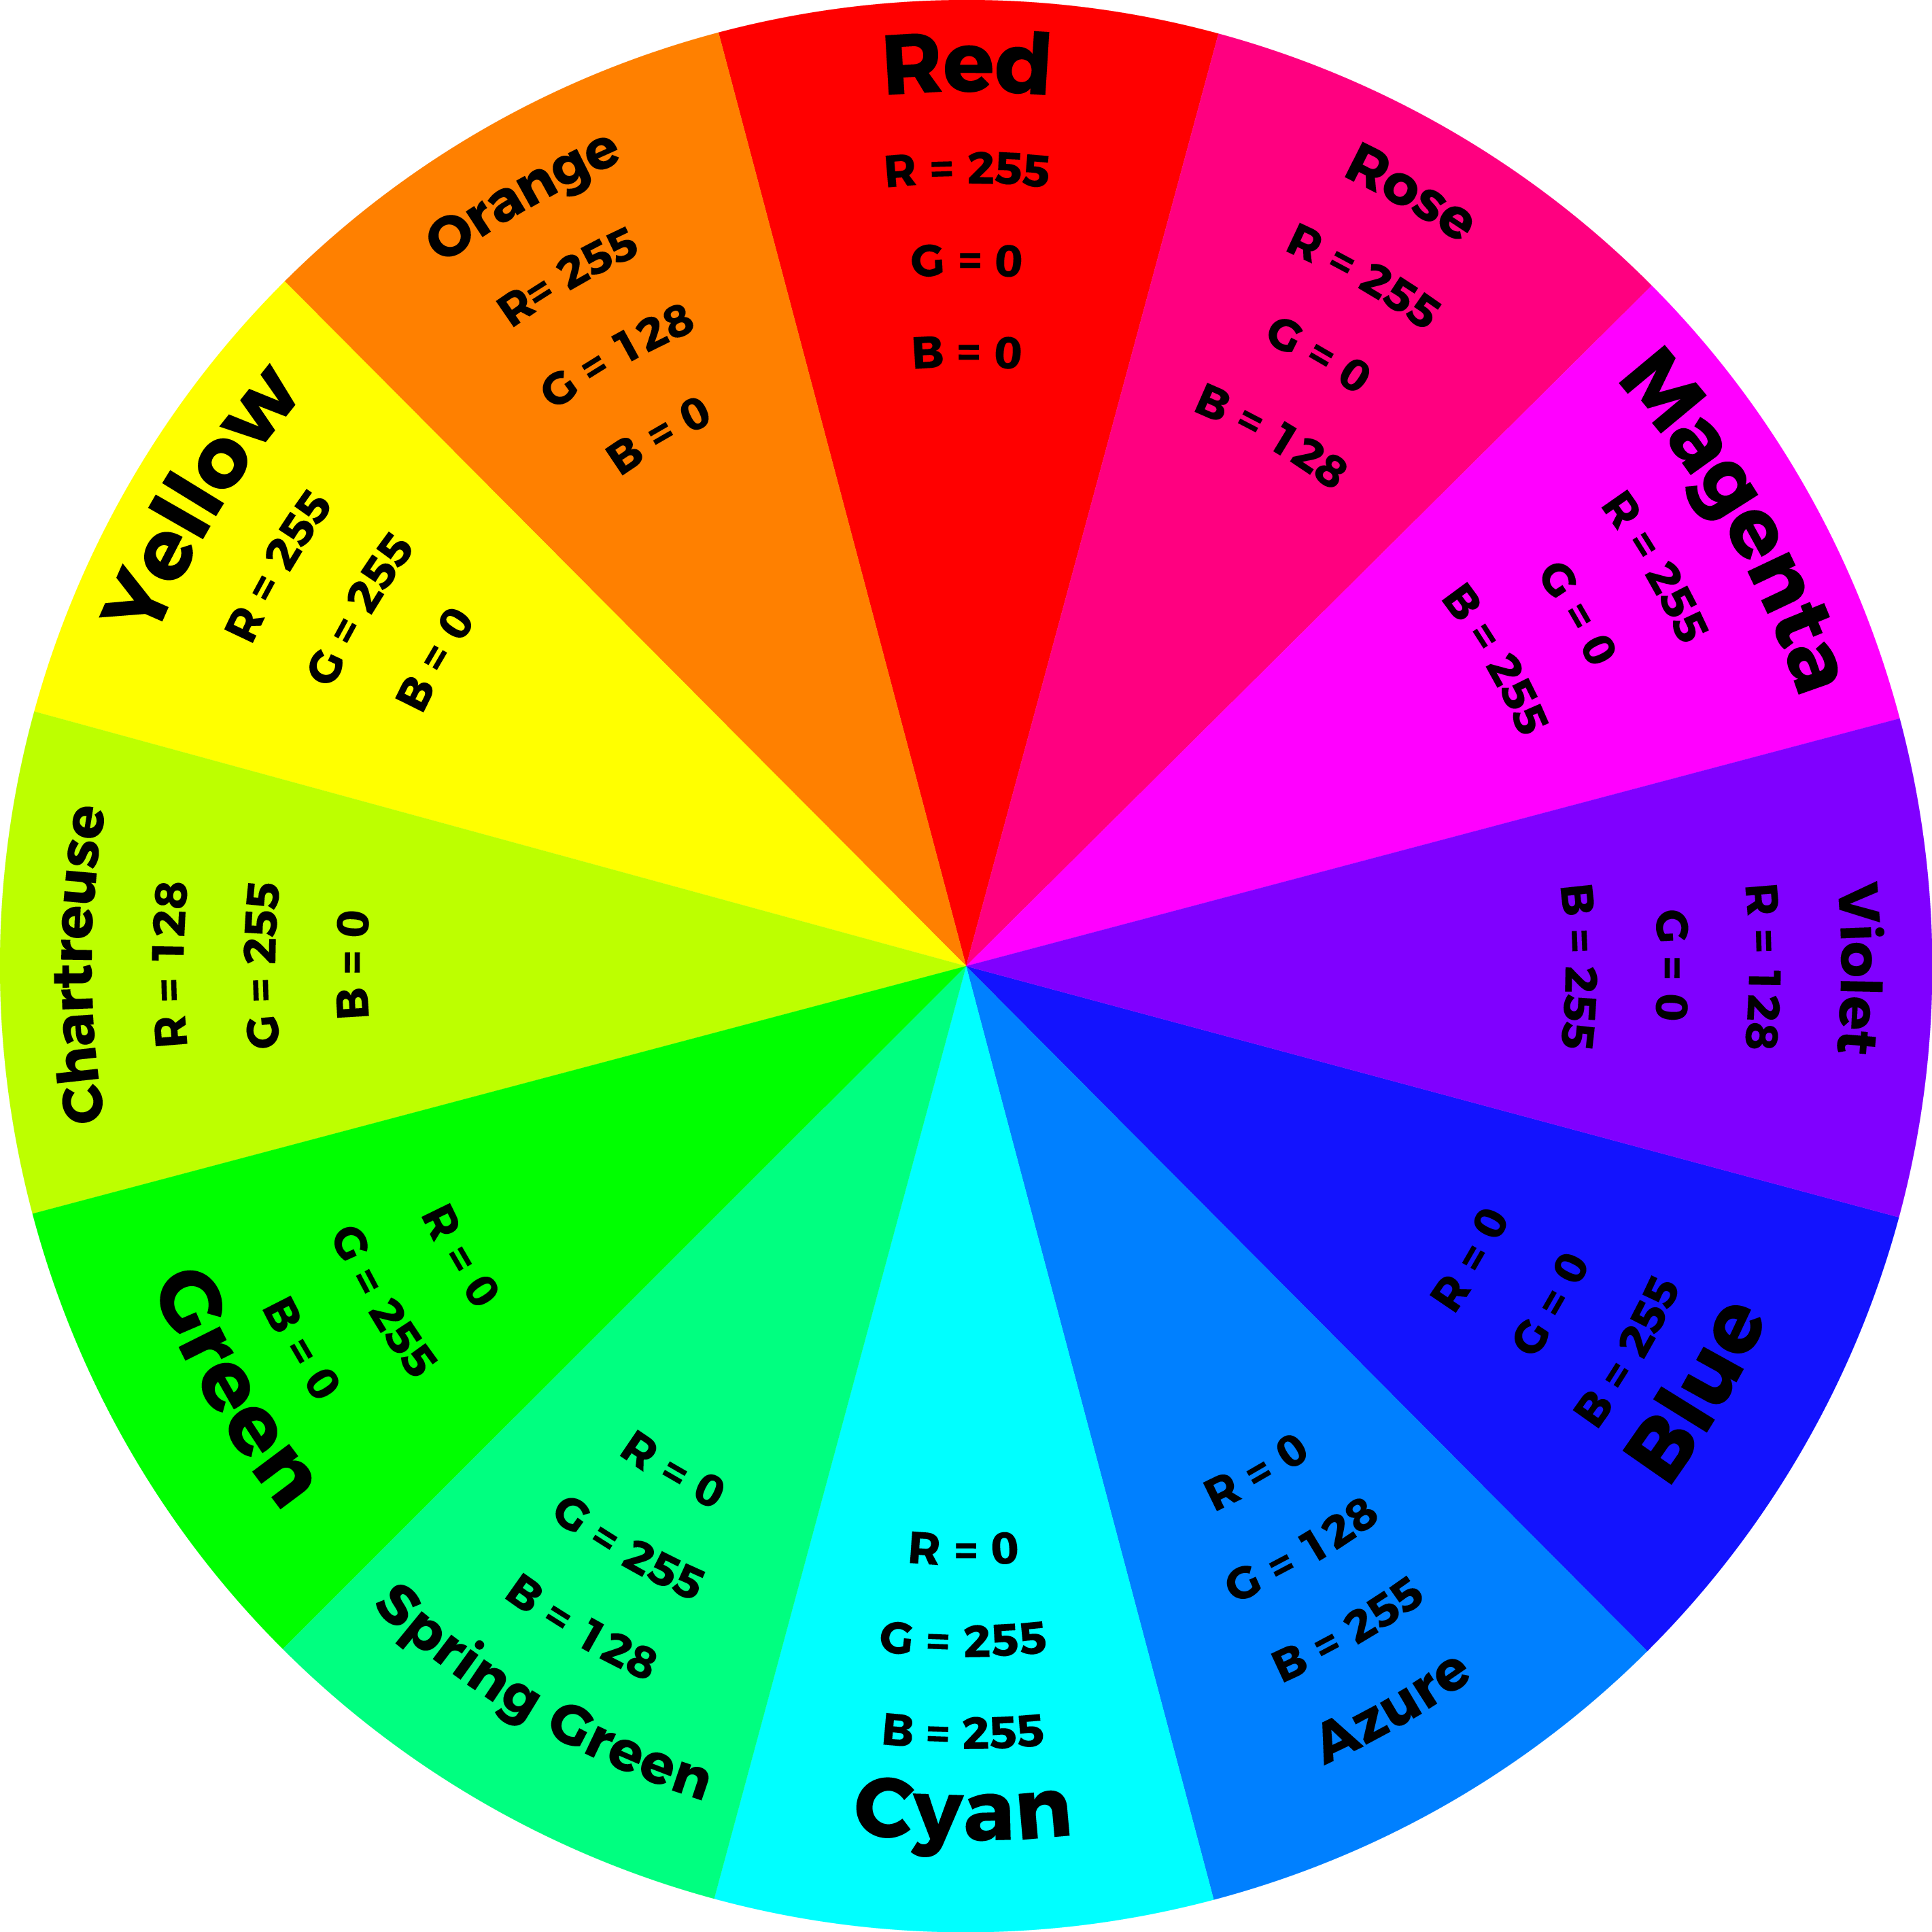

Slide 49
Image Processing
255, 0, 0 | 255, 0, 0 | 255, 128, 0 | 255, 128, 0 | 255, 128, 0
255, 0, 0 | 255, 0, 0 | 255, 128, 0 | 255, 128, 0 | 255, 128, 0
255, 0, 0 | 255, 0, 0 | 255, 128, 0 | 255, 128, 0 | 255, 128, 0
255, 0, 0 | 255, 0, 0 | 255, 128, 0 | 255, 128, 0 | 255, 128, 0
255, 0, 0 | 255, 0, 0 | 255, 128, 0 | 255, 128, 0 | 255, 128, 0

Slide 50
Image Processing
255, 0, 0 | 255, 0, 0 | 255, 128, 0 | 255, 128, 0 | 255, 0, 255
255, 0, 0 | 255, 0, 0 | 255, 128, 0 | 255, 128, 0 | 255, 0, 255
255, 0, 0 | 255, 0, 0 | 255, 128, 0 | 255, 128, 0 | 255, 0, 255
255, 0, 0 | 255, 0, 0 | 255, 128, 0 | 255, 128, 0 | 255, 0, 255
255, 0, 0 | 255, 0, 0 | 255, 128, 0 | 255, 128, 0 | 255, 0, 255

Slide 51
Image Processing
255, 0, 255 | 255, 128, 0 | 255, 128, 0 | 255, 128, 0 | 255, 0, 255
255, 128, 0 | 255, 0, 255 | 255, 128, 0 | 255, 0, 255 | 255, 128, 0
255, 128, 0 | 255, 128, 0 | 255, 0, 255 | 255, 128, 0 | 255, 128, 0
255, 128, 0 | 255, 0, 255 | 255, 128, 0 | 255, 0, 255 | 255, 128, 0
255, 0, 255 | 255, 128, 0 | 255, 128, 0 | 255, 128, 0 | 255, 0, 255

Slide 52
Image Processing
So to represent each pixel as a single value, we convert the values to HEX, and merge.
e.g.
(255, 0, 0) → (FF, 0, 0) → #FF0000
(0, 255, 0) → (0, FF, 0) → #00FF00
(0, 128, 255) → (0, 80, FF) → #0080FF

Slide 53
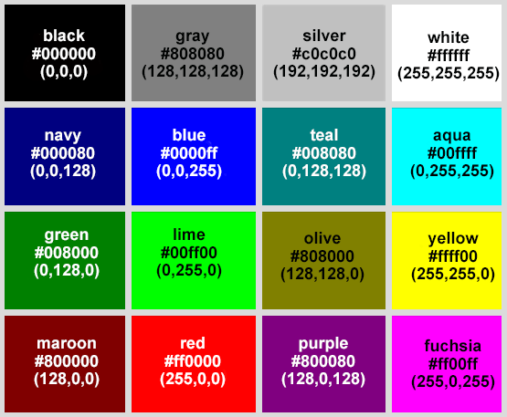

Slide 54
