Slide 1
Tips for writing a paper

Slide 2
Writing for Computer Science
Clear
Concise
Accurate
Organised (Logically)

Slide 3
Writing for Computer Science
Remember what you are doing
  Presenting an idea
  And demonstrating its correctness
    Within your research context
    Through experimentation and evaluation
You need to
  Discuss where your idea fits into the existing body of knowledge
  Clearly and formally state your idea/hypothesis/question
  Explain what is new/different about your work
  Justify yourself through data collection, experimentation and evaluation

Slide 4
Writing for Computer Science
You will present
  Background
  Context
  Arguments
  Evidence
  Experimentation
  Results
  Conclusions

Slide 5
What is your paper about?
Can you put it in two lines?
  summary that is short enough to give in a lift journey
The story is not what you did, but rather
  what you show, new ideas, new insights
  why interesting, important?

Slide 6
Write top down
Computer scientists (and most human beings) think this way!
State broad themes/ideas first, then go into detail
  context, context, context
Even when going into detail … write top down!

Slide 7
Introduction: crucial, formulaic
If reader not excited by intro, paper is lost
Recipe:
  Paragraph1: motivation:
    In broad outline, what is problem area, why important?
  Paragraph2: narrow down:
    What is the problem you specifically consider
  Paragraph 3: “in the paper, ….”
    Important paragraph, your pitch
  Paragraph4: how is this different/better/related to other work
  Paragraph 5: how does the rest of the paper work
    In the next section ….

Slide 8
Know The Mechanics Of Writing
Paragraph
  Ordered set of topically-related sentences
Lead sentence/Topic Sentence
  Sets context for paragraph
  Might tie to previous paragraph
Sentences in paragraph should have logical narrative flow, relating to theme/topic
Don’t mix tenses
Paragraphs should not be too long (or too short).

Slide 9
Remember to Keep the Right Tone
Objectivity
Accuracy
Less is more:
  It takes time to write a shorter amount
  It is easier to pile in a load of text
  Editing takes time

Slide 10
Think about the reader
How much work are you asking your reader to do?
  Shouldn’t have to look up other work to get story, understand context, results
    If they do, they will abandon your paper
  Need signposts to know where ‘story is going
  Need context to know where they are
    Look at how signposting works
Figure out what does reader know/not know, want/not want?
  Write for them, not for yourself
    You know this stuff, they don’t

Slide 11
Think about the reader
Lots of pages with small texts and margins are difficult to read
  Adhere to the template you have been given
  Avoid cramped feeling of tiny fonts, small margins
  Create a feeling of open space by including white space: figures, lists
Think about whether you are providing enough context/information for reader to understand what you write?
  No one has as much background/content as you
  No one can read your mind
  Are all terms/notation defined?

Slide 12
No one is as interested in this topic as you (even if you find it boring)
So you had better be (or appear) interested
Tell readers why they should be interested in your “story”
Don’t overload reader with graphs and tables
  Think about main points you want to convey with graphs
  Don’t use a graph for everything
  If you use a graph in support of a point do not use a table for this point also
    This is too much, you are not helping those who don’t understand the graph
    Rather you are irritating those who do, which will be the majority
    Vice Versa applies
Don’t overload reader with pages of equations
  Unless it is integral to your paper, put long derivations/proofs in appendix, but provide an outline in the main body of paper

Slide 13
State the results carefully
Clearly state assumptions
Provide enough detail on your experiment/simulation so that the reader could nearly recreate it
Provide your findings in a form that makes sense for your simulation experiment
  E.g. statistical properties of your results (e.g., are the test appropriate, are they presented in a form that readers are used to seeing); thematic analysis findings (e.g. are the themes found presented, is your story told logically across the themes, is data included in the discussion e.g. quotes, summaries etc.)
  Quantitative = results
  Qualitative = findings
  In general findings would be a better work
Are findings presented representative?
  Or just a special case that makes the point you want to make
  Be honest, it is more helpful to the readers in the long run

Slide 14
Don’t overstate/understate your results
Overstatement mistake:
  “This paper has shown that X is prevalent in the internet”
  “This paper has shown that approach X is better than Y”
When only actually shown for one/small/limited cases
Understatement mistake
  Fail to consider broader implications of your work
  If your result is small, interest will be small
    Unless you outline its significance in the broader context
      Of the case study, research area, type of research etc.

Slide 15
Study Writing
Learn to write well
  It gives you an “unfair advantage”
Writing well matters in getting your work published in top venues/getting top marks
"In science, the credit goes to the man who convinces the world, not to the man to whom the idea first occurs."
--Sir William Osler

Slide 16
Study Writing
Highly recommended:
  The Elements Of Style, W. Strunk, E.B. White, 4th Edition, 1999, Longman
    Lots of copies in the library
  Writing For Computer Science: The Art Of Effective Communication, Justin Sobel, Springer 1997.
    Available as a pdf on the web
Who do you think are the best writers in your area?
  Study their style

Slide 17
Good writing takes times
Give yourself time to reflect, write, review, refine
  Editing is where you really clarify your thinking
Give others a chance to read/review and provide feedback
  You want feedback from a reader’s point of view
  Find a good writer/editor to critique your writing
Starting a paper three days before the deadline, while results are still being generated, is not going to work
  You need to plan your time and work to a timetable

Slide 18
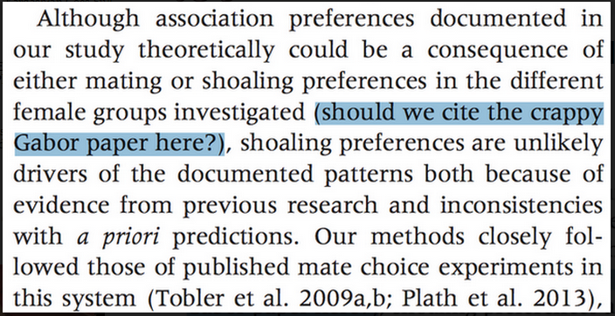
Proofread – you don’t want something like this to happen
http://io9.com/the-most-hilarious-proofreading-mistake-in-a-scientific-1657839235

Slide 19
Your dissertation
Science is all about reporting on research
  – A contribution only exists if and only if it is documented
Eating the elephant in smaller pieces
  – focus on a specific contribution
  – rather than telling the whole story
Your dissertation is the main component in your CV at this moment in time
  It will be what people want to talk to you about most
  It is the main source for people to get to know you, what you are interested in and how you approach work in the area

Slide 20
Your Contribution
Adds to “knowledge”
  – thus it must be a written contribution
  – and not only something you did
  – what can others learn from this
Typically addresses a clear stated problem
  – and explains well, what is new
  – the link/difference to existing work
Relevance of a scientific contribution - some metrics
  – relates to the relevance of the problem
  – relates to the #citations
  – relates to the publications used

Slide 21
You Need to Learn the Game
What is the “standard” in your area?
What type of research question?
What type of experimentation?
What type of results/findings presentation?
What type of evaluation?
What type of writing style is favoured?

Slide 22
Finding A Research Question
What areas of CS interest you most?
  Read, read, read
  Learn the subfield
    Your project is a vehicle to master a small but technical body of knowledge.
    Fill in gaps
      You will learn more through (self-directed) research than courses.
What type of work do you enjoy?
What are your strengths, weaknesses?
Do you like to work alone?
Do you take direction well?
What lecturers would you like to work with?
What organizations would you like to work with?
What type of role would you like to work in on graduation?

Slide 23
Approaching Lecturing Staff
Provide them with a context
  Don’t just ask for a meeting to find a topic
  Outline what you are interested in
  Make sure it links in with what they are interested in
  Don’t leave it too late
  Don’t expect them to come up with work that you can just latch on to
Take ownership
  And ask for guidance

Slide 24
The Science of Scientific Writing (Gopen and Swan)
http://192.38.112.111/write/Science_writing.pdf
“If the reader is to grasp what the writer means, the writer must understand what the reader needs.”

