Slide 1
Research Writing and Scientific Literature
Damian.Gordon@dit.ie

Slide 2
Important Link
www.damiantgordon.com

Slide 3
Module Description
Ideas, Researching, Writing…
Refining, Researching, Writing…
Researching, Refining, Writing…

Slide 4
Module Description
MSc in Computing graduates will need to remain up to date with new innovations in computing which may be applicable to their chosen area of specialism. To achieve this, students must be able to undertake research using appropriate sources in an ethical and professional manner and present their research findings in an appropriate form.
This module develops the student's ability to effectively research and present their research findings introducing them to the research process; equipping them with an understanding of computing research sources and how to use them critically and ethically; and how to present their findings in an acceptable form

Slide 5
Learning Outcomes
On completion of this module, the student will be able to:
Demonstrate an understanding of the research process.
Select, develop and apply appropriate literature search strategies in relation to a chosen approved topic using relevant literature resources and ICT for the purposes of literature review.
Collect and critically evaluate research material from the literature in order to identify the current state of knowledge and key issues in a research topic.
Present a critical and logical interpretation of the issues in the form of a written review of the literature relating to a chosen topic.
Demonstrate an awareness of the ethical issues that may impinge on research in general.
Prepare an elementary literature review which could contribute towards the research proposal for their dissertation should they choose to continue to MSc.
Author a document with an appropriate standard of language, presentation, style and referencing.

Slide 6
Learning Outcomes
On completion of this module, the student will be able to:
Become familiar with academic resources used in your discipline
Become familiar with the resources available to you
Learn how to find materials relevant to your work
Learn how to read critically to support your work
Learn how to keep track of ideas (yours and others)
Learn how to use the work of others in your own work
Learn how to present your work in writing for academic purposes
Provide you with an opportunity to identify topics of interest to you.

Slide 7
Module Content
Introduction to research
Introduction to the Scientific Approach
What is research?
The concept of the body of knowledge
Processes in research
Primary versus secondary research
Qualities of a good researcher in academic and professional contexts
Negotiating access and research ethics.

Slide 8
Module Content
Research sources – using the existing body of knowledge
Research sources, pedigree, types
Identification of subject area experts
Referencing and citations
Reference management tools, such as EndNote, Zotero, BibTeX
Online Survey Software e.g. SpiderMonkey, SurveyMonkey
Plagiarism in research
Ethics

Slide 9
Module Content
Literature Review
Literature Survey
Domain Mapping
Literature search strategies
Sourcing and evaluating published sources for their relevance and quality in relation to the chosen topic
Identifying current state of knowledge and key issues
Critically reviewing
Writing a literature review relating to the chosen topic
Use of literature and libraries and ICT

Slide 10
Module Content
Writing a report (or position paper) and abstract
Scientific Writing: precision, clarity and forthrightness
Problem definition
Aims and Objectives
Structure
Synectic process
Presentation

Slide 11
Module Assessment
Continuous assessment will comprise 100% of the marks for this module. Continuous assessment will take the form of exercises and assignments of varying difficulty. Those within the teaching weeks are aimed to consolidate the material of the module.

Slide 12
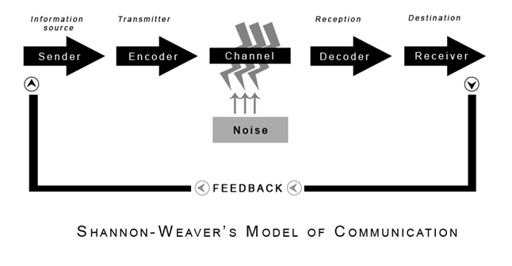
Shannon-Weaver Model

Slide 13
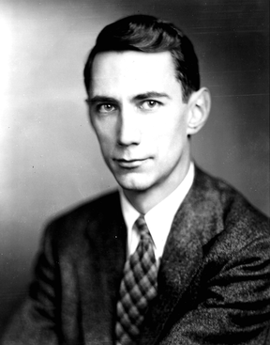
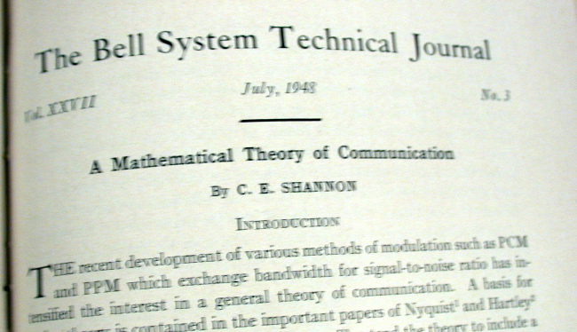
Shannon-Weaver Model
In1948 mathematician Claude Shannon published an article “A Mathematical Theory of Communication”.
It should have been immediately revolutionary, but unfortunately very few people could understand it.

Slide 14
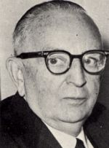
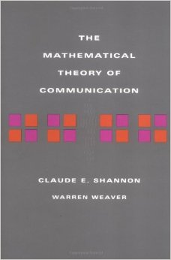
Shannon-Weaver Model
The following year this article was republished as a book with a substantial introduction by Warren Weaver which made clear its importance.
It is possible that the importance of the work would not have been recognised without Weaver.

Slide 15
Lesson
HOW YOU SAY SOMETHING IS AS IMPORTANT AS WHAT YOU SAY.

