Slide 1

DIT Programme for Students Learning With Communities
Computing MSc opportunities

Slide 2
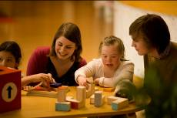
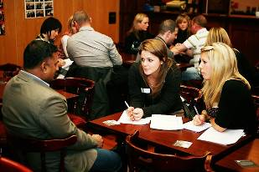

Students Learning With Communities promotes and supports community-based learning (service learning) and community-based research initiatives across DIT
Staff/students collaborate with disadvantaged community partners (local groups, not-for-profit organisations, etc) to develop real-life course-based projects or research for mutual benefit.

Slide 3
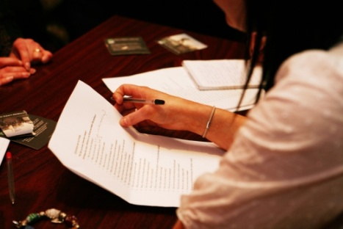

Examples of CBR projects in DIT
Environmental/spatial: Auditing a community partner’s environmental health and safety management and making recommendations for change on a limited budget.
Maths: Students analysing data with Irish Society for Quality and Safety in Healthcare, identifying key themes.
Legal: Law students working with Irish Penal Reform Trust to research the extent to which alternatives to custody are used by judges sentencing children.
Notes:
3

Slide 4
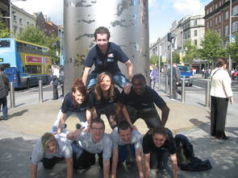
Part of DIT’s Community
Links Programme
Addressing the alleviation of educational disadvantage; civic engagement; widening participation - particularly in Dublin’s Inner-city
Initiatives directed at personal development - self esteem, confidence, motivation and empowerment of individuals and communities.
Programmes located in the Primary, Secondary, Third level and Community Sectors.
1996 to date
Notes:
4

Slide 5
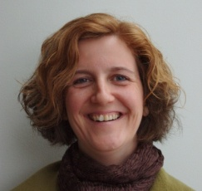
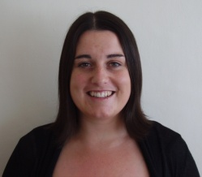
Students Learning With Communities
Dr Catherine Bates, Project Co-ordinator
Sinead McCann, Project Officer
Community Links, 23 Mountjoy Sq, D.1
www.communitylinks.ie/slwc
slwc@dit.ie

Slide 6
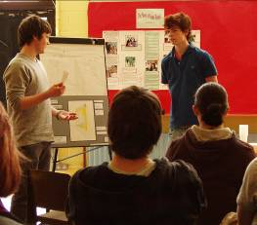
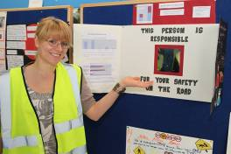
How do students benefit?
Learning comes alive as you work with real clients, applying specialist subject skills, receiving course credits
You develop essential transferrable skills, to include on CV/discuss in interviews
Opportunity to learn from and with communities, increasing critical thinking and developing social awareness

Slide 7
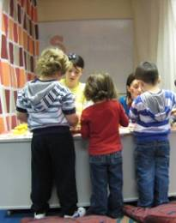

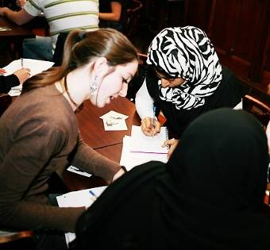
How do communities benefit?
Collaborative learning with students during the project – energising
Project has usable end-product for community (eg research report, designs)
Students as role models for HE
Opportunity to educate future professionals about community needs, and influence curriculum

Slide 8
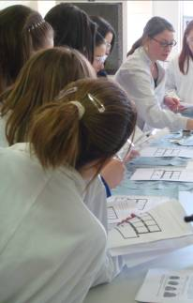
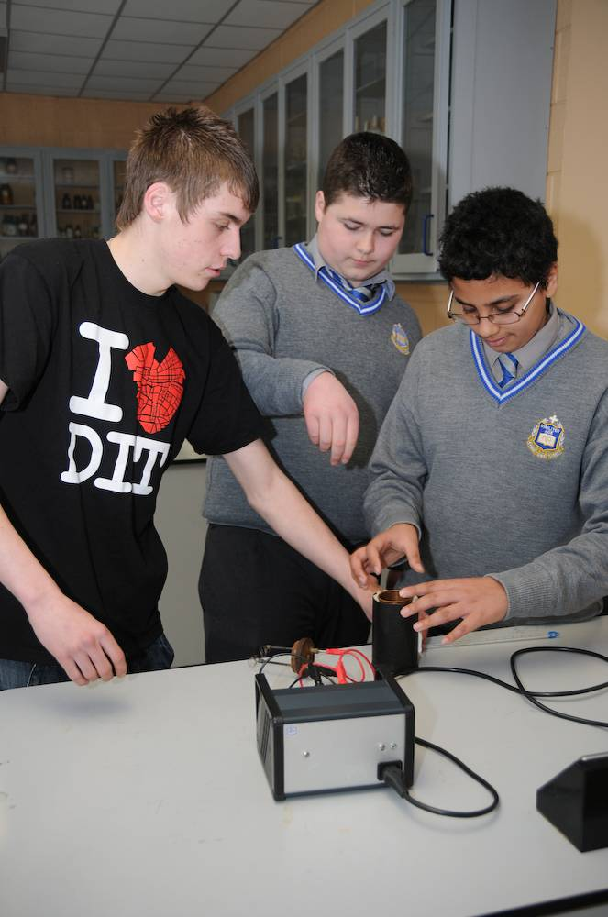
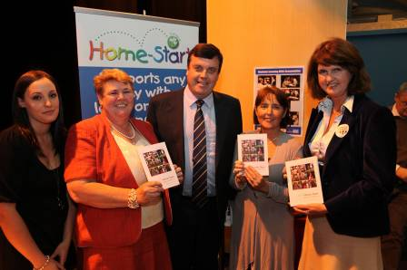
Students and communities benefit:
- Knowledge exchange
- Collaboration for mutual learning
- Combined energy to work for social change

Slide 9
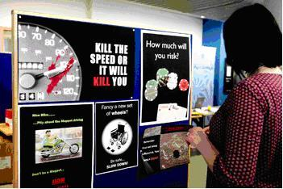
Statistics in DIT 2010/11
1,200 students
100+ community partners
60 academic staff
57 modules
44 programmes
1 in 3 undergrad. programmes
Undergrad. and postgrad.

Slide 10
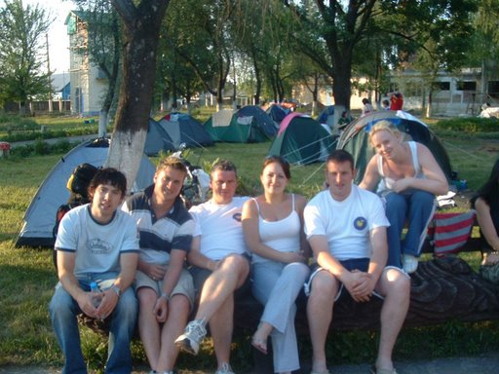
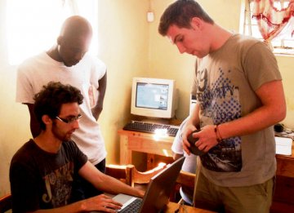
How are Computing students involved?
1st year Computer Science students work with Bike 2 Belarus to produce promotional videos, develop website, and raise funds
3rd year Computer Science students completed a community-based alternative to work placement with Wells for Zoe, identifying and developing technology-based solutions to challenges faced by local Malawian communities
Students on the CPD programme in Accessible Web Design worked with Enable Ireland to design a website for the DIT Design Challenge

Slide 11
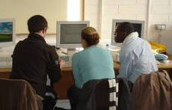
How are Computing MSc students involved?
MSc Assistive Technology student worked with Irish Society for Quality and Safety in Healthcare on their website design and content to increase useability and accessibility
MSc Knowledge Management student worked with ISQSH to research and develop an e-learning tool which they needed
MSc Knowledge Management students worked with DIT’s Computer Learning in Communities (CLiC) Programme to research and develop IT and internet usage policies for schools and community centres participating in the Programme.

Slide 12
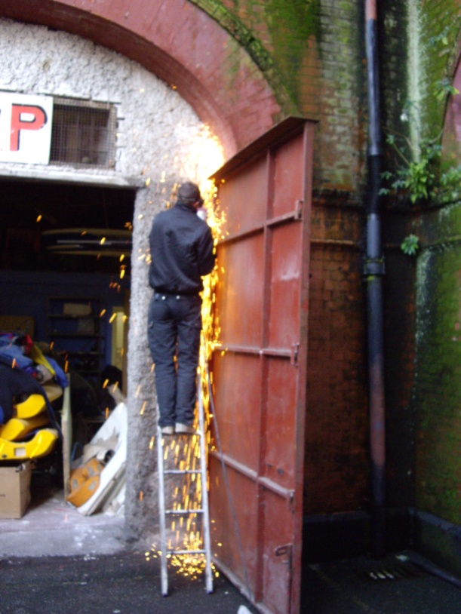
Why get involved?
Join the dots between your programmes of study, combining and applying them to real-life problems to help provide solutions
Contribute to a real issue/community goals
Projects challenge you and give a focus for course-work / studies

Slide 13
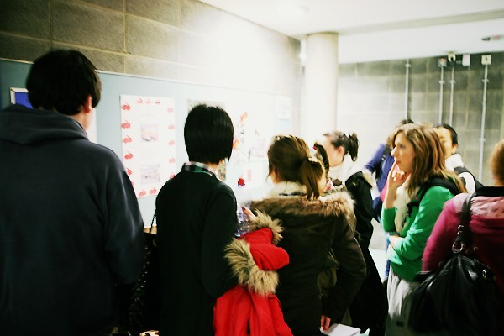
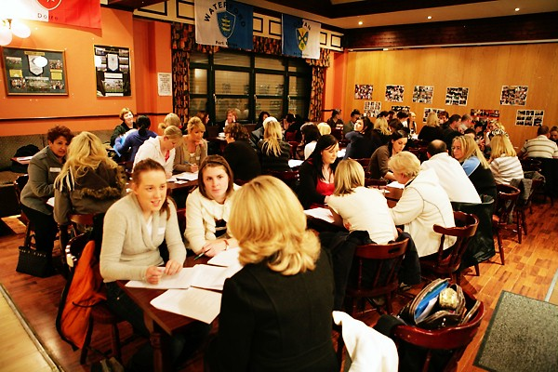
Why get involved?
Improve your confidence, motivation, well- being and college experience
Work is not just about personal satisfaction and financial gain – benefits are much broader. Learn about the impact of your discipline on society / community & voluntary sector
Engage your critical thinking and develop your social awareness

Slide 14
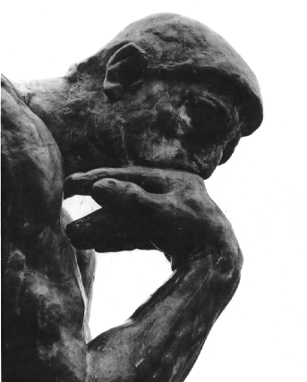
Why should you do reflection?
Personal: Make sense of your experiences, learn about yourselves as learners, transferable skills
Academic: Link your practical learning to your classroom knowledge
Social: Reflect on, question, and challenge, the effects of your discipline in society

Slide 15
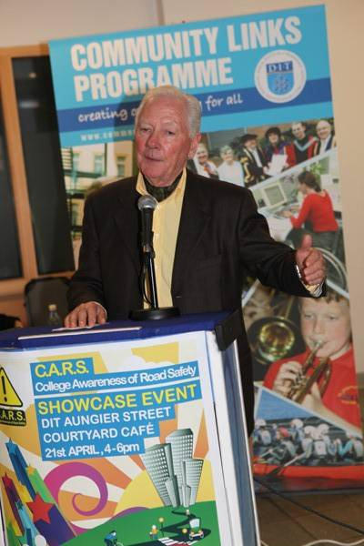
Major cross-disciplinary project:
College Awareness of Road Safety - CARS
    Garda Road Safety Unit partner
    Any coursework related to road safety – investigate and/or raise awareness of road safety and help reduce road deaths, particularly among 17-24 year old males
    Opportunity to present research to panel of judges for annual overall DIT CARS prize.

Slide 16
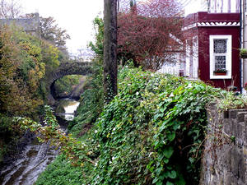
Major cross-disciplinary project:
The LIFELINE project
Urban regeneration project: How to maximise the potential of urban green areas, around the Broadstone railway line in Grangegorman – for health, recreation, transport, biodiversity, education, tourism etc

Slide 17
Possibilities for Computing MSc projects with Lifeline
Research into and development of a knowledge management and development of open source tool for LIFELINE project
Self-directed projects to contribute to producing a layered and broad 'mapping' of the built environment and community cohesion around railway and surrounding areas in Grangegorman

Slide 18

Major cross-disciplinary project:
Wells For Zoe
Technology-based projects that can enhance the work of Irish/Malawian charity Wells for Zoe, including but not limited to: the development of water pumps; test farming; early childhood initiatives; and community development in Malawi. Scope to design own brief in collaboration with Wells for Zoe.

Slide 19
Computing Projects
Research and design on-line meeting template forms to be used by people with intellectual disabilities when on skype when making plans to meet friends – forms that could be filled out by the service-users as they skype (need for primarily graphic content) – content of forms is available from Community Partner

Slide 20
Computing Projects
Research and development of IT/knowledge management solutions to a text heavy website, usage of social media, newsfeeds, effective search engines – and an investigation into whether they are communicating in the best way with their audience.

Slide 21
Computing Projects
Research and design apps for phones for people with intellectual disabilities, relating to topics like money, time management, timetables – content is available as paper-based resources to be turned into apps.
Research and design user-friendly interfaces to overlay onto computer programmes being used by service users with intellectual disabilities – eg making films, comic books, editing photos on-line.

Slide 22
Computing Projects
Explore ways to develop the social networking aspects of the Glasnevin Trust website
Research into: 'What Aspects of Technology are Appropiate for a Cemetary in Developing as a tourist site?’
Research on installing multiseat system in Belarus and development of tools for teaching local community how to use it

Slide 23
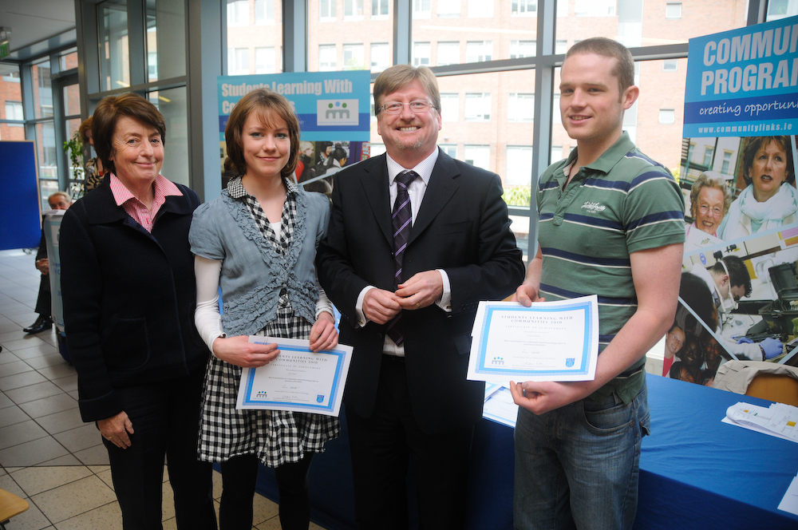
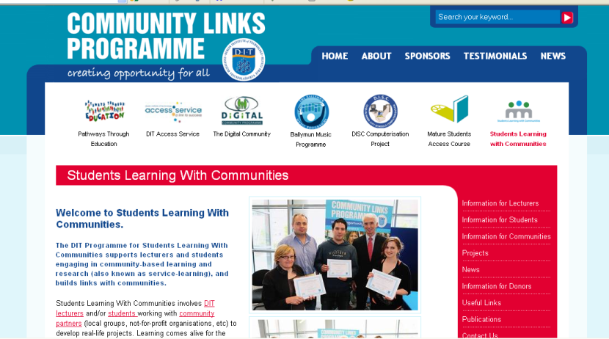
What can we do for you?
Provide useful resources on our website
Promote your project on our website (can’t guarantee that community will use material)
Advertise community research topics on website
Celebrate your work in annual awards ceremony

Slide 24
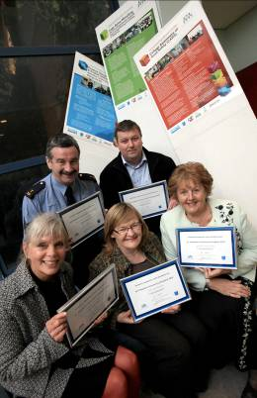
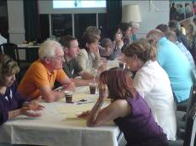
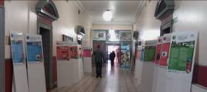
Support and networking in DIT
Practice group – meets 4 times yearly for lunch to explore and energise.
CARS meeting in March
Annual Summer School – June 2012
Join our mailing list for details:
e-mail slwc@dit.ie

Slide 25
Thanks for listening!
Students Learning With Communities
Tel: + 353 1 402 7616
Email: slwc@dit.ie
www.communitylinks.ie/slwc
Join our FACEBOOK page

