Slide 1
Managing your Supervisor
Damian Gordon

Slide 2
Contents
Understanding your supervisor
Manipulating your supervisor
Great Expectations
Common pitfalls
Dealing with conflict
Going forward

Slide 3
Understanding your Supervisor
Their goals
Their skills
Their hates
Their weaknesses

Slide 4
Their goals
Supervision is not a “soft number”
A lecturer gets as much credit on their timetable for doing a two-hour undergraduate first year lab (where they can just come in with little or no preparation required) as supervising four Masters students (which requires a great deal of preparation, continuous reading, and thinking about the topic).
So what is motivating them?

Slide 5
Their goals
Giving back to the system
Help improve the quality of output for the MSc
Helping improve the reputation of the MSc
Interested in the topic
Related to their research interests

Slide 6
Their skills
They vaguely know about the topic you are doing
The offer a different set of skills
Their job isn’t to do the research for you, but rather to guide you on your journey.
They help you in different ways at different times

Slide 7
Their skills
At the beginning of your research
  Identifying a good research question
  Knowing what has already been done
  Anticipating problems that will be too easy or too hard

Slide 8
Their skills
In the middle
  Watching out for the “big picture”
  Nudging you in the right directions
  Identifying common pitfalls
  Keeping an eye on the clock

Slide 9
Their skills
At the end
  Telling you when to stop
  Knowing what a thesis looks like
  Anticipating problems in your final demo

Slide 10
Their hates
Students who quit in the middle
  Wasted effort all around
Students who finish late
  The write-up is problematic
  But it needs to be done

Slide 11
Their weaknesses
They can’t read your mind
They can’t remember everything you’ve told them
  So you need to talk good notes
  And remind them frequently
They may miss meetings

Slide 12
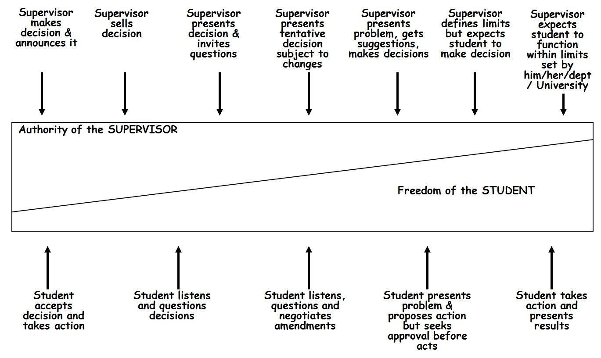
Manipulating your Supervisor

Slide 13
Manipulating your Supervisor
Keep your supervisor informed about
  Scientific obstacles
  Personal obstacles

Slide 14
Manipulating your Supervisor
Always be positive
  You’ve supervisor will want to help if you do
  You’ll feel better

Slide 15
Manipulating your Supervisor
Work hard
  They will be willing to work hard for you
  You’re more likely to get good results
  A thesis is hard work

Slide 16
Manipulating your Supervisor
Write a lot
  Notes to your supervisor
  Notes to yourself (keep a blog)
  Draft chapters
  The more stuff they have to read, the less time they will have to think of stuff for you to do.

Slide 17
Manipulating your Supervisor
Be their ambassador
  Represent them well to all you meet
    Industry contacts
    Scientific contacts
    Social networking

Slide 18
Manipulating your Supervisor
Help them also
  Ask them if you can read drafts of research papers for them
  Offer to give a guest lecture in one of your supervisors classes (e.g. Research Methods)
  Read one of their publications and seem interested in it

Slide 19

Great Expectations
Your expectations
Their expectations

Slide 20
Great Expectations
YOUR EXPECTATIONS
Intellectual support
  Quality assurance
  Tell you when to (not) stop
Emotional support
  Encouragement
  Constructive environment

Slide 21
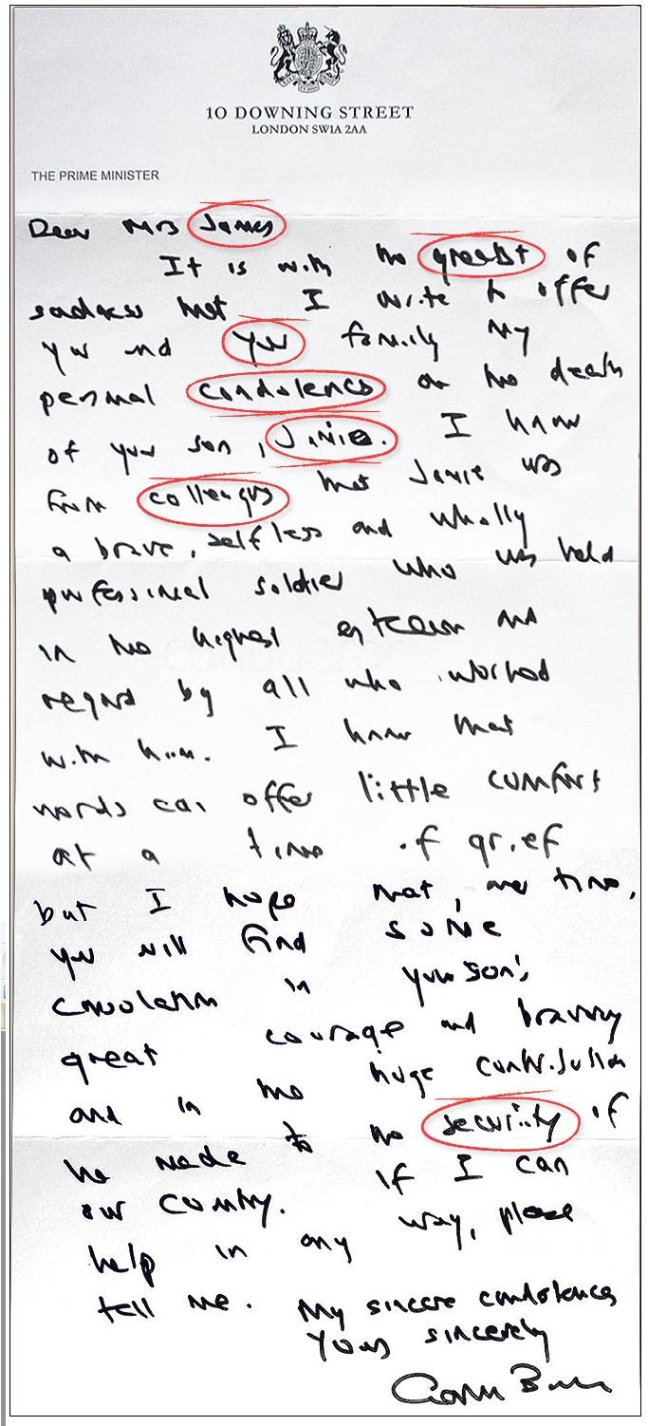
Great Expectations
THEIR EXPECTATIONS
You finish
Your drafts are well put together and spell-checked
You continue on to research

Slide 22
Common pitfalls
Solving the world
Manna from heaven
  sitting around waiting for inspiration
Misunderstood Genius
  Love of Jargon
  If I can do it, it's trivial
  Love of complexity
Lost in abstraction
Analysis paralysis
http://homepages.inf.ed.ac.uk/bundy/how-tos/resbible.html

Slide 23
Psychological hurdles
Self-confidence
Thin skin
Cold start
Theory envy
Fear of exposure

Slide 24
Behind Schedule ?
Report the implications of delays
Discuss changes in plans
Direct resources
Avoid persecution
Respond early
Be flexible
Involve your supervisor(s) and others
Notes:
If you discover or anticipate a delay it is essential to take action
Report the implications of delays - other projects or work may be depending on the outcome of your project so give people time to react
Discuss changes in plans - involve others so they can make suggestions
Direct resources – you can see what tasks need to be completed
Avoid persecution - if someone else is telling you about problems, be constructive - or next time they may not tell you until it is too late
Respond early - so there is time to get back on track or re-think
Be flexible - use your project plans to find alternatives
Involve the client and stakeholders - they may have ideas or be prepared to be flexible too

Slide 25
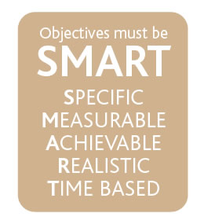
SMART Objectives
Specific
Measurable
Agreed
Realistic
Time Bound
Notes:
SMART Objectives – very common in industry and are used extensively for appraisals and form a simple test of whether the objective is truly a good objective.

Slide 26
Specific
Make the objective specific
  Break large tasks down into smaller tasks
  [X] Write MSc thesis
  [√] Write Results chapter of MSc thesis
  [√] Write section 1 of Results chapter of MSc thesis
Breaking large tasks into smaller ones makes it easier to assess progress
Notes:
Specific – this ties back to the project management module where work breakdown structures where used to split large tasks into much smaller tasks. The aim of doing this allows the objective to be specific. The classic final year PhD student objective is write my PhD. The question of where to start is a difficult one and therefore splitting the task up can make the objective more specific and also achievable within a sensible time frame can help with motivation. Think of other examples of specific objectives. On the previous slide the aim make myself more employable is not at all specific – what is meant by employable !

Slide 27
Measurable
How do you know when you have completed the work
  [X] Make more contacts in the my field of research
  [√] Make 3 contacts at the next conference held on my research topic
  [X] Publish a number of papers from my thesis
  [√] Write two papers after my reference is over at conferences held on my research topic
Make sure they are evidenced based – you should have a deliverable attached to the objective
Notes:
Measurable – You need to know when you have finished the objective / completed the task. There is two elements therefore to writing measurable objectives. They should not include words like more – when do you know when you have made more contacts. Is it one or is it a million. The second element relates to actually having something which you can provide as evidence. Therefore deliverables attached to the objective is good (e.g. Short reports) as these can help you prove that you have achieved the objective (this will be important when you start work!).

Slide 28
Agreed
Get the agreement of the stakeholders in the project
  Especially your supervisor!
  [X] I think I will finish this set of experiments by the end of May
  [X] My supervisor thinks I will finish these experiments by the end of January
  [√] We agreed that my objective will be to finish the experiments by the end of April
Notes:
Agreed – In the project management sessions we talked about stakeholders and involving them in the project. Setting your objectives and agreeing them with your supervisor is important. This might take some negotiation but it worth doing this as everybody will be committed to the plan.
Note that if you ever set objectives for someone else make sure you discuss them with them as setting unachievable objectives for someone can prove a source of conflict.

Slide 29
Realistic
Will you achieve the objective?
  Unrealistic objectives can be very de-motivating
  Challenging objectives which are realistic can be motivating
  [X] Publish 10 papers from my MSc
  [√] Publish a paper from my MSc
Notes:
Realistic Objectives – It is important that the objectives you set are realistic. All too often people will set very unrealistic objectives and the end result is that the project is not delivered on time, resentment develops within the project stakeholders etc. Furthermore if you are being assessed against the objectives which are set, if they are unrealistic you may not achieve any of them! It is however important to set your self challenging objectives which you could achieve if you apply yourself – these are often referred to as stretch targets and are used to motivate staff.

Slide 30
Time Bound
Set timescales on your objectives
  Deadlines and Milestones
Review progress against these deadlines
  [X] Finish writing my literature review
  [√] Finish the first draft of my literature review by the 1st of December
Notes:
Time Bound – It is important that there is an element of time linked to the objective. Again if the objective is open ended when do you when you have achieved the objective. Therefore set yourself deadlines and review yourself against them – don’t let the deadlines slip as the progress of the project overall could be in jeopardy. These can also be a useful time management tool as often people will work on something when little value is being added (80% of the value is provided by 20% of the effort) and a dealine can be used to force you to move on to the next objective.

Slide 31
Time scales
Set objectives at multiple timescales
  This week I will read 4 papers on modelling
  This month I will prepare a short report on modelling
  In the next 2 months I will review the three principle modelling techniques and write the literature review of these techniques for my thesis
Notes:
Time scales - It is useful to set objectives at multiple levels – one week, one month, 6 months – 1 year. This will let you focus on the big picture as well as on the short-term tasks. A useful technique which can be used to improve your time management is to set weekly SMART objectives to help organise your time. The objectives at a number of timescales can be linked back to the WBS discussed in the project management session – the bottom level tasks may be weekly objectives whilst the higher level tasks are longer term.

Slide 32
Mindmap
project
Why am I doing this research ?
for me
the future
Why is this project happening ?
risks
MSc
How is it happening ?
(methodology)
impact
Who are the beneficiaries ?
Challenges
for me
project

Slide 33
Dealing with conflict
Conflict is common
Supervision is like a marriage
  Compromise is key
  Let your supervisor “win” sometimes
  Divorce is possible
Communication is key
  Keep in touch with your supervisor
    Meet
    E-mail
    Telephone
    whatever

Slide 34
Going Forward
As long as there wasn’t too much conflict, your supervisor will make an excellent referee for your CV
But unlike a marriage your supervisor wants you to leave and stand on your own two feet
Your supervisor doesn’t know everything, so talk to many others (but do NOT, repeat DO NOT try to play people off against each other, “Well John said...”
Help others

Slide 35
Remember
“No back-up ….
…no sympathy”

