Slide 1
Advanced Software Development

Slide 2
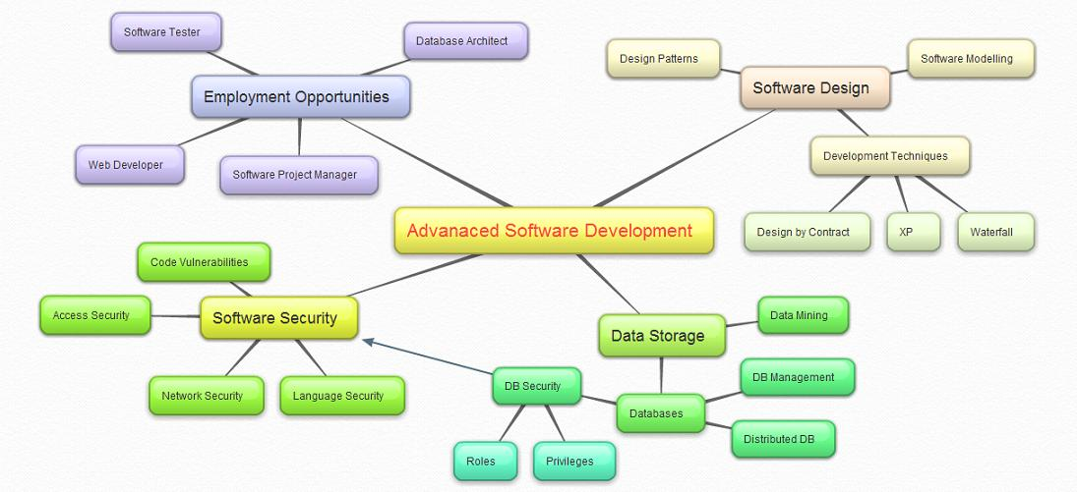

Slide 3
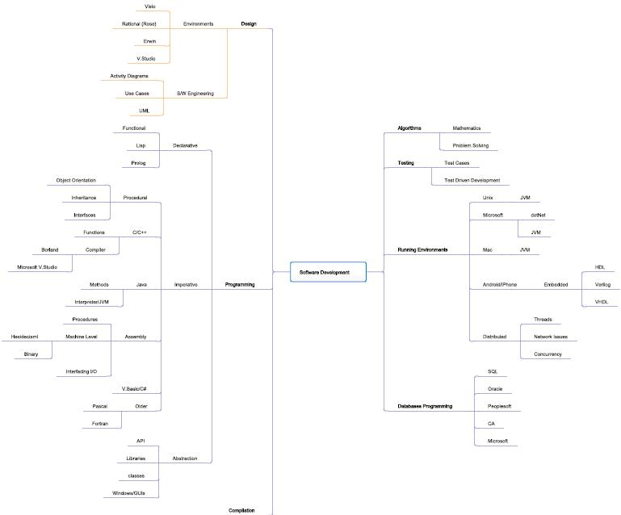

Slide 4
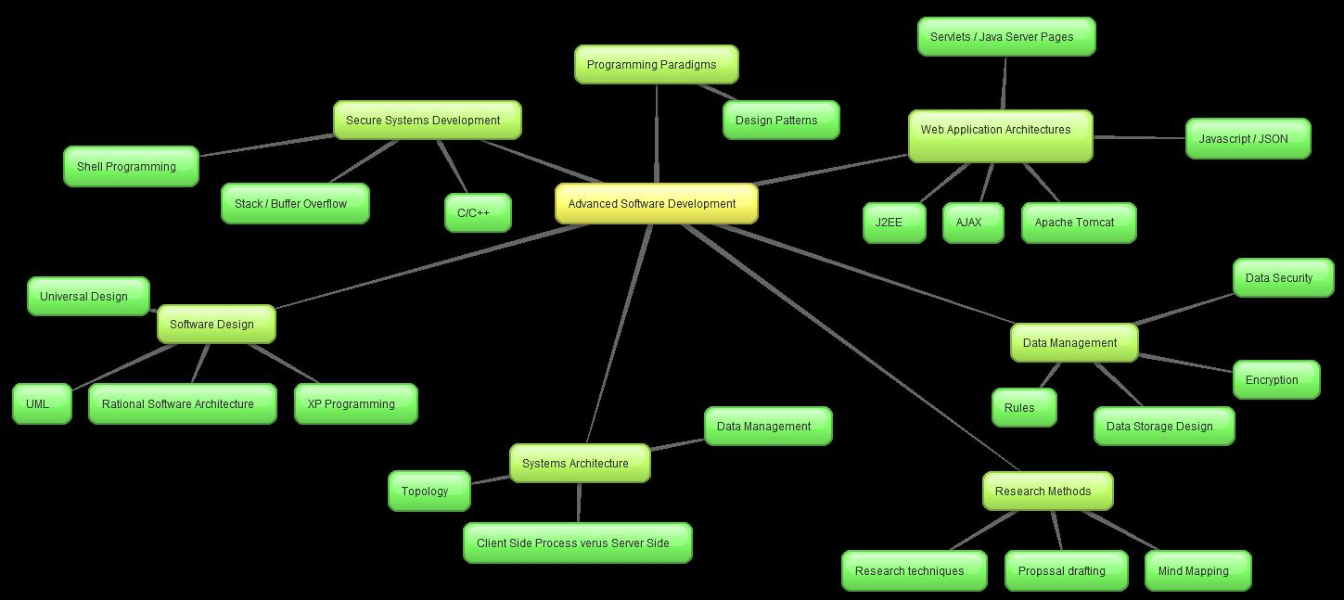

Slide 5
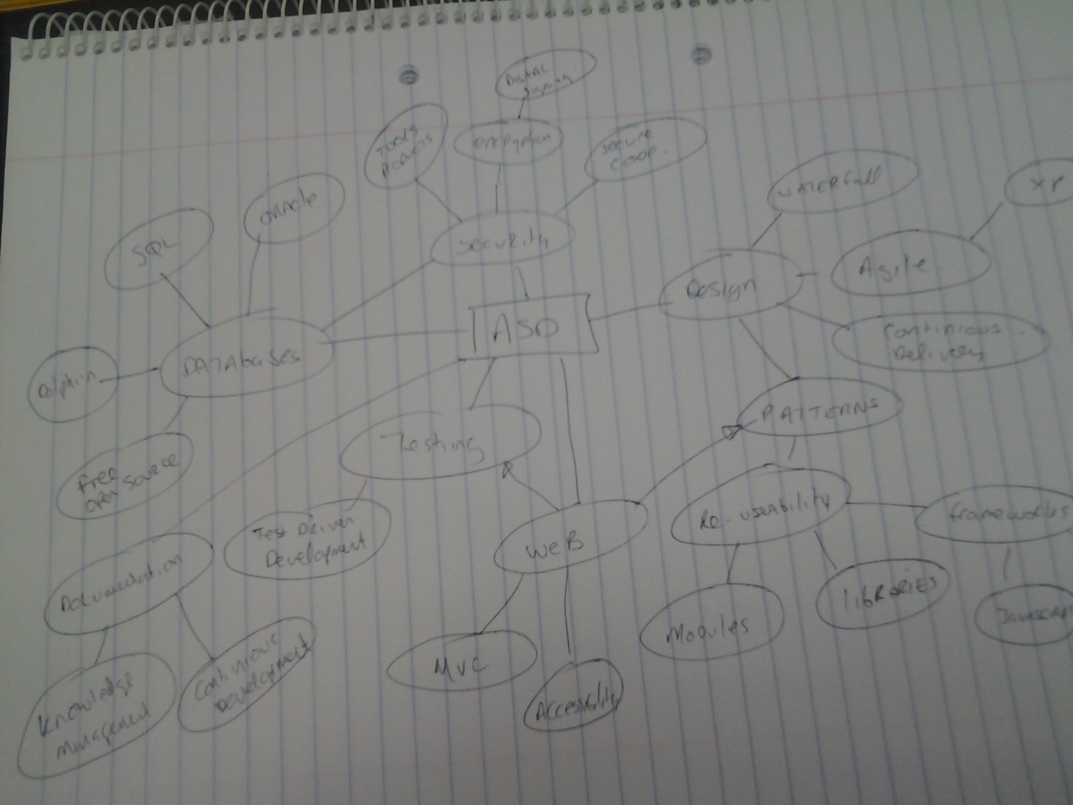

Slide 6
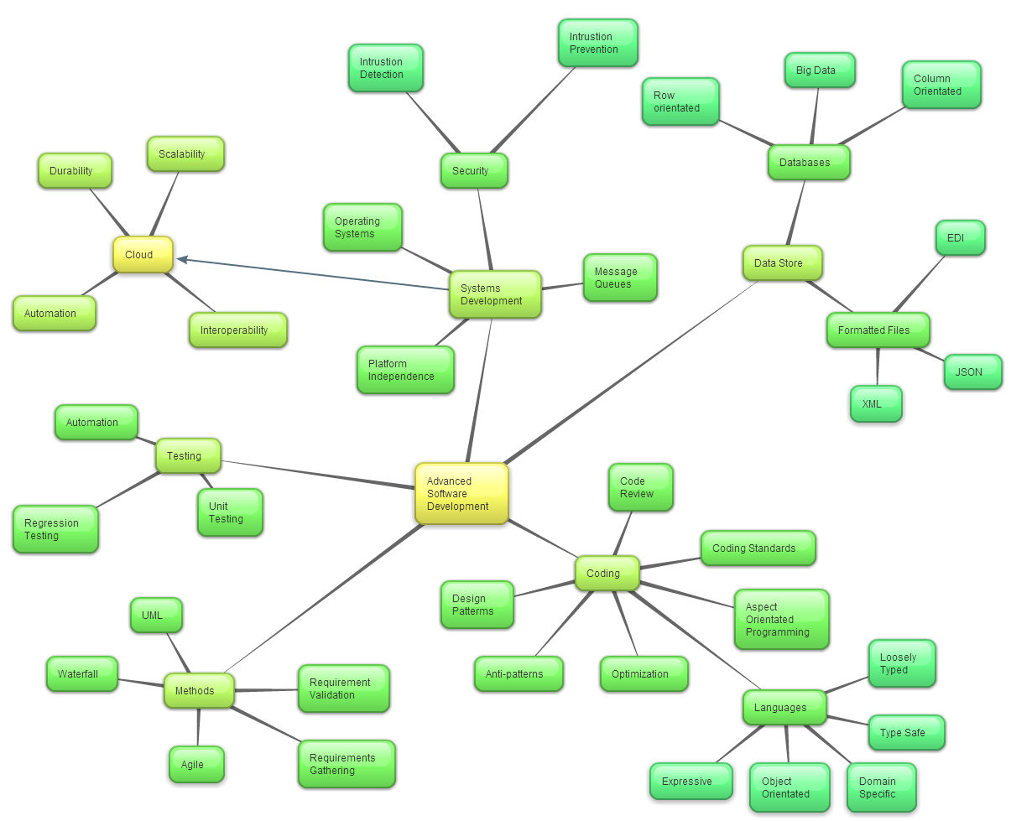

Slide 7
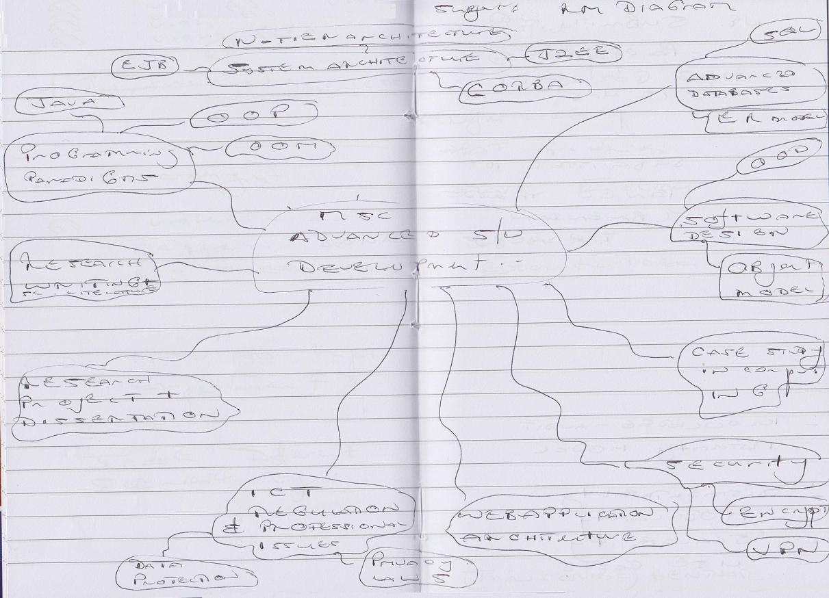

Slide 8
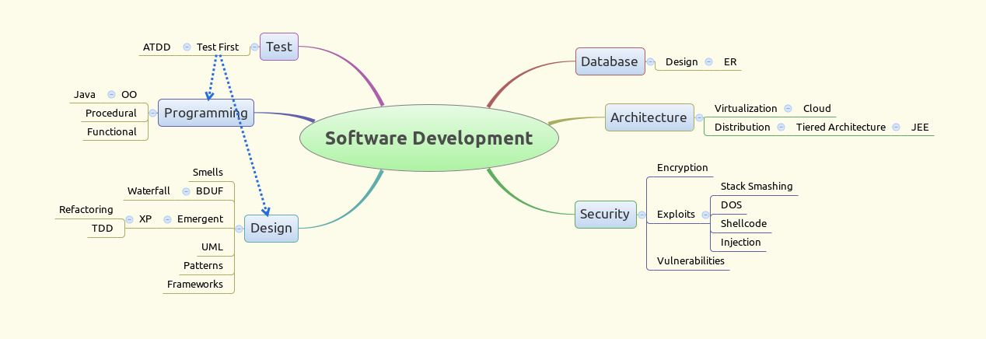

Slide 9
Assistive Technology

Slide 10
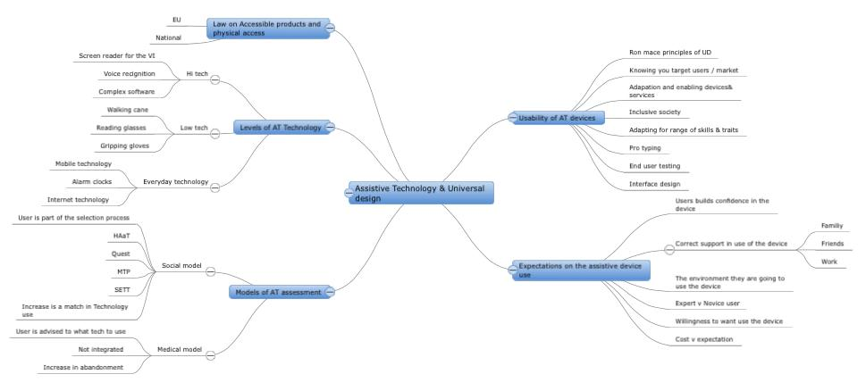

Slide 11
Data Analytics

Slide 12
classifying
clustering
associating
r
weka
Pre-processing
Mining
deploying
sas
Requirements
Implementing
Design
Lifecycles
Current Technology
Mining tools
Visualization
Big Data
Data
Analytics
Databases
Technology
Datasets
Management
Machine Learning
Science
Data Warehouse
Different Domains
Algorithms
business
Statistics
education
health
Hypothesis
Measures

Slide 13
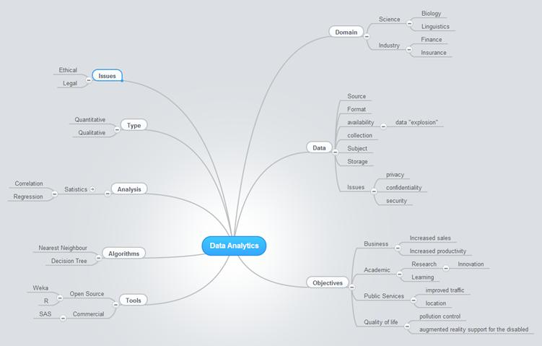

Slide 14
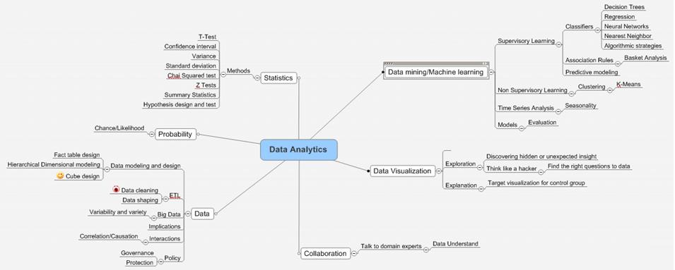

Slide 15
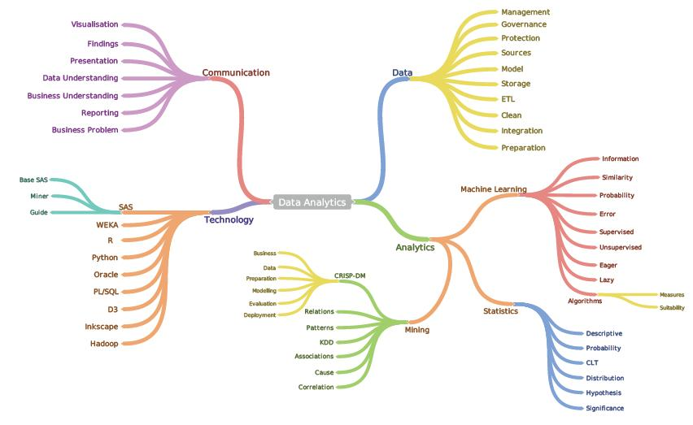

Slide 16
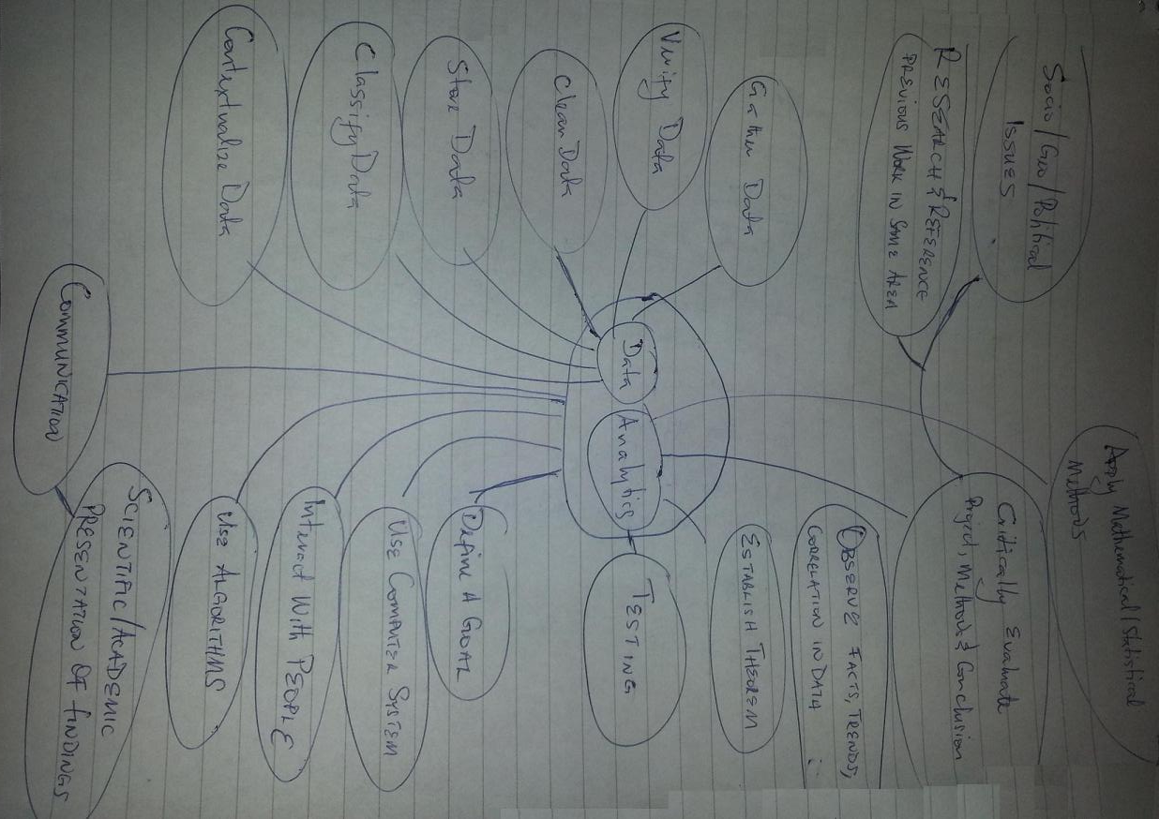

Slide 17
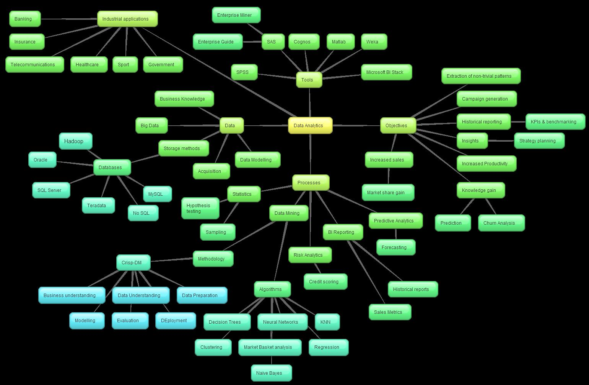

Slide 18
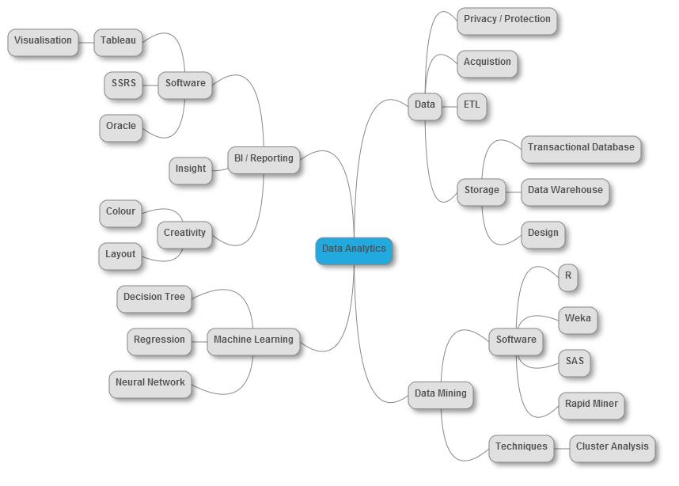

Slide 19
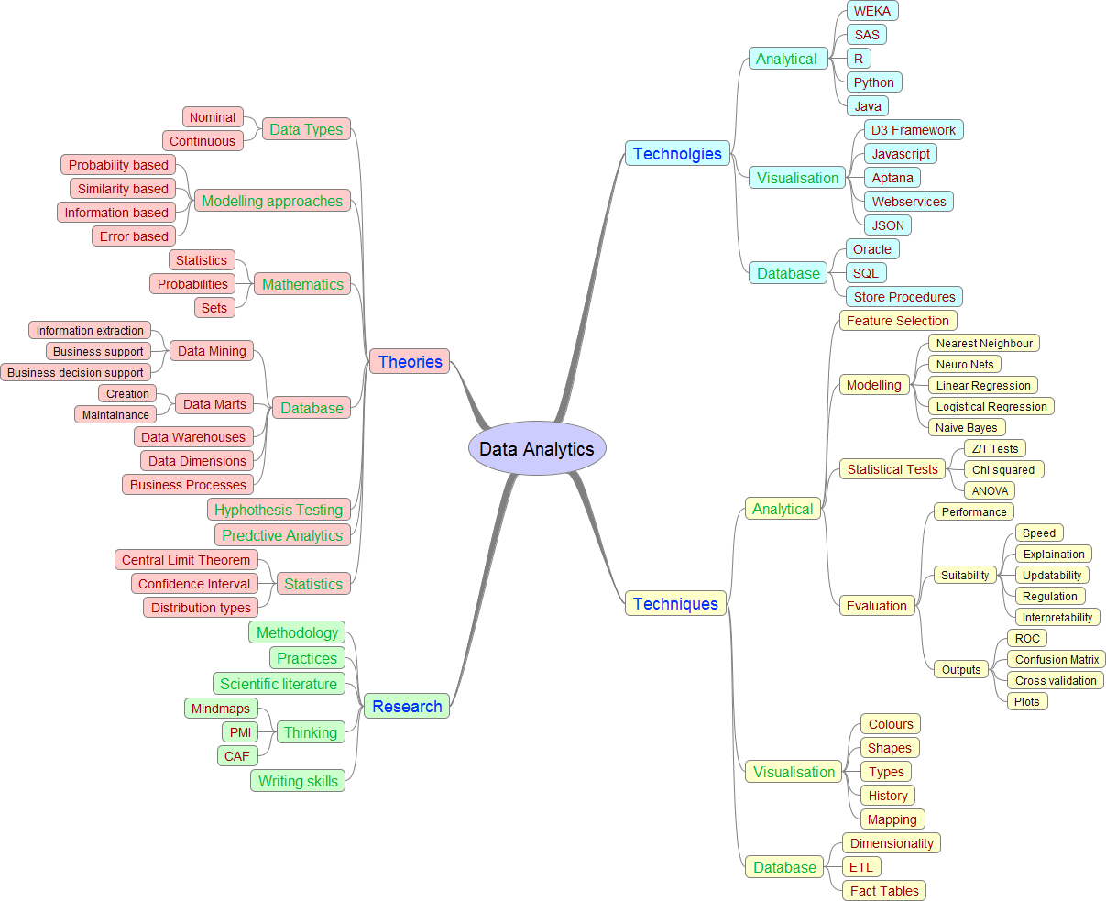

Slide 20
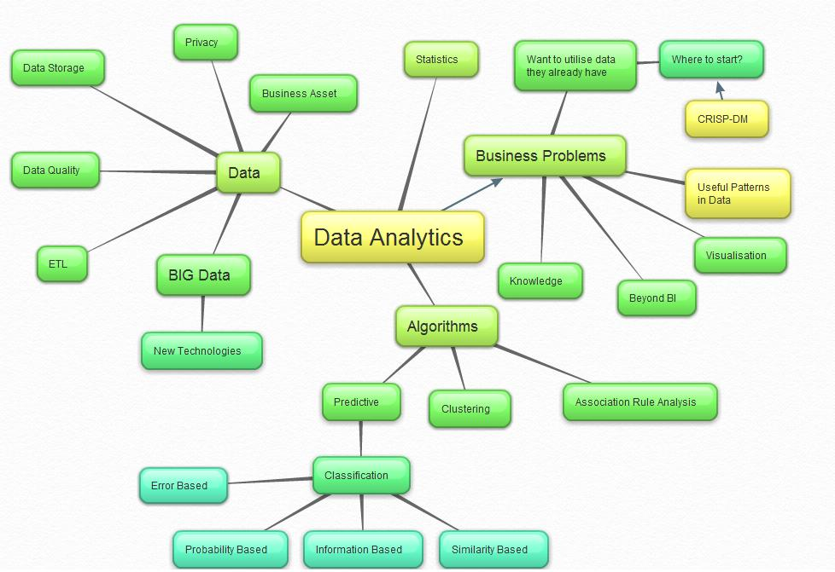

Slide 21
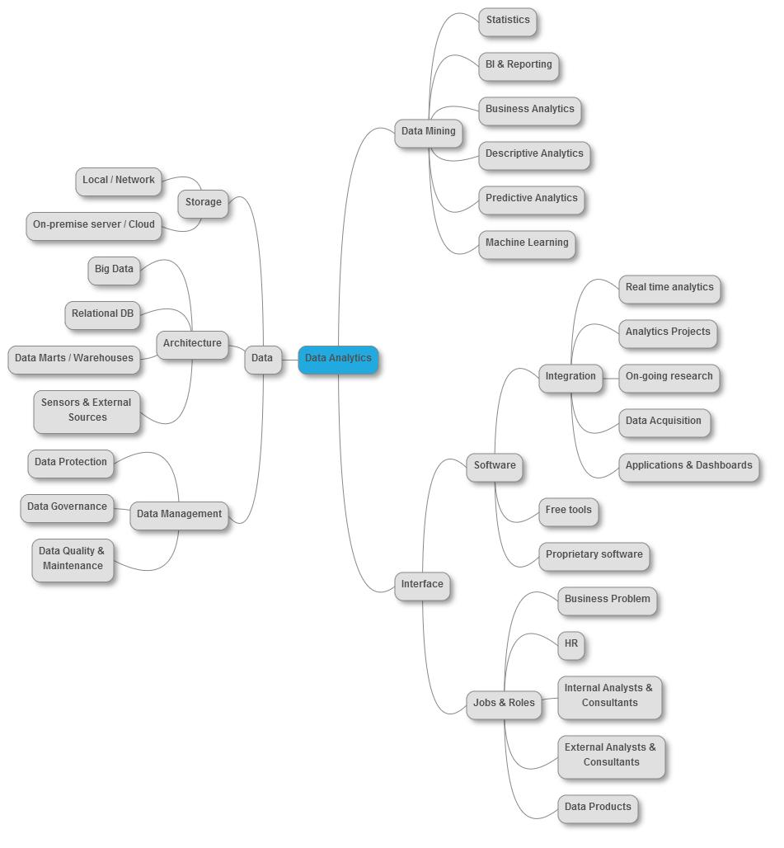

Slide 22
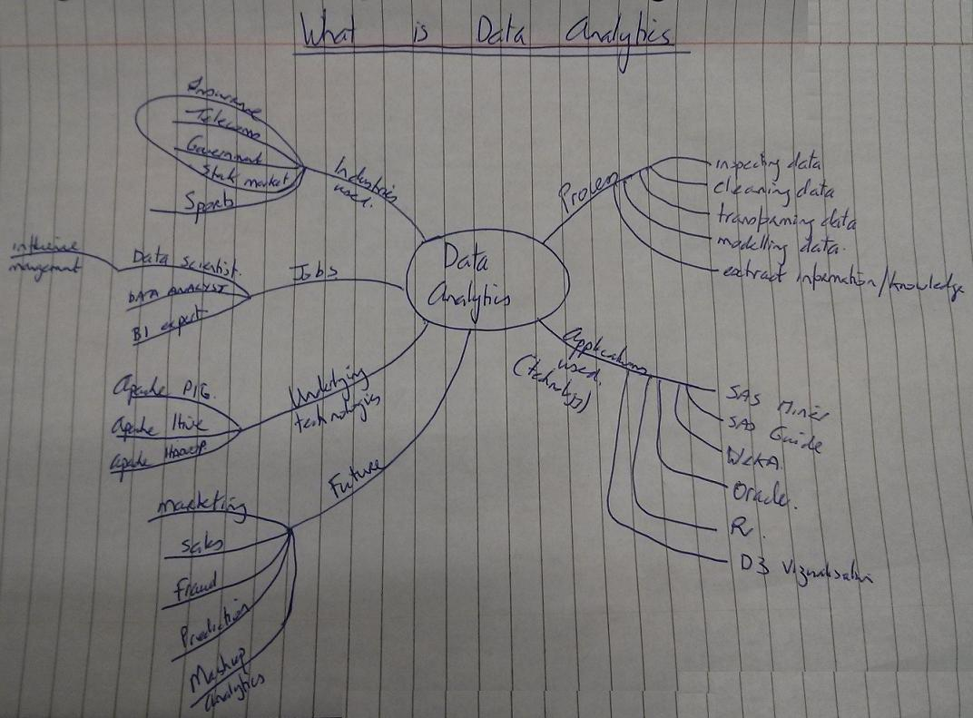

Slide 23
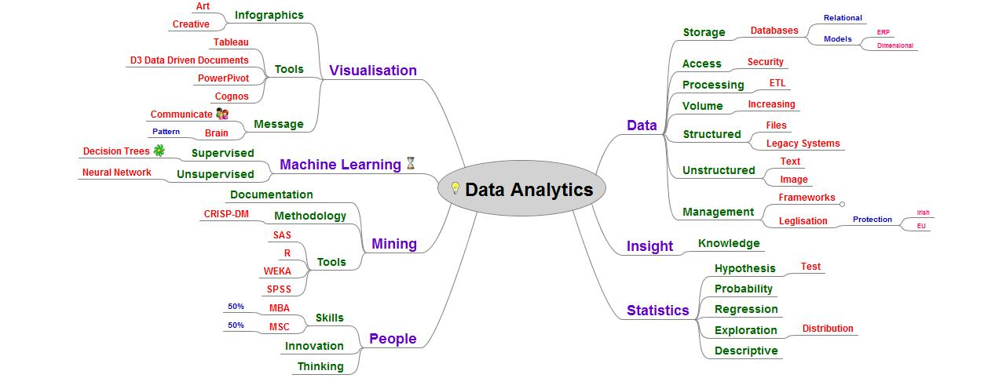

Slide 24
Knowledge Management

Slide 25
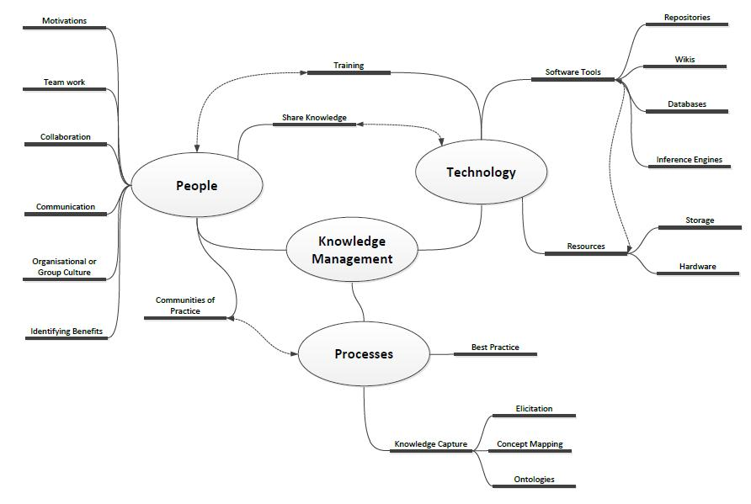

Slide 26
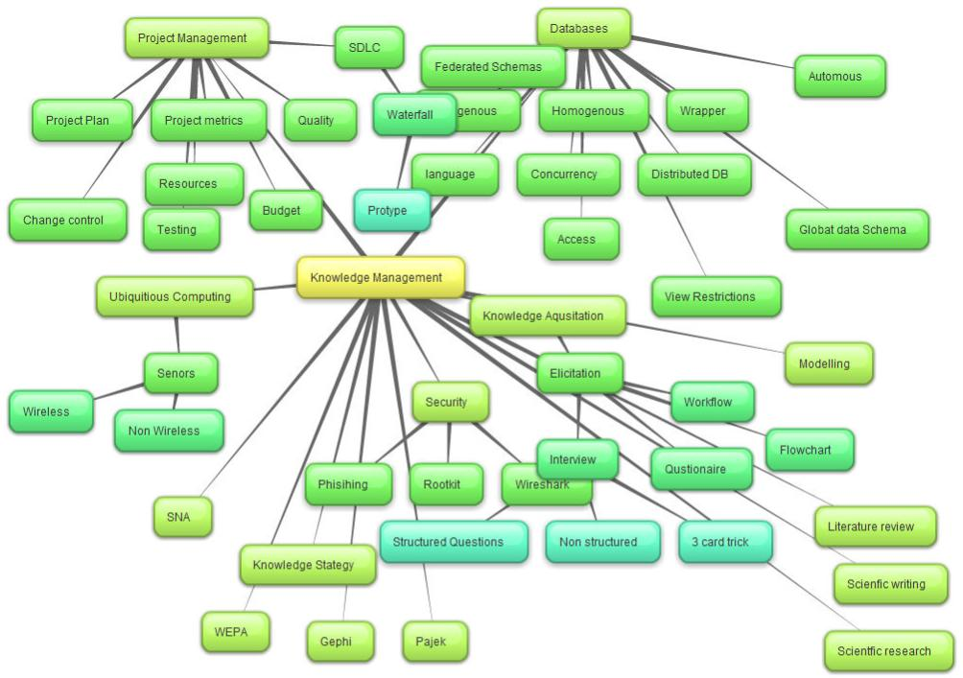

Slide 27
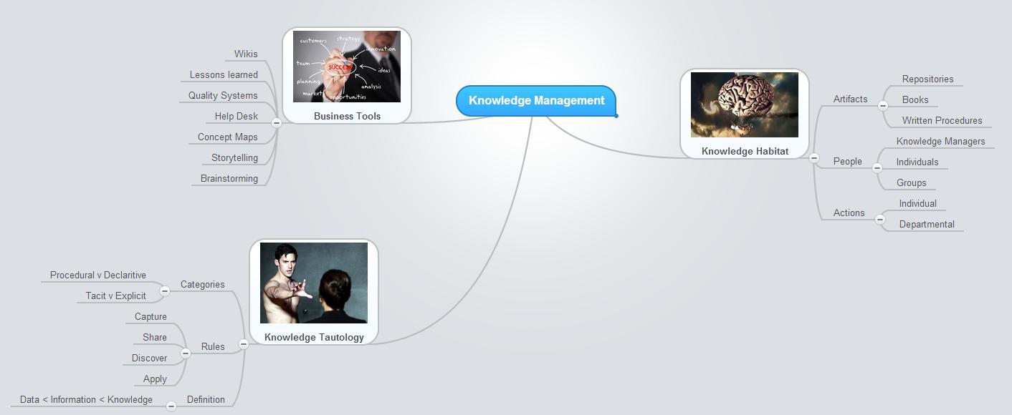

Slide 28
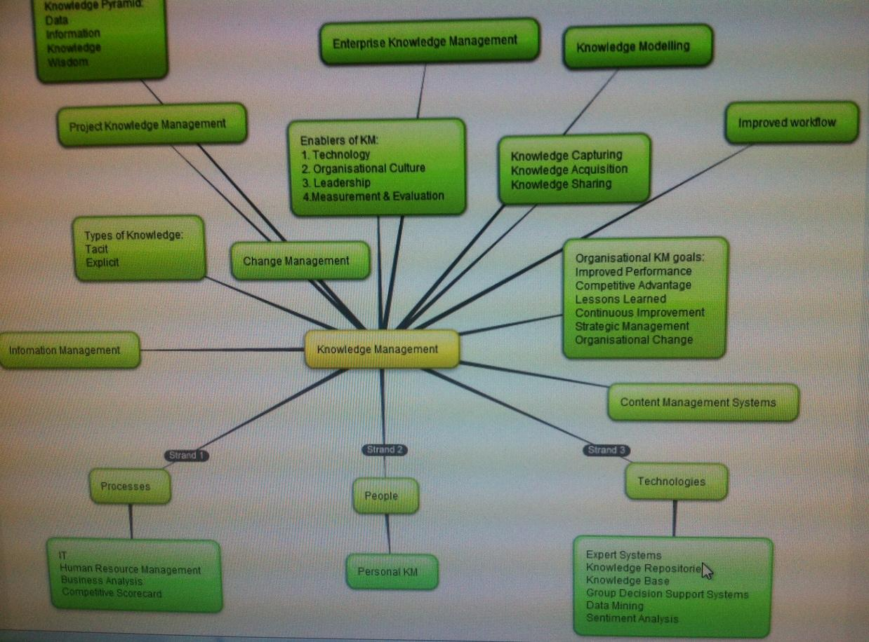

Slide 29
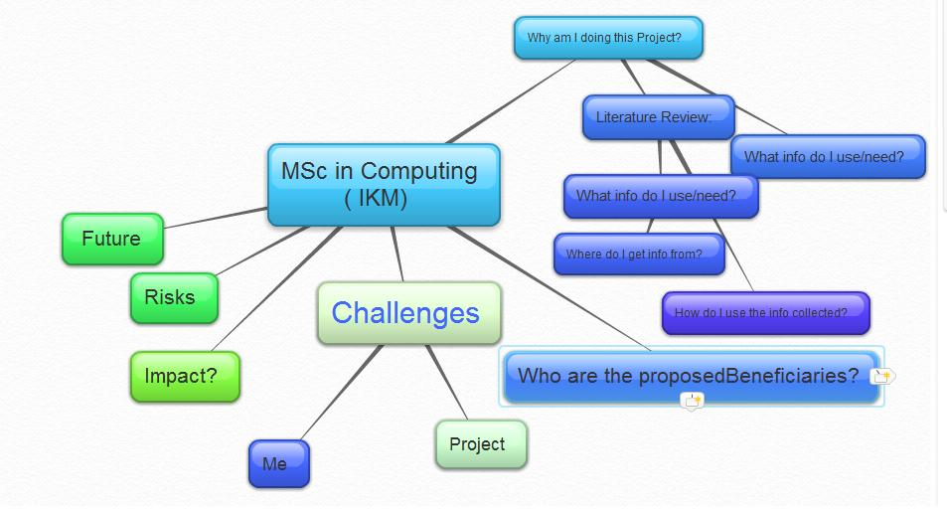

Slide 30
