Slide 1
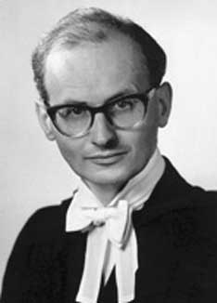
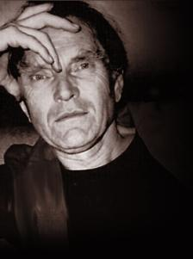
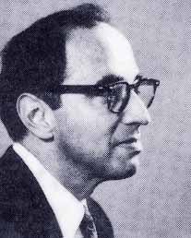
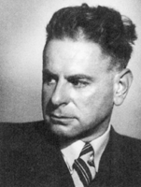
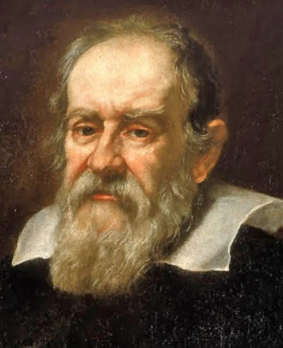
Introduction to Research and the Scientific Method

Slide 2
What is research?
We ask questions all the time
Research is a formal way of going about asking questions
Uses methodologies
Many different kinds (e.g. market research, media research and social research)
Basic research methods can be learned easily

Slide 3
What is science?
Science (from the Latin scientia, meaning "knowledge") is, in its broadest sense, any systematic knowledge-base or prescriptive practice that is capable of resulting in a prediction or predictable type of outcome.
In this sense, science may refer to a highly skilled technique or practice

Slide 4
What is science?
William Whewell's classification of the sciences from Philosophy of the Inductive Sciences, 2nd 3dn. vol.2, 1847, p. 117.

Slide 5
What is science?
It is difficult to pinpoint when science began, but it is conventionally agreed that Galileo Galilei was the father of modern science.
Although others suggest that Paracelsus (Philippus von Hohenheim) may have got the ball rolling with his important work in the fields of medicine and chemistry.

Slide 6
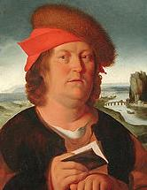
Paracelsus
Philippus von Hohenheim
Born: 17 December 1493
Died: 24 September 1541
Born in Egg, near Einsiede in the Old Swiss Confederacy
Renaissance physician, botanist, alchemist, astrologer, and occultist

Slide 7
Galileo Galilei
Born: 15 February 1564
Died: 8 January 1642
Born in Pisa, Italy
Italian physicist, mathematician, astronomer, and philosopher
improvements to the telescope

Slide 8
Scientific Method
The scientific method is popularly attributed to Galileo who, in 1590, dropped iron balls of two different weights off the Leaning Tower of Pizza.

Slide 9
Scientific Method
He wanted to test his hypothesis that the forces acting on a falling object were independent of the object's weight.

Slide 10
Scientific Method
He was correct and so refuted the previously held belief that heavier objects would fall faster than light objects.

Slide 11
Scientific Method
The steps he took:
observation,
hypothesis generation,
testing of the hypothesis
and refutation or acceptance of the original hypothesis

Slide 12
Inductivism
General statements (theories) have to be based on empirical observations, which are subsequently generalized into statements which can either be regarded as true or probably true.
The classical example goes from a series of observations:
Swan no. 1 was white,
Swan no. 2 was white,
Swan no. 3 was white,…
to the general statement: All swans are white.
Proof by Induction

Slide 13
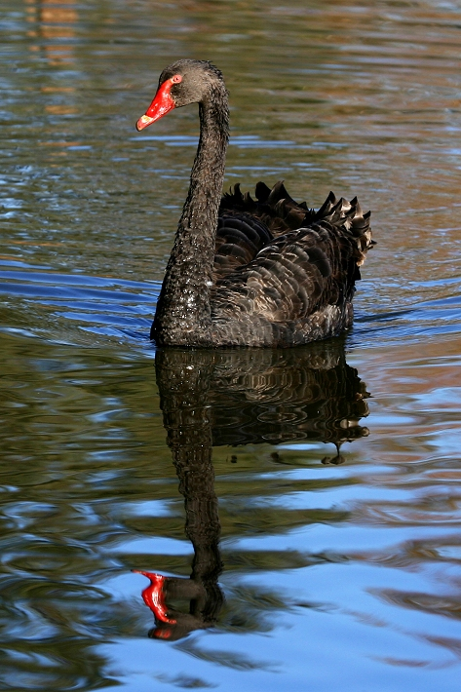
Inductivism
General statements (theories) have to be based on empirical observations, which are subsequently generalized into statements which can either be regarded as true or probably true.
The classical example goes from a series of observations:
Swan no. 1 was white,
Swan no. 2 was white,
Swan no. 3 was white,…
to the general statement: All swans are white.
Proof by Induction

Slide 14
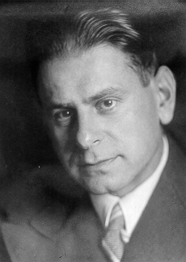
Karl Popper
Born: 28 July 1902
Died: 17 September 1994
Born in Vienna, Austria
Philosopher and a professor at the London School of Economics

Slide 15
Popper’s Falsifiability
In the 1930s Karl Popper made falsifiability the key to his philosophy of science. It has become the most commonly invoked "criterion of demarcation" of science from non-science.

Slide 16
Popper’s Falsifiability
Falsifiability is the logical possibility that an assertion can be shown false by an observation or a physical experiment. That something is "falsifiable" does not mean it is false; rather, that if it is false, then this can be shown by observation or experiment.

Slide 17
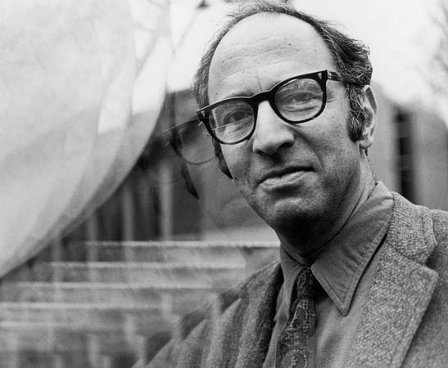
Thomas Kuhn
Born: July 18, 1922
Died: June 17, 1996
Born in Cincinnati, Ohio
Wrote extensively on the history of science

Slide 18
Kuhn’s Paradigm
In his book “The Structure of Scientific Revolutions” Thomas Kuhn transformed the world’s view on the way science is done.

Slide 19
Kuhn’s Paradigm
His opinion was that science with not, in fact, a cumulative process, but in reality, a cyclical process whereby a particular research perspective (paradigm) dominates for a period of time, until a new one is developed which supersedes it.

Slide 20
1. Normal
Science
5. Paradigm
Change
The
Kuhnian
Cycle
2. Model
Drift
4. Model
Revolution
3. Model
Crisis

Slide 21
Kuhn’s Paradigm
The transition from a Ptolemaic cosmology to a Copernican one.
The transition between the worldview of Newtonian physics and the Einsteinian Relativistic worldview.
The development of Quantum mechanics, which redefined Classical mechanics.
The acceptance of Charles Darwin's theory of natural selection replaced Lamarckism as the mechanism for evolution.

Slide 22
Kuhn’s Paradigm
Revolutions: here theories are replaced by new ones.
But there are no clear, rational procedures for this, no "falsification".

Slide 23
Imre Lakatos
Born: Nov 9, 1922
Died: Feb 2, 1974
Born in Debrecen, Hungary
Philosopher of mathematics and science

Slide 24
Imre Lakatos
Attempt at rapprochement
Popper is wrong to think theories must be rejected when they fail tests – there may be a hard core to the theory that is correct.
Kuhn is wrong to think there is no rational comparison: we can compare research programmes over time to see how well they develop, how many novel predictions they make.

Slide 25
Paul Feyerabend
Born: January 13, 1924
Died: February 11, 1994
Born in Vienna, Austria
Philosopher of science

Slide 26
Paul Feyerabend
There are no universal rules of science
"Anything goes"
Truth/meaning is internal to theories.
Freedom superior to truth.

Slide 27
Paul Feyerabend
Feyerabend met Imre Lakatos and planned to write a dialogue volume in which Lakatos would defend a rationalist view of science and Feyerabend would attack it.
This planned joint publication was put to an end by Lakatos's sudden death in 1974.
Feyerabend’s Against Method became a famous criticism of current philosophical views of science and provoked many reactions.

Slide 28
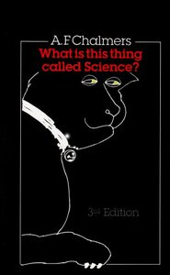
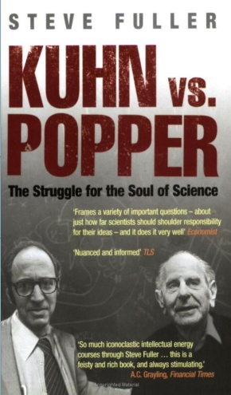
Some interesting reads

Slide 29
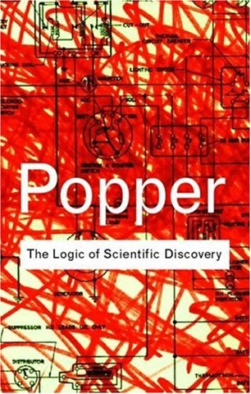
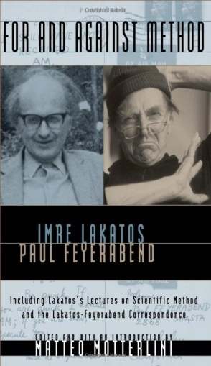
Some interesting reads

Slide 30
O.K. so what does this all mean?
Well really what it means is that we try to avoid using the words
“PROOF”
“PROVEN”
“PROVE”

Slide 31
Scientific Method
1. Observation of phenomena;
2. Development of hypothesis to explain observation;
3. Development of predictions based on hypothesis;
4. Experiments conducted to test predictions;
5. Data collection and analysis (data can be numerical, graphical, visual observations, case studies, etc.);
6. Modify hypothesis until it is consistent with the observations; and
7. Derive conclusion.

Slide 32
Scientific Method
280BC Libraries with Index
1000 Collaborative Encyclopedia
1410 Cross-referenced Encyclopedia
1550 Invention of the Fact
1590 Controlled Experiments
1609 Scopes and Laboratories
1687 Hypothesis/Prediction
1650 Societies of Experts
1665 Necessary Repeatability
1752 Peer Review Referee
1780 Journal Network
1920 Falsifiable Testability
1926 Randomized Design
1937 Controlled Placebo
1950 Double Bind Refinement
1946 Computer simulations
1974 Meta-analysis

Slide 33
The Laws of Logic

Slide 34
Laws of Logic
The Law of Identity
The Law of Non-Contradiction
The Law of the Excluded Middle
plus Occam’s Razor

Slide 35
Laws of Logic
The Law of Identity
This states that if something is true, it is always true. That which is, is, for example, men are men, women are women and small furry creatures from Alpha Centauri are small furry creatures from Alpha Centauri;

Slide 36
Laws of Logic
The Law of Non-Contradiction
This states that two statements which are antithetical (opposite) cannot both be true. For example, Aristotle cannot be both alive and dead at the same time;

Slide 37
Laws of Logic
The Law of the Excluded Middle
This states that if a statement is not true, then the opposite of that statement is taken to be true. For example, if Aristotle is not alive, he must be dead
Or, the disjunctive proposition "Either it is raining or it is not raining" must be true. Also, if it is true that it is raining, then the proposition "Either it is raining, or I own a car" must also be true. It really doesn't matter what the second phrase is.

Slide 38
Laws of Logic
Finally we have Occam’s Razor, which in its original form states "Entities should not be multiplied unnecessarily" {"Pluralitas non est ponenda sine neccesitate"}, taken to mean in this case that if two theories present themselves that are both equally likely to be true, pick the one that makes the fewest assumptions.

Slide 39
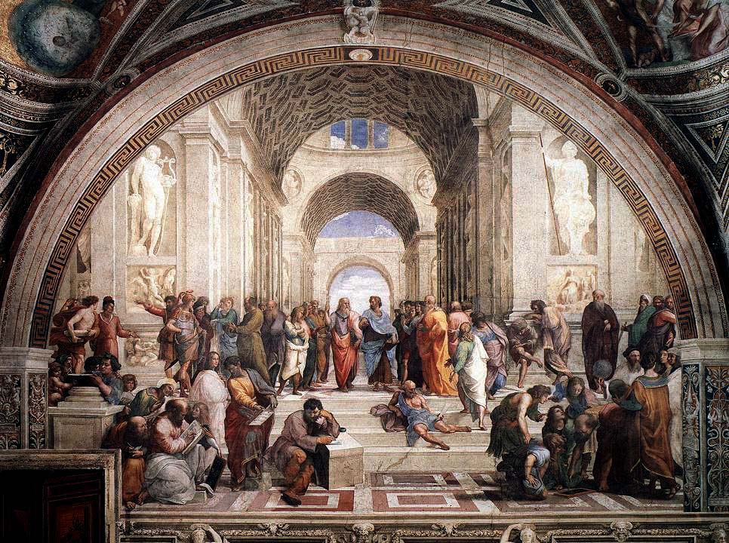
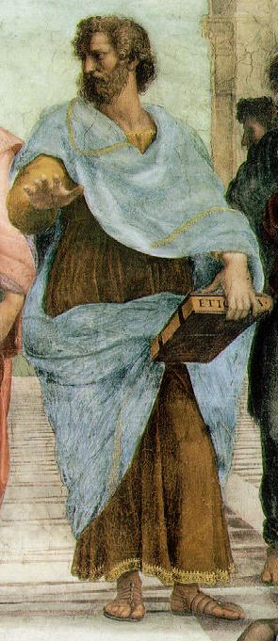
Logic Puzzle

Slide 40
Logic Puzzle
Aristotle said that there is a different between the following two statements;
“The wood is not white”
“It is not white wood”
Can you see the difference?

Slide 41
Logic Puzzle - Solution
“The wood is not white”
This statement means that the thing under discussion IS wood BUT isn’t white, so, from example, it could be green wood, yellow wood or black wood
“It is not white wood”
This statement means that it is anything other that white wood, so, for example, it could be blue wood, green metal, or white plastic.

Slide 42
The Problem of Bias

Slide 43
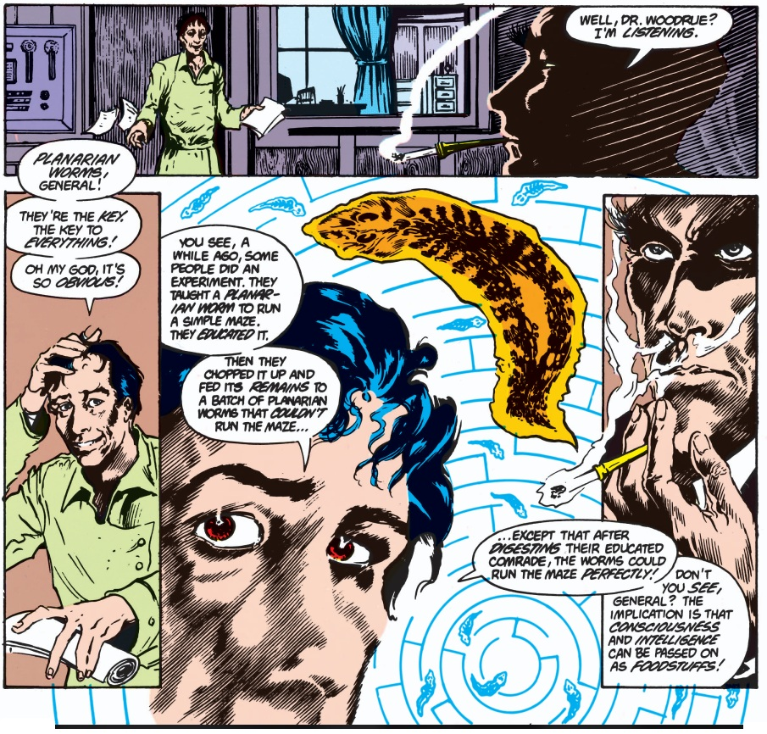

Slide 44
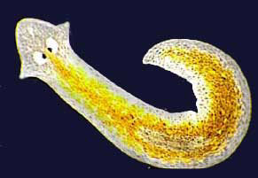
Planarian worms
McConnell, J. V. (1962) “Memory transfer through Cannibalism in Planarium”, J. Neuropsychiat. 3 suppl 1 542-548.
Reports that when planarians conditioned to respond to a stimulus were ground up and fed to other planarians, the recipients learned to respond to the stimulus faster than a control group did.
McConnell believed that this was evidence of a chemical basis for memory, which he identified as memory RNA. Although well publicized, his findings were not reproducible by other scientists.

Slide 45
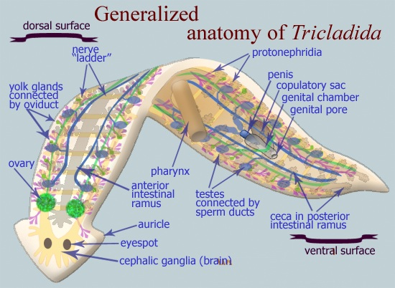

Slide 46
Planarian worms
Potential Issues
In natural conditions, these worms will react to light by elongating and to shock by contracting, in this experiment they were trained to contract in response to light and elongate when exposed to shock, thus not only were they being trained to run a maze but to do so in complete opposition to their instincts. That raises questions and variables which weren't taken into account during the course of the original experiment, and could has caused bias.
The propensity of planarian worms is to choose to follow a path coated in the mucous or slime trail left by a previous worm rather than to slither off in new directions.

Slide 47
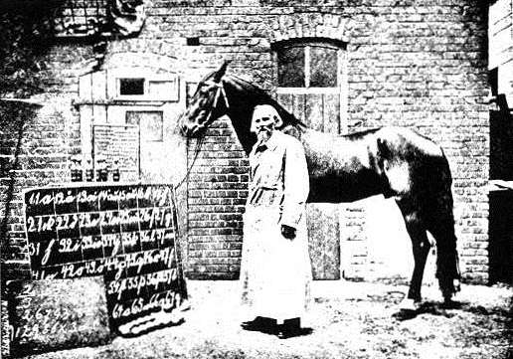
Clever Hans

Slide 48
During the late nineteenth century, the public was especially interested in animal intelligence due in a large part to Charles Darwin’s, and Francis Galton’s, then-recent publications.

Slide 49
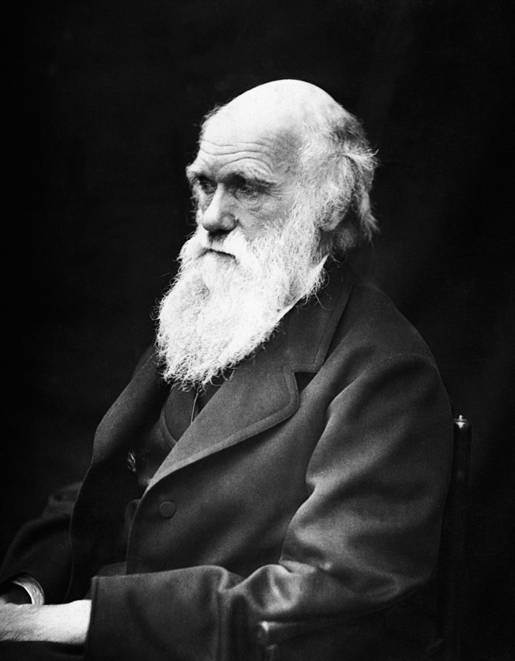
Charles Darwin
Born 12 February 1809
Died 19 April 1882
an English naturalist who established that all species of life have descended over time from common ancestry, and proposed the scientific theory that this branching pattern of evolution resulted from a process that he called natural selection.
In 1859 he published a book On the Origin of Species.
Notes:
Eugenist ….. Part of later facist propaganda
Believed in class system and that certain people were implicitly wise

Slide 50
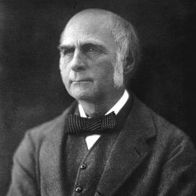
Francis Galton
Born 16 February 1822
Died 17 January 1911
cousin of Charles Darwin, was an English Victorian polymath, anthropologist, eugenicist, tropical explorer, geographer, inventor, meteorologist, proto-geneticist, psychometrician, and statistician.
Notes:
Eugenist ….. Part of later facist propaganda
Believed in class system and that certain people were implicitly wise

Slide 51
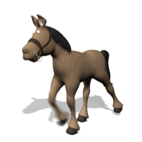
Clever Hans
Hans was a horse owned by Wilhelm von Osten, who said he had taught Hans to add, subtract, multiply, divide, work with fractions, tell time, keep track of the calendar, differentiate musical tones, and read, spell, and understand German.

Slide 52
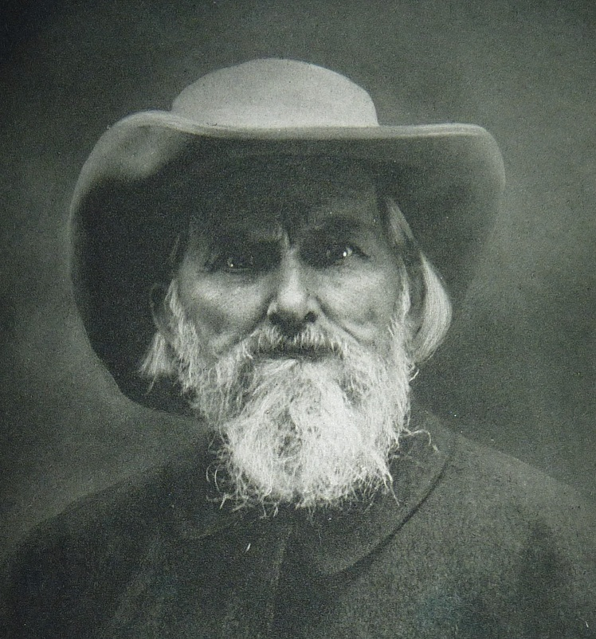
Wilhelm von Osten
Born 30 November 1838
Died 29 June 1909
Born in Toruń, Poland
Worked as a mathematics teacher, an amateur horse trainer, phrenologist, and something of a mystic
Notes:
Eugenist ….. Part of later facist propaganda
Believed in class system and that certain people were implicitly wise

Slide 53
Clever Hans
Von Osten would ask Hans, "If the eighth day of the month comes on a Tuesday, what is the date of the following Friday?” Hans would answer by tapping his hoof. Questions could be asked both orally, and in written form. Von Osten exhibited Hans throughout Germany, and never charged admission.

Slide 54
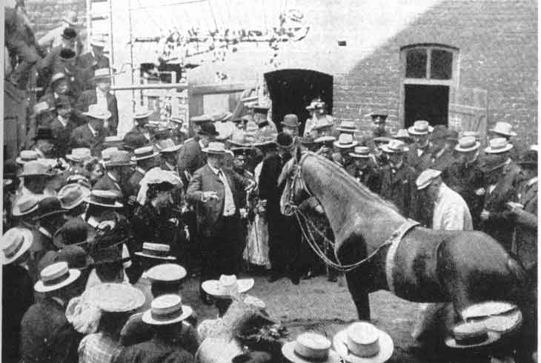
Notes:
Eugenist ….. Part of later facist propaganda
Believed in class system and that certain people were implicitly wise

Slide 55
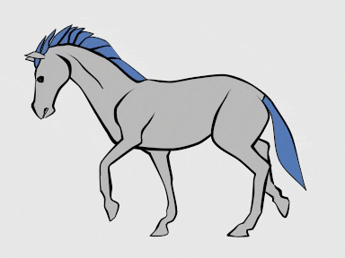
Clever Hans
The German board of education appointed a commission to investigate von Osten's scientific claims. Philosopher and psychologist Carl Stumpf formed a panel of 13 people, known as the Hans Commission. This commission consisted of a veterinarian, a circus manager, a Cavalry officer, a number of school teachers, and the director of the Berlin zoological gardens. This commission concluded in September 1904 that no tricks were involved in Hans’ performance.

Slide 56
Clever Hans
The commission passed off the evaluation to Pfungst, who tested the basis for these claimed abilities by:
Isolating horse and questioner from spectators, so no cues could come from them
Using questioners other than the horse's master
By means of blinders, varying whether the horse could see the questioner
Varying whether the questioner knew the answer to the question in advance.

Slide 57
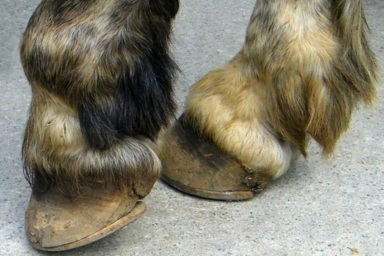
Clever Hans
Using a substantial number of trials, Pfungst found that the horse could get the correct answer even if von Osten himself did not ask the questions, ruling out the possibility of fraud. However, the horse got the right answer only when the questioner knew what the answer was, and the horse could see the questioner.

Slide 58
Clever Hans
He observed that when von Osten knew the answers to the questions, Hans got 89 percent of the answers correct, but when von Osten did not know the answers to the questions, Hans only answered six percent of the questions correctly.

Slide 59
Clever Hans
Pfungst then proceeded to examine the behaviour of the questioner in detail, and showed that as the horse's taps approached the right answer, the questioner's posture and facial expression changed in ways that were consistent with an increase in tension, which was released when the horse made the final, correct tap. This provided a cue that the horse could use to tell it to stop tapping.

Slide 60
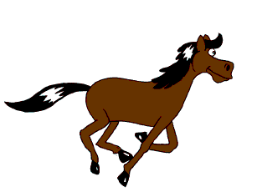
Clever Hans
The social communication systems of horses probably depend on the detection of small postural changes, and this may be why Hans so easily picked up on the cues given by von Osten (who seemed to have been entirely unaware that he was providing such cues).
However, the capacity to detect such cues is not confined to horses.

Slide 61
Clever Hans
Pfungst proceeded to test the hypothesis that such cues would be discernible, by carrying out laboratory tests in which he played the part of the horse, and human participants sent him questions to which he gave numerical answers by tapping. He found that 90% of participants gave sufficient cues for him to get a correct answer.

Slide 62
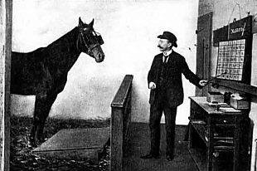
Notes:
Eugenist ….. Part of later facist propaganda
Believed in class system and that certain people were implicitly wise

Slide 63
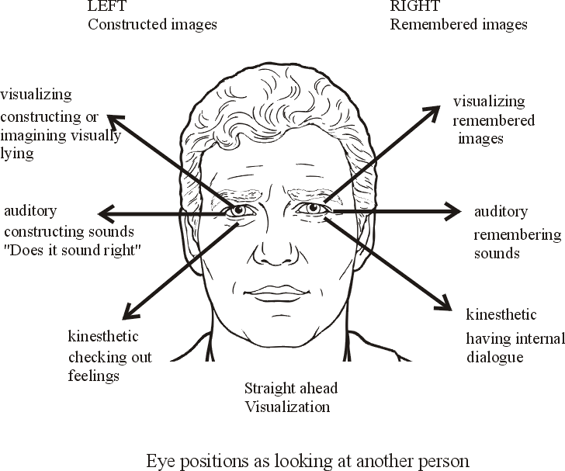
The Clever Hans Effect
Pfungst made an extremely significant observation. After he had become adept at giving Hans performances himself, and fully aware of the subtle cues which made them possible, he discovered that he would produce these cues involuntarily regardless of whether he wished to exhibit or suppress them.
Recognition of this striking phenomenon has had a large effect on experimental design and methodology for all experiments whatsoever involving sentient subjects (including humans).

Slide 64
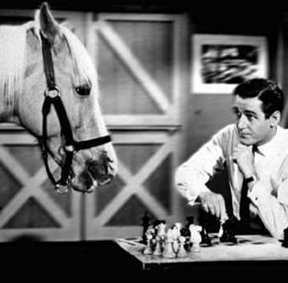

Slide 65
Doing Research

Slide 66
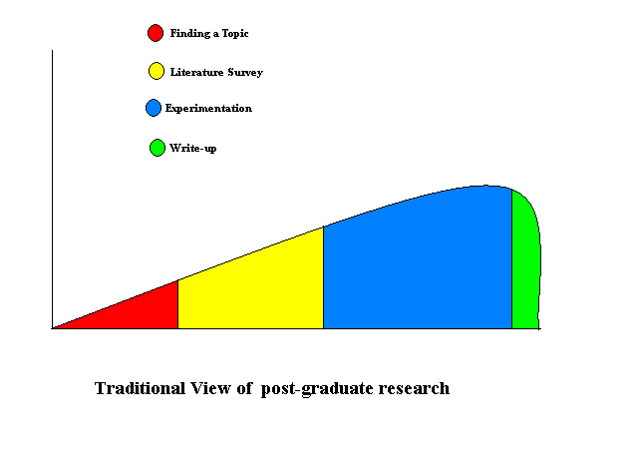
Effort
Time

Slide 67
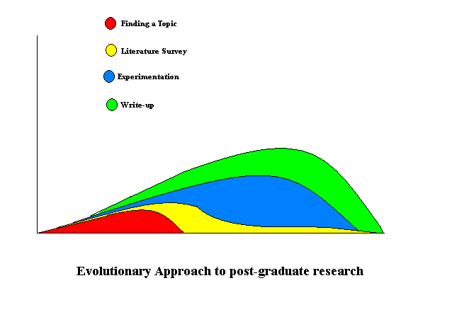
Effort
Time

Slide 68
Finding the Topic
Selecting a topic for your research is the single most important decision that you will make for your post-graduate tenure.
To sustain your interest over a number of months it is very important that you find a topic that not only interests you but engages your imagination.
If you have a passion for a particular area of research, this passion will give you the determination you need to reach your goal.

Slide 69
Finding the Topic
I would expect you all to have a topic by Week 7 of this module.
Let’s work out the date of that.

Slide 70
Types of research (1/5)
Theoretical Orientation
Investigation of field
Identifying strengths & weakness
Acknowledging areas for further development and investigation
Usually involves some type of literature search or review

Slide 71
Types of research (2/5)
Development project
Software systems
Hardware systems
Process models
Methods and algorithms

Slide 72
Types of research (3/5)
Evaluation project
Compare and contrasting programming languages
Judge different user interfaces

Slide 73
Types of research (4/5)
Industry-based project
Finding a solution that benefits a real world problem

Slide 74
Types of research (5/5)
Problem solving
The development of a new technique
Improve existing practice

Slide 75
Basic research methods
Quantitative research (e.g. survey)
Qualitative research (e.g. face-to-face interviews; focus groups; site visits)
Case studies
Participatory research

Slide 76
Planning your research: Key questions
What do you want to know?
How do you find out what you want to know?
Where can you get the information?
Who do you need to ask?
When does your research need to be done?
Why? (Getting the answer)

Slide 77
DIY: Mini-Dissertation
Day 1 | 20 mins | In the beginning, design, consider and ponder the topic or question that will drive your research
Day 2 | 1 hour | Decide on data gathering tools, implement literature survey & review - reviewing content and format
Day 3 | 30 mins | Design Experiments based on literature
Day 4 | 1 hour | Implement experiments, gather data from experiments and literature
Day 5 | 30 mins | Write-up and Present findings – Graphs, stats, etc.
Day 6 | 2 hours | Write up mini-thesis document
Day 7 | 30 mins | Reflect
Notes:
If you are having difficulty deciding whether or not you really what to do stick with a particular topic for your thesis, I just suggest that you do a quick rapid prototype dissertation, spend a week imagining what it would be like to do it, and what each step of the dissertation would be like and if you still want to do the topic by the end of the week, you should be happy to stick with it:
Day 1 - think about topic, related fields, synonyms, etc., 20 mins Day 2 - find 2-3 research papers in the area, 1 hour Day 3 - design and document an experiment, 30 mins Day 4 - Do a "toy" experiment or even a thought experiment for an hour Day 5 - Write up experiment and findings, 30 mins Day 6 - Add in table of contents, declaration, abstract, etc., 2 hours Day 7 - Do I really want to do this thesis? 30 mins

