Slide 1
Exam Preparation
Damian Gordon

Slide 2
Contents
Motivation
Time Management
Doing the Exam

Slide 3
Motivation

Slide 4
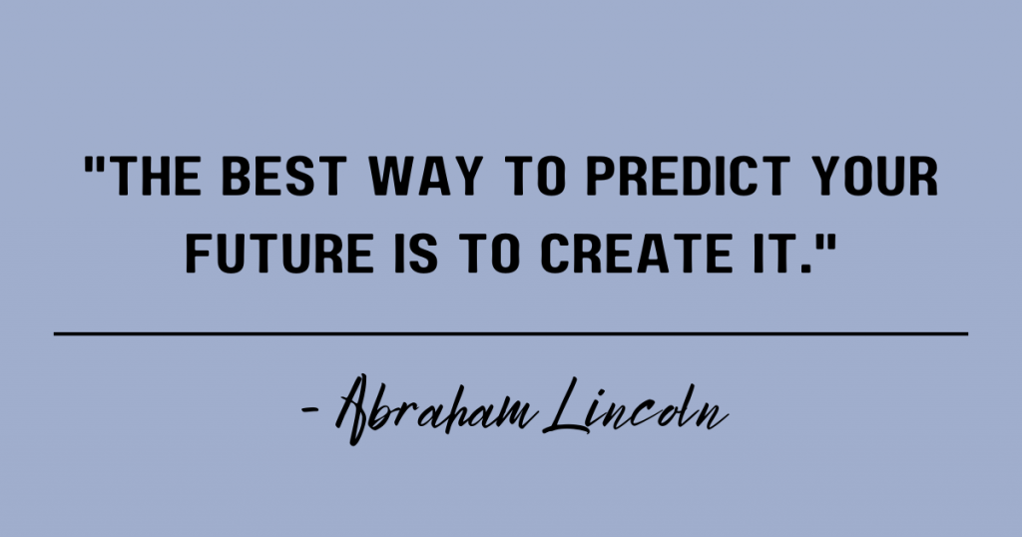
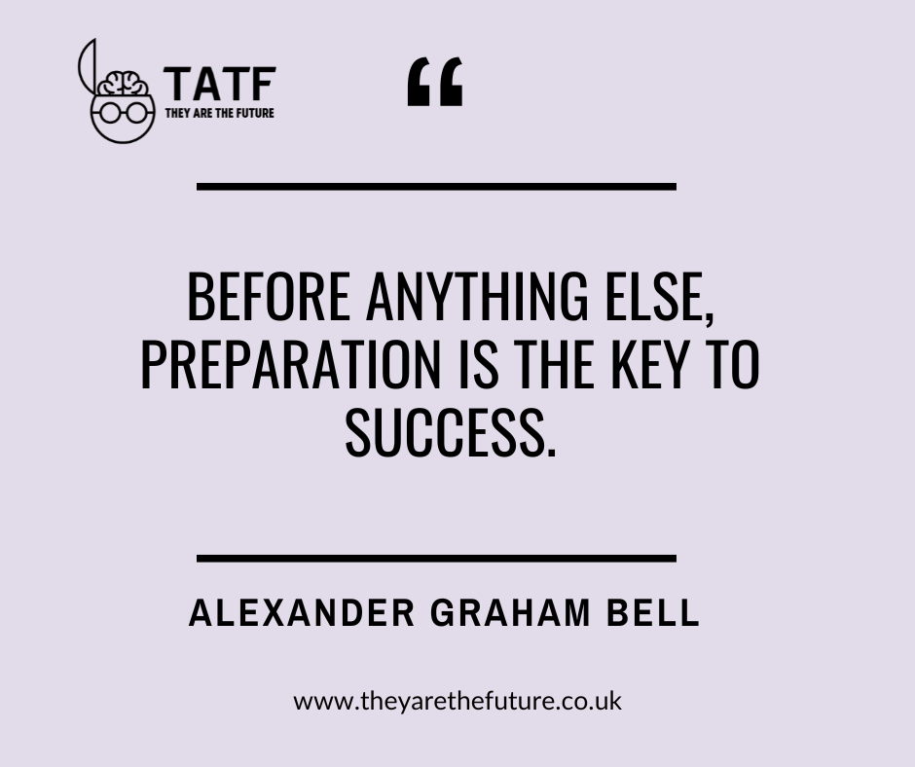
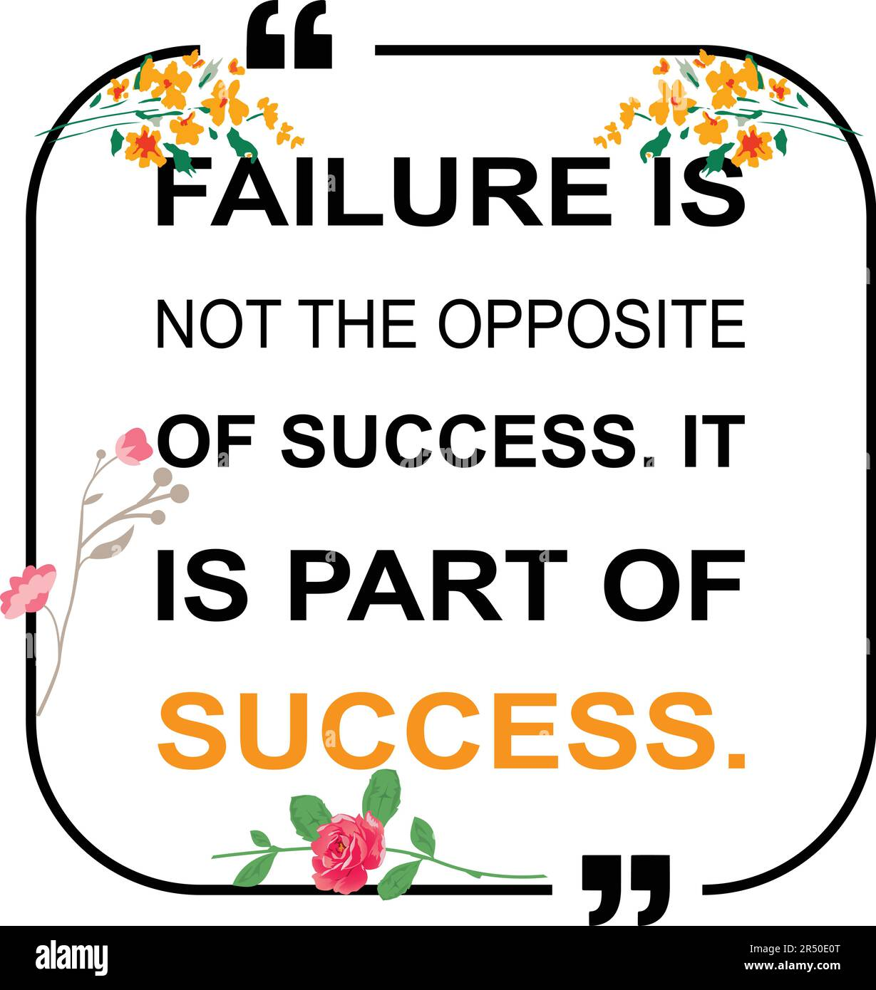

Slide 5
Motivation
Motivation is crucial during exams because it drives focus, enhances productivity, and fosters confidence, all of which are essential for effective preparation and success.
By staying motivated, we can remain committed, resilient, and better equipped to achieve our desired results.

Slide 6
Motivation: Strategies
We’ll discuss some motivational strategies:
Rewards
Goals
Visualization
Health

Slide 7
Motivation: Rewards
A common reason why people don’t want to do exams is because they associate exams with negative experiences, like mental exhaustion, stress, fear of failure, and pressure.
I believe one of the most important things a student can do is change their relationship with exams, by creating more positive associations with them. It won’t solve all the issues with exam, but it will improve the overall experience.

Slide 8
Motivation: Rewards
One of the ways of doing this is with rewards:

Slide 9
Motivation: Rewards
The rewards don’t have to be extravagant, or even expense, but they have to be something you promise yourself you will do after you complete your exams, or milestones towards your exams.
This will create a positive association between exams and something nicer happening.

Slide 10
Motivation: Rewards
The kinds of rewards could be:
Give yourself a long, uninterrupted nap.
Spend an evening binge-watching YouTube.
Go for a walk in nature or explore a local park.
Watch the sunset or stargaze.
Borrow a book from the library.
Visit a local museum or gallery.
Watch a new TV show.

Slide 11
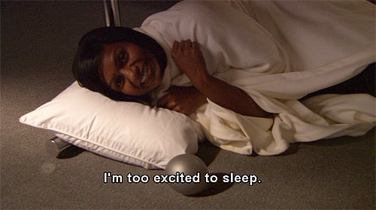

Slide 12
Motivation: Rewards
The kinds of rewards could be:
Give yourself a long, uninterrupted nap.
Spend an evening binge-watching YouTube.
Go for a walk in nature or explore a local park.
Watch the sunset or stargaze.
Borrow a book from the library.
Visit a local museum or gallery.
Watch a new TV show.

Slide 13
Motivation: Rewards
It is really important that whatever reward we choose isn’t something we would do normally, otherwise it won’t be as memorable.
The kinds of rewards could be:
Give yourself a long, uninterrupted nap.
Spend an evening binge-watching YouTube.
Go for a walk in nature or explore a local park.
Watch the sunset or stargaze.
Borrow a book from the library.
Visit a local museum or gallery.
Watch a new TV show.

Slide 14
Motivation: Rewards
Also consider the use of Gummy Bears as a motiving force:

Slide 16
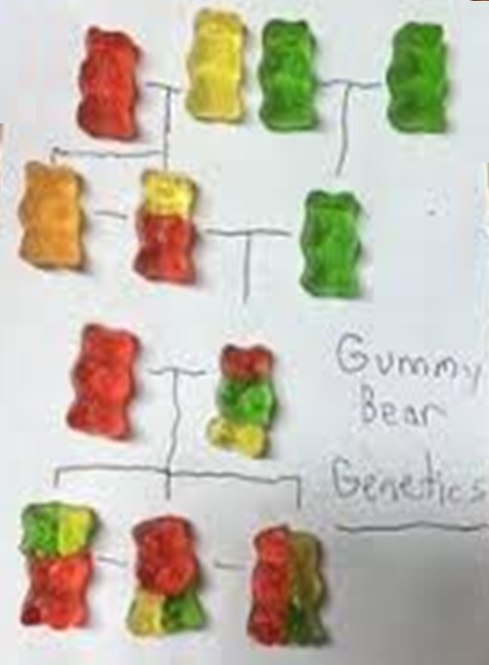
Gummy
Bear
Genetics

Slide 17
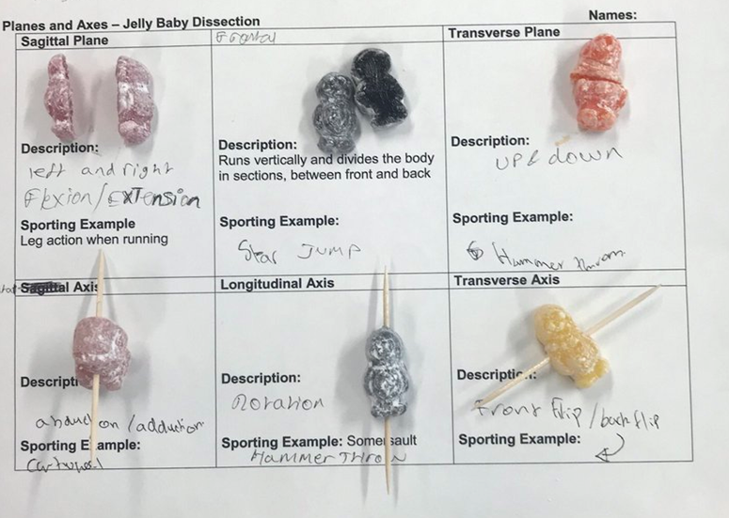
Gummy
Bear
Surgery

Slide 18
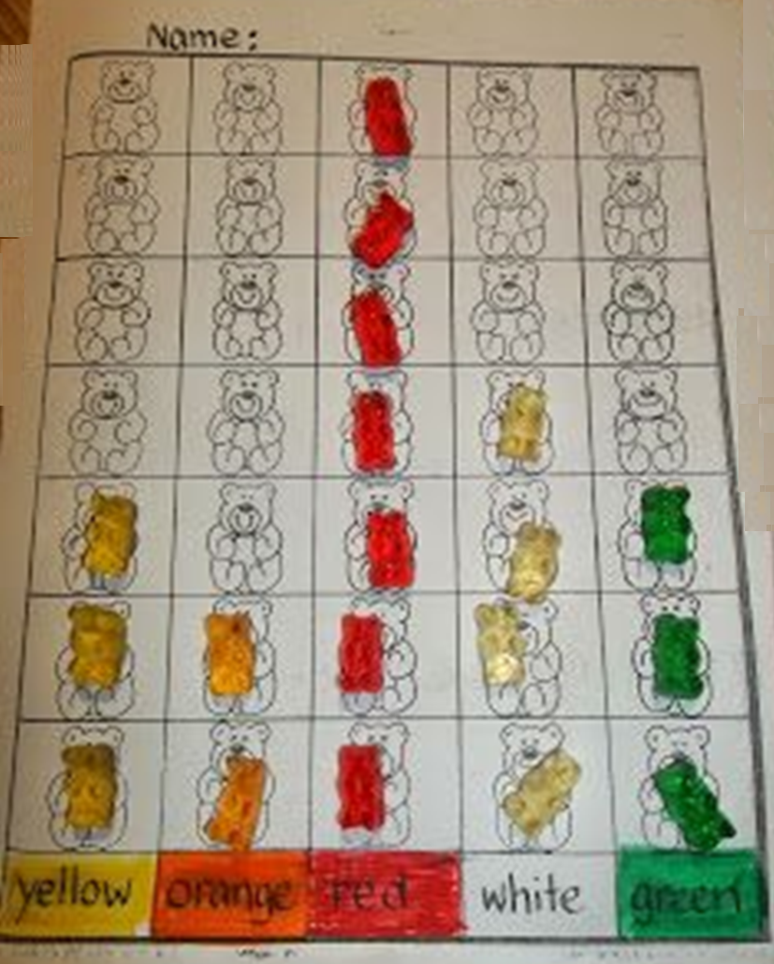
Gummy
Bear
Maths

Slide 19
Motivation: Rewards
It is worth mentioning at this point also, that we need to change our self-talk about exams:

Slide 20
Motivation: Rewards
It is worth mentioning at this point also, that we need to change our self-talk about exams:
Oh no, I have to do an exam

Slide 21
Motivation: Rewards
It is worth mentioning at this point also, that we need to change our self-talk about exams:
Oh no, I have to do an exam

Slide 22
Motivation: Rewards
It is worth mentioning at this point also, that we need to change our self-talk about exams:
I get to show what I've learned!
Oh no, I have to do an exam
How well can I apply my skills today?

Slide 23
Motivation: Goals
One approach to help is to use SMART objectives, which is structured framework for setting and achieving goals in a clear, organized, and measurable way. The acronym SMART stands for Specific, Measurable, Achievable, Relevant, and Time-Bound. The concept of SMART objectives was first introduced by George T. Doran in a 1981 article titled "There's a S.M.A.R.T. Way to Write Management’s Goals and Objectives", published in the journal Management Review.

Slide 24
SMART Objectives
Objectives must be
SMART
SPECIFIC
MEASURABLE
AGREED
REALISTIC
TIME BASED
Notes:
SMART Objectives – very common in industry and are used extensively for appraisals and form a simple test of whether the objective is truly a good objective.

Slide 25
SPECIFIC
Make the objective specific
Break large tasks down into smaller tasks
[X] Revise a complete module
[√] Revise one topic in a module
[√] Search for additional information on a specific topic
Breaking large tasks into smaller ones makes it easier to assess progress
Notes:
Specific – this ties back to the project management module where work breakdown structures where used to split large tasks into much smaller tasks. The aim of doing this allows the objective to be specific. The classic final year PhD student objective is write my PhD. The question of where to start is a difficult one and therefore splitting the task up can make the objective more specific and also achievable within a sensible time frame can help with motivation. Think of other examples of specific objectives. On the previous slide the aim make myself more employable is not at all specific – what is meant by employable !

Slide 26
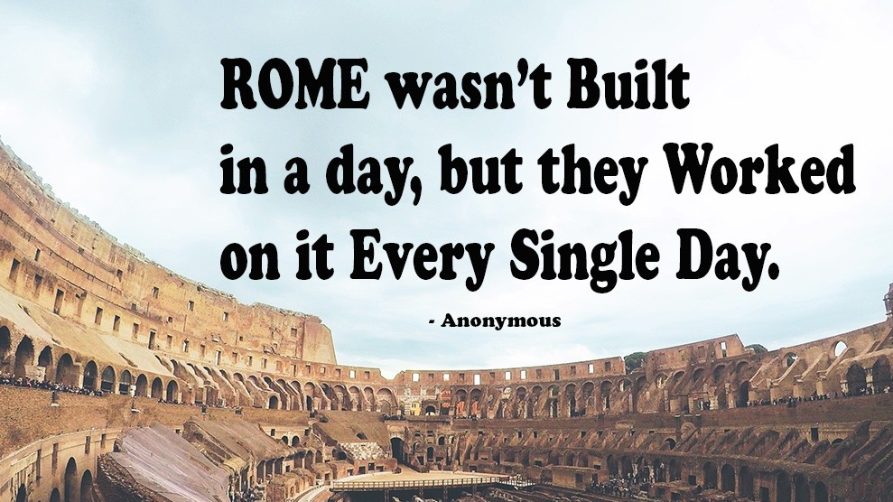

Slide 27
MEASURABLE
How do you know when you have done everything:
[X] Do some practice exam questions
[√] Do 3 practice exam questions in the next week
[X] Do some practice quizzes
[√] Do 3 practice quizzes, and score at least 80% in each
Make sure they are evidenced based – you should have a deliverable attached to the objective
Notes:
Measurable – You need to know when you have finished the objective / completed the task. There is two elements therefore to writing measurable objectives. They should not include words like more – when do you know when you have made more contacts. Is it one or is it a million. The second element relates to actually having something which you can provide as evidence. Therefore deliverables attached to the objective is good (e.g. Short reports) as these can help you prove that you have achieved the objective (this will be important when you start work!).

Slide 28
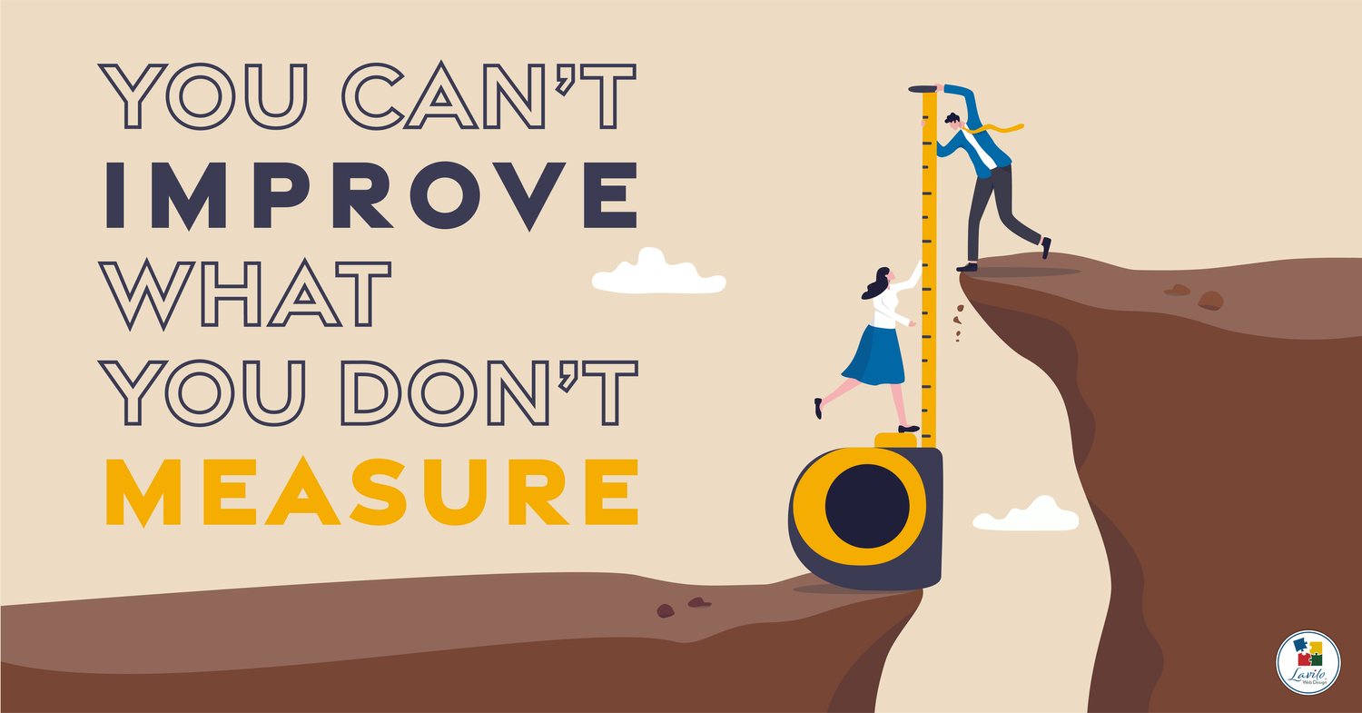

Slide 29
AGREED
Tell other people your goals and ask them to hold you accountable.
Especially your classmates!
[X] I think I will do a bit of revision
[X] Everyone is telling me the exams will be fine
[√] We agreed that I’m going to keep studying for 2 hours every night.
Notes:
Agreed – In the project management sessions we talked about stakeholders and involving them in the project. Setting your objectives and agreeing them with your supervisor is important. This might take some negotiation but it worth doing this as everybody will be committed to the plan.
Note that if you ever set objectives for someone else make sure you discuss them with them as setting unachievable objectives for someone can prove a source of conflict.

Slide 30
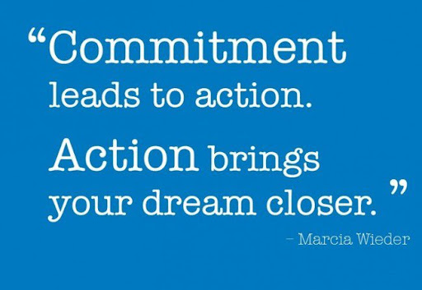

Slide 31
REALISTIC
Will you achieve the objective?
Unrealistic objectives can be very de-motivating
Challenging objectives which are realistic can be motivating
[X] I’ll read over the module content
[√] I’ll do some exam questions in the same duration as I would have to do in a real exam.
Notes:
Realistic Objectives – It is important that the objectives you set are realistic. All too often people will set very unrealistic objectives and the end result is that the project is not delivered on time, resentment develops within the project stakeholders etc. Furthermore if you are being assessed against the objectives which are set, if they are unrealistic you may not achieve any of them! It is however important to set your self challenging objectives which you could achieve if you apply yourself – these are often referred to as stretch targets and are used to motivate staff.

Slide 33
TIME BASED
Set timescales on your objectives
Deadlines and Milestones
Review progress against these deadlines
[X] Finish covering all topics
[√] Finish the current topic by next Monday.
Notes:
Time Bound – It is important that there is an element of time linked to the objective. Again if the objective is open ended when do you when you have achieved the objective. Therefore set yourself deadlines and review yourself against them – don’t let the deadlines slip as the progress of the project overall could be in jeopardy. These can also be a useful time management tool as often people will work on something when little value is being added (80% of the value is provided by 20% of the effort) and a dealine can be used to force you to move on to the next objective.

Slide 34
TIME SCALES
Set objectives at multiple timescales
This week I will review the next 10 pages
This month I will produce 30 flash cards
In the next 2 months I create a detailed MindMap that is a fully overview of the module, and short notes on each of the branches on the Map.
Notes:
Time scales - It is useful to set objectives at multiple levels – one week, one month, 6 months – 1 year. This will let you focus on the big picture as well as on the short-term tasks. A useful technique which can be used to improve your time management is to set weekly SMART objectives to help organise your time. The objectives at a number of timescales can be linked back to the WBS discussed in the project management session – the bottom level tasks may be weekly objectives whilst the higher level tasks are longer term.

Slide 36
Motivation: Visualization
Imagine yourself succeeding in the exam, whether it’s acing a paper or feeling confident while writing. This positive visualization can inspire you to work harder toward your goals.
Create a “vision board” of your future. It could include a picture of you in graduate robes, it could be a pile of money, or a house, or a circle of friends.

Slide 37
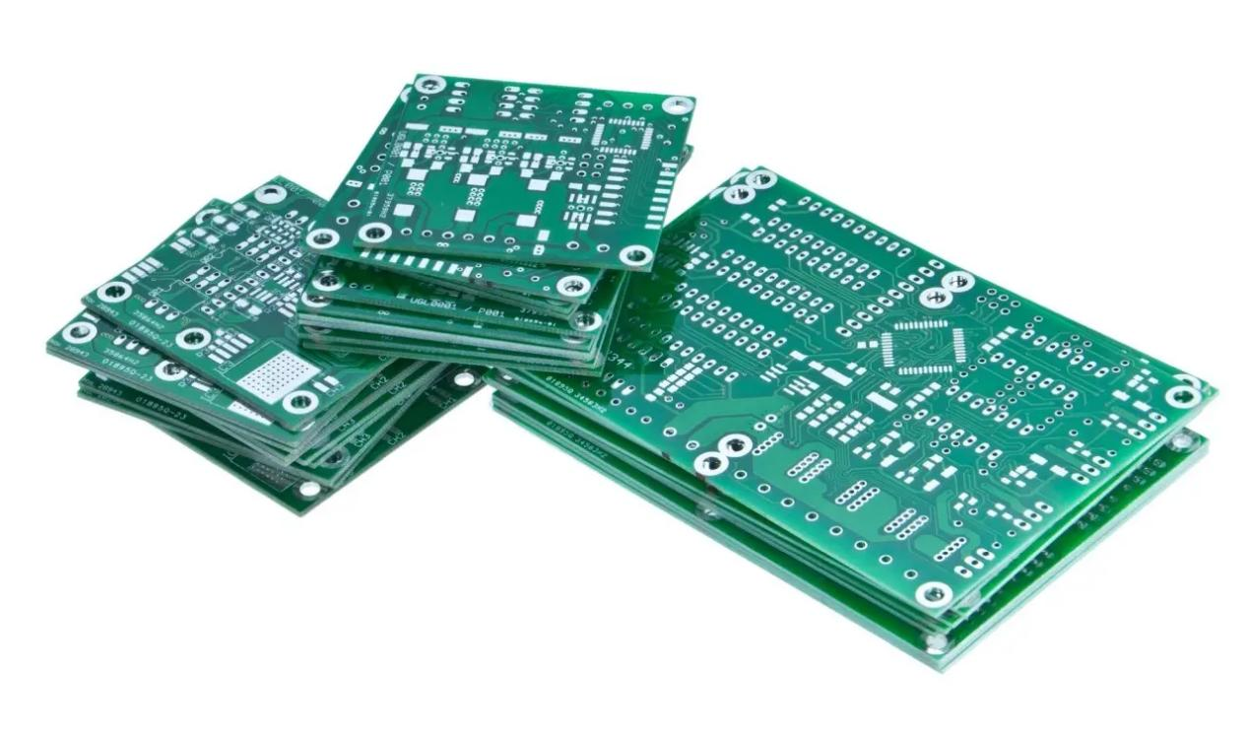
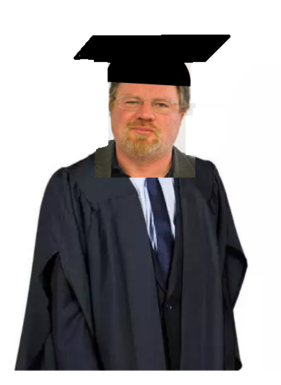
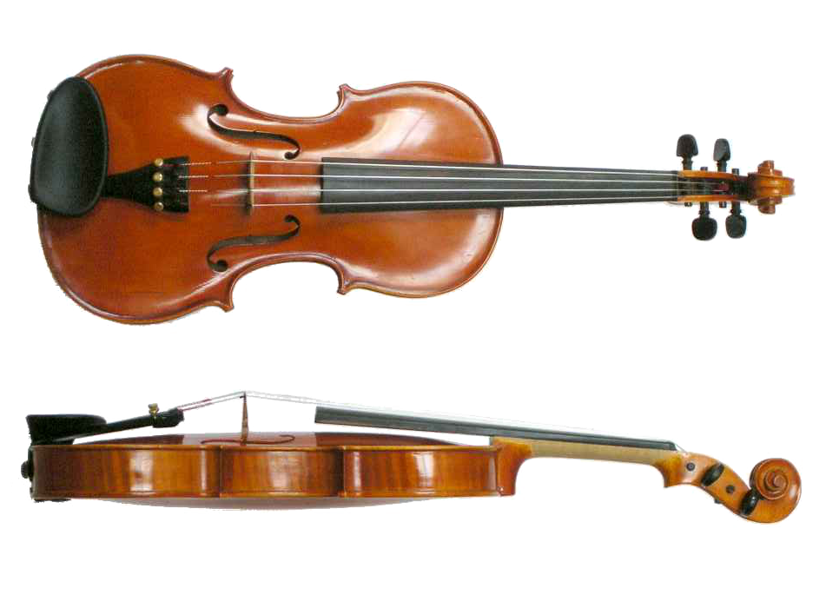
VISION BOARD

Slide 41
Motivation: Visualization
Maintain a positive mindset by focusing on your progress rather than dwelling on what’s left to do. Surround yourself with encouraging people or affirmations to keep your spirits high.

Slide 42
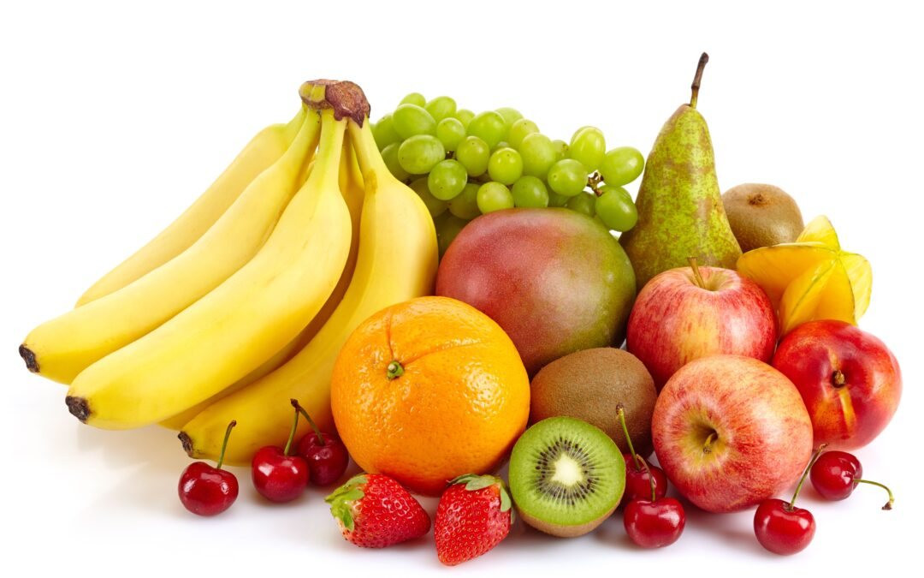
Motivation: Health
Exercise, eat nutritious meals, and get adequate sleep. Physical well-being is directly linked to mental clarity and motivation, so take care of your body to stay energized.

Slide 43
Motivation: Health
Aerobic exercise
Do something you enjoy
Walking, running, dancing, swimming
Strength training
Find a coach
Flexibility exercise
Stretching exercises

Slide 44
Motivation: Health
The Alexander Technique
A technique of body reeducation and coordination, accomplished through physical and psychological principles. The technique focuses on the self-perception of movement and has applications in alleviating back pain, promoting rehabilitation after accidents, improving breathing, playing musical instruments or singing.

Slide 45
Motivation: Health
Cultivate Ambidexterity
Cross your arms and legs in the opposite to the normal way you do it
Use your non-dominant hand to turn on lights, brush your teeth, etc. record the feeling
Try writing with your non-dominant hand
Try drawing with both hands simultaneously
Experiment with mirror writing

Slide 46
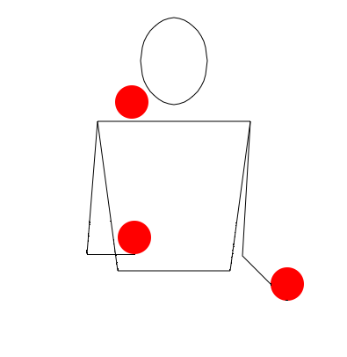
Motivation: Health
Cultivate Ambidexterity
Learn to juggle

Slide 47
Time Management

Slide 48
Time Management
Why is Time Management important?
Time management is important because it allows you to use your time effectively and efficiently, helping you achieve your goals and maintain a balanced life.

Slide 49
Time Management: Create a Schedule
A well-designed revision schedule serves as a roadmap, helping you allocate time efficiently, prioritize important topics, and balance study sessions with breaks to maximize retention and minimize stress.
Creating a revision schedule requires thoughtful planning, realistic goal-setting, and an understanding of your personal study habits.
By organizing your revision into manageable chunks and setting clear objectives, you can improve focus, track your progress, and approach exams with confidence.

Slide 50
Time Management: Create a Schedule
For each module, list the topics you need to cover in a TO-DO LIST. Estimate how much time you have left to revise. Assign topics as either topics you enjoy or do not enjoy. Divide out your remaining time better these topics. Alternating between topics you enjoy, and those you don’t.
Create a master timetable – BE REALISTIC about you other life activities to have to fit in, so take into account your other commitments e.g. work, family, etc.
Tick off the topics as you complete them. Pat yourself on the back by looking back on what you have done

Slide 51
Time Management: Create a Schedule
TO DO LIST
_____________________________________________________
_____________________________________________________
_____________________________________________________
_____________________________________________________
_____________________________________________________
_____________________________________________________
_____________________________________________________
_____________________________________________________

Slide 52
Time Management: Create a Schedule
 | Mon | Tues | Wed | Thurs | Fri | Sat | Sun
9am
10am
11am
12 noon
1pm
2pm
3pm
4pm
5pm
6pm
7pm
8pm
9pm

Slide 53
Time Management: Create a Schedule
 | Mon | Tues | Wed | Thurs | Fri | Sat | Sun
9am | NON-STUDY | NON-STUDY | NON-STUDY | NON-STUDY | NON-STUDY | NON-STUDY | NON-STUDY
10am | NON-STUDY | NON-STUDY | NON-STUDY | NON-STUDY | NON-STUDY | NON-STUDY | NON-STUDY
11am | NON-STUDY |  |  |  |  | NON-STUDY | NON-STUDY
12 noon | NON-STUDY |  |  |  |  | NON-STUDY | NON-STUDY
1pm | NON-STUDY |  | NON-STUDY |  |  | NON-STUDY | NON-STUDY
2pm |  |  | NON-STUDY |  |  | NON-STUDY | NON-STUDY
3pm |  |  |  |  |  | NON-STUDY | NON-STUDY
4pm |  |  |  |  |  | NON-STUDY | NON-STUDY
5pm |  |  |  |  |  | NON-STUDY | NON-STUDY
6pm |  |  | NON-STUDY | NON-STUDY | NON-STUDY
7pm | NON-STUDY |  | NON-STUDY | NON-STUDY | NON-STUDY
8pm | NON-STUDY |  | NON-STUDY | NON-STUDY | NON-STUDY
9pm

Slide 54
Time Management: Create a Schedule
 | Mon | Tues | Wed | Thurs | Fri | Sat | Sun
9am | NON-STUDY | NON-STUDY | NON-STUDY | NON-STUDY | NON-STUDY | NON-STUDY | NON-STUDY
10am | NON-STUDY | NON-STUDY | NON-STUDY | NON-STUDY | NON-STUDY | NON-STUDY | NON-STUDY
11am | NON-STUDY | STUDY TIME | STUDY TIME | STUDY TIME | STUDY TIME | NON-STUDY | NON-STUDY
12 noon | NON-STUDY | STUDY TIME | STUDY TIME | STUDY TIME | STUDY TIME | NON-STUDY | NON-STUDY
1pm | NON-STUDY | STUDY TIME | NON-STUDY | STUDY TIME | STUDY TIME | NON-STUDY | NON-STUDY
2pm | STUDY TIME | STUDY TIME | NON-STUDY | STUDY TIME | STUDY TIME | NON-STUDY | NON-STUDY
3pm | STUDY TIME | STUDY TIME | STUDY TIME | STUDY TIME | STUDY TIME | NON-STUDY | NON-STUDY
4pm | STUDY TIME | STUDY TIME | STUDY TIME | STUDY TIME | STUDY TIME | NON-STUDY | NON-STUDY
5pm | STUDY TIME | STUDY TIME | STUDY TIME | STUDY TIME | STUDY TIME | NON-STUDY | NON-STUDY
6pm | STUDY TIME | STUDY TIME | NON-STUDY | NON-STUDY | NON-STUDY | STUDY TIME | STUDY TIME
7pm | NON-STUDY | STUDY TIME | NON-STUDY | NON-STUDY | NON-STUDY | STUDY TIME | STUDY TIME
8pm | NON-STUDY | STUDY TIME | NON-STUDY | NON-STUDY | NON-STUDY | STUDY TIME | STUDY TIME
9pm | STUDY TIME | STUDY TIME | STUDY TIME | STUDY TIME | STUDY TIME | STUDY TIME | STUDY TIME

Slide 55
Time Management: Create a Schedule
Writing the Schedule out is very important; once you write something down, you are far more likely to follow it, and do it!
 | Mon | Tues | Wed | Thurs | Fri | Sat | Sun
9am | NON-STUDY | NON-STUDY | NON-STUDY | NON-STUDY | NON-STUDY | NON-STUDY | NON-STUDY
10am | NON-STUDY | NON-STUDY | NON-STUDY | NON-STUDY | NON-STUDY | NON-STUDY | NON-STUDY
11am | NON-STUDY | STUDY TIME | STUDY TIME | STUDY TIME | STUDY TIME | NON-STUDY | NON-STUDY
12 noon | NON-STUDY | STUDY TIME | STUDY TIME | STUDY TIME | STUDY TIME | NON-STUDY | NON-STUDY
1pm | NON-STUDY | STUDY TIME | NON-STUDY | STUDY TIME | STUDY TIME | NON-STUDY | NON-STUDY
2pm | STUDY TIME | STUDY TIME | NON-STUDY | STUDY TIME | STUDY TIME | NON-STUDY | NON-STUDY
3pm | STUDY TIME | STUDY TIME | STUDY TIME | STUDY TIME | STUDY TIME | NON-STUDY | NON-STUDY
4pm | STUDY TIME | STUDY TIME | STUDY TIME | STUDY TIME | STUDY TIME | NON-STUDY | NON-STUDY
5pm | STUDY TIME | STUDY TIME | STUDY TIME | STUDY TIME | STUDY TIME | NON-STUDY | NON-STUDY
6pm | STUDY TIME | STUDY TIME | NON-STUDY | NON-STUDY | NON-STUDY | STUDY TIME | STUDY TIME
7pm | NON-STUDY | STUDY TIME | NON-STUDY | NON-STUDY | NON-STUDY | STUDY TIME | STUDY TIME
8pm | NON-STUDY | STUDY TIME | NON-STUDY | NON-STUDY | NON-STUDY | STUDY TIME | STUDY TIME
9pm | STUDY TIME | STUDY TIME | STUDY TIME | STUDY TIME | STUDY TIME | STUDY TIME | STUDY TIME

Slide 56
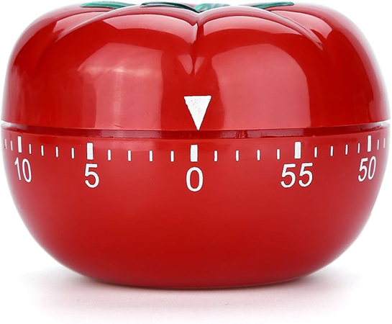
Time Management
If we have 2 hour slots available, we could consider using the Pomodoro Technique, which involves working on revision for 25 minutes, then taking a five minute break, and repeating that cycle four times.
In a 2 hour slot
25 mins | Work
5 mins | BREAK
25 mins | Work
5 mins | BREAK
25 mins | Work
5 mins | BREAK
25 mins | Work
5 mins | BREAK

Slide 57
Time Management
We also need to build in time for Stress Management, and that could include activities such as:
Practicing deep breathing (for example, spend 4 seconds inhaling, 4 seconds holding, 4 seconds exhaling)
Getting enough sleep (7-9 hours usually)
Practicing mindfulness or guided meditation
Engage in a Hobby, painting, gardening, or playing music
Take a walk in a park, hike, or simply sit outside
Watch a comedy and share jokes

Slide 58
Time Management
Further mental health activities could include:
Journaling: Write down your thoughts, worries, or things you're grateful for to process emotions and gain perspective.
Challenge Negative Thoughts: Replace unhelpful self-talk with positive affirmations or realistic, supportive thoughts.
Practice Gratitude: Reflect on things you’re thankful for to shift your focus from stressors to positives.
Set Boundaries: Learn to say no and protect your time and energy.

Slide 59
Time Management
Also, don’t forget to build in time for past exam papers, mock exams and time for working with study buddies:
Past Exam Papers: Review past exams papers to get familiar with the format of the paper and the type of questions.
Mock Exams: Treat it like the real exam, use the same time, and try to replicate the environment, and resources. Complete your revision for key topics before attempting. Do the exam, and fill in forgotten facts with another colour pen.
Study Buddies: Study buddies can improve understanding, motivation, and test performance. Split complex topics between each member of the team, and teach each other.

Slide 60
Doing the Exam

Slide 61
Doing the Exam: BEFORE THE EXAM
THE NIGHT BEFORE THE EXAM
Get to bed on time.
Try not to get in any fights with family and friends
Pack the following items:
Some different coloured pens (including a pink/purple pen for underlining)
Some pencils
Pencil pairers and erasers
A small ruler
Food and drink

Slide 62
Doing the Exam: BEFORE THE EXAM
THE MORNING OF THE EXAM
Start you day as always
Eat a good breakfast if you can
Make sure you are hydrated
Think of what reward you will give yourself after the exams are over
Review some of the key concepts
Visual success and practice calm breathing
BE POSITIVE

Slide 63
Doing the Exam: DURING THE EXAM
At the Start of the Exam BREATH:
Take a deep breath and relax
Remain calm
If you are getting nervous, picture a shaft of warm, blue light coming down from the sky and warming you
If that doesn’t work, wiggle your toes in your shoes

Slide 64
Doing the Exam: DURING THE EXAM
At the Start of the Exam:
Now once you turn over the exam paper, carefully read all instructions on the exam paper, especially when given options of questions to answer.
Now read them again.

Slide 65
Doing the Exam: DURING THE EXAM
At the Start of the Exam:
Read all of the questions on the paper
Choose the questions you wish to answer carefully

Slide 66
Doing the Exam: DURING THE EXAM
During the Exam:
WRITING
Write in clear, concise legible English and give all necessary details.
DIAGRAMS
Make them large
Label them clearly
Draw in pencil first
Use many colours

Slide 67
Doing the Exam: DURING THE EXAM
During the Exam:
ROUGH WORK
If there is content you need to get down on the paper immediately to help you remember it, just write down the heading “Rough Work” at the top of the page, and similarly, if you are planning a question and need to sketch it out, write down “Rough Work” and the Question number.

Slide 68
Doing the Exam: DURING THE EXAM
During the Exam:
WHICH QUESTION FIRST?
You should do the question you are more confident of answering first.
This gets you started working immediately, steadies the nerves and gives you confidence.
Starting with a harder one first may increase the amount of time spent on the first essay, causing you to panic and rush the second.

Slide 69
Doing the Exam: DURING THE EXAM
During the Exam:
PLANNING YOUR ANSWER
When faced with an exam question a good staring point is to gather ideas.
Write these down on paper in any order.
The more ideas you have, the more can select when you start to write.
Ideas should occur to as you write and these can be accepted or rejected according to your answer plan

Slide 70
Doing the Exam: DURING THE EXAM
During the Exam:
PLANNING YOUR ANSWER
The next stage is the rough plan, reorganise your ideas into a logical order that will answer the question.
Delete irrelevant initial ideas that will not contribute to answering the question.
At this stage don’t worry about a conclusion, you should be able to do this after you have written the answer.

Slide 71
Doing the Exam: DURING THE EXAM
During the Exam:
“EXPLAIN” Questions
Provide a definition or simple explanation
Draw a diagram, if possible
Provide an example
Discuss the strengths and weaknesses, and alternatives.

Slide 72
Doing the Exam: DURING THE EXAM
During the Exam:
CODING Questions
Provide a short pseudocode explanation
Draw a diagram, if possible
Write the code
Comment it clearly

Slide 73
Doing the Exam: DURING THE EXAM
During the Exam:
When answering questions:
Give each paragraph a heading, and then underline that heading in pink/purple ink. This means that the examiner can read very, very quickly what you are doing and how the answer is being structured. These efforts towards clarity will help the examiner to follow the thrust of your argument more clearly.

Slide 74
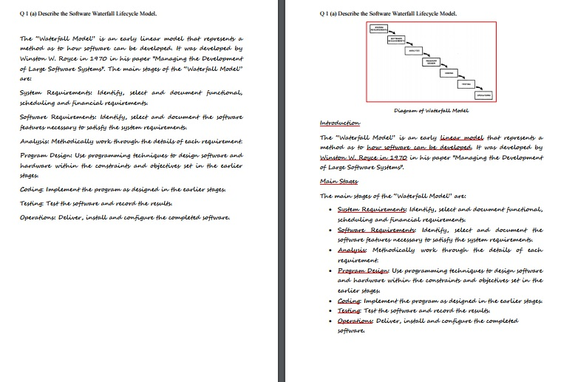
This is the same answer, but on the left, it’s just text, and on the right, there’s a diagram, bullet points, and underlined text.

Slide 76
Diagram

Slide 77
Diagram
Header
Header

Slide 78
Diagram
Header
Header
Bullet Points

Slide 79
Diagram
Header
Header
Bullet Points
UNDERLINED

Slide 80
Doing the Exam: DURING THE EXAM
During the Exam:
WHITESPACE
You have paid for the exam booklets, use as many as you want.
Each part of each question on a separate page
Leave a blank page between each question
Leave two blank lies between each paragraph

Slide 81
Doing the Exam: DURING THE EXAM
Exam Time Management:
If you have 2 hours for the exam, that’s 120 minutes. So If we give ourselves 10 minutes to read the paper at the start, to read the questions and pick the ones we want to do, and 10 minutes at the end for any changes and corrections we need to do, we have exactly 100 minutes for 100 marks.

Slide 82
Doing the Exam: DURING THE EXAM
Exam Time Management:
So if a question is worth 25 marks, and we have already spent 25 minutes on it, and we are only halfway through it, leave a few blank pages, and move onto another question, and get back to this one if you have time at the end.

Slide 83
Doing the Exam: DURING THE EXAM
Exam Time Management:
In a similar way, if a question is worth 20 marks, the examiner will expect to see a much longer answer than if it is worth 5 marks. So a rough rule is: a sentence per mark. So for a 5 mark question, do at least 5 sentences (or work on it for 5 minutes), and for a 20 mark question, do 20 sentences.

Slide 84
Doing the Exam: DURING THE EXAM
Exam Time Management:
THERE ARE TWO GOLDEN RULES
ONE MARK FOR ONE MINUTE
ONE MARK FOR ONE SENTENCE

Slide 85
Doing the Exam: DURING THE EXAM
Exam Time Management:
10 mins | 100 minutes | 10 mins
Read the exam paper and plan your answers. | Work on the answers, do rough work, complete the required number of questions, 1 mark per minute or sentence | Read your answers and do corrections

Slide 86
Doing the Exam: DURING THE EXAM
Finishing off the Exam:
Add instructions for the examiner to make things clear, so if the current question is continued on the next page, add a note “Continued on next page”. If you skipped a few pages for the rest of this answer, add a note “Continued in 5 pages”, and if the answer is continued in another booklet, just note “Continued in Yellow Booklet +1”.

Slide 87
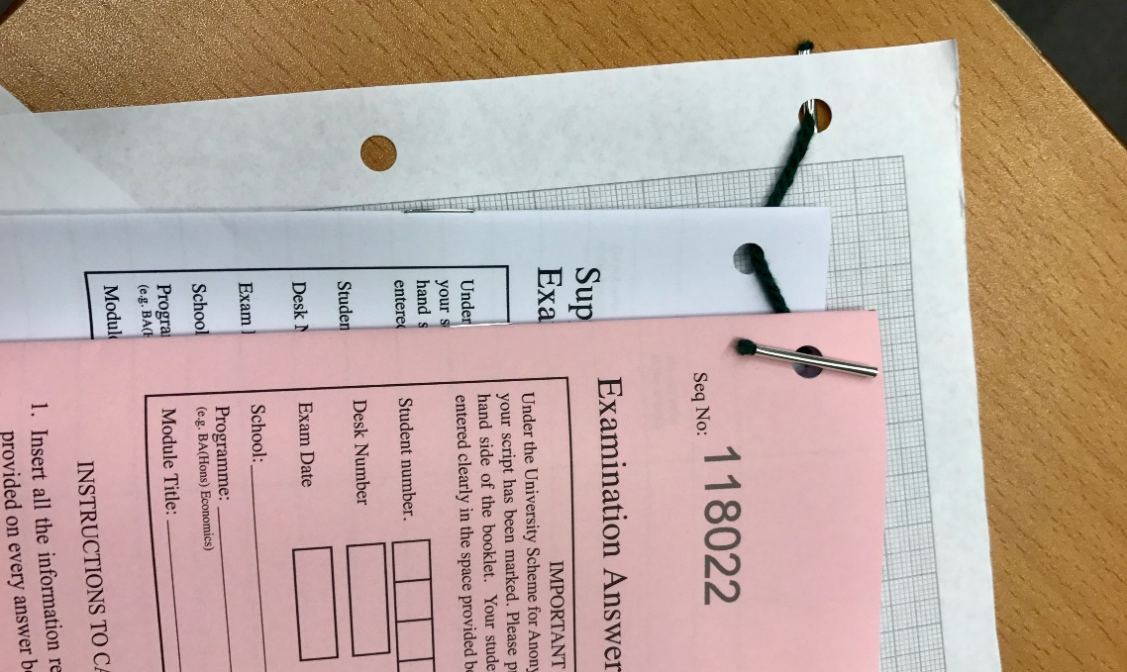
Doing the Exam: DURING THE EXAM
Finishing off the Exam:
You will be given a treasury tag to join the booklets together, don’t put one booklet into another, join as below (and fill out the covers of all booklets):

Slide 88
Doing the Exam: DURING THE EXAM
The three most common exam errors:
Answering the wrong number of questions (i.e. doing too few)
Answering the wrong question (i.e. not answering the question being asked)
Badly presented answers (i.e. not following the guidelines we have just looked at).

Slide 89
Doing the Exam: AFTER THE EXAM
Reward Yourself
Whatever reward you promised yourself, make sure you do it soon after the exam is over, it doesn’t matter if the exam went well or badly, if you put in a good effort, reward yourself.

Slide 90
Doing the Exam: AFTER THE EXAM
Review Later
After a few days, review your studying and revision process, and honestly reflect on what went well, and what went badly.
Whether you pass or fail, as long as put in an honest effort, you did your best.

