Slide 1
Advanced Algorithms:
Sorting
Damian Gordon

Slide 2
Advanced Algorithms
Sorting Algorithms
  Insertion Sort
  Shell Sort
  Merge Sort
  Quick Sort

Slide 3
We’ll remember …

Slide 4
Sorting: Bubble Sort
PROGRAM BubbleSort:
Integer Age[8] <- {44,23,42,33,16,54,34,18};
    FOR Outer-Index IN 0 TO N-1
    DO FOR Index IN 0 TO N-2
    DO IF (Age[Index+1] < Age[Index])
    THEN Temp_Value <- Age[Index+1];
    Age[Index+1] <- Age[Index];
    Age[Index] <- Temp_Value;
    ENDIF;
    ENDFOR;
    ENDFOR;
    END.

Slide 5
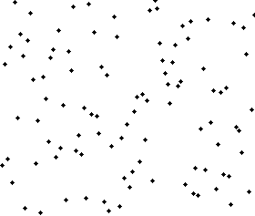
Sorting: Bubble Sort

Slide 6
Sorting: Selection Sort
PROGRAM SelectionSort:
Integer Age[8] <- {44,23,42,33,16,54,34,18};
    FOR Outer-Index IN 0 TO N-1
    MinValueLocation <- Outer-Index;
    FOR Index IN Outer-Index+1 TO N-1
    DO IF (Age[Index] < Age[MinValueLocation])
    THEN MinValueLocation <- Index;
    ENDIF;
    ENDFOR;
    IF (MinValueLocation != Outer-Index)
    THEN Swap(Age[Outer-Index], Age[MinValueLocation]);
    ENDIF;
    ENDFOR;
    END.

Slide 7
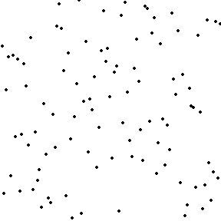
Sorting: Selection Sort

Slide 8

etc.

