Slide 1
Recursion
Damian Gordon

Slide 2
Recursion

Slide 3
Recursion

Slide 4
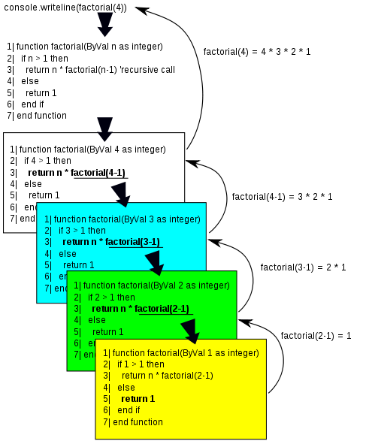
Recursion

Slide 5
Recursion: Factorial
Recursion is a feature of modularisation, when a module can call itself to complete a solution.

Slide 6
Recursion: Factorial
Recursion is a feature of modularisation, when a module can call itself to complete a solution.
Let’s remember factorial:
7! = 7 * 6 * 5 * 4 * 3 * 2 * 1

Slide 7
Recursion: Factorial
Recursion is a feature of modularisation, when a module can call itself to complete a solution.
Let’s remember factorial:
7! = 7 * 6 * 5 * 4 * 3 * 2 * 1
and
6! = 6 * 5 * 4 * 3 * 2 * 1

Slide 8
Recursion: Factorial
So
7! = 7 * (6 * 5 * 4 * 3 * 2 * 1)

Slide 9
Recursion: Factorial
So
7! = 7 * (6 * 5 * 4 * 3 * 2 * 1)
is
7! = 7 * 6!

Slide 10
Recursion: Factorial
So
7! = 7 * (6 * 5 * 4 * 3 * 2 * 1)
is
7! = 7 * 6!
and
9! = 9 * 8 * 7 * 6 * 5 * 4 * 3 * 2 * 1
9!= 9 * (8 * 7 * 6 * 5 * 4 * 3 * 2 * 1)
9! = 9 * 8!

Slide 11
Recursion: Factorial
Or, in general:

Slide 12
Recursion: Factorial
Or, in general:
N! = N * (N-1)!

Slide 13
Recursion: Factorial
Or, in general:
N! = N * (N-1)!
or
Factorial(N) = N * Factorial(N-1)

Slide 14
Recursion: Factorial
Let’s remember how we did Factorial iteratively:

Slide 15
Recursion: Factorial
PROGRAM Factorial:
READ Value;
Total <- 1;
WHILE (Value != 0)
DO Total <- Value * Total;
Value <- Value - 1;
ENDWHILE;
PRINT Total;
END.

Slide 16
Recursion: Factorial
Now this is how we implement the following:
Factorial(N) = N * Factorial(N-1)

Slide 17
Recursion: Factorial
MODULE Fact(N):
IF (N <= 0)
THEN RETURN 1;
ELSE RETURN N * Fact(N-1);
ENDIF;
END.
PROGRAM Factorial:
Get Value;
PRINT Fact(Value);
END.

Slide 18
Recursion: Factorial
MODULE Fact(N):
IF (N <= 0)
THEN RETURN 1;
ELSE RETURN N * Fact(N-1);
ENDIF;
END.
PROGRAM Factorial:
Get Value;
PRINT Fact(Value);
END.

Slide 19
Recursion: Factorial
So if N is 5

Slide 20
Recursion: Factorial
So if N is 5
MODULE Fact(5) returns
5 * Fact(4)

Slide 21
Recursion: Factorial
So if N is 5
MODULE Fact(5) returns
5 * Fact(4)
5 * 4 * Fact(3)

Slide 22
Recursion: Factorial
So if N is 5
MODULE Fact(5) returns
5 * Fact(4)
5 * 4 * Fact(3)
5 * 4 * 3 * Fact(2)

Slide 23
Recursion: Factorial
So if N is 5
MODULE Fact(5) returns
5 * Fact(4)
5 * 4 * Fact(3)
5 * 4 * 3 * Fact(2)
5 * 4 * 3 * 2 * Fact(1)

Slide 24
Recursion: Factorial
So if N is 5
MODULE Fact(5) returns
5 * Fact(4)
5 * 4 * Fact(3)
5 * 4 * 3 * Fact(2)
5 * 4 * 3 * 2 * Fact(1)
5 * 4 * 3 * 2 * 1 * Fact(0)

Slide 25
Recursion: Factorial
So if N is 5
MODULE Fact(5) returns
5 * Fact(4)
5 * 4 * Fact(3)
5 * 4 * 3 * Fact(2)
5 * 4 * 3 * 2 * Fact(1)
5 * 4 * 3 * 2 * 1 * Fact(0)
5 * 4 * 3 * 2 * 1 * 1

Slide 26
Recursion: Factorial
So if N is 5
MODULE Fact(5) returns
5 * Fact(4)
5 * 4 * Fact(3)
5 * 4 * 3 * Fact(2)
5 * 4 * 3 * 2 * Fact(1)
5 * 4 * 3 * 2 * 1 * Fact(0)
5 * 4 * 3 * 2 * 1 * 1
120

Slide 27
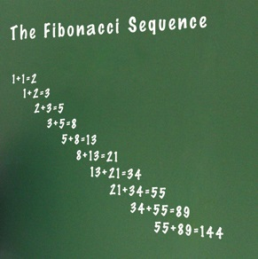
Recursion: Fibonacci
The Fibonacci numbers are numbers where the next number in the sequence is the sum of the previous two.
The sequence starts with 1, 1,
And then it’s 2
Then 3
Then 5
Then 8
Then 13

Slide 28
Recursion: Fibonacci
Let’s remember how we did Fibonacci iteratively:

Slide 29
Recursion: Fibonacci
PROGRAM FibonacciNumbers:
READ A;
FirstNum <- 1;
SecondNum <- 1;
WHILE (A != 2)
DO Total <- SecondNum + FirstNum;
FirstNum <- SecondNum;
SecondNum <- Total;
A <- A – 1;
ENDWHILE;
PRINT Total;
END.

Slide 30
Recursion: Fibonacci
Now let’s look at the recursive version:

Slide 31
Recursion: Fibonacci
MODULE RecurFib(N):
IF N == 1 OR N == 2:
THEN RETURN 1;
ELSE RETURN RecurFib(N-1) + RecurFib(N-2);
ENDIF;
END.
PROGRAM FibonacciNumbers:
READ A;
PRINT RecurFib(A);
END.

Slide 32
Recursion: Decimal to Binary Conversion
How do we convert decimal numbers to binary?

Slide 33
Recursion: Decimal to Binary Conversion
How do we convert decimal numbers to binary?
Let’s try the number 23…

Slide 34
Recursion: Decimal to Binary Conversion
How do we convert decimal numbers to binary?
Let’s try the number 23…
23 / 2

Slide 35
Recursion: Decimal to Binary Conversion
How do we convert decimal numbers to binary?
Let’s try the number 23…
23 / 2 = 11 and remainder is 1

Slide 36
Recursion: Decimal to Binary Conversion
How do we convert decimal numbers to binary?
Let’s try the number 23…
23 / 2 = 11 and remainder is 1
11/2 = 5 and remainder is 1

Slide 37
Recursion: Decimal to Binary Conversion
How do we convert decimal numbers to binary?
Let’s try the number 23…
23 / 2 = 11 and remainder is 1
11/2 = 5 and remainder is 1
5/2 = 2 and remainder is 1

Slide 38
Recursion: Decimal to Binary Conversion
How do we convert decimal numbers to binary?
Let’s try the number 23…
23 / 2 = 11 and remainder is 1
11/2 = 5 and remainder is 1
5/2 = 2 and remainder is 1
2/2 = 1 and remainder is 0

Slide 39
Recursion: Decimal to Binary Conversion
How do we convert decimal numbers to binary?
Let’s try the number 23…
23 / 2 = 11 and remainder is 1
11/2 = 5 and remainder is 1
5/2 = 2 and remainder is 1
2/2 = 1 and remainder is 0
1/2 = 0 and remainder is 1

Slide 40
Recursion: Decimal to Binary Conversion
How do we convert decimal numbers to binary?
Let’s try the number 23…
23 / 2 = 11 and remainder is 1
11/2 = 5 and remainder is 1
5/2 = 2 and remainder is 1
2/2 = 1 and remainder is 0
1/2 = 0 and remainder is 1
>> So DEC 23 is BIN 10111

Slide 41
Recursion: Decimal to Binary Conversion
MODULE DecToBin(N):
IF N == 0
THEN RETURN ‘0’;
ELSE RETURN DecToBin(N DIV 2) + String(N MOD 2);
ENDIF;
END.
PROGRAM DecimalToBinary:
READ A;
PRINT DecToBin(A);
END.

Slide 42
Recursion: Linked Lists
A linked list is made up of nodes.
Each node has two parts to it:
The pointer points to another node of the same type (recursively)
Value
Pointer

Slide 43
RecursiveCount()

Slide 44
23
62
26
37
31
NULL

Slide 45
23
62
26
37
31
NULL
1
+
REST OF LIST

Slide 46
23
62
26
37
31
NULL
1
+
REST OF LIST
1
+
REST OF LIST

Slide 47
23
62
26
37
31
NULL
1
+
REST OF LIST
1
+
REST OF LIST
1
+
REST OF LIST

Slide 48
23
62
26
37
31
NULL
1
+
REST OF LIST
1
+
REST OF LIST
1
+
REST OF LIST
1
+
REST OF LIST

Slide 49
23
62
26
37
31
NULL
1
+
REST OF LIST
1
+
REST OF LIST
1
+
REST OF LIST
1
+
1

Slide 50
Linked Lists: Recursive Count
MODULE RecursiveCount(Current):
IF (Current == NULL)
THEN RETURN 0;
ELSE RETURN 1 + RecursiveCount(Current.pointer)
ENDIF;
END.

Slide 51
RecursivePrint()

Slide 52
Linked Lists: Recursive Print
MODULE RecursivePrint(Current):
IF (Current == NULL)
THEN RETURN 0;
ELSE PRINT Current.value;
RecursivePrint(Current.pointer);
ENDIF;
END.

Slide 53
FindANode()

Slide 54
Linked Lists: Find a node
MODULE FindANode(Current, N):
IF (Current.pointer == NULL)
THEN RETURN NULL;
ELSE IF (Current.value == N)
THEN PRINT N “was found”;
ELSE RETURN FindANode(Current.pointer, N)
ENDIF;
ENDIF;
END.

Slide 55
InsertANode()

Slide 56
Linked Lists: Insert a node
MODULE InsertANode(Current, Pos, N):
IF (Current.pointer == NULL)
THEN RETURN NULL;
ELSE IF (Current.value == Pos)
THEN Nnode <- NEW Node(N, NULL);
Nnode.pointer <- Current.pointer;
Current.pointer <- Nnode;
ELSE RETURN InsertANode(Current.pointer, Pos, N);
ENDIF;
ENDIF;
END.

Slide 57
DeleteANode()

Slide 58
Linked Lists: Delete a node
MODULE DeleteANode(Current, N):
IF (Current.pointer != NULL)
THEN IF (Current.value == N)
THEN Current <- Current.pointer;
ELSE Current.pointer <- DeleteANode(Current.pointer, N);
ENDIF;
ENDIF;
END.

Slide 59
etc.

