Slide 1
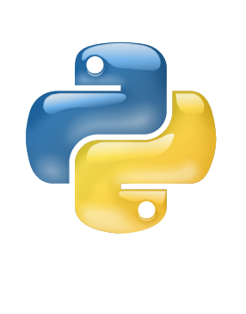
Introduction to Python Part 1
Damian Gordon

Slide 2
Introduction
We will take a quick look at Python.
We will look at SEQUENCE, SELECTION, and ITERATION.
We will look at some COMMON ALGORITHMS.

Slide 3
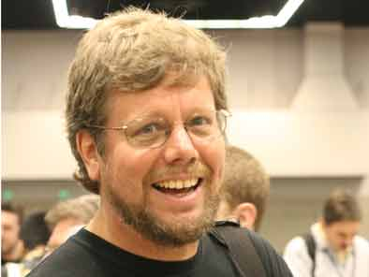
The Python Programming Language
Python was developed by Guido van Rossum in the Netherlands in 1989.
Van Rossum is Python's principal author, and his continuing central role in deciding the direction of Python is reflected in the title given to him by the Python community, Benevolent Dictator for Life (BDFL).

Slide 4
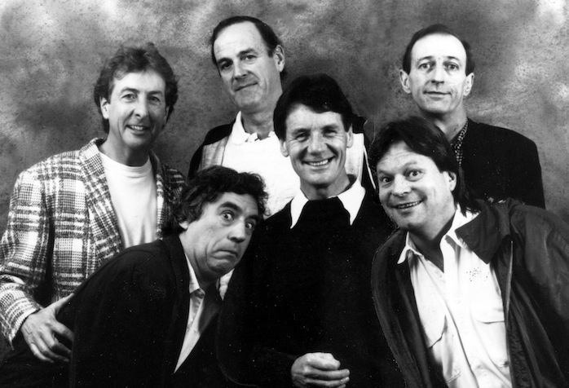
The Python Programming Language
Python is named for the British comedy group Monty Python.
The main members of the group are Eric Idle, Terry Jones, John Cleese, Michael Palin, Graham Chapman, and Terry Gilliam.

Slide 5
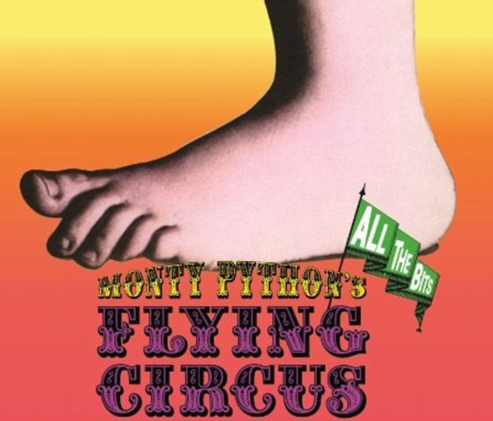
The Python Programming Language
Python is named for the British comedy group Monty Python.
The main members of the group are Eric Idle, Terry Jones, John Cleese, Michael Palin, Graham Chapman, and Terry Gilliam.

Slide 6
The Python Programming Language
1989
Ver 1
2008
Ver 3
2000
Ver 2

Slide 7
The Python Programming Language
Python is a multi-paradigm programming language:
structured programming
object-oriented programming
functional programming
aspect-oriented programming
design by contract
logic programming

Slide 8
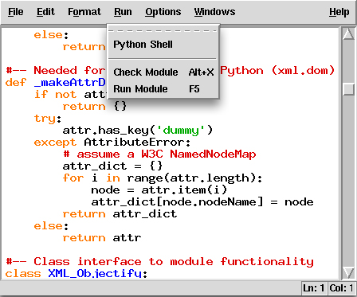
IDLE

Slide 9
Python: Print
Damian Gordon

Slide 10
Your first Python program
When learning a new computer programming language, the first thing typically taught is how to write a message to the screen saying “Hello, World”.
Let’s see how to do that:

Slide 11
print(“Hello, World”)

Slide 12
# PROGRAM HelloWorldProgram:
print(“Hello, World”)
# END.

Slide 13
The PRINT statement
To print out two lines of text we do:

Slide 14
# PROGRAM HelloWorldProgramTwoLines:
print(“Hello, World”)
print(“I’m here”)
# END.

Slide 15
The PRINT statement
To join two strings together:

Slide 16
# PROGRAM HelloWorldProgramJoined:
print(“Hello, World” + “ I’m here”)
# END.

Slide 17
The PRINT statement
To print out the same message 10 times:

Slide 18
# PROGRAM HelloWorldProgramNewLine10Times:
print(“Hello, World\n” * 10)
# END.

Slide 19
Code | Description
\\ | Print a backslash
\’ | Print a single quote
\” | Print a double quote
\a | Play a beep
\n | Print a new line
\t | Print a tab

Slide 20
Python: Maths
Damian Gordon

Slide 21
Some Simple Maths
Let’s look at some simple maths first:

Slide 22
# PROGRAM AddingNumbers:
print(10 + 7)
# END.

Slide 23
Some Simple Maths
Let’s try subtraction:

Slide 24
# PROGRAM SubtractingNumbers:
print(10 - 7)
# END.

Slide 25
Some Simple Maths
Let’s try multiplication:

Slide 26
# PROGRAM MultiplyingNumbers:
print(10 * 7)
# END.

Slide 27
Some Simple Maths
Division is a lot cooler, we can do three kinds of division,
Regular Division
Integer Division
Division Remainder

Slide 28
# PROGRAM RegularDivision:
print(10 / 7)
# END.

Slide 29
# PROGRAM RegularDivision:
print(10 / 7)
# END.
This should give us:
1.428571

Slide 30
# PROGRAM IntegerDivision:
print(10 // 7)
# END.

Slide 31
# PROGRAM IntegerDivision:
print(10 // 7)
# END.
This should give us:
1

Slide 32
# PROGRAM IntegerDivision:
print(10 // 7)
# END.
which is how many times 7 divides evenly into 10
This should give us:
1

Slide 33
# PROGRAM DivisionRemainder:
print(10 % 7)
# END.

Slide 34
# PROGRAM DivisionRemainder:
print(10 % 7)
# END.
This should give us:
3

Slide 35
# PROGRAM DivisionRemainder:
print(10 % 7)
# END.
which is what is left over when we divide 7 into 10
This should give us:
3

Slide 36
Python: Variables
Damian Gordon

Slide 37
Using Variables
Variables are easy to use in Python, there is no need to declare the type of the variable.
Python will work it out for you (mostly!).

Slide 38
# PROGRAM VariableAssignment:
x = 6
# END.

Slide 39
Using Variables
And if we want to check the value of the variable:

Slide 40
# PROGRAM VariablePrint:
x = 6
print(x)
# END.

Slide 41
Using Variables
Let’s add 1 to x:

Slide 42
# PROGRAM AddOneVariablePrint:
x = 6
print(x + 1)
# END.

Slide 43
Using Variables
Let’s try two variables:

Slide 44
# PROGRAM TwoVariablePrint:
x = 6
y = 5
print(x + y)
# END.

Slide 45
Using Variables
If we want to move from integers to real numbers

Slide 46
# PROGRAM RealVariablePrint:
x = 6.56
print(x)
# END.

Slide 47
# PROGRAM AnotherRealVariablePrint:
x = 6.0
print(x)
# END.

Slide 48
Using Variables
If we want to create character variables

Slide 49
# PROGRAM CharacterVariablePrint:
x = ‘@’
print(x)
# END.

Slide 50
# PROGRAM AnotherCharacterVariablePrint:
x = ‘5’
print(x)
# END.

Slide 51
Using Variables
Now we can see that we can’t do arithmetic with characters:

Slide 52
# PROGRAM ErrorProgram:
x = ‘5’
print(x + 1)
# END.

Slide 53
Using Variables
If we want to create String variables

Slide 54
# PROGRAM StringVariablePrint:
x = “This is a string”
print(x)
# END.

Slide 55
Using Variables
To get input from the screen, we can do the following:

Slide 56
# PROGRAM PrintMessage:
print(“Please input a message: ”)
NewMsg = input()
print(NewMsg)
# END.

Slide 57
Using Variables
Let’s do the converting temperature program:

Slide 58
# PROGRAM ConvertFromCelsiusToFahrenheit:
print(“Please input your temperature in C:”)
InputVal = int(input());
print(“That temperature in F is:”)
print((InputVal *2) + 30)
# END.

Slide 59
Convert | Description | Result
int(x) | Convert variable into an integer, e.g. x = “10” int(x) | 10
float(x) | Convert variable into a real e.g. x = “10.5” float(x) | 10.5
str(x) | Convert variable into an string, e.g. x = 10 str(x) | “10”

Slide 60
Using Variables
The following words cannot be used as variable names:
and | del | from | not | while
as | elif | global | or | with
assert | else | if | pass | yield
break | except | import | print
class | exec | in | raise
continue | finally | is | return
def | for | lambda | try

Slide 61
A Special Note On Boolean Variables

Slide 62
Boolean Variables
In the original version of Python (1989), there was no Boolean type, in Version 2.2.1 (2002) True and False constants were added to the built-ins (they were simply set to integer values of 1 and 0 and weren't a different type.

Slide 63
Boolean Variables
Finally in Version 2.3 (2003) True and False were added in as constants to the __builtin__ module, making them a core part of Python.

Slide 64
# PROGRAM BooleanVar:
x = True
print(x)
# END.

Slide 65
# PROGRAM BooleanVar:
x = False
print(x)
# END.

Slide 66
etc.

