Slide 1
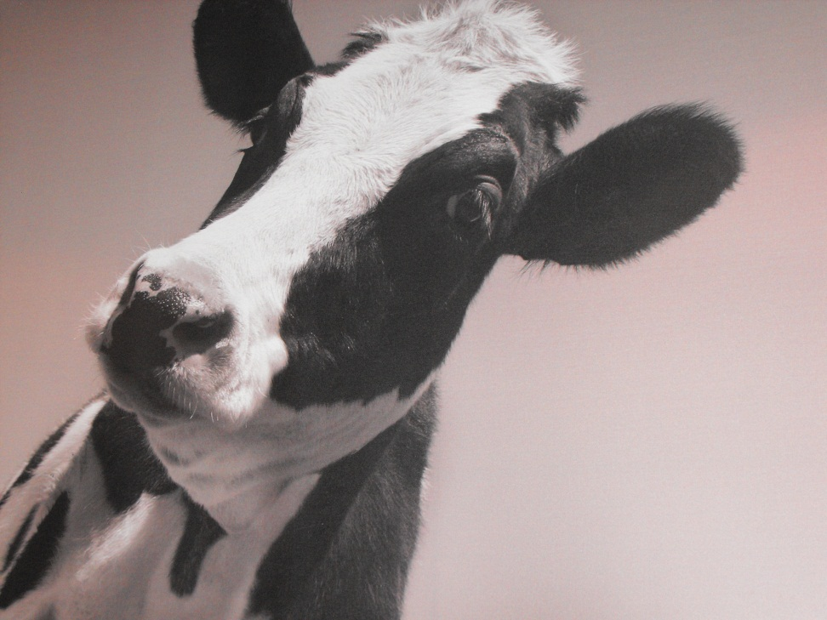
Christmas Cancelled
John
Robert
Christina
Marcus
Vincent

Slide 2
Cancelled Christmas
Canteen
More Relaxed
Coffee
People playing games
xBox
Chatty
Classroom
Plenty of room
Able to plug in laptop
Semi-formal
Access to internet
More computers

Slide 3

Christmas Cancelled
Creativity techniques
PMI
CAF
OPV
PESTLE
C&S
Random word

Slide 4
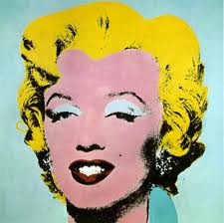
Christmas Cancelled
PMI
Plus
Minus
Interesting
To generate discussion
Involve everyone

Slide 5
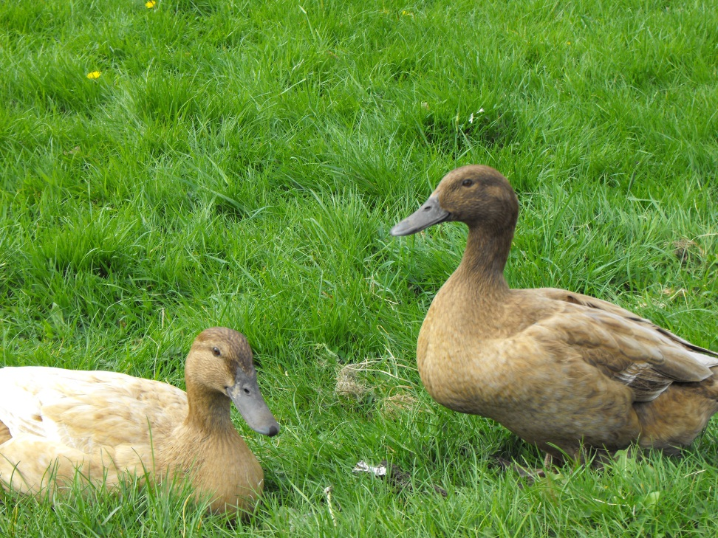
Christmas Cancelled
CAF
To have an all round view
More rounded view
Include everything

Slide 6
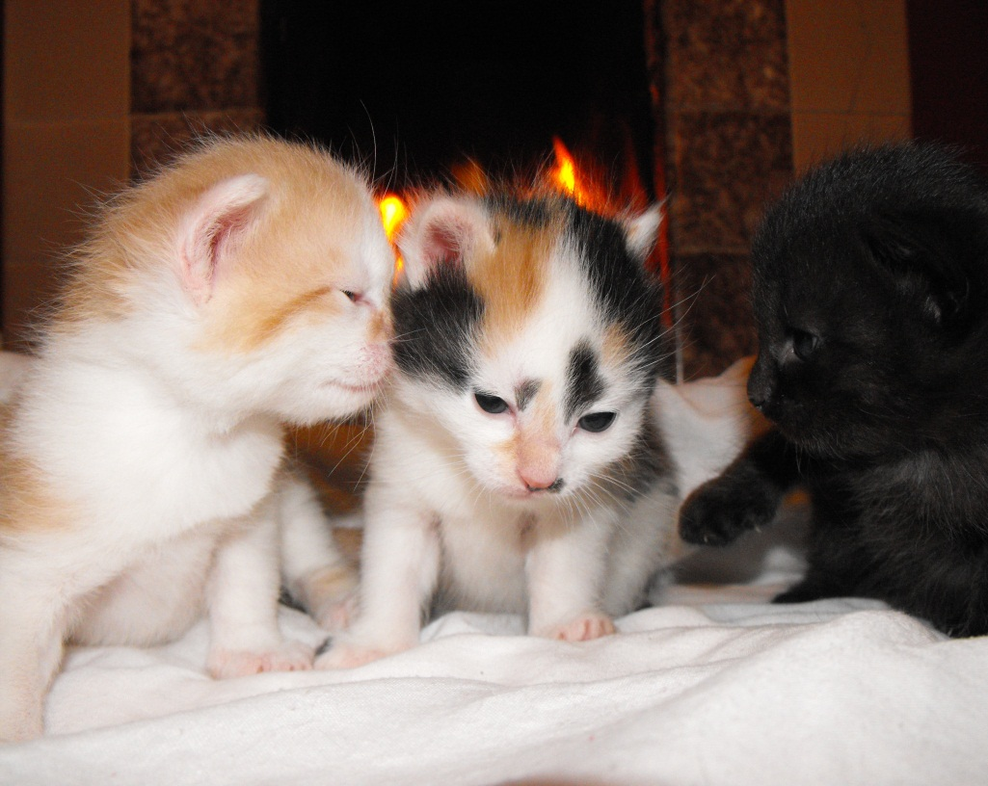
Christmas Cancelled
OPV
To get different views
Group
Child
Parent

Slide 7
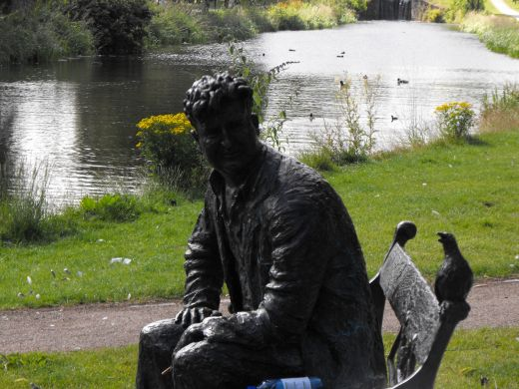
Christmas Cancelled
PESTLE
Political
Economic
Social
Technological
Legal
Environmental

Slide 8
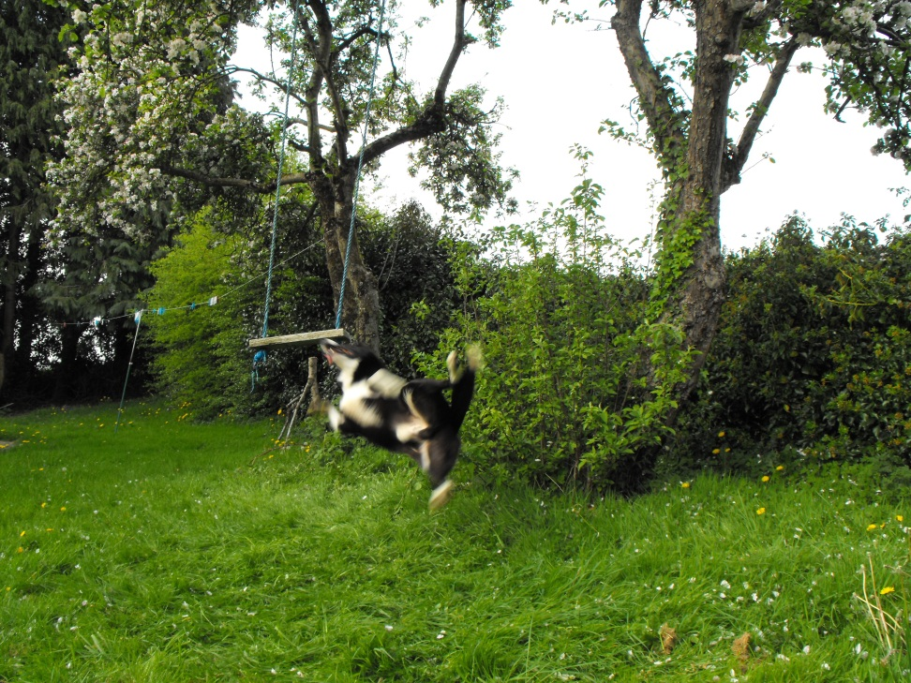
Christmas Cancelled
C&S
Unhappy children
Disappointment
Business collapse
Alternative Holiday

Slide 9
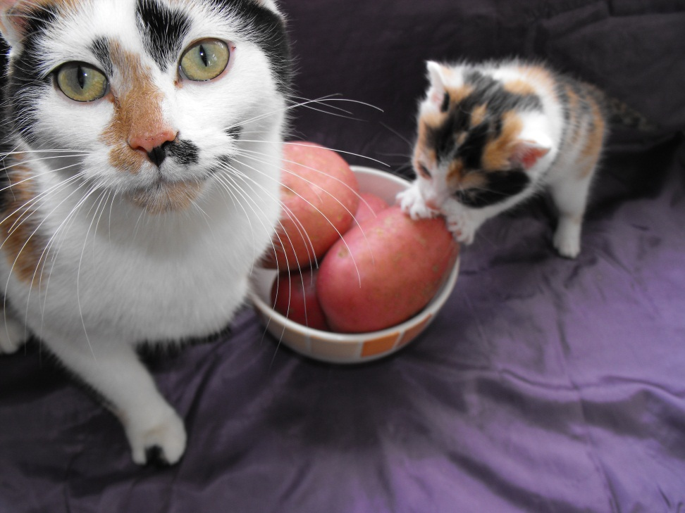
Christmas Cancelled
Random Word
Kitchen
Cooking
Greece
Lights
Turkey

Slide 10
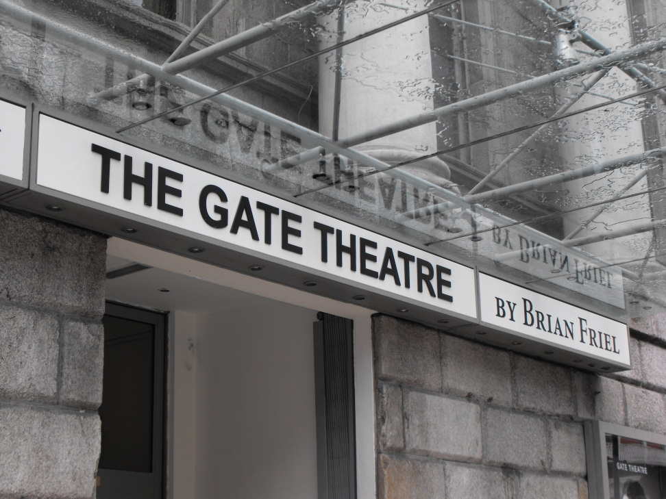
Christmas Cancelled
Most Effective
PMI-2
Random Word-2
OPV-1

Slide 11
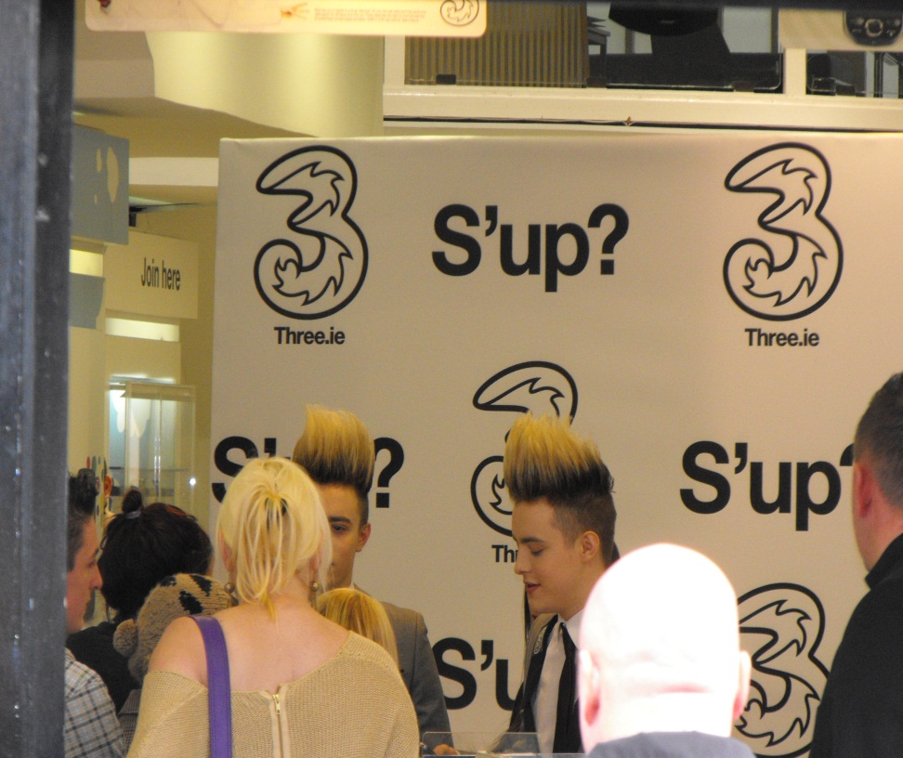
Christmas Cancelled
Least Effective
CAF
No stimuli
No inspiration
Not effective as others

Slide 12
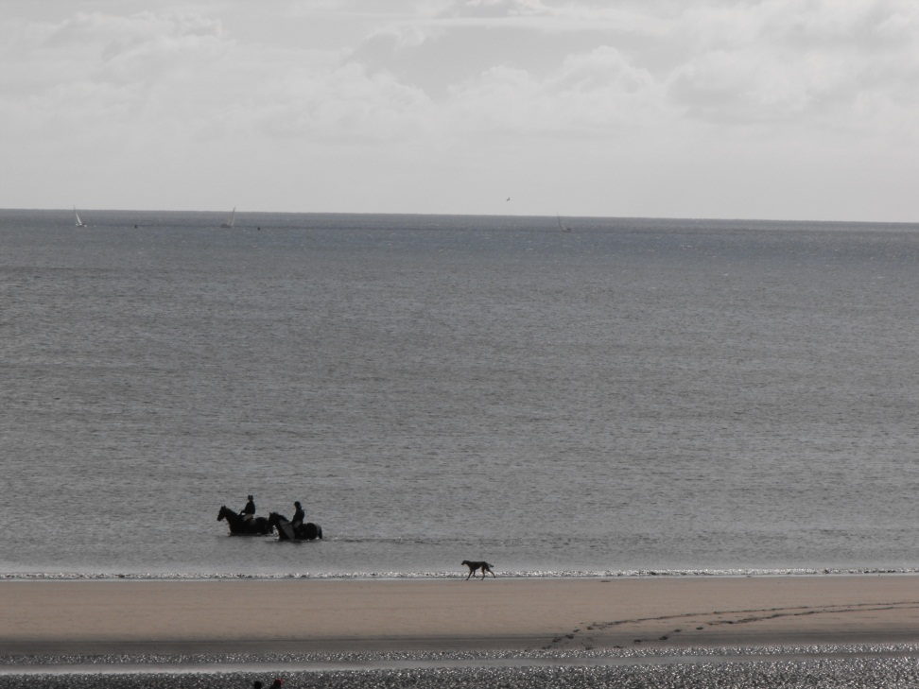
Christmas Cancelled
What ideas…..
Religious vacuum
Alternative Holiday
All religions
Fmas

Slide 13
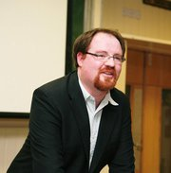
Christmas Cancelled
What decision….
At least one person happy to cancel CHRISTMAS
Move away from materialism
Everyone has an opinion

