Slide 1
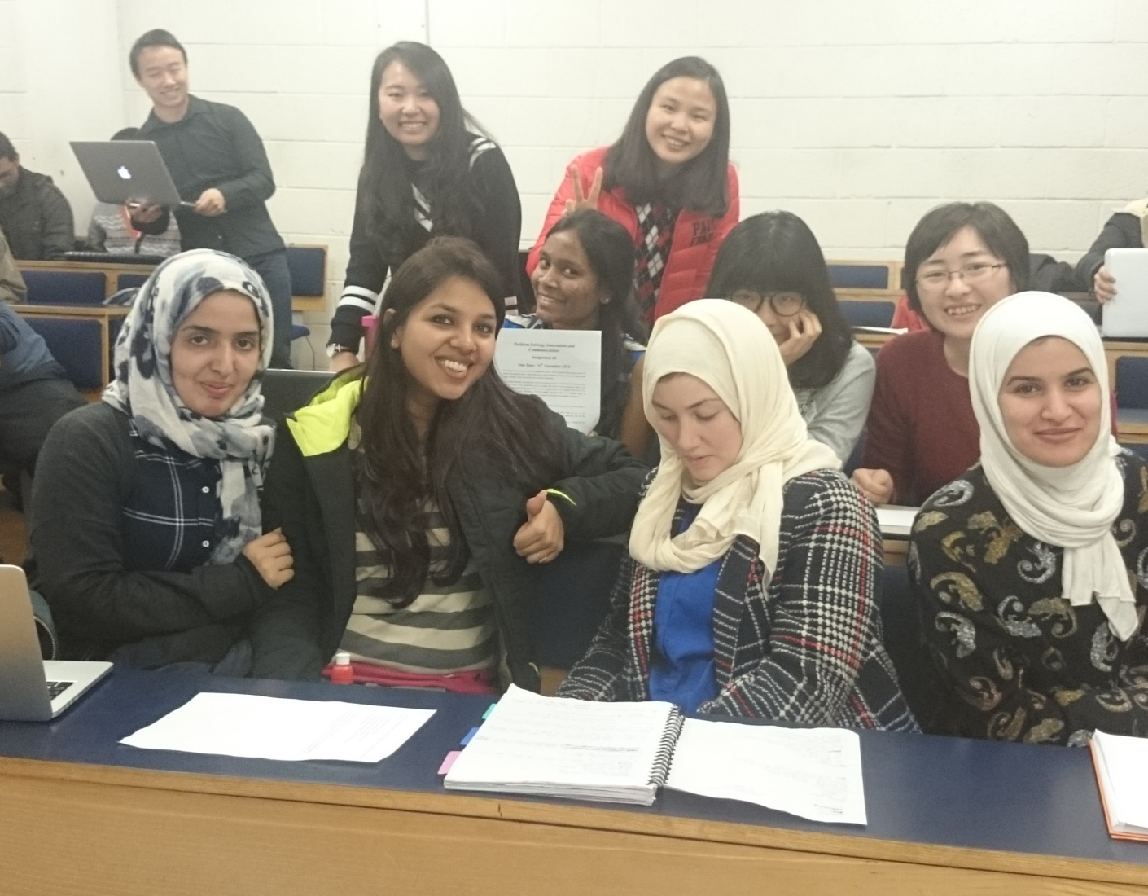
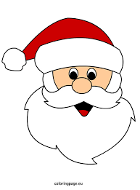
Problem Solving, innovation & Communication Assignment 2

Slide 2
Topic
Idea of cancelling Christmas

Slide 3
In the canteen
Noisy
Cramped
No place to jot down points
Hard to talk and communicate ideas to the rest of the team

Slide 4
In the classroom
Spacious
Quite
Environment which is used to work
White board help

Slide 5
Creativity techniques
PMI
OPV
6 Thinking hats
Mind maps

Slide 6
Decision
Chose the comprehensive techniques.
Partially on the basis of the familiarity of the techniques.
Consensus

Slide 7
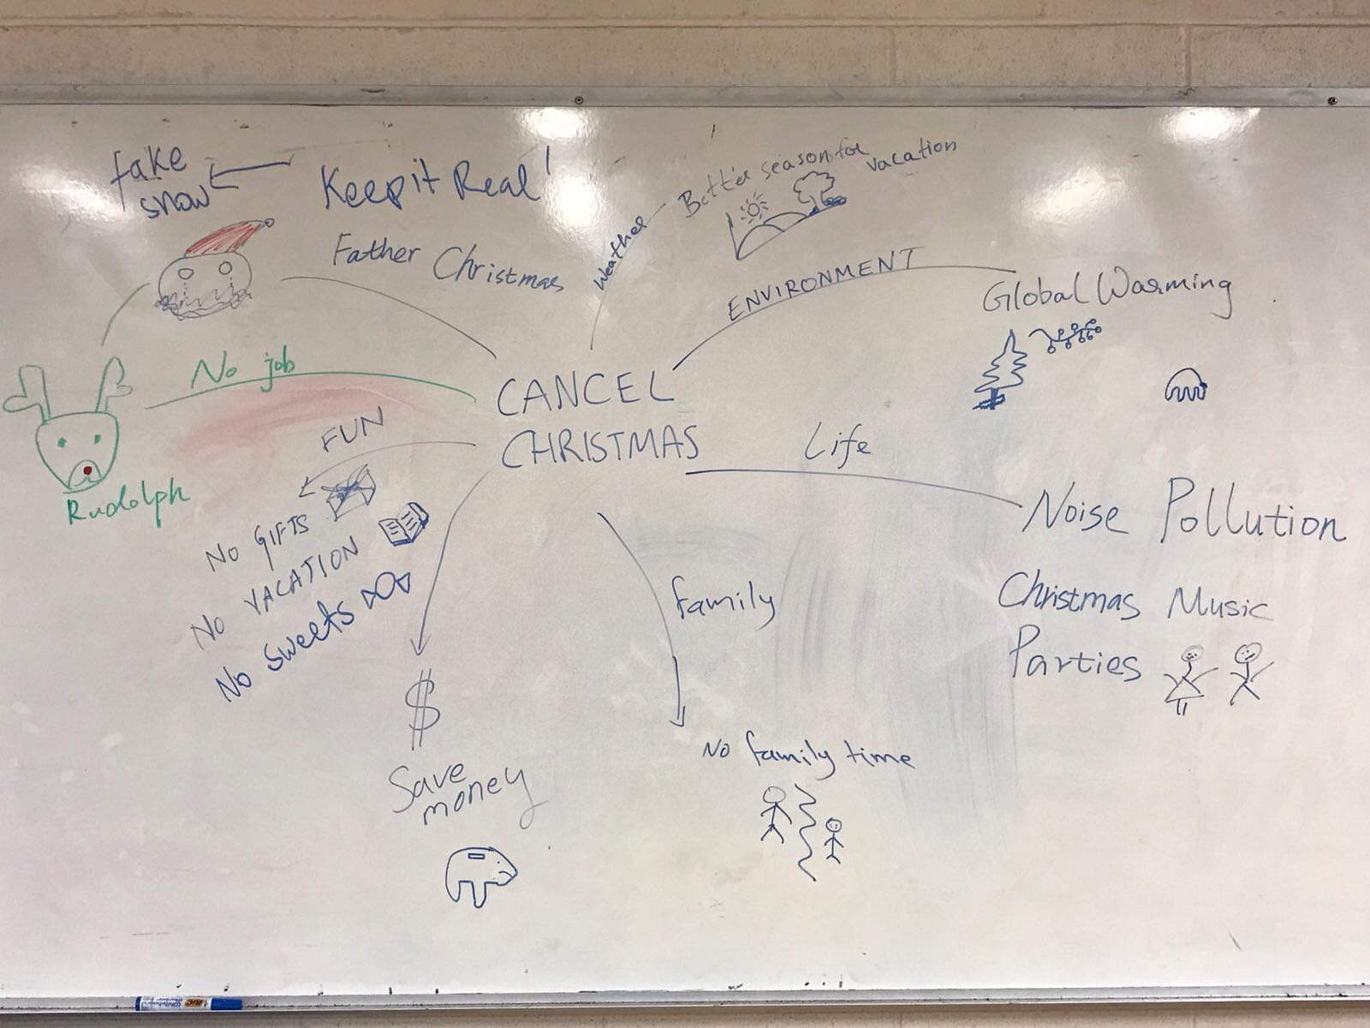
Most effective
Mind Map

Slide 8
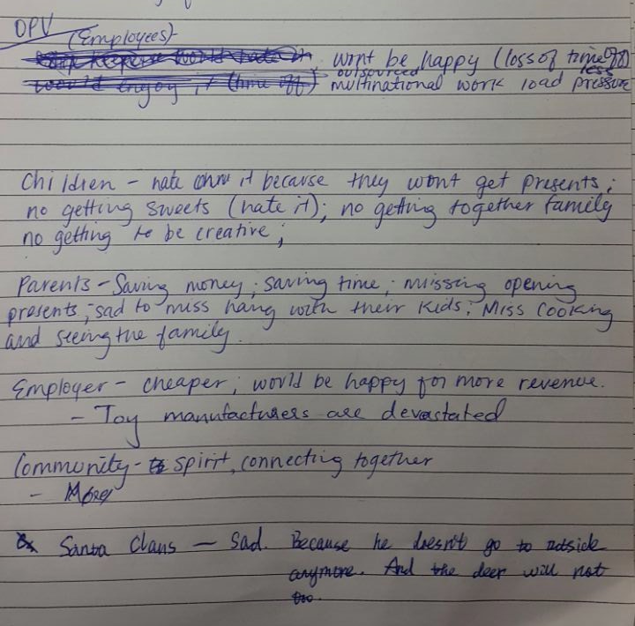
Least Effective
Other peoples views

Slide 9
Ideas/ Alternatives
1 vote for ‘Total Cancel’
1 vote Partial Cancel: get rid of canned music and commercialism
8 voted for Leave it Alone: it is a cultural phenomenon and as such interesting
Migrate to new festival: Winter, music or Summer Fest

Slide 10
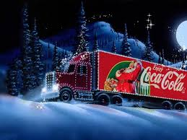
Final Decision
Keep the festival but make few changes.

