Slide 1
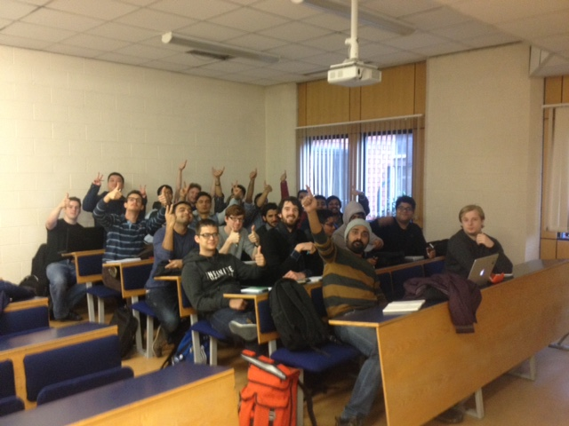
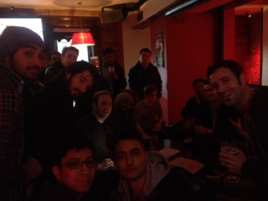
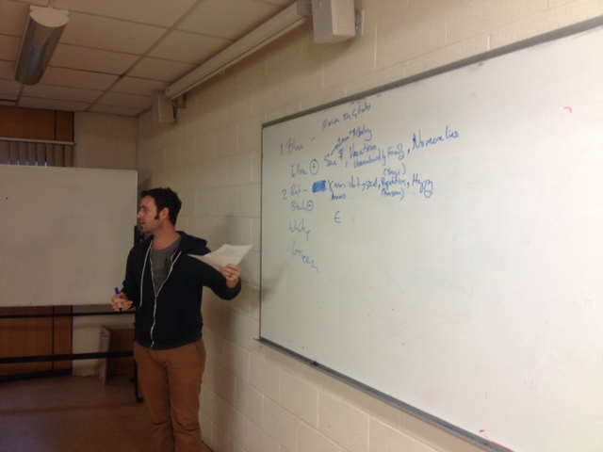
PSCI “Navidad” is cancelled this year
Assignment 2 Group assignment (Boys allowed)

Slide 2
Topic covered “In recognition of the recession Christmas is cancelled this year”
Techniques covered
Class
6 Thinking Hats
PMI
Public place
Random word
Other’s people’s work

Slide 3
Members of group
Fernando Ayuso – D15123249
James DiPauda – D14128214
Robert Kelly – d14126766
Clement Roux – D14123722
Gmyzin Dmitrii D14128190
Hasan Badat – d14128418
Vinayak Parashan – d15123001
Hithuam PavndiamD15122857
Nikhil Patil - D15122858
–Stijo P Moni –d15123617
Rajkumar ThenMozhi Mohan Kumai – d15124160
Mohammed Elywi – d15124106
Noel Rogers – D13128921
Nicholas Renard – d15123408
Devesh Shasma – D15123379
Pranav Sharma – d15122896
Pranav Murali – d15123199
Sultan Alghamdi- d15124914
Zechen Wang – d15124793
Bill Macnamara – c10344405
Carl Lawrence Mariano – c10309107
Xin Li – d14126406
Aifan Gaughon D13129182
Rajveer Singh D15122838

Slide 4
Differences Between doing it in different spaces
In Class
Focus
Easier to talk
Whiteboard
Less creative
More boring
Public place
More people are talking
Music helps creativity
Can’t hear everybody
Advantages
Disadvantage

Slide 5
Great minds at work – The process
6 Thinking Hats: Very good technique for a big group.
PMI: Because it’s got a clear procedure and usually have clear outcomes.
Random Word: It is very creative and expand the scope of the topic. Good in relax environments.
Other peoples views: We were a very homogenous in the group and we wanted to look into more diversity.
ULTIMATE DECISION: Cancel it and donate the money to the poor

Slide 6
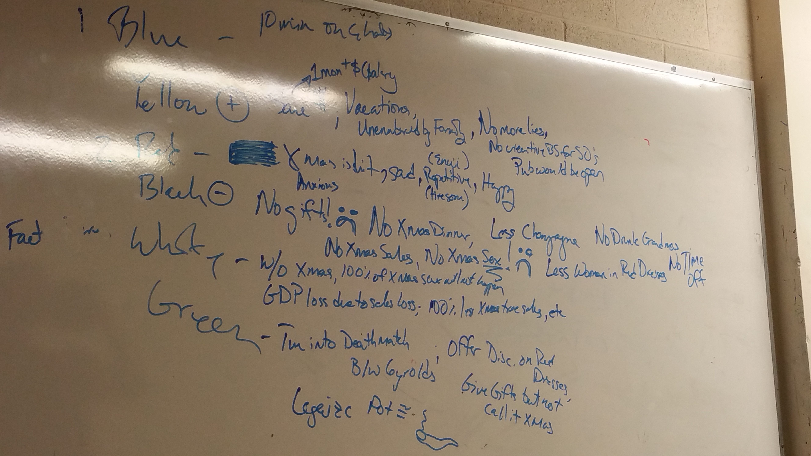
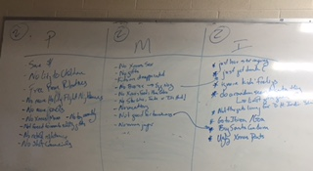
Ideas/Alternative decisions/
Would be bad for kids and families
Give money to the poor

Slide 7
Decisions
6 Thinking Hats: Keep Christmas
PMI: Realization, You can have fun and “fun” without Christmas
Random Word: If Christmas is not done we can donate the money to charity.
Other people’s views: Families would be unhappy and kids will be grumpy all their lives because they didn’t have that much fun when they were kids
Most effective: 6 Thinking hats in class and secondly random word out of class
Less effective: Other people’s views

