Slide 1
Problem Mitigation
Damian Gordon

Slide 2
Problem Solving
Much of the focus of problem solving is focussed on the notion that the problem has already occurred.
  What about trying to eliminate problems before they occur?
  What about trying to learn from what mistakes have occurred in the past?
This is what learning organisations do, they design well, and if they encounter problems, they learn from them and change processes and procedures to accommodate.

Slide 3
Managing the Development of Large Software Systems by
W.W. Royce

Slide 4
Reference
Royce, W.W., 1970, "Managing the Development of Large Software Systems", Proceedings of IEEE WESCON 26 (August), pp.1–9.

Slide 5

Winston W. Royce
Born in 1929.
Died in 1995.
An American computer scientist, director at Lockheed Software Technology Center in Austin, Texas, and one of the leaders in software development in the second half of the 20th century.
He was the first person to describe the “Waterfall model” for software development, although Royce did not use the term "waterfall" in that article, nor advocated the waterfall model as a working methodology.

Slide 6
Introduction
“I am going to describe my personal views about managing large software developments.
I have had various assignments during the past nine years, mostly concerned with the development of software packages for spacecraft mission planning, commanding and post-flight analysis.
In these assignments I have experienced different degrees of success with respect to arriving at an operational state, on-time, and within costs.
I have become prejudiced by my experiences and I am going to relate some of these prejudices in this presentation.”

Slide 7
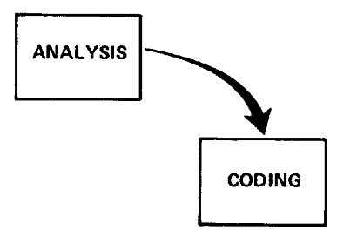
Small Developments
For a small development, you only need the following steps
  Typically done for programs for internal use

Slide 8
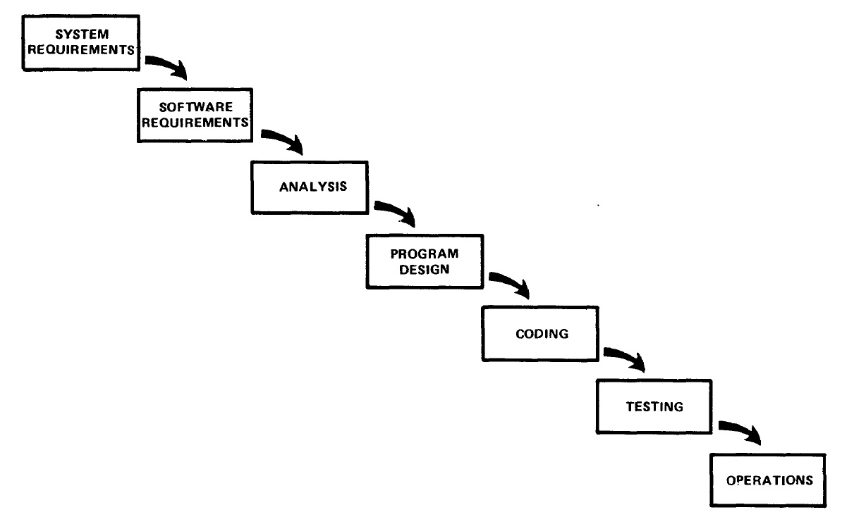
Large Developments

Slide 9
Large Developments
System Requirements: Identify, select and document functional, scheduling and financial requirements.

Slide 10
Large Developments
Software Requirements: Identify, select and document the software features necessary to satisfy the system requirements.

Slide 11
Large Developments
Analysis: Methodically work through the details of each requirement.

Slide 12
Large Developments
Program Design: Use programming techniques to design software and hardware within the constraints and objectives set in the earlier stages.

Slide 13
Large Developments
Coding: Implement the program as designed in the earlier stages.

Slide 14
Large Developments
Testing: Test the software and record the results.

Slide 15
Large Developments
Operations: Deliver, install and configure the completed software.

Slide 16
Large Developments

Slide 17
Large Developments
"I believe in this concept,
but the implementation
described above is risky
and invites failure."

Slide 18
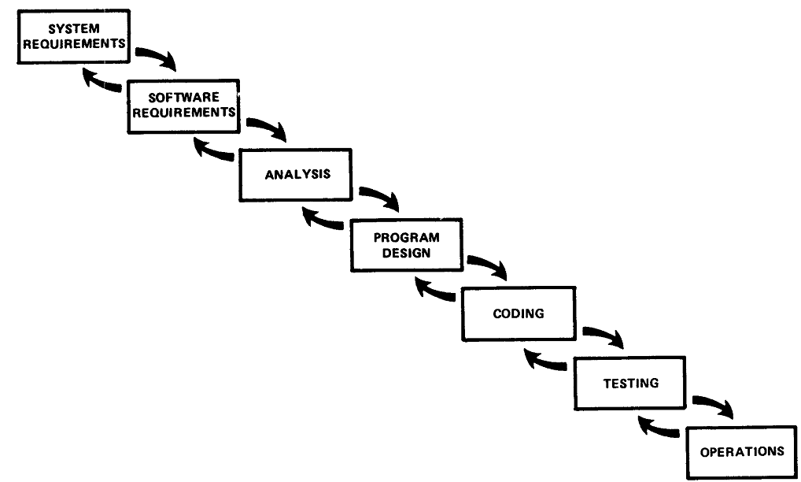
Iterative Relationship between Successive Development Phases

Slide 19
Iterative Relationship between Successive Development Phases
Each step progresses and the design is further detailed, there is an iteration with the preceding and succeeding steps but rarely with the more remote steps in the sequence.
The virtue of all of this is that as the design proceeds the change process is scoped down to manageable limits.

Slide 20
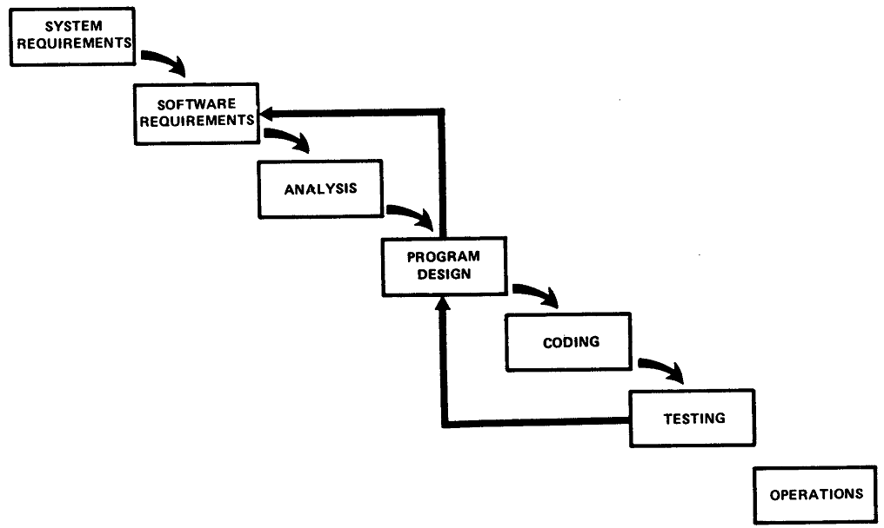
Unfortunately the design iterations are never confined to the successive steps

Slide 21
Unfortunately the design iterations are never confined to the successive steps
The testing phase which occurs at the end of the development cycle is the first event for which timing, storage, input/output transfers, etc., are experienced as distinguished from analyzed.
These phenomena are not precisely analyzable.
Yet if these phenomena fail to satisfy the various external constraints, then invariably a major redesign is required.

Slide 22
How do we fix this?

Slide 23
Five Steps
Program Design comes first
Document the Design
Do it twice
Plan, Control and Monitor Testing
Involve the Customer

Slide 24
1. Program Design comes first
A preliminary program design phase has been inserted between the Software Requirements Generation phase and the Analysis phase.

Slide 25
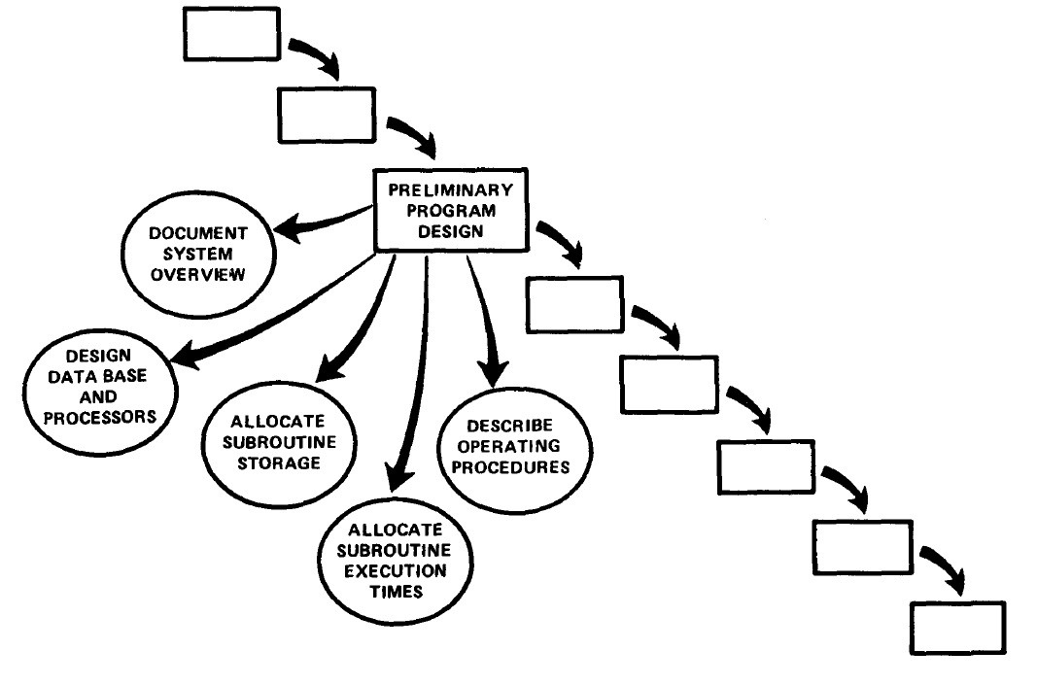
1. Program Design comes first

Slide 26
1. Program Design comes first
The following steps are required:
1) Begin the design process with program designers, not analysts or programmers.
2) Design, define and allocate the data processing modes.
3) Write an overview document that is understandable, informative and current.

Slide 27
2. Document the Design
“How much documentation?"
“Quite a lot"
More than most programmers, analysts, or program designers are willing to do if left to their own devices.
The first rule of managing software development is ruthless enforcement of documentation requirements.

Slide 28
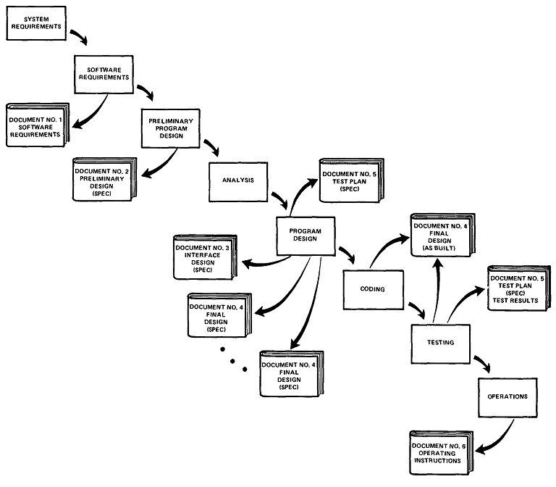
2. Document the Design

Slide 29
3. Do It Twice
Create a pilot study
If the computer program in question is being developed for the first time, arrange matters so that the version finally delivered to the customer for operational deployment is actually the second version insofar as critical design/operations areas are concerned.

Slide 30
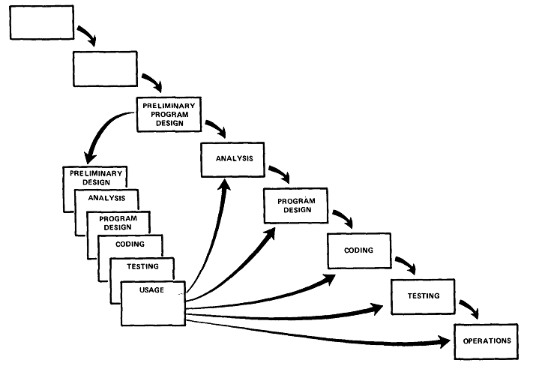
3. Do It Twice

Slide 31
4. Plan, Control and Monitor Testing
Without question the biggest user of project resources, whether it be manpower, computer time, or management judgment, is the test phase. It is the phase of greatest risk in terms of dollars and schedule.

Slide 32
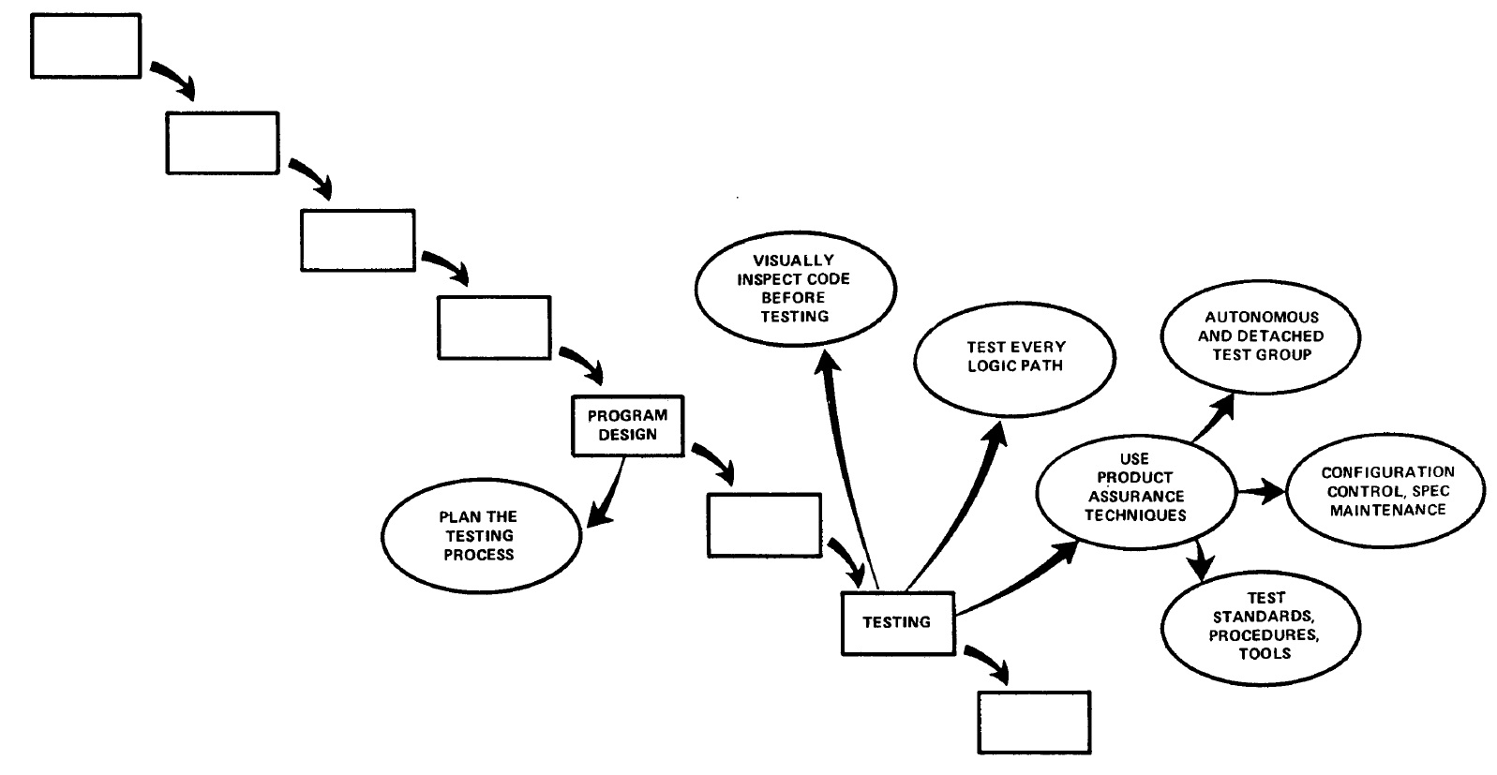
4. Plan, Control and Monitor Testing

Slide 33
4. Plan, Control and Monitor Testing
1) Many parts of the test process are best handled by test specialists who did not necessarily contribute to the original design.
2) Most errors are of an obvious nature that can be easily spotted by visual inspection.
3) Test every logic path in the computer program at least once with some kind of numerical check.
4) After the simple errors (which are in the majority, and which obscure the big mistakes) are removed, then it is time to turn over the software to the test area for checkout purposes.

Slide 34
5. Involve the Customer
For some reason what a software design is going to do is subject to wide interpretation even after previous agreement.
It is important to involve the customer in a formal way so that he has committed himself at earlier points before final delivery.
To give the contractor free rein between requirement definition and operation is inviting trouble.

Slide 35
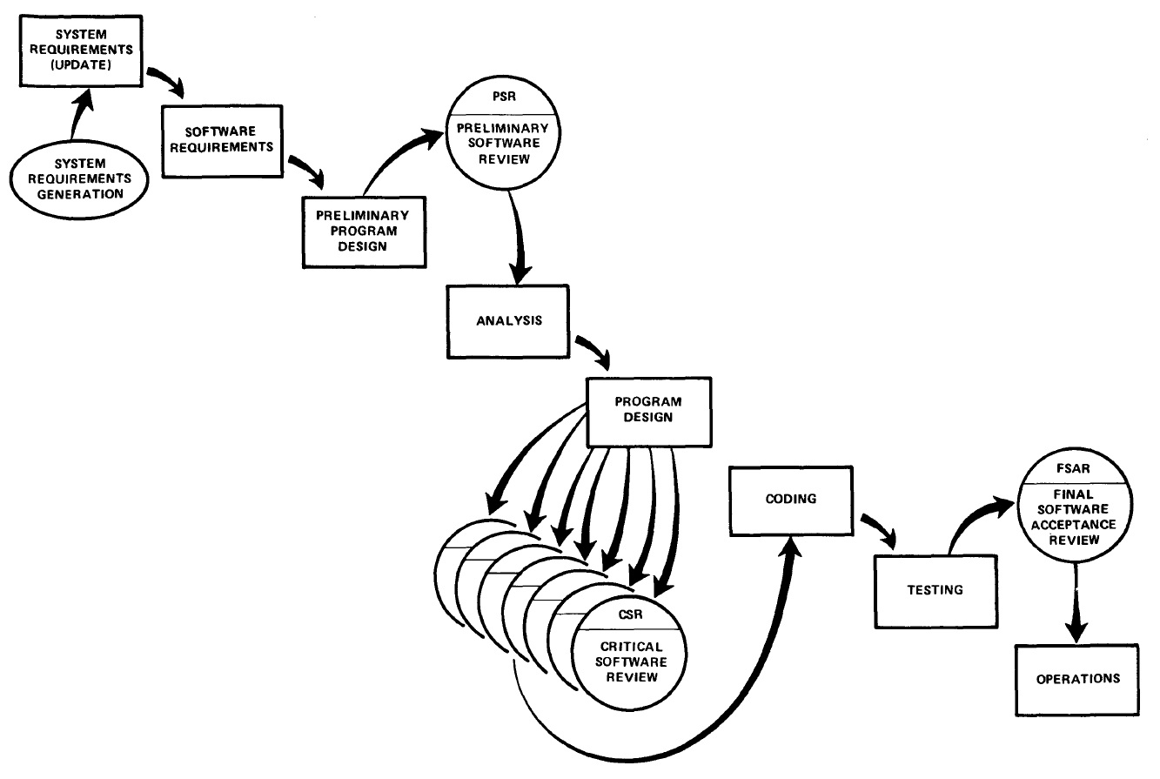
5. Involve the Customer

Slide 36
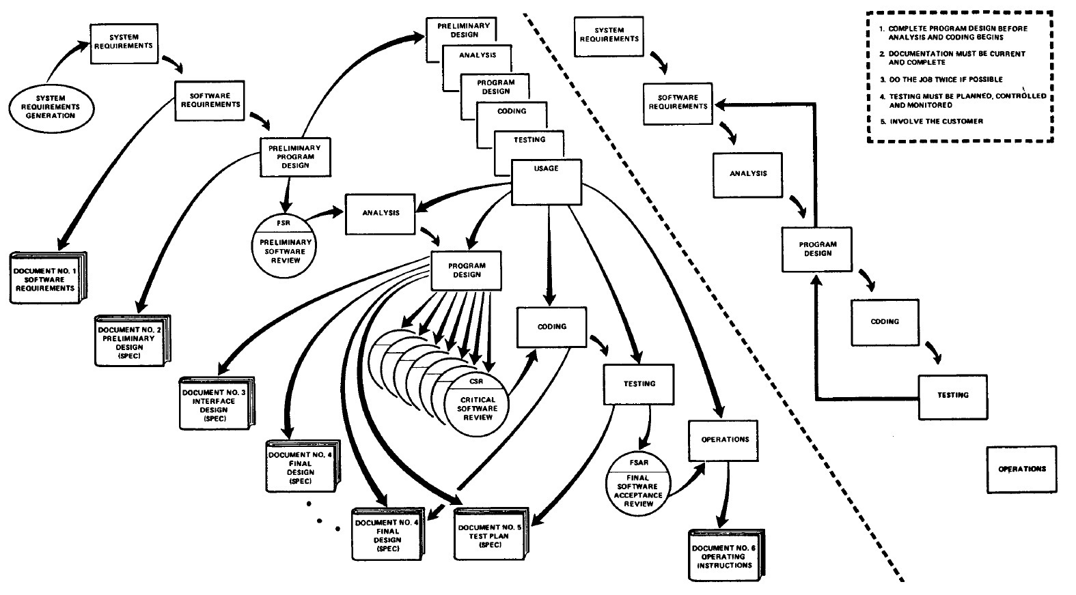
Summary

Slide 37
User Engagement Toolkit
Irish Legislation
Health and Safety
Insurance
Garda Clearance
Responsibilities
Design Project Protocol
Risks and Benefits
User Engagement Plan
Data Management Plan
Ethics Protocol
Ethical Approval
Reimbursement or Payment
Understanding the Specific Needs of Your Users
Confidentiality and Privacy
Participant Information
Informed Consent
Use of Data
Following up with the User

