Slide 1
Theory of Inventive Problem-Solving
TRIZ
Damian Gordon

Slide 2
Introduction
Theoria Resheneyva Isobretatelskehuh Zadach
(Theory of Solving Problems Inventively)

Slide 3
Introduction
Developed by Soviet engineer Genrich Altshuller and his colleagues, beginning in 1946.
“a problem-solving, analysis and forecasting tool derived from the study of patterns of invention in the global patent literature”
Altshuller and his colleagues studied more than 300,000 patents and discerned inventive principles were often present in the most successful cases.

Slide 4
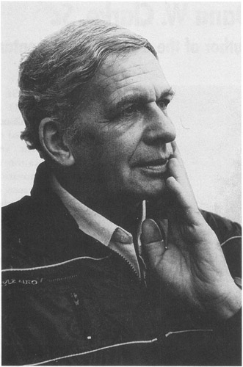
Genrich Altshuller
Born October 15, 1926
Died September 24, 1998
Born in Tashkent, Uzbek SSR, USSR
a Soviet engineer, inventor, scientist, journalist and writer.
He is most notable for the creation of TRIZ.
He founded the Azerbaijan Public Institute for Inventive Creation, and was the first President of the TRIZ Association.
He also wrote science fiction under the pen-name Genrikh Altov.
Covers of
Altshuller
Books

Slide 5
Introduction
A full-fledged TRIZ movement developed among Soviet engineers and other technically inclined people by the 1970s, and Altshuller played the role of its intellectual leader.
He lectured at TRIZ congresses, published articles and books and corresponded with various TRIZ practitioners.
He became the founding member and president of the Russian TRIZ Association.
A number of his close friends and students have become the most prominent thinkers and teachers of the movement, popularizing TRIZ in Russia and abroad.

Slide 6
Some Good Links
Timeline of TRIZ
http://www.triz-journal.com/archives/2008/11/06/
Genrich Altshuller Teaching TRIZ 1 of 6
http://www.youtube.com/watch?v=dawPn8neL-U
The TRIZ Journal
http://www.triz-journal.com/
TRIZ in Detail
http://www.mazur.net/triz/

Slide 7
40 Principles of Invention
TRIZ

Slide 8
Principle 1. Segmentation
A. Divide an object into independent parts.
Replace mainframe computer by personal computers.
Replace a large truck by a van and trailer.
B. Make an object easy to disassemble.
Modular furniture
Quick disconnect joints in plumbing
C. Increase the degree of fragmentation or segmentation.
Replace solid shades with Venetian blinds.

Slide 9
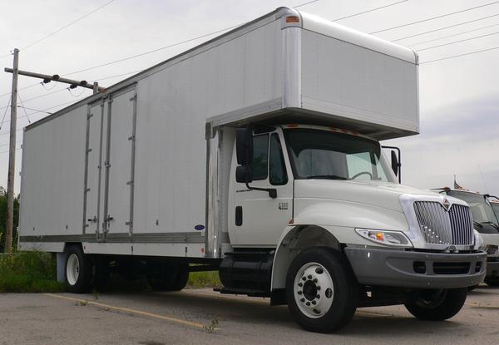
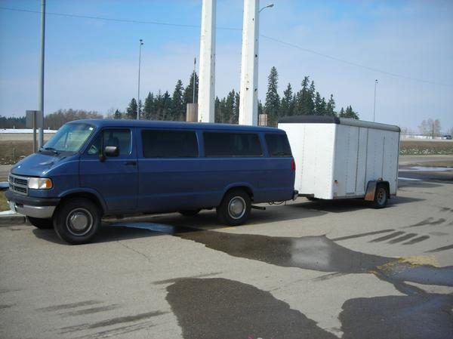
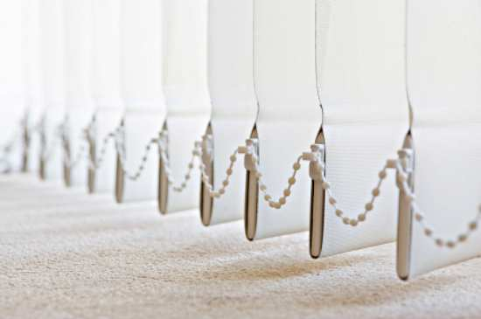
Principle 1. Segmentation

Slide 10
Principle 2. Taking Out
A. Separate an interfering part or property from an object, or single out the only necessary part (or property) of an object.
Locate a noisy compressor outside the building where compressed air is used.
Use fibre-optics or a light pipe to separate the hot light source from the location where light is needed.
Use the sound of a barking dog, without the dog, as a burglar alarm.

Slide 11
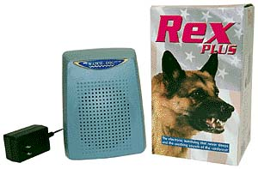
Principle 2. Taking Out

Slide 12
Principle 3. Local Quality
A. Change an object's structure from uniform to non-uniform, change an external environment (or external influence) from uniform to non-uniform.
Use a temperature, density, or pressure gradient instead of constant temperature, density or pressure.
B. Make each part of an object function in conditions most suitable for its operation.
Lunch box with special compartments for hot and cold
solid foods and for liquids.
C. Make each part of an object fulfil a different and useful function.
Multi-function tool that scales fish, acts as a pliers, a wire stripper, a flat-blade screwdriver, a Phillips screwdriver, manicure set, etc.
Hammer with nail puller
Pencil with eraser

Slide 13
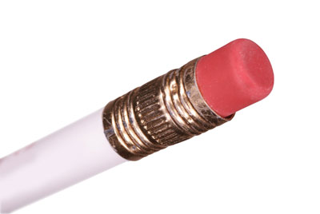
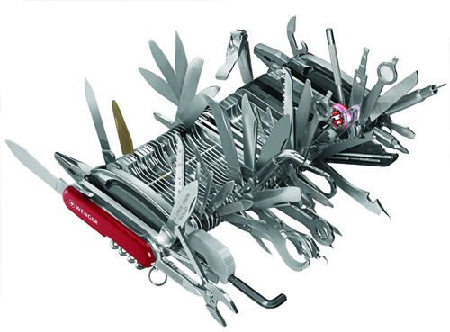
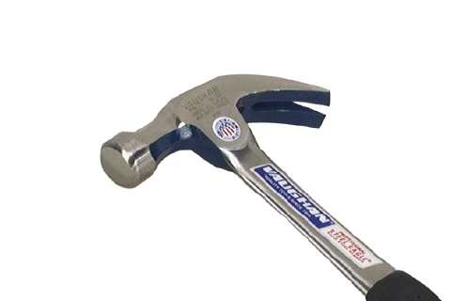
Principle 3. Local Quality

Slide 14
Principle 4. Asymmetry
A. Change the shape of an object from symmetrical to asymmetrical.
Asymmetrical mixing vessels or asymmetrical vanes in symmetrical vessels improve mixing (cement trucks, cake mixers, blenders).
Put a flat spot on a cylindrical shaft to attach a knob securely.
B. If an object is asymmetrical, increase its degree of asymmetry.
Change from circular O-rings to oval cross-section to specialized shapes to improve sealing.
Use astigmatic optics to merge colours.

Slide 15
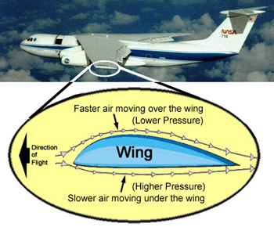
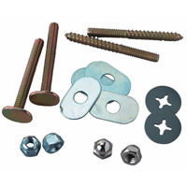
Principle 4. Asymmetry

Slide 16
Principle 5. Merging
A. Bring closer together (or merge) identical or similar objects, assemble identical or similar parts to perform parallel operations.
Personal computers in a network
Thousands of microprocessors in a parallel processor computer
Electronic chips mounted on both sides of a circuit board or subassembly
B. Make operations contiguous or parallel; bring them together in time.
Link slats together in Venetian or vertical blinds.
Medical diagnostic instruments that analyze multiple blood parameters simultaneously
Mulching lawnmower

Slide 17
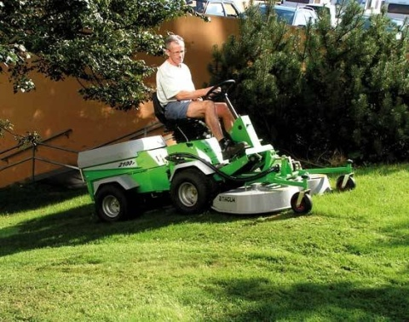
Principle 5. Merging

Slide 18
Principle 6. Universality
A. Make a part or object perform multiple functions; eliminate the need for other parts.
Handle of a toothbrush contains toothpaste
Child's car safety seat converts to a stroller
Mulching lawnmower (Yes, it demonstrates both Principles 5 and 6, Merging and Universality.)
Team leader acts as recorder and timekeeper.

Slide 19
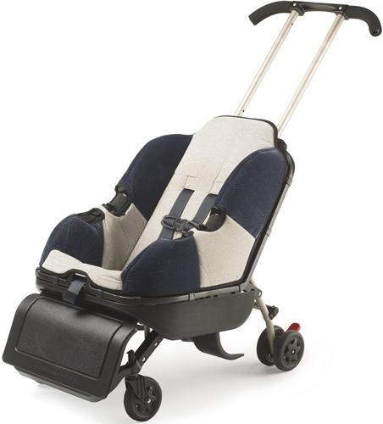
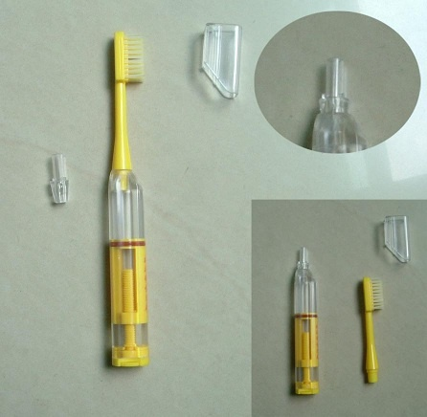
Principle 6. Universality

Slide 20
Principle 7. "Nested Doll"
A. Place one object inside another; place each object, in turn, inside the other.
Portable audio system (microphone fits inside transmitter, which fits inside amplifier case)
Measuring cups or spoons
Russian dolls
B. Make one part pass through a cavity in the other.
Retractable aircraft landing gear stow inside the fuselage (also demonstrates Principle 15, Dynamism).
Seat belt retraction mechanism
Extending radio antenna
Zoom lens

Slide 21
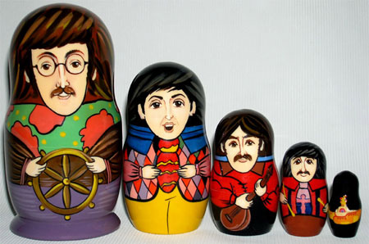
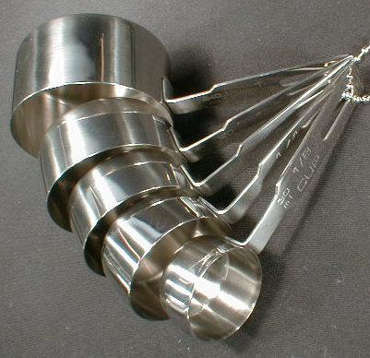
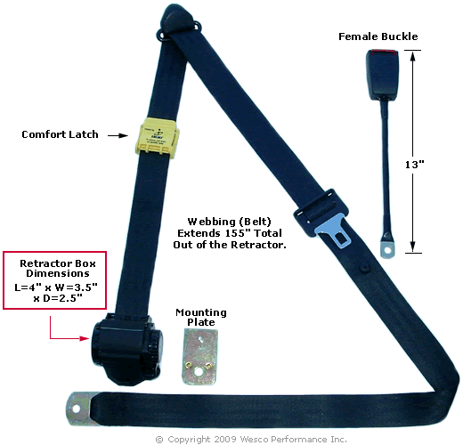
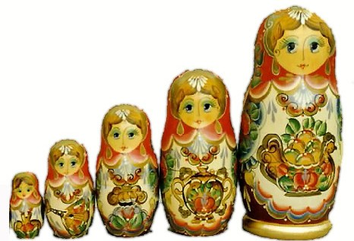
Principle 7. "Nested Doll"

Slide 22
Principle 8. Anti-Weight
A. To compensate for the weight of an object, merge it with other objects that provide lift.
Inject foaming agent into a bundle of logs, to make it float better.
Use helium balloon to support advertising signs.
B. To compensate for the weight of an object, make it interact with the environment (e.g. use aerodynamic, hydrodynamic, buoyancy and other forces).
Aircraft wing shape reduces air density above the wing, increases density below wing, to create lift. (This also demonstrates Principle 4, Asymmetry.)
Vortex strips improve lift of aircraft wings.
Hydrofoils lift ship out of the water to reduce drag.

Slide 23
Principle 8. Anti-Weight

Slide 24
Principle 9. Preliminary Anti-Action
A. If it will be necessary to do an action with both harmful and useful effects, this action should be replaced with anti-actions to control harmful effects.
Buffer a solution to prevent harm from extremes of pH.
B. Create beforehand stresses in an object that will oppose known undesirable working stresses later on.
Masking anything before harmful exposure: Use a lead apron on parts of the body not being exposed to X-Rays. Use masking tape to protect the part of an object not being painted
Pre-stress reinforcing bar before pouring concrete.

Slide 25
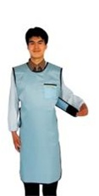
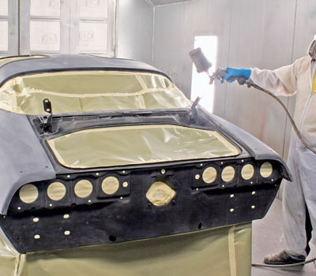
Principle 9. Preliminary Anti-Action

Slide 26
Principle 10. Preliminary Action
A. Perform, before it is needed, the required change of an object (either fully or partially).
Sterilize all instruments needed for a surgical procedure on a sealed tray.
Pre-pasted wall paper
B. Pre-arrange objects such that they can come into action from the most convenient place and without losing time for their delivery.
Kanban arrangements in a Just-In-Time factory
Flexible manufacturing cell

Slide 27
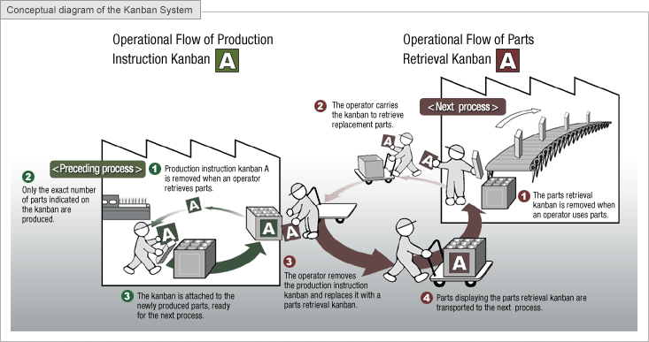
Principle 10. Preliminary Action

Slide 28
Principle 11. Beforehand Cushioning
A. Prepare emergency means beforehand to compensate for the relatively low reliability of an object.
Alternate air system for aircraft instruments
Back-up parachute

Slide 29
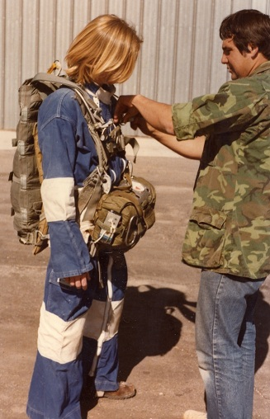
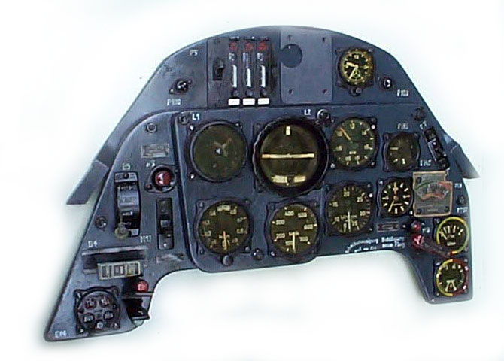
Principle 11. Beforehand Cushioning

Slide 30
Principle 12. Equi-potentiality
A. In a potential field, limit position changes (e.g. change operating conditions to eliminate the need to raise or lower objects in a gravity field)
"Skillets" in an automobile plant that bring all tools to the right position (also demonstrates Principle 10, Preliminary Action)
Locks in a channel between 2 bodies of water (Panama Canal)
Spring loaded parts delivery system in a factory

Slide 31
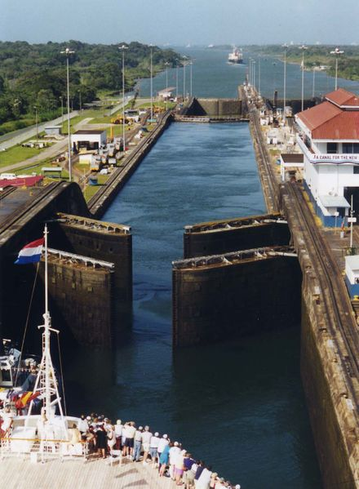
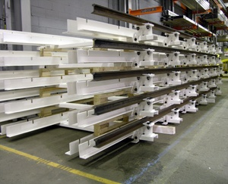
Principle 12. Equi-potentiality

Slide 32
Principle 13. “The Other Way Round”
A. Invert the action(s) used to solve the problem
To loosen stuck parts, cool the inner part instead of heating the outer part.
Bring the mountain to Mohammed, instead of bringing Mohammed to the mountain.
B. Make movable parts (or the external environment) fixed, and fixed parts movable.
Rotate the part instead of the tool.
Moving sidewalk with standing people
C. Turn the object (or process) 'upside down'.
Turn an assembly upside down to insert fasteners (especially screws).
Empty grain from containers (ship or railroad) by inverting them.

Slide 33
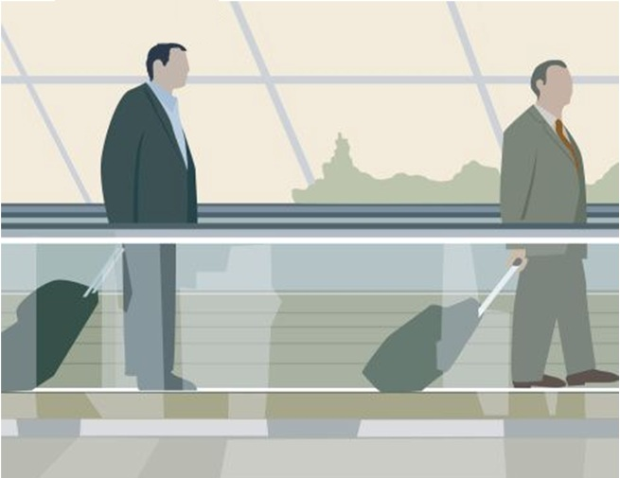
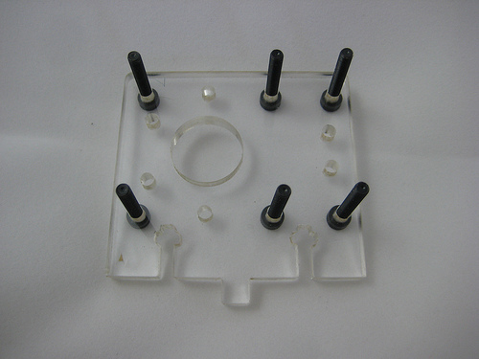
Principle 13. “The Other Way Round”

Slide 34
Principle 14. Spheroidality/Curvature
A. Instead of using rectilinear parts, surfaces, or forms, use curvilinear ones; move from flat surfaces to spherical ones; from parts shaped as a cube (parallelepiped) to ball-shaped structures.
Use arches and domes for strength in architecture.
B. Use rollers, balls, spirals, domes.
Spiral gear (Nautilus) produces continuous resistance for weight lifting.
Ball point and roller point pens for smooth ink distribution
C. Go from linear to rotary motion, use centrifugal forces.
Produce linear motion of the cursor on the computer screen using a mouse or a trackball.
Replace wringing clothes to remove water with spinning clothes in a washing machine.
Use spherical casters instead of cylindrical wheels to move furniture.

Slide 35
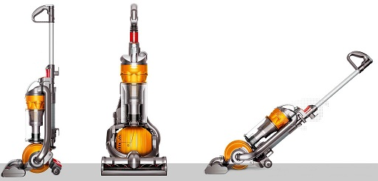
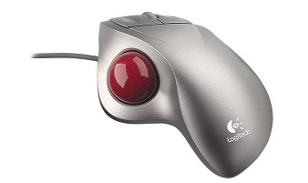
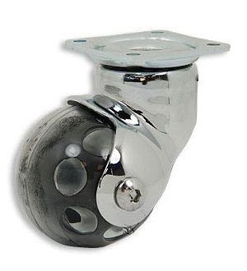
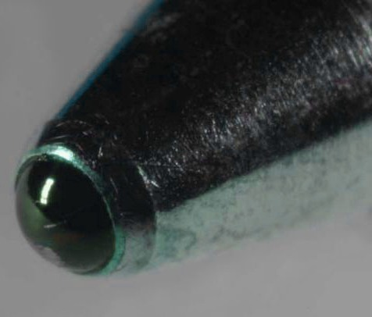
Principle 14. Spheroidality/Curvature

Slide 36
Principle 14. Spheroidality/Curvature

Slide 37
Principle 15. Dynamics
A. Allow (or design) the characteristics of an object, external environment, or process to change to be optimal or to find an optimal operating condition.
Adjustable steering wheel (or seat, or back support, or mirror position...)
B. Divide an object into parts capable of movement relative to each other.
The "butterfly" computer keyboard (also demonstrates Principle 7, "Nested doll")
C. If an object (or process) is rigid or inflexible, make it movable or adaptive.
The flexible borescope for examining engines
The flexible sigmoidoscope, for medical examination

Slide 38
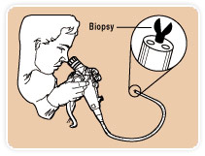
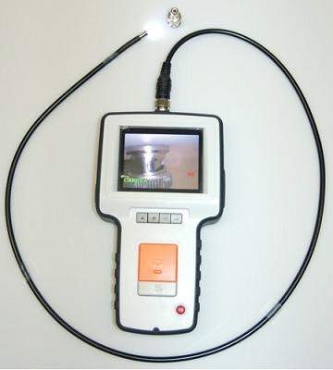
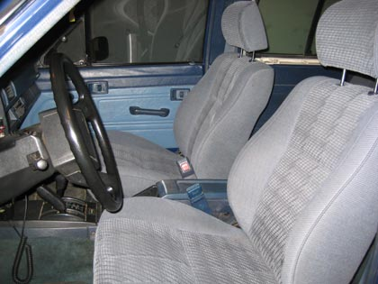
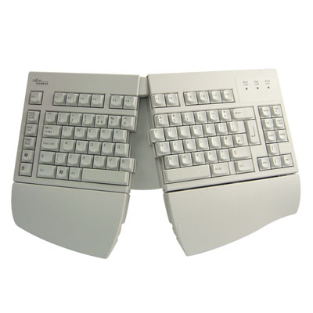
Principle 15. Dynamics

Slide 39
Principle 16. Partial or Excessive Actions
A. If 100 percent of an object is hard to achieve using a given solution method then, by using “slightly less” or “slightly more” of the same method, the problem may be considerably easier to solve.
Over spray when painting, then remove excess. (Or, use a stencil--this is an application of Principle 3, Local Quality and Principle 9, Preliminary anti-action).
Fill, then "top off" when filling the gas tank of your car.

Slide 40
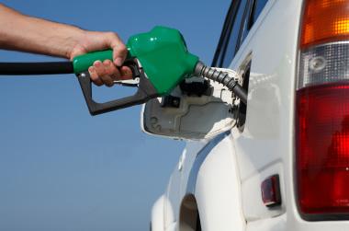
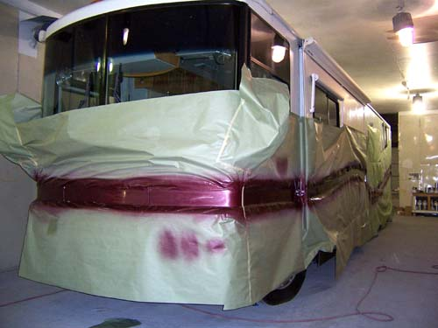
Principle 16. Partial or Excessive Actions

Slide 41
Principle 17. Another Dimension
A. To move an object in two- or three-dimensional space.
Infrared computer mouse moves in space, instead of on a surface, for presentations.
Five-axis cutting tool can be positioned where needed.
B. Use a multi-story arrangement of objects instead of a single-story arrangement.
Music player with 6 CD's to increase music time and variety
Electronic chips on both sides of a printed circuit board
C. Tilt or re-orient the object, lay it on its side.
Dump truck
D. Use 'another side' of a given area.
Stack microelectronic hybrid circuits to improve density.

Slide 42
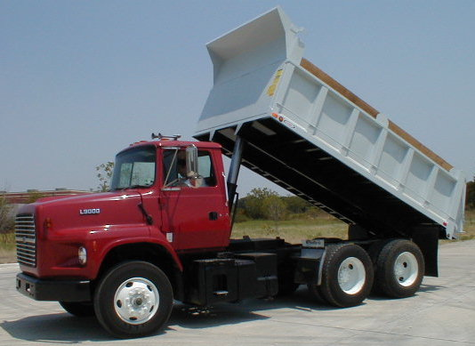
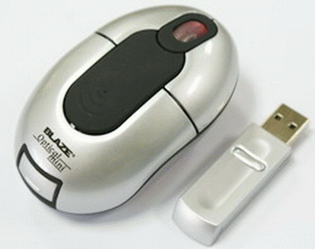
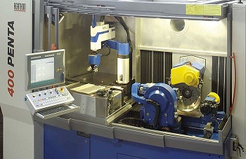
Principle 17. Another Dimension

Slide 43
Principle 18. Mechanical Vibration
A. Cause an object to oscillate or vibrate.
Electric carving knife with vibrating blades
B. Increase its frequency (even up to the ultrasonic).
Distribute powder with vibration.
C. Use an object's resonant frequency.
Destroy gall stones or kidney stones using ultrasonic resonance.
D. Use piezoelectric vibrators instead of mechanical ones.
Quartz crystal oscillations drive high accuracy clocks.
E. Use combined ultrasonic and electromagnetic field oscillations.
Mixing alloys in an induction furnace

Slide 44
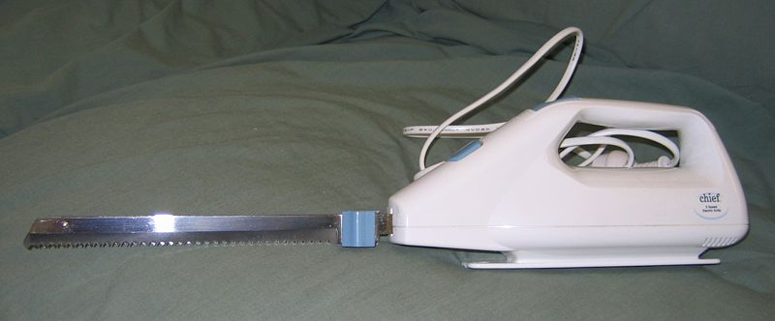
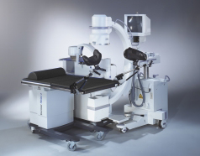
Principle 18. Mechanical Vibration

Slide 45
Principle 19. Periodic Action
A. Instead of continuous action, use periodic or pulsating actions.
Hitting something repeatedly with a hammer
Replace a continuous siren with a pulsed sound.
B. If an action is already periodic, change the periodic magnitude or frequency.
Use Frequency Modulation to convey information, instead of Morse code.
Replace a continuous siren with sound that changes amplitude and frequency.
C. Use pauses between impulses to perform a different action.
In cardio-pulmonary respiration (CPR) breathe after every 5 chest compressions.

Slide 46
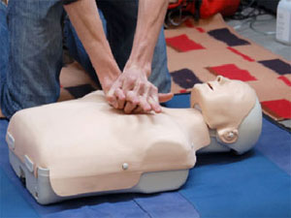
Principle 19. Periodic Action

Slide 47
Principle 20. Continuity of Useful Action
A. Carry on work continuously; make all parts of an object work at full load, all the time.
Flywheel (or hydraulic system) stores energy when a vehicle stops, so the motor can keep running at optimum power.
Run the bottleneck operations in a factory continuously, to reach the optimum pace.
B. Eliminate all idle or intermittent actions or work.
Print during the return of a printer carriage--dot matrix printer, daisy wheel printers, inkjet printers.

Slide 48
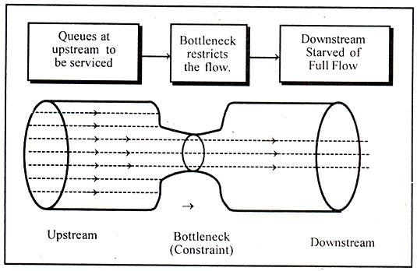
Principle 20. Continuity of Useful Action

Slide 49
Principle 21. Skipping
A. Conduct a process, or certain stages (e.g. destructible, harmful or hazardous operations) at high speed.
Use a high-speed dentist's drill to avoid heating tissue.
Cut plastic faster than heat can propagate in the material, to avoid deforming the shape.

Slide 50
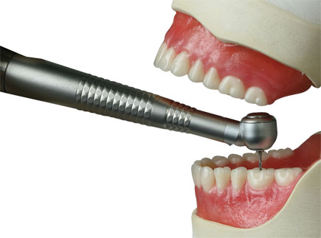
Principle 21. Skipping

Slide 51
Principle 22. “Blessing in disguise” or “Turn Lemons into Lemonade”
A. Use harmful factors (particularly, harmful effects of the environment or surroundings) to achieve a positive effect.
Recycle waste (scrap) material from one process as raw materials for another.
Use waste heat to generate electric power.
B. Eliminate the primary harmful action by adding it to another harmful action to resolve the problem.
Use a helium-oxygen mix for diving, to eliminate both nitrogen narcosis and oxygen poisoning from air and other nitrox mixes.
Amplify a harmful factor to such a degree that it is no longer harmful.
Use a backfire to eliminate the fuel from a forest fire.
Add a buffering material to a corrosive solution.

Slide 52
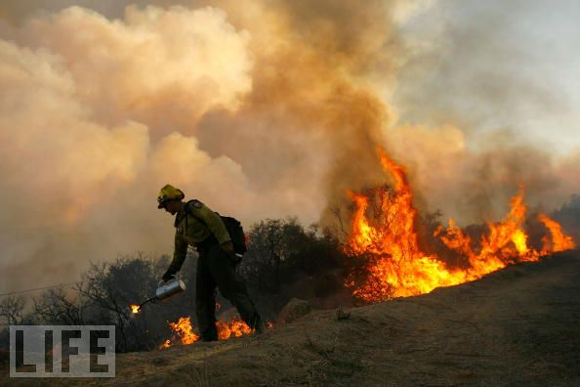
Principle 22. “Blessing in disguise” or “Turn Lemons into Lemonade”

Slide 53
Principle 23. Feedback
A. Introduce feedback (referring back, cross-checking) to improve a process or action.
Statistical Process Control (SPC) -- Measurements are used to decide when to modify a process. (Not all feedback systems are automated!)
Automatic volume control in audio circuits
Signal from gyrocompass used to control simple aircraft autopilots.
Budgets --Measurements are used to decide when to modify a process.
B. If feedback is already used, change its magnitude or influence.
Change sensitivity of a thermostat when cooling vs. heating, since it uses energy less efficiently when cooling.
Change a management measure from budget variance to customer satisfaction.
Change sensitivity of an autopilot when within 5 miles of an airport.

Slide 54
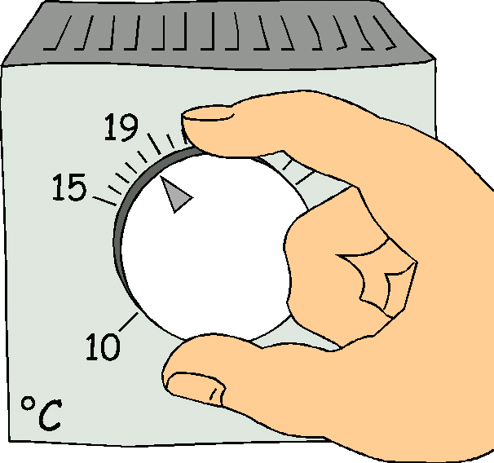
Principle 23. Feedback

Slide 55
Principle 24. “Intermediary”
A. Use an intermediary carrier article or intermediary process.
Carpenter's nailset, used between the hammer and the nail
B. Merge one object temporarily with another (which can be easily removed).
Pot holder to carry hot dishes to the table

Slide 56
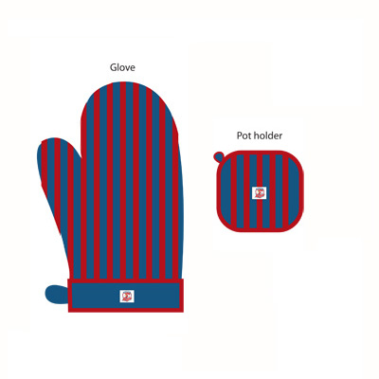
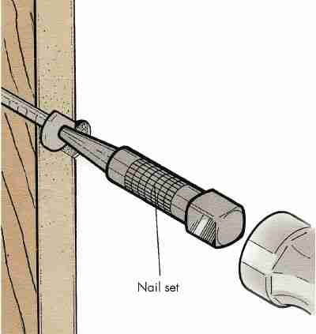
Principle 24. “Intermediary”

Slide 57
Principle 25. Self-service
A. Make an object serve itself by performing auxiliary helpful functions
To weld steel to aluminium, create an interface from alternating thin strips of the 2 materials. Cold weld the surface into a single unit with steel on one face and copper on the other, then use normal welding techniques to attach the steel object to the interface, and the interface to the aluminium. (This concept also has elements of Principle 24, Intermediary, and Principle 4, Asymmetry.)
A soda fountain pump that runs on the pressure of the carbon dioxide that is used to "fizz" the drinks. This assures that drinks will not be flat, and eliminates the need for sensors.
Halogen lamps regenerate the filament during use--evaporated material is re-deposited.
B. Use waste resources, energy, or substances.
Use heat from a process to generate electricity: "Co-generation".
Use animal waste as fertilizer.
Use food and lawn waste to create compost.

Slide 58
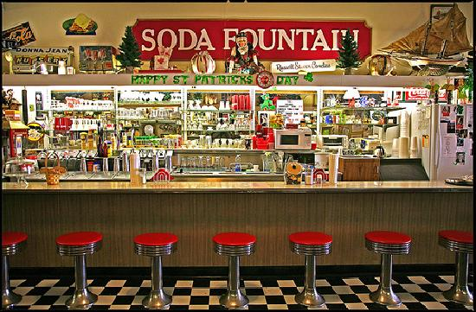
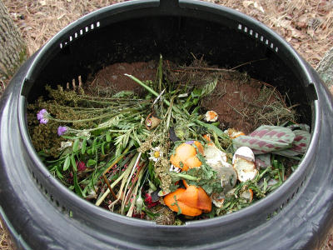
Principle 25. Self-service

Slide 59
Principle 26. Copying
A. Instead of an unavailable, expensive, fragile object, use simpler and inexpensive copies.
Virtual reality via computer instead of an expensive vacation
Listen to an audio tape instead of attending a seminar.
B. Replace an object, or process with optical copies.
Survey from space photographs instead of on the ground.
Measure an object by measuring the photograph.
C. If visible optical copies are already used, move to infrared or ultraviolet copies.
Make images in infrared to detect heat sources, such as diseases in crops, or intruders in a security system.

Slide 60
Principle 26. Copying

Slide 61
Principle 27. Cheap Short-Living Objects
A. Replace an inexpensive object with a multiple of inexpensive objects, comprising certain qualities (such as service life, for instance).
Use disposable paper objects to avoid the cost of cleaning and storing durable objects. Plastic cups in motels, disposable diapers, many kinds of medical supplies.

Slide 62
Principle 27. Cheap Short-Living Objects

Slide 63
Principle 28: Mechanics Substitution
A. Replace a mechanical means with a sensory (optical, acoustic, taste or smell) means.
Replace a physical fence to confine a dog or cat with an acoustic “fence” (signal audible to the animal).
Use a bad smelling compound in natural gas to alert users to leakage, instead of a mechanical or electrical sensor.
B. Use electric, magnetic and electromagnetic fields to interact with the object.
To mix 2 powders, electrostatically charge one positive and the other negative. Either use fields to direct them, or mix them mechanically and let their acquired fields cause the grains of powder to pair up.
C. Change from static to movable fields, from unstructured fields to those having structure.
Early communications used omni-directional broadcasting. We now use antennas with very detailed structure of the pattern of radiation.
D. Use fields in conjunction with field-activated (e.g. ferromagnetic) particles.
Heat a substance containing ferromagnetic material by using varying magnetic field. When the temperature exceeds the Curie point, the material becomes paramagnetic, and no longer absorbs heat.

Slide 64
Principle 28: Mechanics Substitution

Slide 65
Principle 29. Pneumatics and Hydraulics
A. Use gas and liquid parts of an object instead of solid parts (e.g. inflatable, filled with liquids, air cushion, hydrostatic, hydro-reactive).
Store energy from decelerating a vehicle in a hydraulic system, then use the stored energy to accelerate later.
Comfortable shoe sole inserts filled with gel

Slide 66
Principle 29. Pneumatics and Hydraulics

Slide 67
Principle 30. Flexible Shells and Thin Films
A. Use flexible shells and thin films instead of three dimensional structures
Use inflatable (thin film) structures as winter covers on tennis courts.
B. Isolate the object from the external environment using flexible shells and thin films.
Float a film of bipolar material (one end hydrophilic, one end hydrophobic) on a reservoir to limit evaporation.

Slide 68
Principle 30. Flexible Shells and Thin Films

Slide 69
Principle 30. Flexible Shells and Thin Films

Slide 70
Principle 31. Porous Materials
A. Make an object porous or add porous elements (inserts, coatings, etc.).
Drill holes in a structure to reduce the weight.
B. If an object is already porous, use the pores to introduce a useful substance or function.
Use a porous metal mesh to wick excess solder away from a joint.
Store hydrogen in the pores of a palladium sponge. (Fuel "tank" for the hydrogen car - much safer than storing hydrogen gas)

Slide 71
Principle 31. Porous Materials

Slide 72
Principle 32. Colour Changes
A. Change the colour of an object or its external environment.
Use safe lights in a photographic darkroom.
B. Change the transparency of an object or its external environment.
Use photolithography to change transparent material to a solid mask for semiconductor processing. Similarly, change mask material from transparent to opaque for silk screen processing.

Slide 73
Principle 32. Colour Changes

Slide 74
Principle 33. Homogeneity
A. Make objects interacting with a given object of the same material (or material with identical properties).
Make the container out of the same material as the contents, to reduce chemical reactions.
Make a diamond cutting tool out of diamonds.

Slide 75
Principle 33. Homogeneity

Slide 76
Principle 34. Discarding & Recovering
A. Make portions of an object that have fulfilled their functions go away (discard by dissolving, evaporating, etc.) or modify these directly during operation.
Use a dissolving capsule for medicine.
Sprinkle water on cornstarch-based packaging and watch it reduce its volume by more than 1000X!
Ice structures: use water ice or carbon dioxide (dry ice) to make a template for a rammed earth structure, such as a temporary dam. Fill with earth, then, let the ice melt or sublime to leave the final structure.
B. Conversely, restore consumable parts of an object directly in operation.
Self-sharpening lawn mower blades
Automobile engines that give themselves a "tune up" while running (the ones that say "100,000 miles between tune ups")

Slide 77
Principle 34. Discarding & Recovering

Slide 78
Principle 35. Parameter Changes
A. Change an object's physical state (e.g. to a gas, liquid, or solid).
Freeze the liquid centres of filled candies, then dip in melted chocolate, instead of handling the messy, gooey, hot liquid.
Transport oxygen or nitrogen or petroleum gas as a liquid, instead of a gas, to reduce volume.
B. Change the concentration or consistency.
Liquid hand soap is concentrated and more viscous than bar soap at the point of use, making it easier to dispense in the correct amount and more sanitary when shared by several people.
C. Change the degree of flexibility.
Use adjustable dampers to reduce the noise of parts falling into a container by restricting the motion of the walls of the container.
Vulcanize rubber to change its flexibility and durability.
D. Change the temperature.
Raise the temperature above the Curie point to change a ferromagnetic substance to a paramagnetic substance.
Raise the temperature of food to cook it. (Changes taste, aroma, texture, chemical properties, etc.)
Lower the temperature of medical specimens to preserve them for later analysis.

Slide 79
Principle 35. Parameter Changes

Slide 80
Principle 36. Phase Transitions
A. Use phenomena occurring during phase transitions (e.g. volume changes, loss or absorption of heat, etc.)
Water expands when frozen, unlike most other liquids. Hannibal is reputed to have used this when marching on Rome a few thousand years ago. Large rocks blocked passages in the Alps. He poured water on them at night. The overnight cold froze the water, and the expansion split the rocks into small pieces which could be pushed aside.
Heat pumps use the heat of vaporization and heat of condensation of a closed thermodynamic cycle to do useful work.

Slide 81
Principle 36. Phase Transitions

Slide 82
Principle 37. Thermal Expansion
A. Use thermal expansion (or contraction) of materials.
Fit a tight joint together by cooling the inner part to contract, heating the outer part to expand, putting the joint together, and returning to equilibrium.
B. If thermal expansion is being used, use multiple materials with different coefficients of thermal expansion.
The basic leaf spring thermostat: (2 metals with different coefficients of expansion are linked so that it bends one way when warmer than nominal and the opposite way when cooler.)

Slide 83
Principle 37. Thermal Expansion

Slide 84
Principle 38. Strong Oxidants
A. Replace common air with oxygen-enriched air.
Scuba diving with Nitrox or other non-air mixtures for extended endurance
B. Replace enriched air with pure oxygen.
Cut at a higher temperature using an oxy-acetylene torch.
Treat wounds in a high pressure oxygen environment to kill anaerobic bacteria and aid healing.
C. Expose air or oxygen to ionizing radiation.
D. Use ionized oxygen.
Ionize air to trap pollutants in an air cleaner.
E. Replace ozonized (or ionized) oxygen with ozone.
Speed up chemical reactions by ionizing the gas before use.

Slide 85
Principle 38. Strong Oxidants

Slide 86
Principle 39. Inert Atmosphere
A. Replace a normal environment with an inert one.
Prevent degradation of a hot metal filament by using an argon atmosphere.
B. Add neutral parts, or inert additives to an object.
Increase the volume of powdered detergent by adding inert ingredients. This makes it easier to measure with conventional tools.

Slide 87
Principle 39. Inert Atmosphere

Slide 88
Principle 40. Composite Materials
A. Change from uniform to composite (multiple) materials.
Composite epoxy resin/carbon fibre golf club shafts are lighter, stronger, and more flexible than metal. Same for airplane parts.
Fibreglass surfboards are lighter and more controllable and easier to form into a variety of shapes than wooden ones.

Slide 89
Principle 40. Composite Materials

Slide 90
Table of 39 Contradictions
TRIZ

Slide 91
Altshuller's Table of Contradicitons

Slide 92
Altshuller's Table of Contradicitons
Altshuller later developed a Matrix of Contradictions. Rows of the matrix indicate the 39 features that one typically wants to improve, such as speed, weight, accuracy of measurement and so on. Columns refer to typical undesired results. Each matrix cell points to principles that have been most frequently used in patents in order to resolve the contradiction.

Slide 93
Altshuller's Table of Contradicitons
For instance, to increase accuracy of measurement of machined balls without incurring in expensive microscopes and control equipment. The matrix cell in row "accuracy of measurement" and column "complexity of control" points to several principles, among them the Copying Principle, which states "Use a simple and inexpensive / optical / copy (with a suitable scale) instead of an object which is complex, expensive, fragile or inconvenient to operate".

Slide 94
Altshuller's Table of Contradicitons
From this general invention principle, the following idea might solve the problem: take a high-resolution image of the machined ball. A screen with a grid might provide the required measurement.

Slide 95
Altshuller's Table of Contradicitons

Slide 96
Altshuller's Table of Contradicitons

Slide 97
Altshuller's Table of Contradicitons

Slide 98
Altshuller's Table of Contradicitons

Slide 99
Altshuller's Table of Contradicitons

Slide 100
Altshuller's Table of Contradicitons
35

Slide 101
Principle 35. Parameter Changes
A. Change an object's physical state (e.g. to a gas, liquid, or solid).
Freeze the liquid centres of filled candies, then dip in melted chocolate, instead of handling the messy, gooey, hot liquid.
Transport oxygen or nitrogen or petroleum gas as a liquid, instead of a gas, to reduce volume.
B. Change the concentration or consistency.
Liquid hand soap is concentrated and more viscous than bar soap at the point of use, making it easier to dispense in the correct amount and more sanitary when shared by several people.
C. Change the degree of flexibility.
Use adjustable dampers to reduce the noise of parts falling into a container by restricting the motion of the walls of the container.
Vulcanize rubber to change its flexibility and durability.
D. Change the temperature.
Raise the temperature above the Curie point to change a ferromagnetic substance to a paramagnetic substance.
Raise the temperature of food to cook it. (Changes taste, aroma, texture, chemical properties, etc.)
Lower the temperature of medical specimens to preserve them for later analysis.

Slide 102
Altshuller's Table of Contradicitons

Slide 103
Altshuller's Table of Contradicitons
This table is a bit too
detailed, let’s break it
up into six parts.

Slide 104
Altshuller's Table of Contradicitons

Slide 105
Altshuller's Table of Contradicitons
Features to Improve #1-20 vs. Undesired Result #1-13.

Slide 106
Altshuller's Table of Contradicitons
Features to Improve #1-20 vs. Undesired Result #14-26.

Slide 107
Altshuller's Table of Contradicitons
Features to Improve #1-20 vs. Undesired Result #27-39.

Slide 108
Altshuller's Table of Contradicitons
Features to Improve #21-39 vs. Undesired Result #1-13.

Slide 109
Altshuller's Table of Contradicitons
Features to Improve #21-39 vs. Undesired Result #14-26

Slide 110
Altshuller's Table of Contradicitons
Features to Improve #21-39 vs. Undesired Result #27-39.

