Slide 1
George Pólya How to Solve It
Damian Gordon

Slide 2
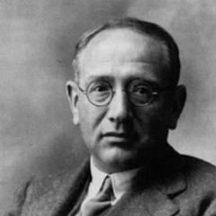
George Pólya (Pólya György)
Born December 13th, 1887, in Budapest.
Died September 7th, 1985 (aged 97)
A Hungarian mathematician and Problem Solver.
He made fundamental contributions to combinatorics, number theory, numerical analysis and probability theory.

Slide 3
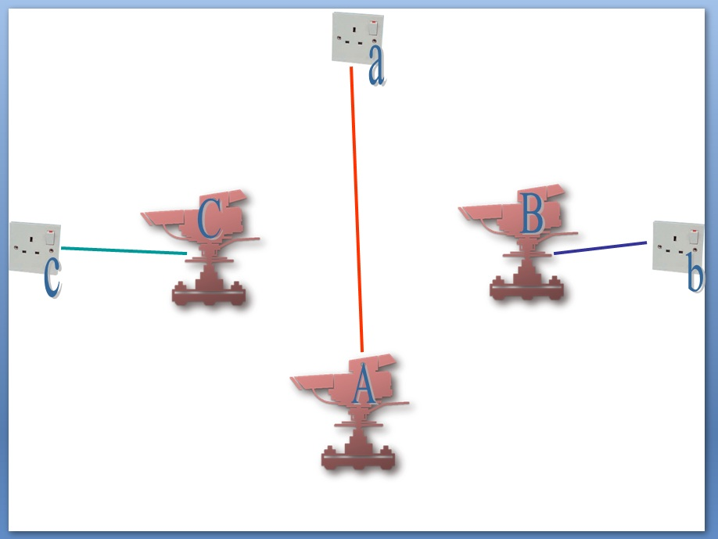
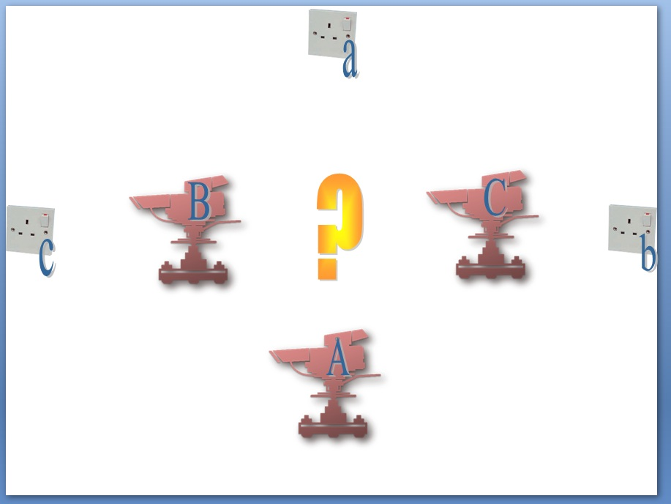
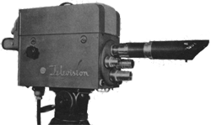
Polya’s Camera Problem

