Slide 1
Problem Solving, Communications & Innovation
Introduction to Module
Damian Gordon

Slide 2
Module Aims

Slide 3
To show you
a bunch of
Problem Solving
techniques

Slide 4
How Many Fs?
FINISHED FILES ARE THE RESULT OF YEARS OF SCIENTIFIC STUDY COMBINED WITH THE EXPERIENCE OF YEARS.

Slide 5
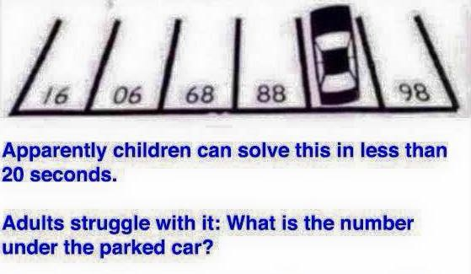

Slide 7
Learning Outcomes

Slide 8
Learning Outcomes
Brainstorm and organise questions related to problems
Apply a range of problem-solving techniques to fuzzily-defined problems and fluently generate potential solutions
Develop and justify strategies to employ appropriate problem-solving techniques to solve problems

Slide 9
Learning Outcomes
Illustrate the communication skills required
Apply the communication skills required
Work successfully independently and as part of a team

Slide 10
Learning Outcomes
Demonstrate an appreciation of different models of innovation
Explain how individuals and teams act as innovators
Discuss the role of innovation within an enterprise

Slide 11
Learning Outcomes
Discuss the major ethical issues in innovation and in the investigation and development of problems and solutions
Demonstrate an ability to employ ethics in the development of problem solving strategies for problems
Monitor and evaluate their progress as reflective practitioners and problem solvers.

Slide 12
Syllabus

Slide 13
Syllabus
Lateral Thinking Approaches:
Six Hats (de Bono)
CoRT Techniques (de Bono)
MindMapping (Buzan)
Polya’s Heurisitcs

Slide 14
Syllabus
Problem Solving:
Brainstorming
Critical Path Analysis
Root Cause Analysis
Decision Trees
Force Field Analysis
SWOT Analysis
Contingency Diagramming
Leapfrogging

Slide 15
Syllabus
Advanced Approaches to Problems:
Deductive and Inductive Reasoning
Reflective Practice
Systems Thinking (Senge)

Slide 16
Syllabus
Innovation
Understand the concept of innovation.
Demonstrate how innovation creates competitive advantage.
Discuss the future of innovation.

Slide 17
Syllabus
Communication
Interpersonal dynamics.
Leadership.
Team working.
Human diversity.
Planning, preparation and delivery of presentations.
Professional ethics and conduct

Slide 18
Assessment

Slide 19
Assessment
Continuous assessment will comprise 100% of the marks for this module.
There will be two assignments; the first is an individual assignment which will be given to you next week and is due on the last class, the second assignment will take place in the last class, and is a group assignment.

Slide 20
Assessment
Assignment #1 is due on the 14th of March 2025.

Slide 21
Recommended Reading

Slide 22
Reading
We will take bits and pieces from a while range of books, articles etc
Don’t worry about buying anything for now
Here are some of the books we will take bits from:

Slide 23
Four People Crossing a Bridge

Slide 24
Four People Crossing a Bridge
There are four people who would all like to cross a rickety old bridge. (Perhaps it is more accurate to say that they'd like to get to the other side.) The old bridge will only support 2 people at a time, and it is night time, so every crossing must use the one flashlight that they all share. The four people each have different walking speeds; the fastest each of them can cross is 1 minute, 2 minutes, 5, minutes, and 10 minutes. If they pair up, since they must share the flashlight, they can only cross in the time that it would take the slower of the two. Given that the shortest time to get them all across is 17 minutes total, how should they all cross?

