Slide 1
Problem Solving,
Assignment #2
Group Name

Slide 2
Names of Group Members
XXXXXXXXXXXXXXXXXXX
XXXXXXXXXXXXXXXXX
XXXXXXXXXXXXXXXXXXX
XXXXXXXXXXXXXXXXX
XXXXXXXXXXXXXXXXXXX
XXXXXXXXXXXXXXXXX
XXXXXXXXXXXXXXXXXXX
XXXXXXXXXXXXXXXXX
XXXXXXXXXXXXXXXXXXX
XXXXXXXXXXXXXXXXX
XXXXXXXXXXXXXXXXXXX
XXXXXXXXXXXXXXXXX

Slide 3
Pic of Group

Slide 4
Topic of Discussion
FULL DESCRIPTION OF TOPIC
(10-15 Words)

Slide 5
How was it in the Room 1?
ZZZZZZZZZZZZZ
ZZZZZZZZZZZZZZZ
ZZZZZZZZZZZZZZZZZZZZZZZZZZZZZZ

Slide 6
How was it in the Room 2?
ZZZZZZZZZZZZZ
ZZZZZZZZZZZZZZZ
ZZZZZZZZZZZZZZZZZZZZZZZZZZZZZZ

Slide 7
Creativity Techniques chosen
Tech1
Tech2
Tech3

Slide 8
Tech 1
Pic of
Whiteboard
or Paper notes

Slide 9
Tech 2
Pic of
Whiteboard
or Paper notes

Slide 10
Tech 3
Pic of
Whiteboard
or Paper notes

Slide 11
Doing the Techniques
How did you divide up the techniques, did everyone work on all parts or did you divide the group?
Who took notes?
How were decisions made?

Slide 12
Most Effective Technique
TECH was the most effective because:
Xxxxxxxxxxxxxxxxxxxxxxxxxxxxxx
Xxxxxxxxxxxxxxxxxxxxxxxxxxxxxx

Slide 13
Least Effective Technique
TECH was the least effective because:
Xxxxxxxxxxxxxxxxxxxxxxxxxxxxxx
Xxxxxxxxxxxxxxxxxxxxxxxxxxxxxx

Slide 14
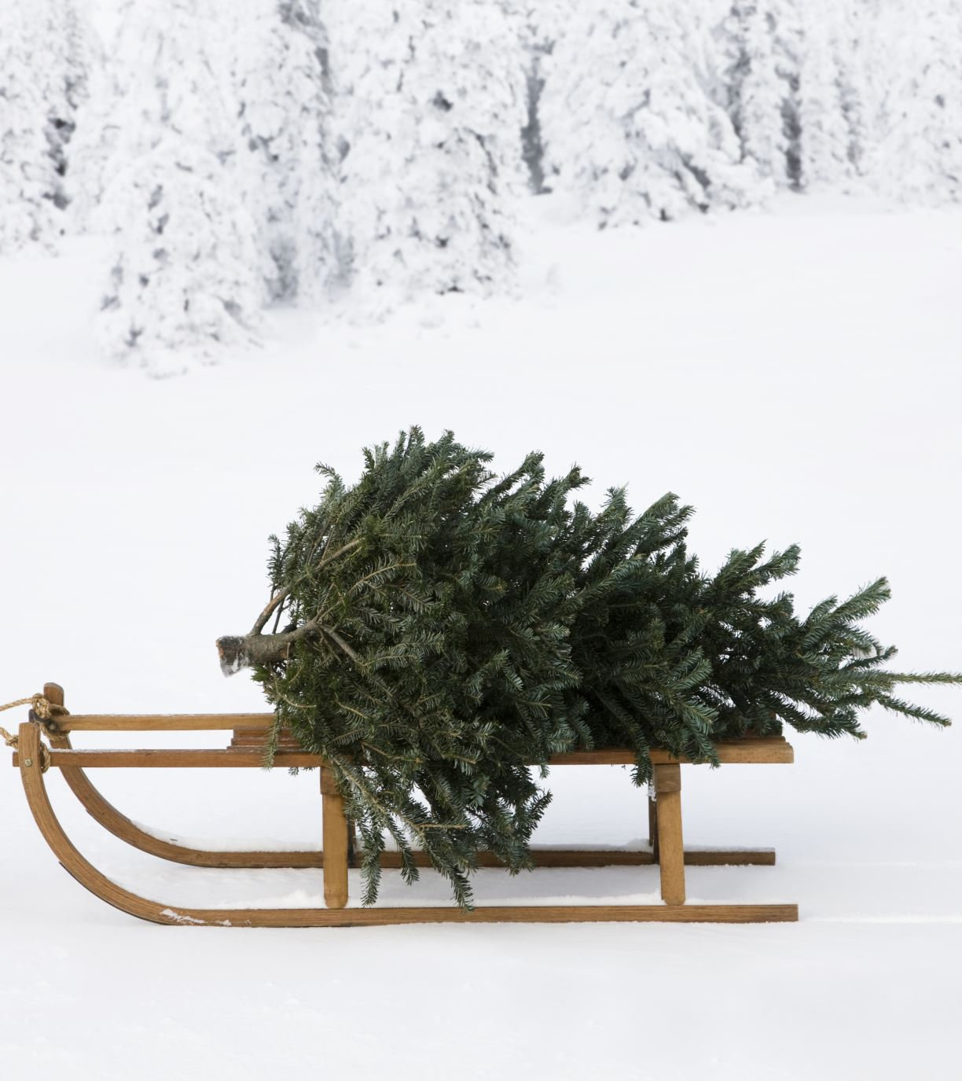
Decision Taken
(NOT)
CANCEL
CHRISTMAS

Slide 15
Reasons:
1.XXXXXXXXXXXXXXXXXXXXXXXXX
2.XXXXXXXXXXXXXXXXXXXXXXXXX
3.XXXXXXXXXXXXXXXXXXXXXXXXX
4.XXXXXXXXXXXXXXXXXXXXXXXXX

