Slide 1
Names of Group Members
Sohini Das(D18123624)
Swathi MaheshKumar Geetha(D18123606)
Pooja Sarath Suvarna(D17129910)
Esra Aynali(D17124854)
Aleksandra Turanjanin(D18123494)
Yifan li(D17125528)
Suha Shaheen(D15127871)
Arshdeep Kaur(D18125470)
Netra Jayakumar(D17129768)
Sowmya Damodaran(D17129113)
Maria Sussan(D17129869)
Priyam Bansal(D17129566)
Aleena Sara Mathew(D17129866)
Ming Tang(D18125356)
Ruiqi Li(D18125180)

Slide 2
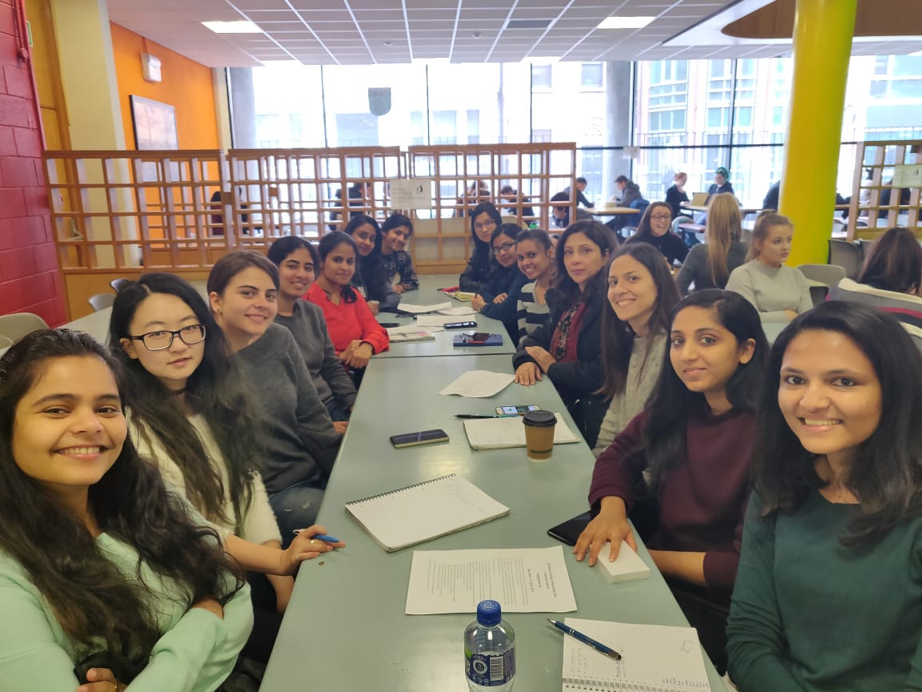

Slide 3
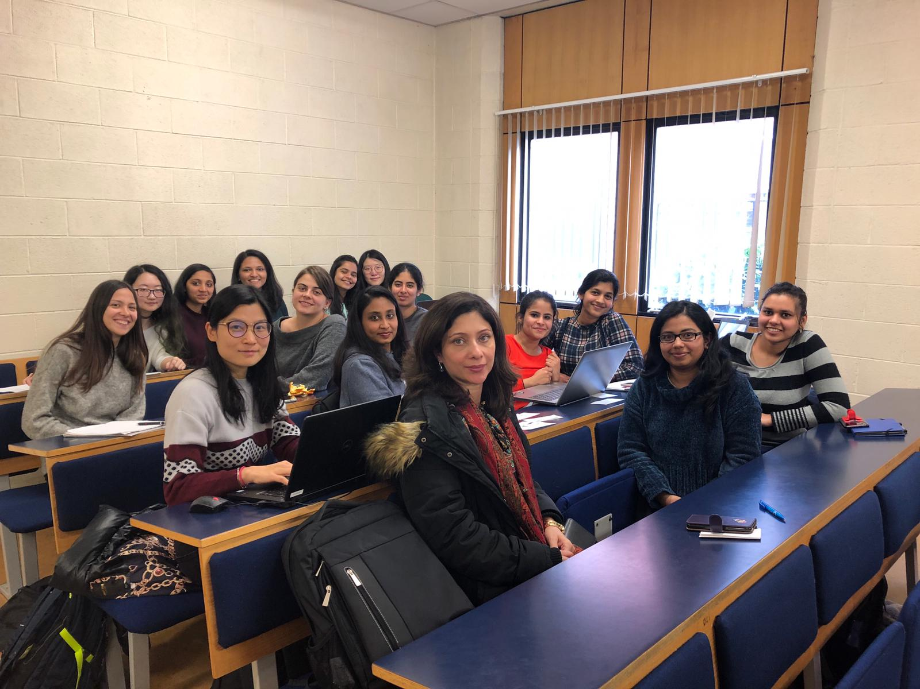

Slide 4
Topic of Discussion
Cancellation of Christmas in recognition of ongoing recession

Slide 5
How was it in the Canteen
Noisy
Distracted because people were eating and speaking
Everyone's thinking about coffee and lunch

Slide 6
How was it in the classroom?
Too quiet
Very boring
Difficult to communicate with rest of the team

Slide 7
Creativity Techniques choosen
Six Thinking Hats
PMI
CAF
Random Words

Slide 8
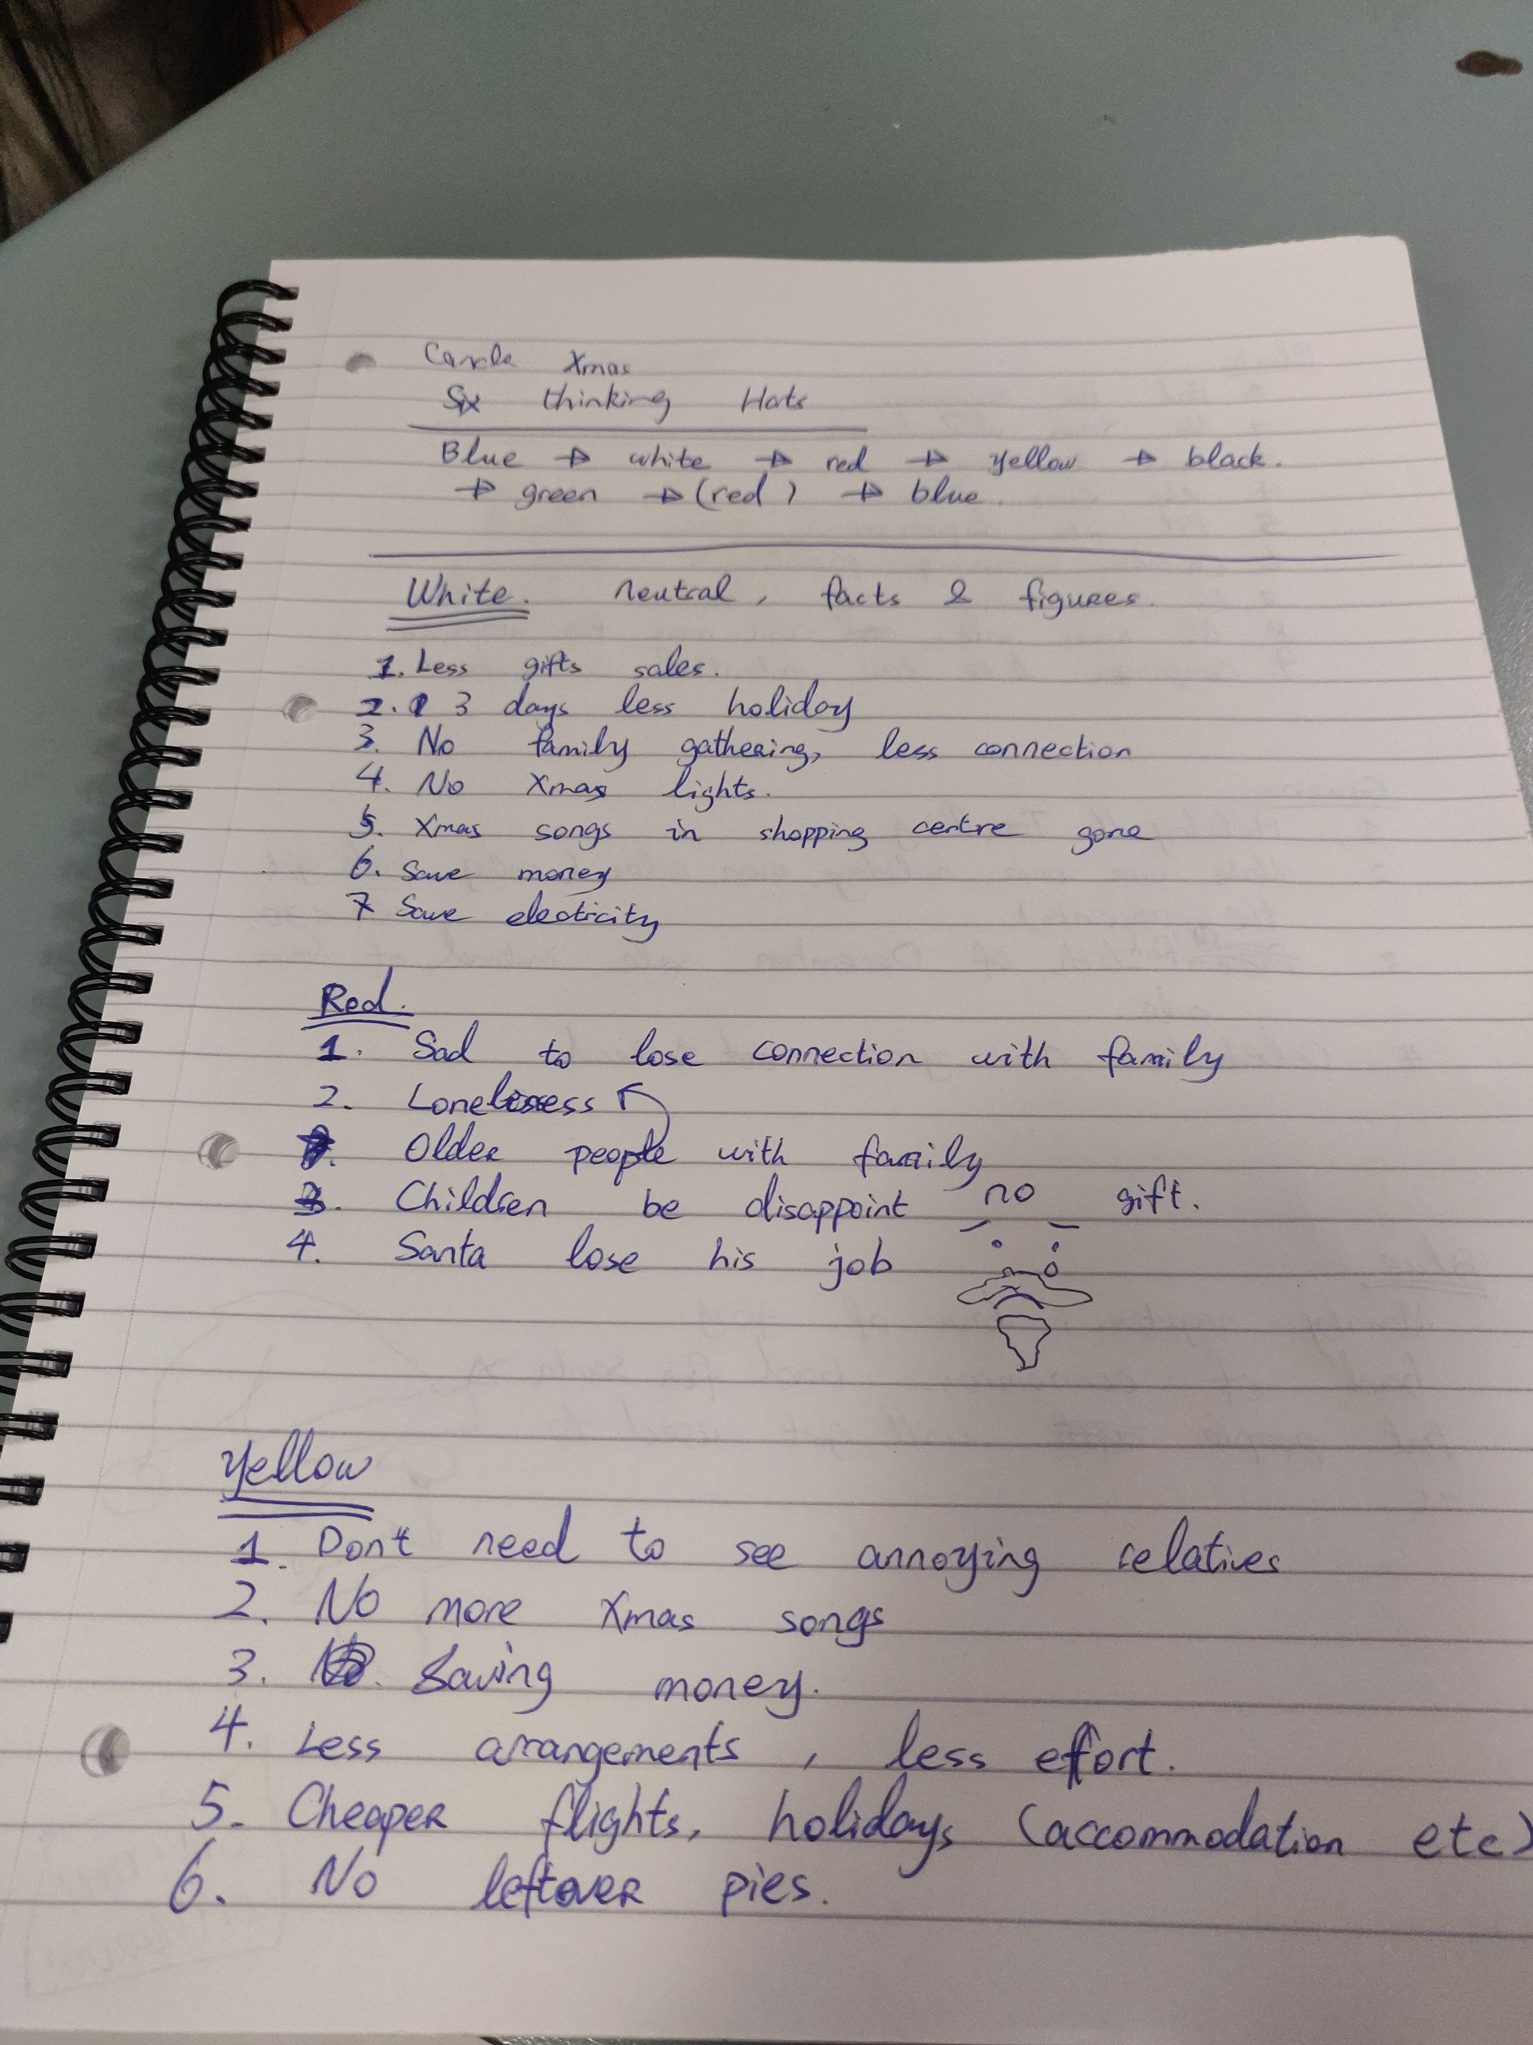
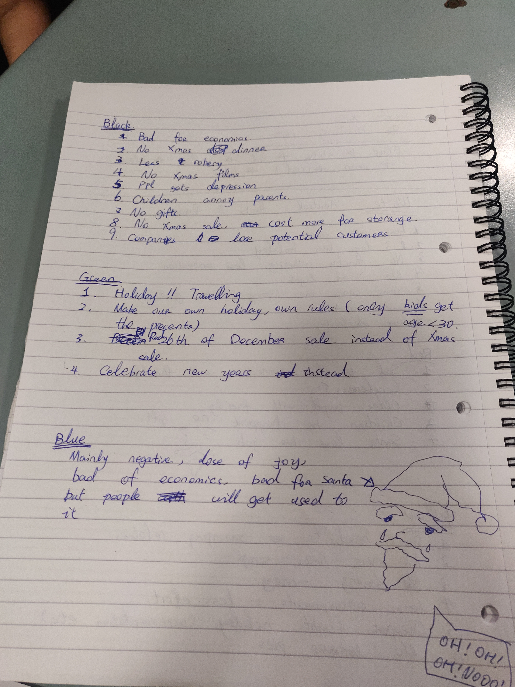
Six Thinking Hats

Slide 9
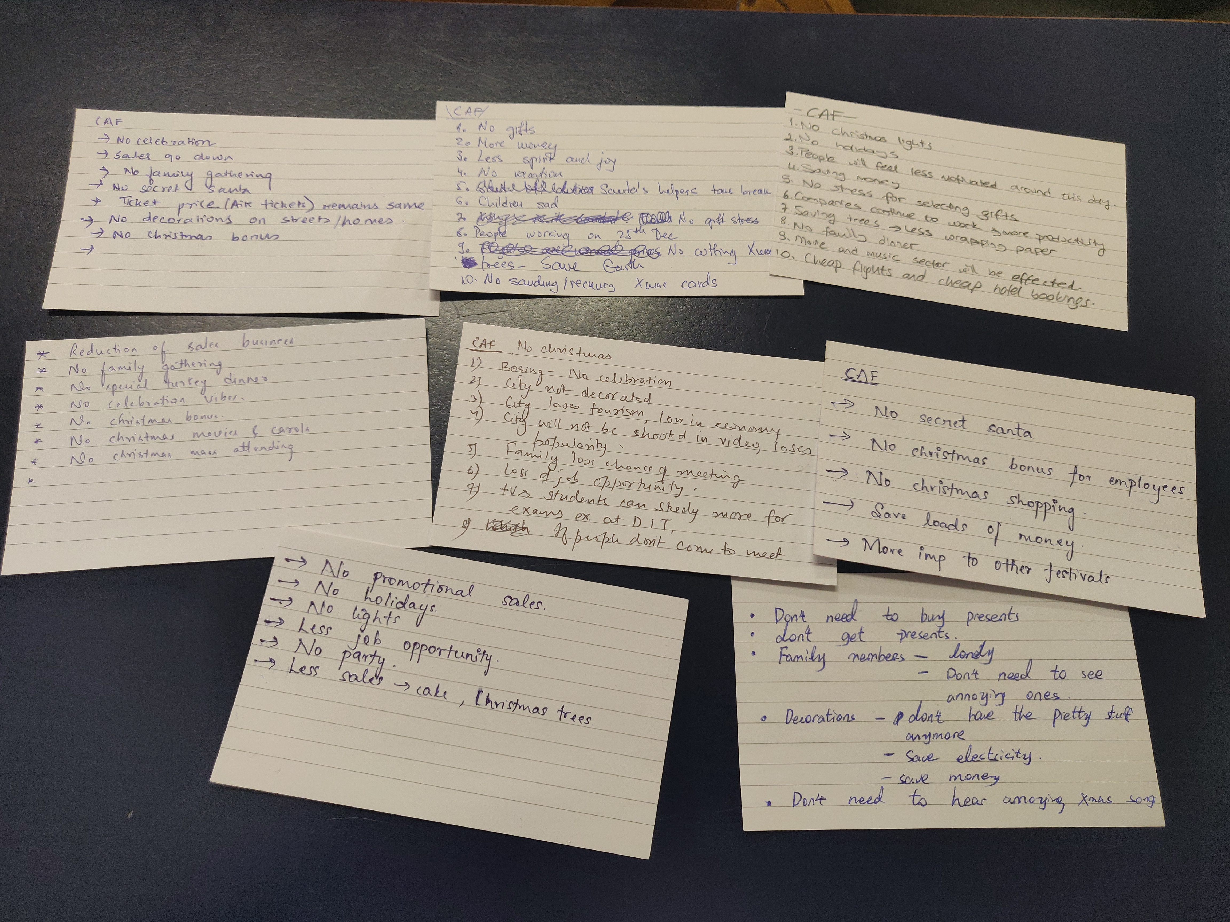
CAF

Slide 10
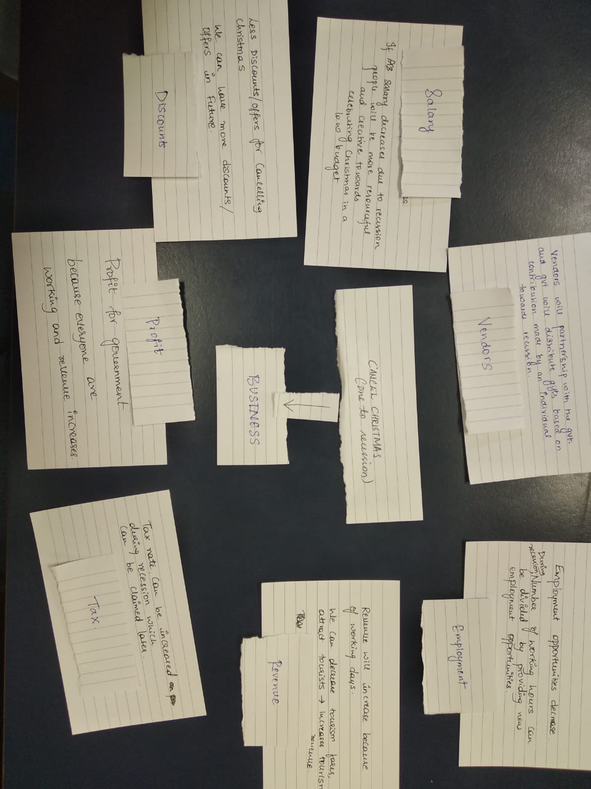
Random Words

Slide 11
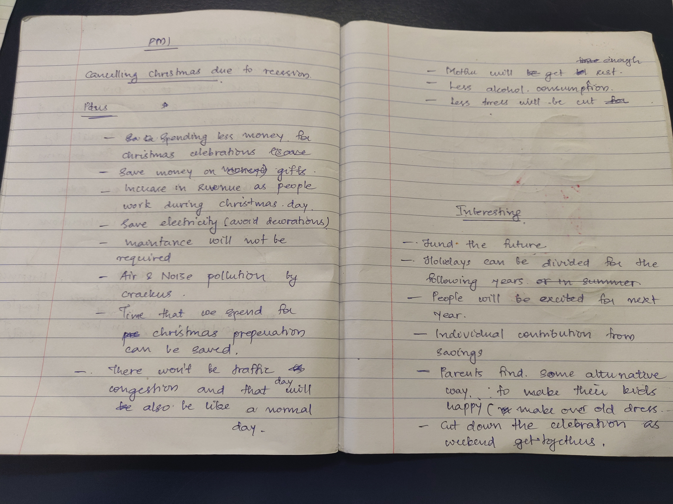
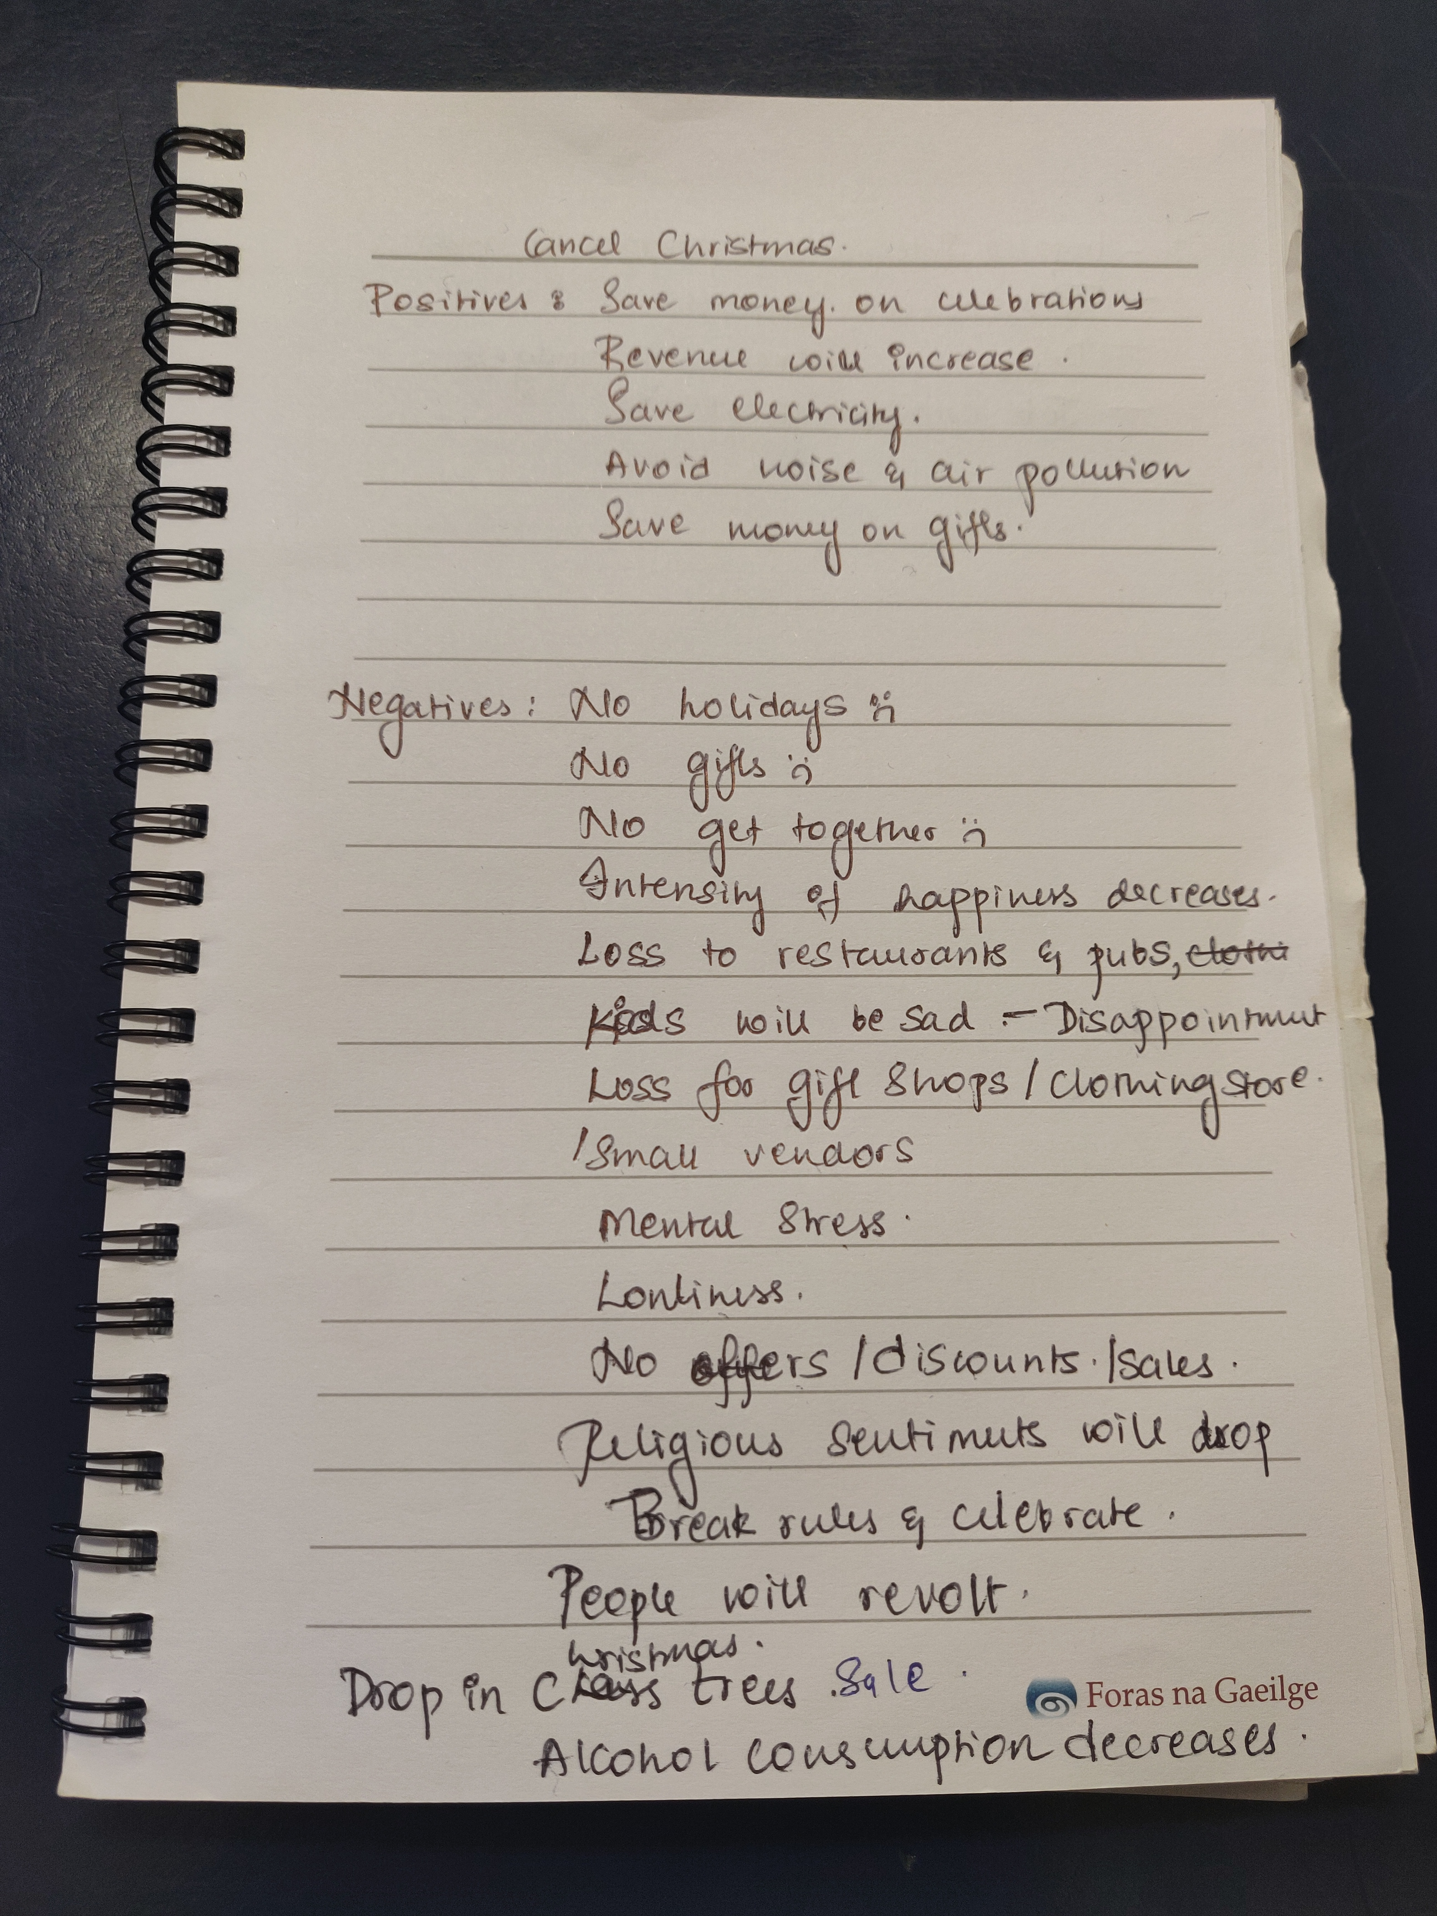
PMI

Slide 12
Deciding of Techniques
Divided the group into two and did majority voting to list down the techniques

Slide 13
Most Effective: Random Words * Could think ideas out of box * Direct solutions were derived

Slide 14
Least Effective: CAF * Difficult to come up for any conclusion

Slide 15
Decisions taken
Christmas is not only about spending, its more about happiness and family get together so we can celebrate christmas with low budget and no impact on recession by celebrating it in weekends

Slide 16
Ideas/Reasons/Alternatives
Individual contributions towards recession can be rewarded
Government in profit since people are contributing
Vendors can become partners with government, then government can distribute gifts based in contribution made by an individual towards recession
Happiness of people will be retained
Number of working hours will be more which can be divided by providing new employment oppurtunities
Tourism fares can be decreased to attract more tourists which leads to increase in tourism

