Slide 1

James Bond and the Open Systems Interconnection (OSI) Model
Damian Gordon

Slide 2
WARNING:
This presentation contains some mild *spoilers* for “Skyfall” and major *spoilers* for network transmission protocols. Proceed with caution.

Slide 3

James Bond has had many faces
And now…

Slide 4
YOU are James Bond

Slide 5
You have been summoned to Vauxhall House (Home of MI5) for a new mission.

Slide 6
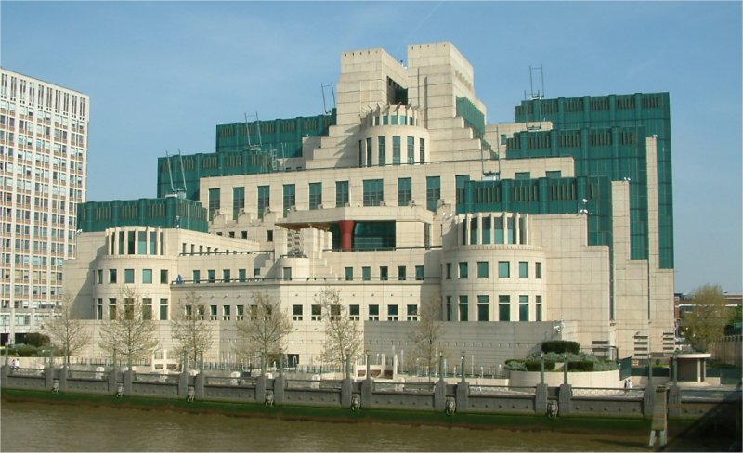

Slide 7
The building says “Universal Exports Ltd.” on the outside, that’s the cover business.

Slide 8


Slide 9
Here’s a plan of the building:

Slide 11
7th Floor – M.
6th Floor – Q Branch
5th Floor – Bill Tanner
4th Floor – Ms. Moneypenny
3rd Floor – Loelia Ponsonby
2nd Floor – John Strangways
1st Floor – Garage

Slide 12
You head straight up to the 7th floor, to M.’s office.

Slide 13
You knock at the door, and M. says “Come in”.

Slide 14

7th Floor

Slide 15
7th Floor
This is M,
your boss.
He can be grumpy.

Slide 16
7th Floor
M. says “Ah, Bond, this is a secret message that you must get through to the US Embassy across town”
XXXXXXX
XXXXXXX
XXXXXXX
XXXXXXX

Slide 17
7th Floor
M. says “Ah, Bond, this is a secret message that you must get through to the US Embassy across town”
You say “Yes, sir.”
XXXXXXX
XXXXXXX
XXXXXXX
XXXXXXX

Slide 18
7th Floor
M. says “Ah, Bond, this is a secret message that you must get through to the US Embassy across town”
You say “Yes, sir.”
M. says “Now pop downstairs to Q Branch”.
XXXXXXX
XXXXXXX
XXXXXXX
XXXXXXX

Slide 19
7th Floor
M. says “Ah, Bond, this is a secret message that you must get through to the US Embassy across town”
You say “Yes, sir.”
M. says “Now pop downstairs to Q Branch”.
You say “Yes, sir.”
XXXXXXX
XXXXXXX
XXXXXXX
XXXXXXX

Slide 20
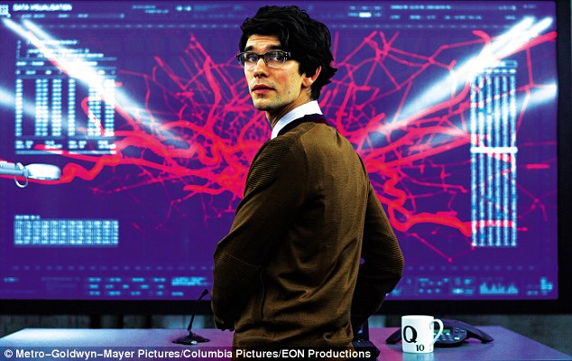
6th Floor

Slide 21
6th Floor
This is Q, your quartermaster.
He provides you with gadgets.

Slide 22
6th Floor
Q says “Pay attention, 007. I’ve translated the message into an intermediary language, and also, encrypted and miniaturized the message.”
Codecode
Codecode
Codecode
Codecode
Code
Code
Code

Slide 23
6th Floor
Q says “Pay attention, 007. I’ve translated the message into an intermediary language, and also, encrypted and miniaturized the message.”
You say “Thank you, Q, I’m familiar with standard message conversion protocol”.
Codecode
Codecode
Codecode
Codecode
Code
Code
Code

Slide 24
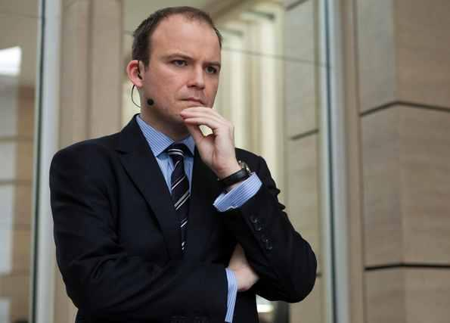
5th Floor

Slide 25
5th Floor
This is Bill Tanner, the Chief-of-staff at MI5.
He’s a good mate and golfing buddy.

Slide 26
5th Floor
Bill Tanner says “James, I’ve done all the security checks on the message, and checked it to be sure it’s all there. I’ve also put in some checkpoints in the message so your counterpart at the US end can be sure he’s got the whole message”.
Code
Code
Code
Code[x]
Code[x]
Code[x]

Slide 27
5th Floor
Bill Tanner says “James, I’ve done all the security checks on the message, and checked it to be sure it’s all there. I’ve also put in some checkpoints in the message so your counterpart at the US end can be sure he’s got the whole message”.
You say “Cheers, Bill. Let’s have a round of golf this weekend at Sunningdale”.
Code
Code
Code
Code[x]
Code[x]
Code[x]

Slide 28

4th Floor

Slide 29
4th Floor
This is Eve Moneypenny, M.’s secretary.

Slide 30
4th Floor
Miss Moneypenny: “James, why are you so late?”
Code[x]
Code[x]
Code[x]
Code[x]
Code[x]
Code[x]
Code[x]
Code[x]
Code[x]

Slide 31
4th Floor
Miss Moneypenny: “James, why are you so late?”
You: “I fell out of an airplane without a parachute”.
Code[x]
Code[x]
Code[x]
Code[x]
Code[x]
Code[x]
Code[x]
Code[x]
Code[x]

Slide 32
4th Floor
Miss Moneypenny: “James, why are you so late?”
You: “I fell out of an airplane without a parachute”.
Miss Moneypenny: “James, I’ve analysed the message to see if it could be combined with some other small messages that need to go to the US end. And it’s been combined with two others”.
Code[x]
Code[x]
Code[x]
Code[x]
Code[x]
Code[x]
Code[x]
Code[x]
Code[x]

Slide 33

3rd Floor

Slide 34
3rd Floor
This is Loelia Ponsonby, your secretary.
She is also secretary to 008 and 0011.

Slide 35

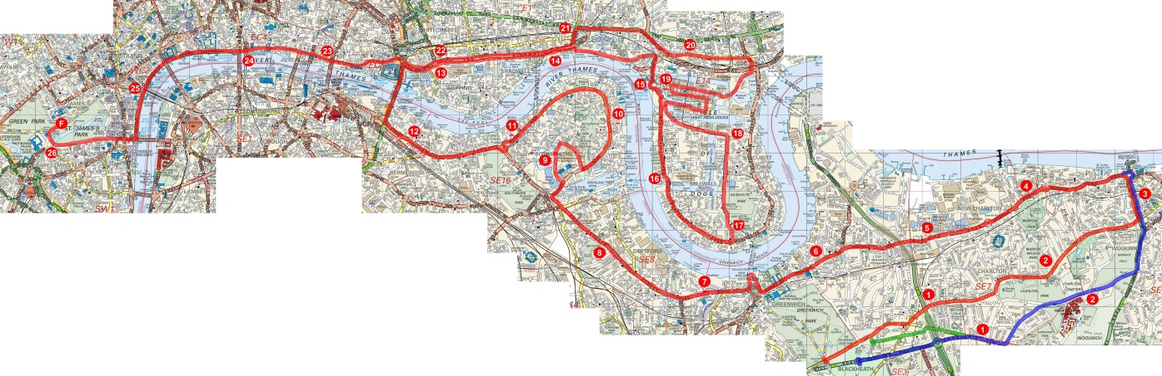
3rd Floor
Loelia: “James, I’ve checked the address on the message to determine the addressee, and here’s my advice on the fastest route to the Embassy”.

Slide 36
3rd Floor
Loelia: “James, I’ve checked the address on the message to determine the addressee, and here’s my advice on the fastest route to the Embassy”.
You: “Thank you, Loelia”.

Slide 37
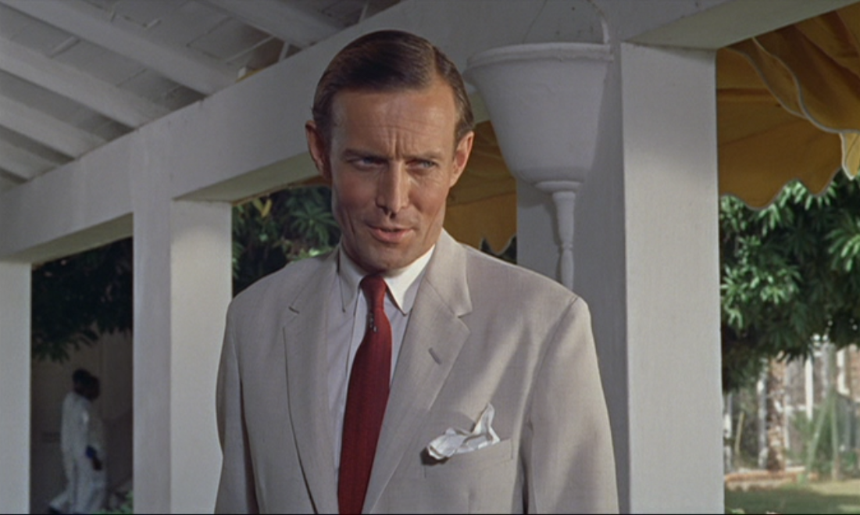
2nd Floor

Slide 38
2nd Floor
This is John Strangways, Chief Secret Service agent in the Caribbean.

Slide 39


2nd Floor
John Strangways: “James, I’ve put your messages into a special MI5 courier pouch. It contains the messages, the sender, and destination ID. The pouch also warns the recipient if other pieces are still coming”.

Slide 40
2nd Floor
John Strangways: “James, I’ve put your messages into a special MI5 courier pouch. It contains the messages, the sender, and destination ID. The pouch also warns the recipient if other pieces are still coming”.
You: “Thanks, John”.

Slide 41

1st Floor

Slide 42
1st Floor
This is you car.
It’s cool

Slide 43

1st Floor
Q has prepared your Aston Martin for the trip to the Embassy. You depart for the US Embassy with the secret packet in hand.

Slide 44
7th Floor: M.’s Office
6th Floor: Q Branch Headquarters
5th Floor: Chief-of-Staff, Bill Tanner
4th Floor: Ms. Moneypenny
3rd Floor: Loelia Ponsonby
2nd Floor: John Strangways
1st Floor: Garage

Slide 45
7th Floor: M.’s Office
Send the message
6th Floor: Q Branch Headquarters
Encryption and Miniaturisation
5th Floor: Chief-of-Staff, Bill Tanner
Checkpoints and Checks
4th Floor: Ms. Moneypenny
Combining messages
3rd Floor: Loelia Ponsonby
Finding the best route
2nd Floor: John Strangways
Packaging the message
1st Floor: Garage
Conveying the message

Slide 46
THE END
You, James Bond,
will return in…

Slide 47
THE END
“Untitled James Bond Movie 25”

Slide 48
Open Systems Interconnection Model
The Open Systems Interconnection (OSI) Model is a 7-layer model that allows us to picture what happens when we send a message from one computer to another.
Let’s imagine we are sending an e-mail from one machine to another.

Slide 49
Application Layer
Presentation Layer
Session Layer
OSI
Model
Transport Layer
Network Layer
Data Link Layer
Physical Layer

Slide 50
Application Layer
Application Layer
When you send an e-mail, it looks like it goes from your application (e.g. Thunderbird), to their application.

Slide 51
Application Layer
Application Layer
When you send an e-mail, it looks like it goes from your application (e.g. Thunderbird), to their application.
But in reality it’s sent as a series of binary values, 1s and 0s.

Slide 52
Application Layer
Application Layer
When you send an e-mail, it looks like it goes from your application (e.g. Thunderbird), to their application.
But in reality it’s sent as a series of binary values, 1s and 0s.
Physical Layer
Physical Layer
11001001 11001001 1100100111001001

Slide 53
Application Layer
Application Layer
When you send an e-mail, it looks like it goes from your application (e.g. Thunderbird), to their application.
But in reality it’s sent as a series of binary values, 1s and 0s.
And there are layers in between.
Physical Layer
Physical Layer
11001001 11001001 1100100111001001

Slide 54
Application Layer
Application Layer
Intermediate
Layers
Intermediate
Layers
Physical Layer
Physical Layer
11001001 11001001 1100100111001001

Slide 55
Application Layer
Application Layer
Presentation Layer
Presentation Layer
Session Layer
Session Layer
Transport Layer
Transport Layer
Network Layer
Network Layer
Data Link Layer
Data Link Layer
Physical Layer
Physical Layer
11001001 11001001 1100100111001001

Slide 56
Application Layer
Application, e.g. Thunderbird, Chrome
Presentation Layer
Presentation, e.g. HTTPS, encryption
Session Layer
Starts and ends sessions
Transport Layer
Defines Ports and Reliability
Network Layer
IP Addressing and best route
Data Link Layer
Switches and MAC Addressing
Physical Layer
Cable and Network cards.

Slide 57
7th Layer
The Application Layer
This layer is at the same layer as the user sending the e-mail (or using the e-mail application), this layer focuses on identifying communication partners, determining resource availability, and synchronizing communication.

Slide 58
6th Layer
The Presentation Layer
This layer provides independence from data representation (e.g., encryption) by translating between application and network formats. The presentation layer transforms data into the form that the application accepts. This layer formats and encrypts data to be sent across a network.

Slide 59
5th Layer
The Session Layer
This layer establishes, manages and terminates the connections between the applications. It establishes checkpointing, adjournment, termination, and restart procedures.

Slide 60
4th Layer
The Transport Layer
This layer controls the reliability of a given link through flow control, segmentation, and error control. Some protocols are state- and connection-oriented. This means that the transport layer can keep track of the segments and retransmit those that fail.

Slide 61
3rd Layer
The Network Layer
This layer helps the nodes in the network that are connected to it to transfer messages to other nodes by providing the content of a message and the address of the destination node and letting the network find the way to deliver ("route") the message to the destination node.

Slide 62
2nd Layer
The Data Link Layer
This layer provides a reliable link between two directly connected nodes, by detecting and possibly correcting errors that may occur in the lower layer.

Slide 63
1st Layer
The Physical Layer
This layer defines the electrical and physical specifications of the data connection. It defines the relationship between a device and a physical transmission medium (e.g., a copper or fiber optical cable).

