Slide 1
Operating Systems 1: 2018-2019 News
Damian Gordon

Slide 2
Contents
Windows 10
Android 9
iOS 12
macOS 10.14
Linux 5

Slide 3
Windows 10.5
NEW RELEASE: Version 1809 (Redstone 5)
RELEASE DATE: November 13th 2018
KEY CHANGES:
More features for Windows on phones
Changes to File Explorer tool
Window Security improvements
Added Network Support

Slide 4
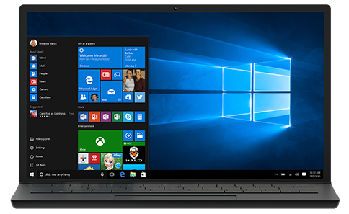
Windows 10.5

Slide 5
Windows 10.5
On October 6, 2018, Microsoft halted the public rollout of the update due to a serious bug that deletes user's files after updating.
On October 9, 2018, Microsoft re-released the update, stating that all known issues in the update (including file deletion bug) was identified and fixed.
On October 25, 2018, Microsoft confirmed the existence of another bug which overwrites files without any confirmation when extracting from a ZIP file.
The ZIP bug was fixed on October 30, 2018.

Slide 6
Android 9
NEW RELEASE: Version 9.0 (Pie)
RELEASE DATE: August 6th 2018
KEY CHANGES:
New interface for Quick Settings
"Adaptive Battery" prediction
Lock screen security changes
Android Dashboard

Slide 7
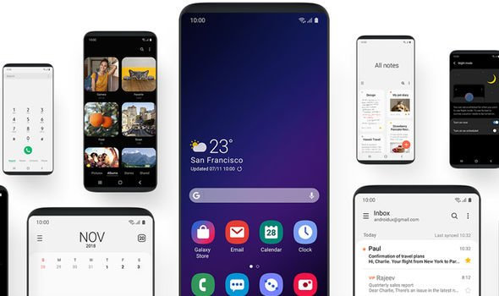
Android 9

Slide 8
Android 9
On January 29, 2019, Samsung announced UK owners of the Galaxy Note 9 and Galaxy S9 can now download Android Pie.
Android 9 Pie on Samsung devices runs the firm's new One UI skin on top it. One UI aims to make navigating on larger devices easier overall.
Discussing One UI, Samsung said: "One UI helps you focus on what really matters to you. With hardware and software working together in harmony, see only what you need, using and viewing your phone with an experience that feels second nature. Because it’s the small details that make a big difference. One UI changes how you view your phone. "

Slide 9
iOS 12
NEW RELEASE: Version 12.0
RELEASE DATE: September 17th 2018
KEY CHANGES:
"Adaptive Battery" prediction
Several security changes
Performance Improvements
Apples Maps rebuilt

Slide 10
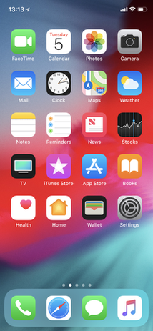
iOS 12

Slide 11
iOS 12
After upgrading to iOS 12.1.1, users have reported being cut off from normal wireless partially or entirely, varying by location and country per Forbes. The only way they've been able to get online is using WiFi.
Backing up to the iCloud is proving to be challenging.
Users are reporting that after updating to iOS 12, their iMessages are being sent to the wrong people. There's at least one obvious culprit here, but we don't quite know why: both the intended and actual recipients are all using the same Apple ID. Others are saying everyone with the same Apple ID gets looped into the same group conversation.

Slide 12
macOS 10.14
NEW RELEASE: Version 10.14
RELEASE DATE: September 24th 2018
KEY CHANGES:
Improved memory management
Several security improvements
FaceTime upgrades, group chat
Improved Power settings

Slide 13
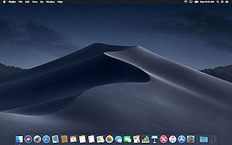
macOS 10.14

Slide 14
macOS 10.14
Apple has disabled Group FaceTime as a temporary fix until a patch is available.﻿
January 28th 2019: There's a major issue affecting FaceTime, a bug with Group FaceTime can let someone force a FaceTime call with you, giving them access to your iPhone, iPad, or Mac's video and audio even when you don't accept the FaceTime call. In the video below, the bug is demonstrated:
https://www.youtube.com/watch?time_continue=18&v=lI2za9p95r0
UPDATE: January 29th 2019, 10am, GMT: Apple has disabled Group FaceTime as a temporary fix until a patch is available.﻿

Slide 15
Linux 5
NEW RELEASE: Version 5.0
RELEASE DATE: January 27th 2019
KEY CHANGES:
“About 50 percent is drivers, 20 percent is architecture updates, 10 percent is tooling, and the remaining 20 percent is all over (documentation, networking, filesystems, header file updates, core kernel code). Nothing particular stands out, although I do like seeing how some ancient drivers are getting put out to pasture (*cough*isdn*cough*)."

Slide 16
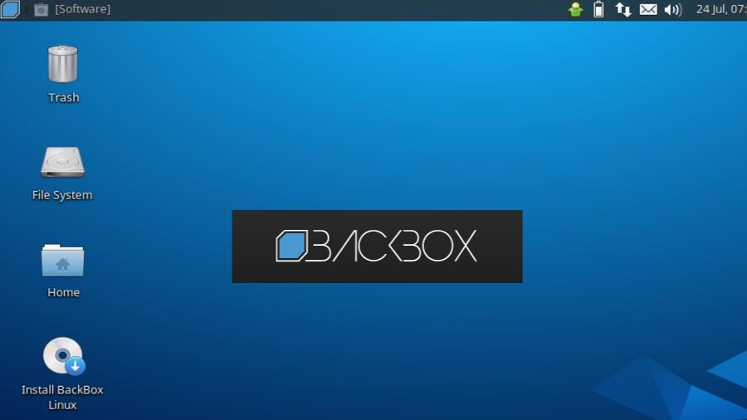
Linux 5

Slide 17
Linux 5
Apple has disabled Group FaceTime as a temporary fix until a patch is available.﻿
Even now it's hard to believe that Linus Torvalds took a break from running Linux. For almost 25 years, Torvalds was the benevolent dictator for life of Linux.
It turns out that what could make him step back was realizing his take-no-crap from anyone management style wasn't working anymore. Torvalds said, "I need to change some of my behaviour, and I want to apologize to the people that my personal behaviour hurt and possibly drove away from kernel development entirely."
Torvalds wouldn't be gone for long. As he came back, a new code of conduct for Linux kernel developers came with him. Despite numerous cries of outrage, mostly from people who weren't Linux programmers, claiming Linux had been taken over by Social Justice Warriors (SJW)s, Linux development has continued on as always.

