Slide 1
Other Versions of Linux
Damian Gordon

Slide 2
Slackware
July
1993
Slackware is oriented toward simplicity and software purity
Provides no graphical installation procedure
Developed by:
Patrick Volkerding

Slide 3
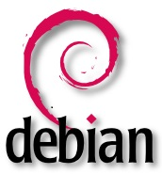
Debian
September
1993
The Debian Project's policies focus on collaborative software development and testing processes
New release every two years.
Developed by:
Ian Murdock and the Debian Project

Slide 4
SUSE
1994
"Software und System-Entwicklung", meaning "Software and systems development".
Often includes YaST setup and configuration tool
Developed by:
Roland Dyroff, Thomas Fehr, Burchard Steinbild, and Hubert Mantel

Slide 5
Red Hat
May
1995
In 2003 Red Hat Linux merged with the community-based Fedora Project
Introduced a graphical installer called Anaconda and Lokkit for configuring the firewall capabilities.
Developed by:
Bob Young, Marc Ewing and Red Hat Inc.

Slide 6
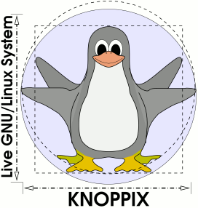
Knoppix
September
2000
Can be used to copy files easily from hard drives with inaccessible operating systems.
Designed to be booted straight from CD, DVD or USB.
Developed by:
Klaus Knopper

Slide 7
Gentoo
March
2002
Gentoo package management is designed to be modular, portable, and easy to maintain.
Not a binary software distribution, source code is compiled locally and optimized for the specific type of computer.
Developed by:
Daniel Robbins and Gentoo Foundation

Slide 8
Arch
March
2002
The development team focused on elegance, code correctness, and minimalism.
The user is expected to make significant effort to understand the systems function.
Developed by:
Judd Vinet, Aaron Griffin and the Arch Linux team

Slide 9
Fedora
November
2003
Focuses on innovation, integrating new technologies early on and working closely with Linux communities.
Linus Torvalds uses Fedora on all of his computers.
Developed by:
Fedora Project (owned by Red Hat)

Slide 10
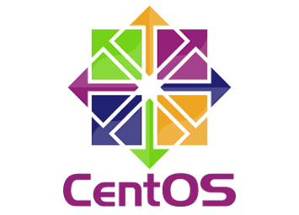
CentOS
2004
The project is affiliated with Red Hat but aspires to be more public, open, and inclusive.
Provides a free, enterprise-class, community-supported computing platform.
Developed by:
David Parsley, Lance Davis and the CentOS Project

Slide 11
Ubuntu
October
2004
Committed to open source development; encouraged to use free software, study how it works, improve upon it, and distribute it.
Named after the Southern African philosophy of ubuntu (literally, "human-ness").
Developed by:
Mark Shuttleworth and Canonical Ltd.

Slide 12
Alpine
2006
Lightweight and secure by default while still being useful for general-purpose tasks.
Compiles all packages with stack-smashing protection.
Developed by:
Alpine Linux development team

Slide 13
Oracle
October
2006
Based on Red Hat Enterprise Linux (RHEL), repackaged and freely distributed by Oracle.
Oracle Linux supports KVM and Xen.
Developed by:
Oracle Corporation

Slide 14
Musix
December
2006
Collection of software for audio production, graphic design, video editing and general purpose applications.
Documentation is in Spanish.
Developed by:
Marcos Germán Guglielmetti. And teams from Argentina, Spain, Mexico and Brazil.

Slide 15
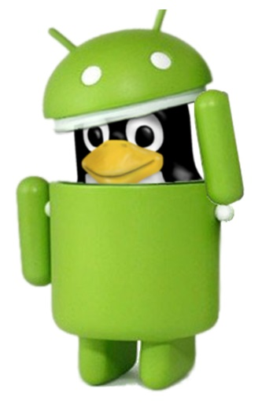
Android
September
2008
Android is designed primarily for touchscreen mobile devices such as smartphones and tablet computers.
The most widely used mobile OS.
Developed by:
Google, and Open Handset Alliance

Slide 16
Mageia
June
2011
A secure, and sustainable operating system, designed to set up a stable and trustable governance to direct collaborative projects.
Uses all major desktop environments
Developed by:
Former employees of Mandriva

Slide 17
Some Linux Desktop Environments

Slide 18
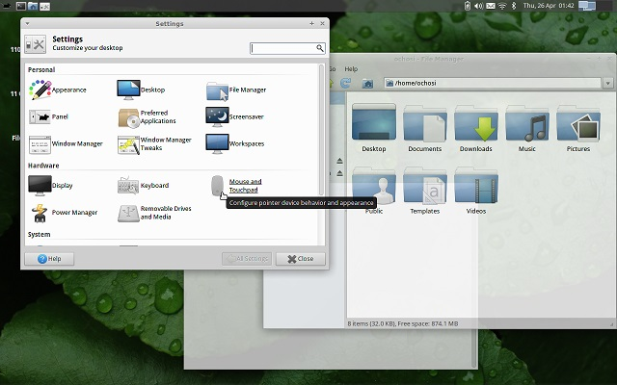
Xfce
1996
It aims to be fast and lightweight, while still being visually appealing and easy to use.
Does not feature any desktop animations, but translucency effect is supported.
Developed by:
Olivier Fourdan

Slide 19
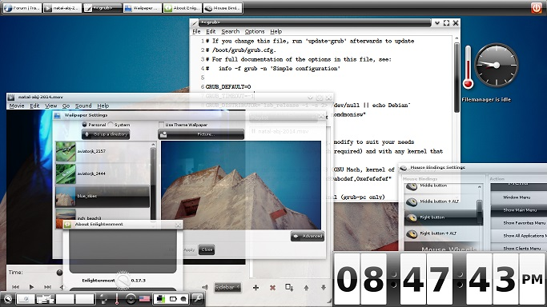
Enlightenment
1997
Enlightenment developers have referred to it as "the original eye-candy window manager“
Supports virtual desktops
Developed by:
Carsten Haitzler (aka Raster or Rasterman)

Slide 20
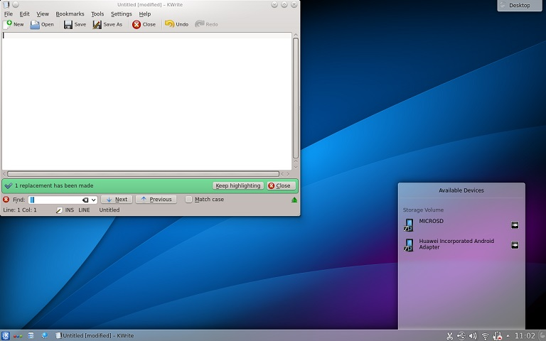
KDE
July
1998
Developed as an easy-to-use environment
Works well with multimedia devices and applications and mobile devices.
Developed by:
Matthias Ettrich and KDE

Slide 21
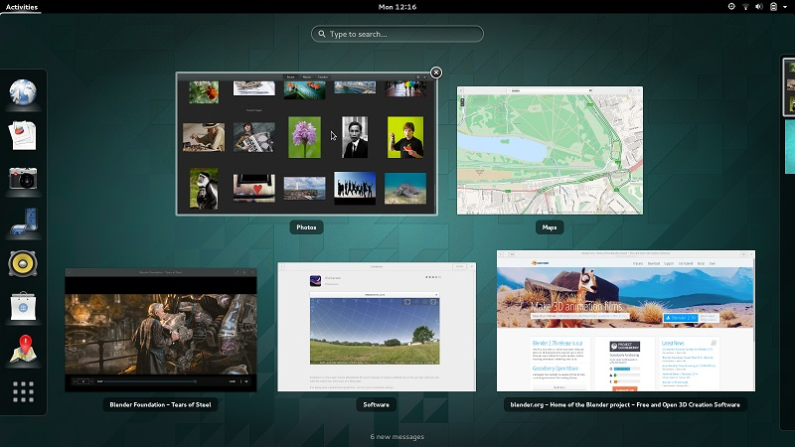
GNOME
March
1999
Focuses on internationalization and localization and accessibility of software.
Incorporates freedesktop.org standards and programs to better interoperate with other desktops.
Developed by:
Miguel de Icaza, Federico Mena, and the GNOME project

Slide 22
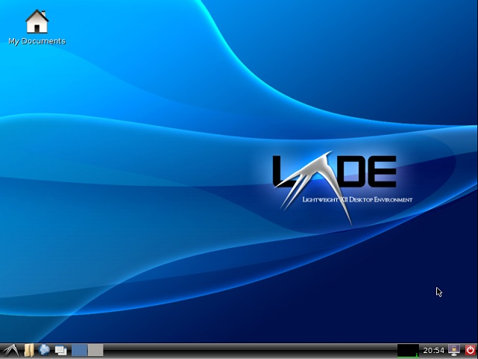
LXDE
2006
Suitable for resource-constrained computers, e.g., netbooks or System on a chip computers.
A desktop environment that is fast and energy efficient
Developed by:
Hong Jen Yee ( aka PCMan)

Slide 23
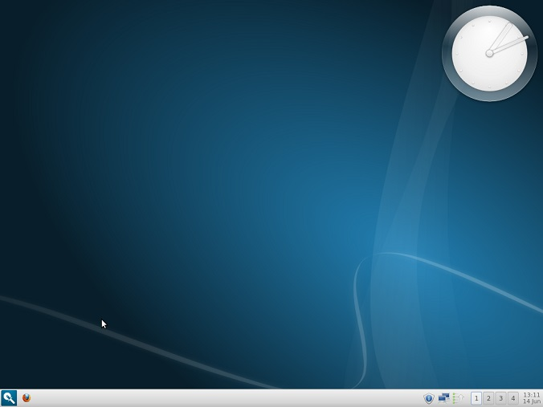
Razor-qt
2010
Tailored for users who value simplicity, speed, and an intuitive interface
Merged with LXDE in 2013 to become LXQt
Developed by:
The Razor-qt Team

Slide 24
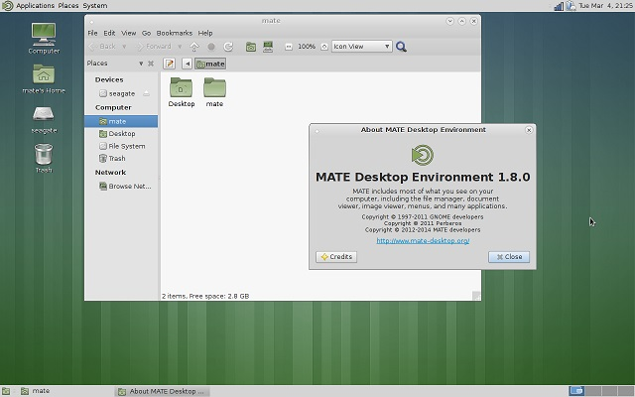
MATE
August
2011
Forked from GNOME 2, to maintain the simple and clean interface that was controversially removed in GNOME 3.
Developed by:
Perberos and MATE Developers

Slide 25
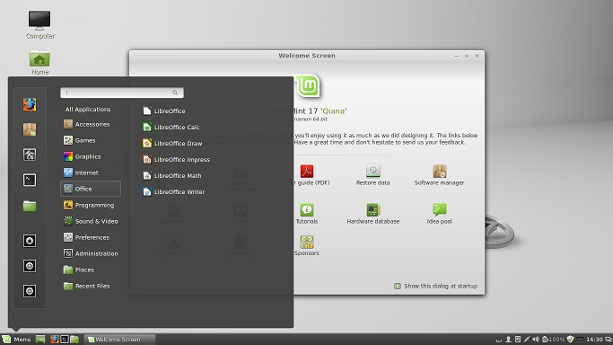
Cinnamon
December
2011
Another fork of GNOME 2, which provides a range of user configurable interface components.
Better performance.
Developed by:
Linux Mint development team

