Slide 1
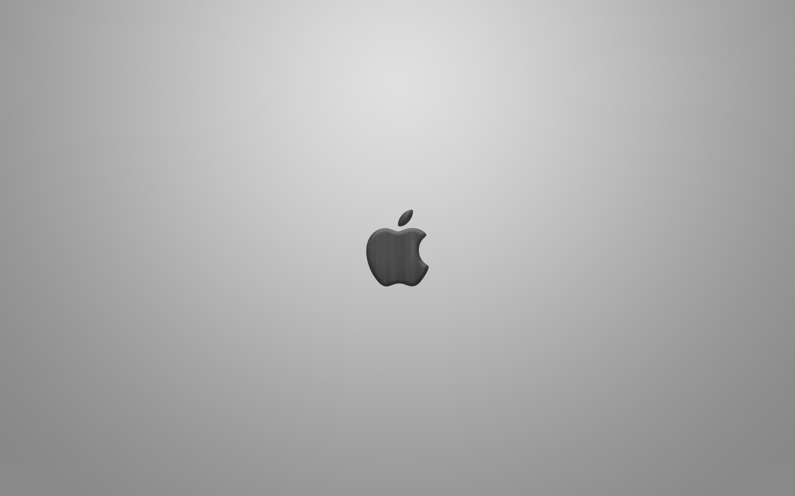
A History of Mac OS
Damian Gordon

Slide 2
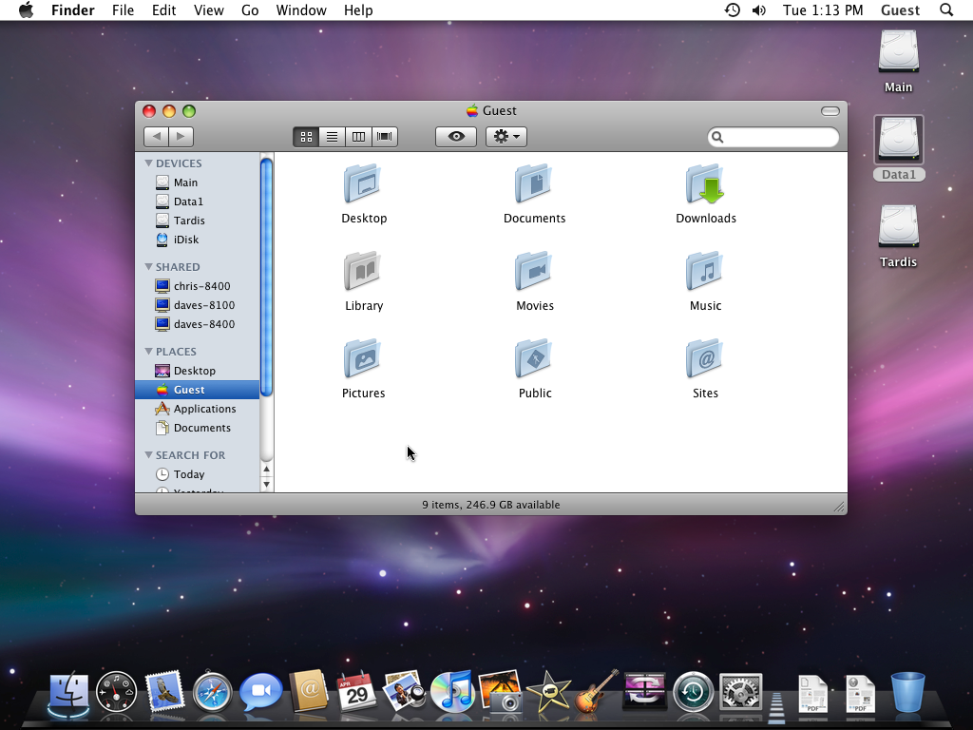

Slide 3
Timeline of Mac OS
1984
Sys 1
1986
Sys 3
1987
Sys 5
1991
Sys 7
1999
Mac OS 9
1985
Sys 2
1987
Sys 4
1988
Sys 6
1997
Mac OS 8
2001
Mac OS X
2001
OS X v10.0
2002
OS X v10.2
2005
OS X v10.4
2009
OS X v10.6
2012
OS X v10.8
2014
OS X v10.10
2001
OS X v10.1
2003
OS X v10.3
2007
OS X v10.5
2011
OS X v10.7
2013
OS X v10.9

Slide 4
Timeline of Mac OS
2015
OS X v10.11
2017
OS X v10.13
2016
OS X v10.12
2018
OS X v10.14

Slide 5
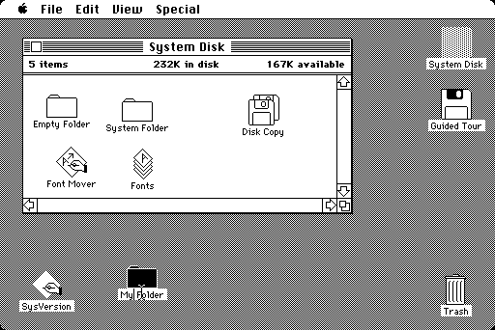
System 1
January
1984
Introduced menu bar, pop-up menus; concept of drag-and-drop and direct manipulation.
Only runs one application at a time
Based on the pioneering GUI technology developed at Xerox PARC, but Apple added many game-changing innovations.

Slide 6
System 2
April
1985
Introduced multiple folders, the "Shut Down" command, and a quick-launching application feature.
Added support for AppleTalk (networking) and the newly introduced LaserWriter to use it. Also introduced the HFS (Hierarchical File System).

Slide 7
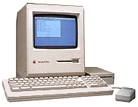
System 3
January
1986
Implemented HFS, support for several new technologies including SCSI and AppleShare, and Trash "bulging“.
Introduced with
the Mac Plus

Slide 8
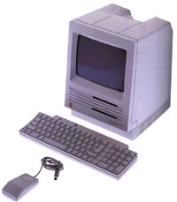
System 4
January
1987
Software for improved hardware - expansion slots, the Apple Desktop Bus (ADB), internal hard drives.
Introduced with
the Mac SE

Slide 9
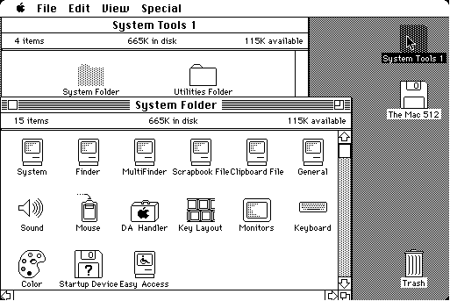
System 5
October
1987
Added MultiFinder which allowed cooperative multitasking, so time was given to the background applications only when the running application yielded control.
System Software 5 is the first Macintosh operating system to be given a unified "Macintosh System Software" version number

Slide 10
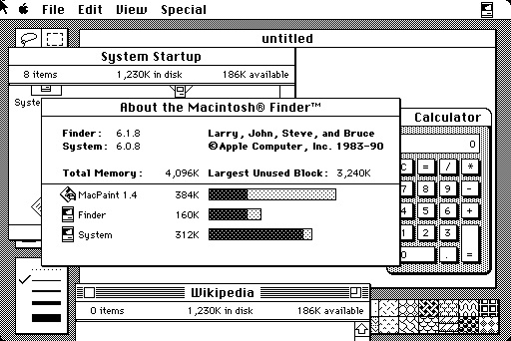
System 6
April
1988
Added MacroMaker allowed users to record mouse and keyboard input as "macros."
A complete, stable, and long-lasting operating system
A maximum of 15 Desk Accessories could be installed at one time, including the Chooser, Scrapbook, and Control Panel.

Slide 11
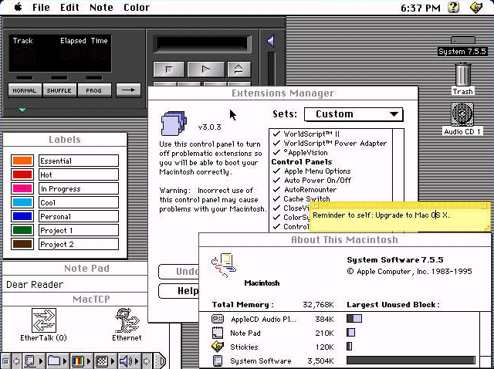
System 7
May
1991
Big Bang
Added virtual memory, personal file sharing, QuickTime, QuickDraw 3D, and improved UI.
Used over a megabyte (Sys 6 took up 600K).
It was the first Apple operating system to be available on CD, although it shipped on a set of 15 floppy disks initially.

Slide 12
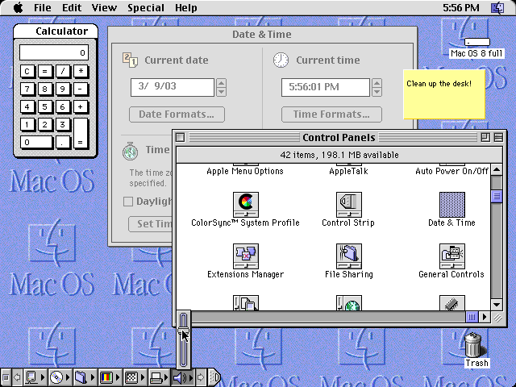
System 8
July
1997
Copland
Improved multi-tasking, files can be copied in the background, GUI skins introduced.
Released shortly after Steve Jobs return.
Initially planned as Mac OS 7.7, renumbered "8" to exploit a legal loophole and terminate third-party manufacturers' licenses to System 7

Slide 13
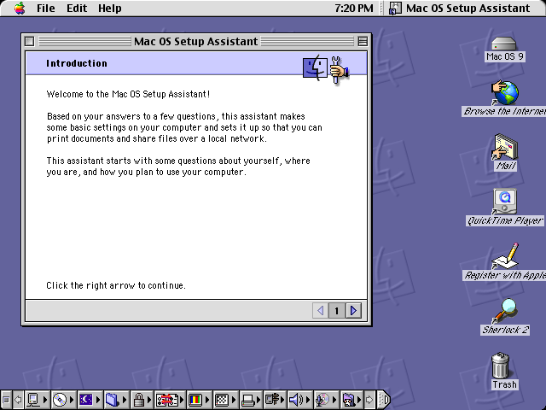
System 9
October
1999
Sonata
Provides a much improved memory implementation and management.
Improved support for wireless networking
Makes the first use of the centralized Apple Software Update to find and install OS and hardware updates

Slide 14
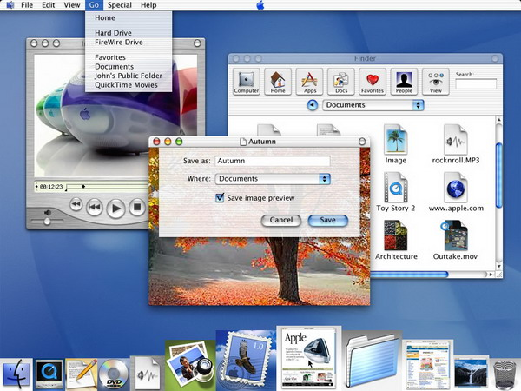
System 10 (OS X)
March
2001
Cheetah
Introduced Launch Pad, a springboard-style home for applications.
OS X is a Unix-based operating system
Heavily criticized for three main reasons: Interface responsiveness was sluggish. It was riddled with bugs. And had Missing Features and Compatibility Issues

Slide 15
Versions of OS X
Version | Release Date
Mac OS X v10.0 (Cheetah) | 24th March 2001
Mac OS X v10.1 (Puma) | 25th September 2001
Mac OS X v10.2 (Jaguar) | 24th August 2002
Mac OS X v10.3 (Panther) | 24th October 2003
Mac OS X v10.4 (Tiger) | 29th April 2005
Mac OS X v10.5 (Leopard) | 26th October 2007
Mac OS X v10.6 (Snow Leopard) | 28th August 2009
Mac OS X v10.7 (Lion) | 20th July 2011
OS X v10.8 (Mountain Lion) | 25th July 2012
OS X v10.9 (Mavericks) | 22nd September 2013
OS X v10.10 (Yosemite) | 16th October 2014

Slide 16
Versions of OS X
Version | Release Date
OS X v10.11 (El Capitan) | 30th September 2015
OS X v10.12 (Sierra) | 13th June 2016
OS X v10.13 (High Sierra) | 5th June 2017
OS X v10.14 (Mojave) | 4th June 2018

Slide 17
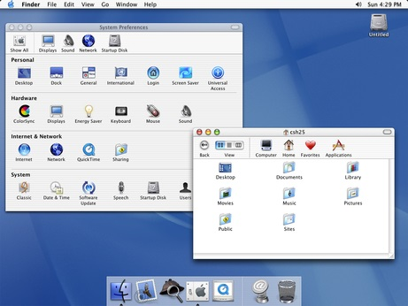
OS X v10.1
September
2001
Puma
Improved AppleScript, allows scripting access to system components
Easier CD and DVD burning, and DVD playback support
Still criticized for Interface responsiveness that was sluggish

Slide 18
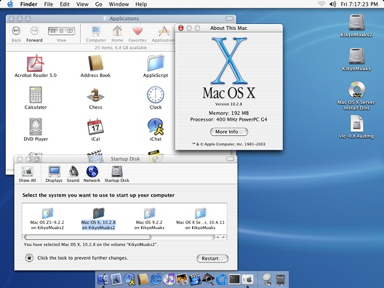
OS X v10.2
August
2002
Jaguar
Introduced Rendezvous (renamed Bonjour) allows networked devices to find each other
Added Inkwell, for handwriting recognition.
The operating system was available for single-computer installations, or in a “family pack”, which allowed five installations on separate computers

Slide 19
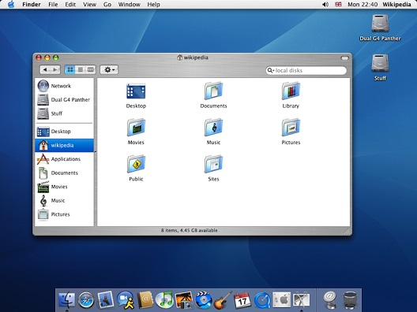
OS X v10.3
October
2003
Panther
Allows a user to remain logged in while another user logs in
TextEdit now compatible with Microsoft Word
On older machines third-party software (such as XPostFacto) was required override checks made during the installation process to get it to work.

Slide 20
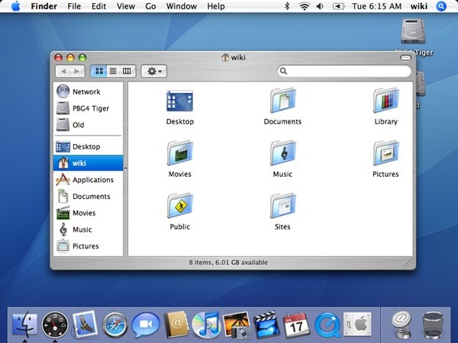
OS X v10.4
April
2005
Tiger
Added Quartz Composer, a development tool for processing and rendering graphical data.
Added Dashboard, a widget application.
Apple announced a transition to Intel x86 processors during Tiger's lifetime, making it the first Apple OS to work on Apple–Intel architecture machines.

Slide 21
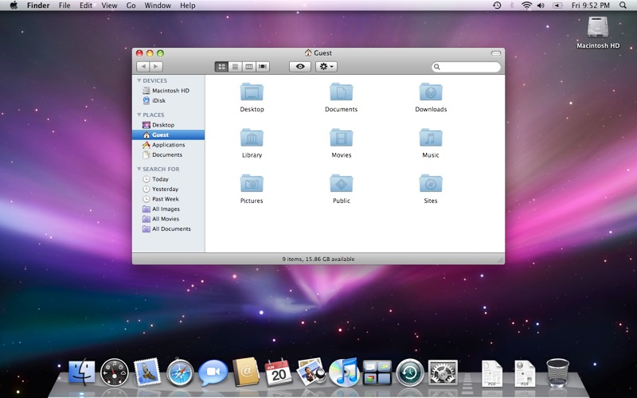
OS X v10.5
October
2007
Leopard
Network file sharing improvements including more granular control over permissions
Introduced an automated backup utility called Time Machine
According to Apple, Leopard contains over 300 changes and enhancements over its predecessor.

Slide 22
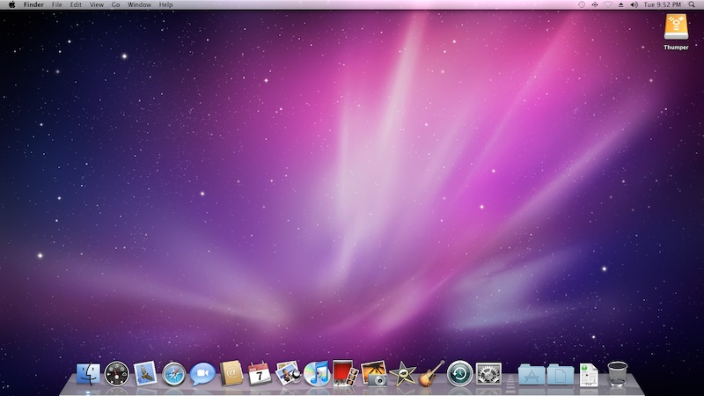
OS X v10.6
August
2009
Snow Leopard
Improved performance, greater efficiency and the reduction of its overall memory footprint.
Implemented stack protection and sandboxing
Breaks compatibility with several older versions of some applications, such as Parallels Desktop, versions of Aperture, and versions of Keynote

Slide 23
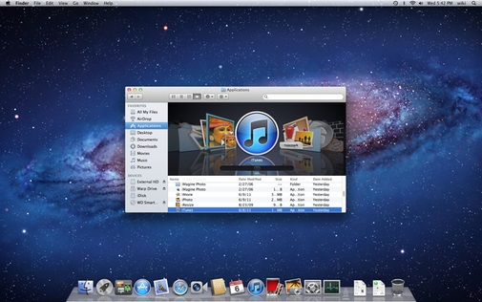
OS X v10.7
July
2011
Lion
Includes an easily navigable display of all of the installed applications
Introduced a recovery partition with tools
Applications such as Office for Mac 2004, AppleWorks, and early versions of Quicken for Mac 2007, are no longer supported.

Slide 24
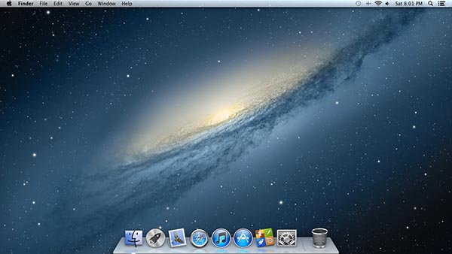
OS X v10.8
July
2012
Mountain Lion
Allows users to easily manage and synchronise content between multiple Apple devices.
New malware-blocking system Gatekeeper
Notification Center was added, which provides an overview of alerts from applications and displays notifications until the user completes an associated action.

Slide 25
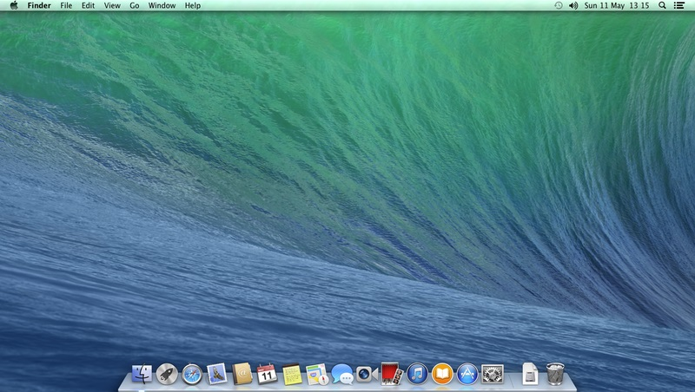
OS X v10.9
September
2013
Mavericks
The update places emphasis on battery life, and Finder enhancements.
Added more of Apple's iOS apps to the OS X platform.
During the first few weeks of release, a number of Western Digital external hard drive users complained about data losses and corruption.

Slide 26
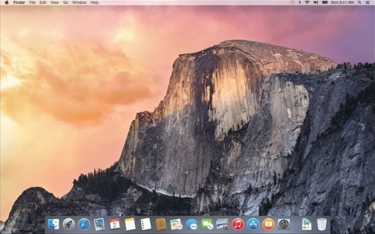
OS X v10.10
October
2014
Yosemite
New features focus on increasing integration with other services such as iOS and iCloud
Some icons changed to correspond with iOS 7 and iOS 8.
Many components send data to Apple by default, reporting the user's current location (at the city level) and all their search queries to Apple and third parties.

Slide 27
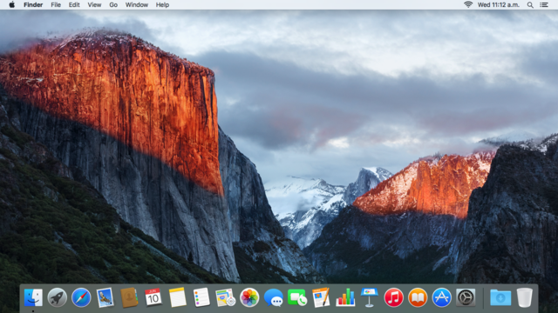
OS X v10.11
September
2015
El Capitan
Focuses mainly on performance, stability and security. Adds multi-touch gestures to applications like Mail and Messages
Has a new security feature called System Integrity Protection (SIP, aka "rootless") that protects system processes, files and folders from being tampered with.

Slide 28
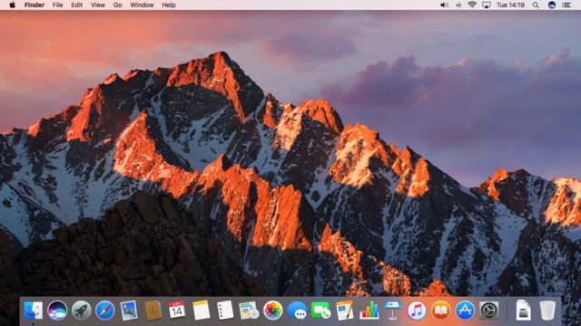
OS X v10.12
June
2016
Sierra
Its major new features concern Continuity, iCloud, and windowing, as well as support for Apple Pay and Siri.
In the 10.12.2 update the "time remaining" estimate has been removed after complaints of the battery life of 2016 MacBook Pros.

Slide 29
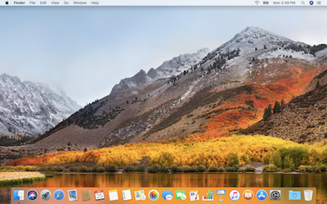
OS X v10.13
June
2017
High Sierra
Focused mainly on updates to existing software, including to the Apple File System (APFS), and improvements to VR support.
Numerous changes were made to standard applications including Photos, Safari, Notes, and Spotlight

Slide 30
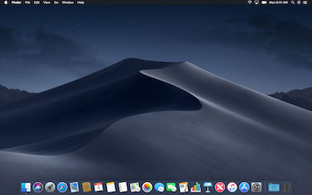
OS X v10.14
June
2018
Mojave
Brings several iOS apps to the desktop operating system, including Apple News, Voice Memos, and Home.
Includes "dark mode" a colour scheme that uses light-coloured text, icons, and graphical user interface elements on a dark background.

