Slide 1
Google Hacking
Damian Gordon

Slide 2
Google Hacking
index of /passwd
index of /secret
index of /confidential

Slide 3
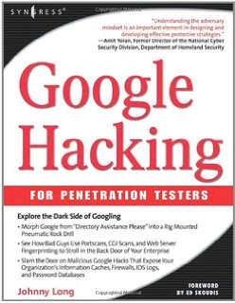
Google Hacking

Slide 4
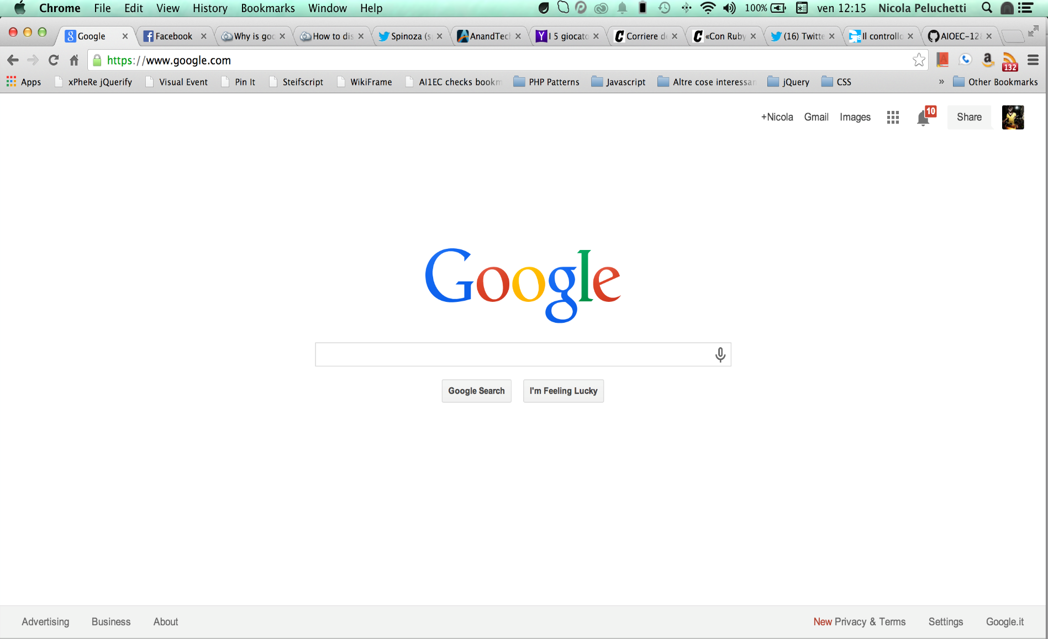
Google Hacking

Slide 5
Basic Search Operations

Slide 6
Basic Searching Operations
Damian Gordon
“Damian Gordon”

Slide 7
Basic Searching Operations
Damian Gordon
“Damian Gordon”
Search for a page with the words “Damian” and “Gordon” on it (in any order).

Slide 8
Basic Searching Operations
Search for a page with the phrase “Damian Gordon” on it.
Damian Gordon
“Damian Gordon”

Slide 9
Basic Searching Operations
Damian OR Gordon
Damian | Gordon

Slide 10
Basic Searching Operations
Damian OR Gordon
Damian | Gordon
THESE TWO ARE THE SAME: Search for a page with either the word “Damian” or “Gordon” on it.

Slide 11
Basic Searching Operations
Damian OR Gordon DIT
(Damian OR Gordon) DIT

Slide 12
Basic Searching Operations
Damian OR Gordon DIT
(Damian OR Gordon) DIT
Search for a page with either of the following: “Damian” or “Gordon DIT” on it.

Slide 13
Basic Searching Operations
Search for a page with the words “Damian” and “DIT” on it; or a page with the phrase “Gordon” and “DIT” on it.
Damian OR Gordon DIT
(Damian OR Gordon) DIT

Slide 14
Basic Searching Operations
”Damian *” DIT

Slide 15
Basic Searching Operations
”Damian *” DIT
Search for a page with the word “Damian” followed by any other word, and the page must also have “DIT”.

Slide 16
Basic Searching Operations
"Damian Gordon" 2015..2018

Slide 17
Basic Searching Operations
"Damian Gordon" 2015..2018
Search for a page with the phrase “Damian Gordon”, and the page must also have “2015”, “2016”, “2017”, and “2018”.

Slide 18
Advanced Search Operations

Slide 19
Advanced Searching Operations
site:www.damiantgordon.com

Slide 20
Advanced Searching Operations
site:www.damiantgordon.com
Search only in the site www.damiantgordon.com

Slide 21
Advanced Searching Operations
intitle:"Damian Gordon”

Slide 22
Advanced Searching Operations
intitle:"Damian Gordon”
Search only in the page's title for the phrase “Damian Gordon”.

Slide 23
Advanced Searching Operations
allintitle:Damian Gordon

Slide 24
Advanced Searching Operations
allintitle:Damian Gordon
Search only in the page's title for the words “Damian” and “Gordon” (in any order).

Slide 25
Advanced Searching Operations
inurl:location

Slide 26
Advanced Searching Operations
inurl:location
Search for the word “location” in the document URL.

Slide 27
Advanced Searching Operations
allinurl:location wikipedia

Slide 28
Advanced Searching Operations
allinurl:location wikipedia
Search for the words “location” and “wikipedia” in the document URL (in any order).

Slide 29
Advanced Searching Operations
filetype:pdf

Slide 30
Advanced Searching Operations
filetype:pdf
Match only a specific file type, in this case a PDF.

Slide 31
Ten Simple Google Hacks

Slide 32
Google Hacking
1. To find sites hosted on a server other than the WWW domain:
site:washingtonpost.com -site:www.washingtonpost.com

Slide 33
Google Hacking
2. Search for directory listings:
intitle:index.of
Notes:
https://hypem.com/download/

Slide 34
Google Hacking
3. Find error warnings:
intitle:error "access denied for user" "on line"
Notes:
https://hypem.com/download/

Slide 35
Google Hacking
4. To find login portals:
login | logon
Notes:
https://hypem.com/download/

Slide 36
Google Hacking
5. To search for sites with usernames:
site:XXXXX employee.ID | username | userid
Notes:
https://hypem.com/download/

Slide 37
Google Hacking
6. To search for sites with passwords:
password | passcode | “your password is”
Notes:
https://hypem.com/download/

Slide 38
Google Hacking
7. To search for sites with admin:
admin | administrator
Notes:
https://hypem.com/download/

Slide 39
Google Hacking
8. To search for sites with admin logins:
“admin login”
Notes:
https://hypem.com/download/

Slide 40
Google Hacking
9. To search for strange logins:
login -html -php -htm -asp -pdf -cgi -cfm
-shtml -jsp -php3
Notes:
https://hypem.com/download/

Slide 41
Google Hacking
10. To search for more strange logins:
login -html -php -htm -asp -pdf -cgi -cfm
-shtml -jsp -php3 -aspx
Notes:
https://hypem.com/download/

Slide 42
Google Hacking
BONUS HACK. To search for excel spreadsheets with a list of contact details:
filetype:xlsx "email" "@" "first name" "last name" "company" -sample "website" -template "contacts"
Notes:
https://hypem.com/download/

