Slide 1
Device Management
Damian Gordon

Slide 2
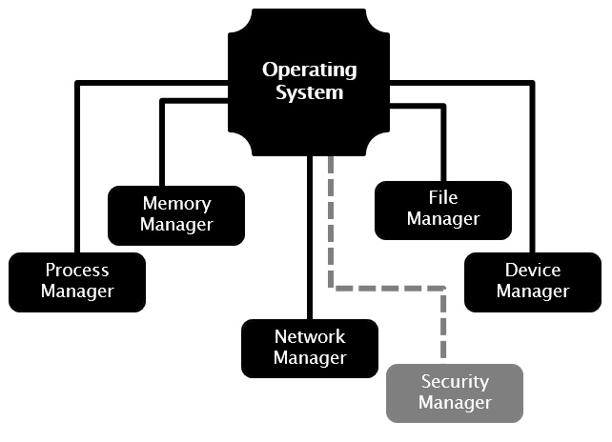
Device Management

Slide 3
Device Management
The main functions of the device manager are:
  Monitor the status of all devices, including storage drives, printers and other peripherals
  Enforce pre-set policies on which process gets which device for how long
  Deal with the allocation of devices to processes
  Deal with the de-allocation of devices to processes, both at a temporary basis (e.g. when the process is interrupted) and on a permanent basis (e.g. when the process is completed).

Slide 4
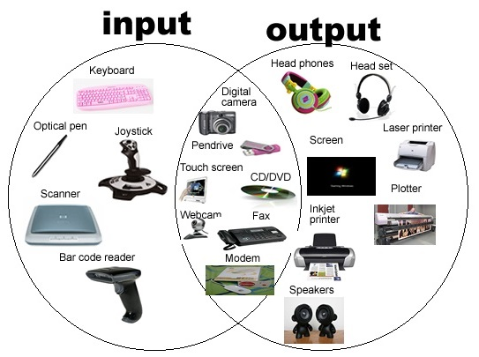
Device Management
Examples of devices:
  Keyboard
  Mouse
  Monitor
  Scanner
  Camcorder
  CD-ROM
  USB Ports
  WebCam
  Microphone
  Printer

Slide 5
Device Management
There are three main types of devices:
  Dedicated Devices
  Shared Devices
  Virtual Devices

Slide 6
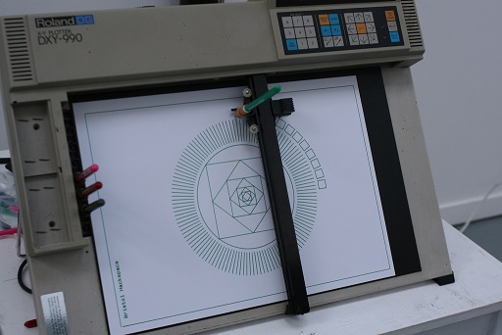
Device Management
Dedicated Devices
Plotter

Slide 7
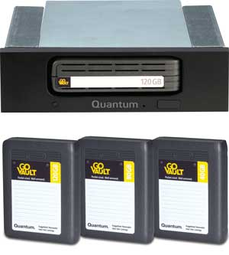
Device Management
Dedicated Devices
  These are devices that are assigned to one process at a time, and the process only releases the device once it is completed.
  This makes sense for devices like plotters, and tape drives.
  The problem with this is that it means only one user is using it at a time, and it might be inefficient if the device isn’t being used 100% of the time that it is being locked by the user.

Slide 8
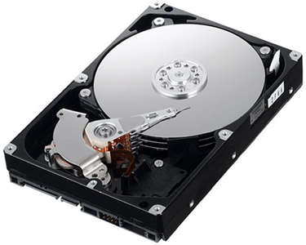
Device Management
Shared Devices

Slide 9
Device Management
Shared Devices
  These are devices that can be shared between several processes.
  Considering an example like a hard disk, it is shared, but interleaving between different processes’ requests.
  All conflicts for device need to be resolved but pre-determined policies to decide which request is handled first.

Slide 10
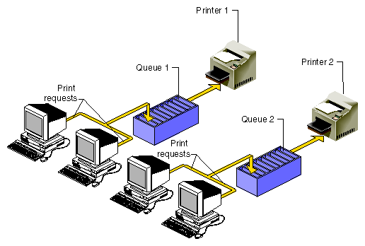
Device Management
Virtual Devices
Spool 1
Spool 2

Slide 11
Device Management
Virtual Devices
  These are devices are a combination of Dedicated and Shared Devices.
  So a printer is a dedicated device, but using the spooling (queues) means it can be shared.
  A print job isn’t sent straight to the printer, instead it goes to the disk (spool) until it is fully prepared with all the necessary printer sequences and formatting, then it goes to the printer, ensuring that the printers (and all I/O devices) are used efficiently.

Slide 12
Hard Disks:
Direct Access Storage Devices

Slide 13
Hard Disk
v
v
v

Slide 14
Hard Disk
Track
v
v
v

Slide 15
Hard Disk
Track
v
v
v
Sector

Slide 16
Hard Disk
Track
Block
v
v
v
Sector

Slide 17
Device Management

Slide 18
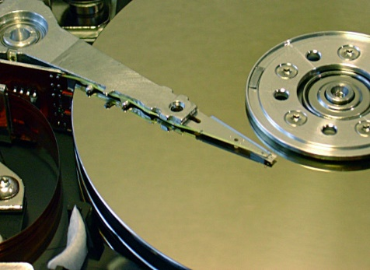
Device Management

Slide 19
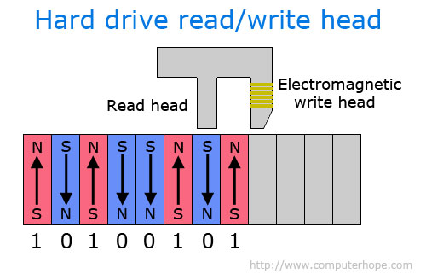
Device Management

Slide 20
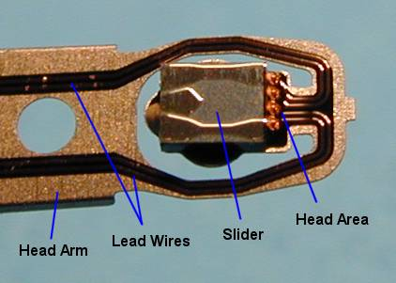
Device Management

Slide 21
Device Management
We’ll look at two hard disk configurations:
  Mobile-Head Magnetic Disk Storage
  Fixed-Head Magnetic Disk Storage

Slide 22
Device Management
Mobile-Head Magnetic Disk Storage
  Both the reading(/writing) head moves and the disk spins.
  Usually formatted on both sides.
  Data is recorded on tracks.

Slide 23
Device Management
v
v
v
v
Moving
Read/Write
Head

Slide 24
Device Management
v
v
v
v
Moving
Read/Write
Head

Slide 25
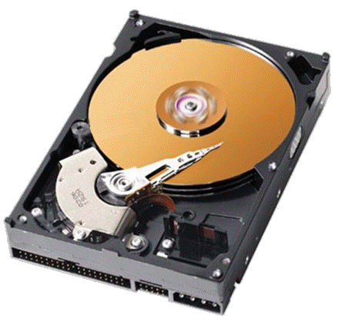
Device Management

Slide 26
Device Management
Mobile-Head Magnetic Disk Storage
Typically there is more than one disk (platter), and they are arranged in a stack (we also call this as being part of a disk pack).
The disks are stacked on a common spindle, and have Read/Write heads on both sides.
All of the Read/Write heads are move in unison.

Slide 27
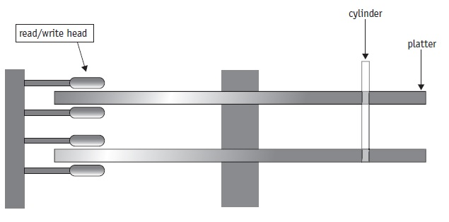
Device Management
Mobile-Head Magnetic Disk Storage
spindle

Slide 28
Device Management
Fixed-Head Magnetic Disk Storage
Works like a CD or DVD, the disk spins and the reading head stays stationary.
Usually formatted on both sides.
Data is recorded on tracks.

Slide 29
Device Management
Rotation
v
v
Multiple Fixed
Read/Write
Heads
Track 4
Track 3
Track 2
Track 1

Slide 30
Device Management
Rotation
v
v
Multiple Fixed
Read/Write
Heads
Track 4
Track 3
Track 2
Track 1

Slide 31
Device Management
Fixed-Head Magnetic Disk Storage
This means it’s very fast compared to a moving Read/Write head, however, it is more costly to manufacture, and it has less storage space as the tracks have to be positioned farther apart.
These are often used in space flight and aircraft applications where speed is most important.

Slide 32
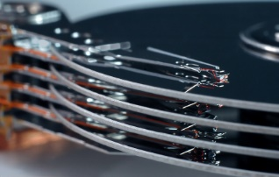
Device Management
In either case we may have a disk pack:

Slide 33
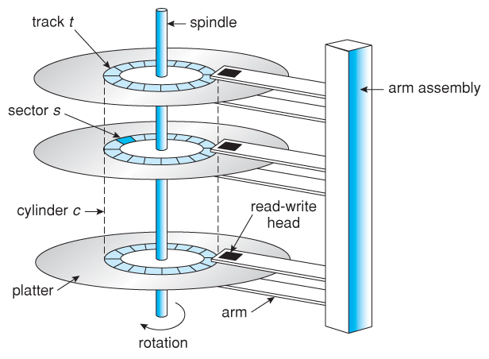
Device Management
Disk pack:

Slide 34
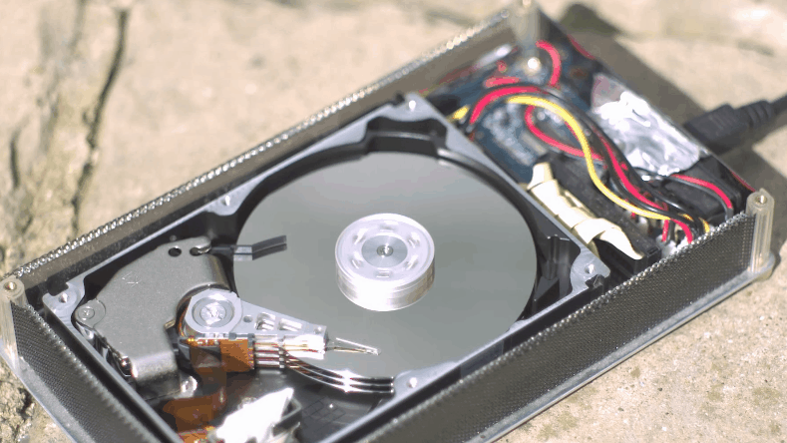
Device Management
Disk pack:

Slide 35
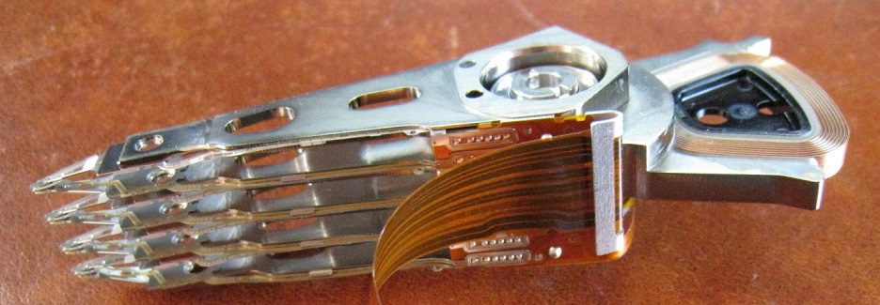
Device Management
Disk pack:

Slide 36
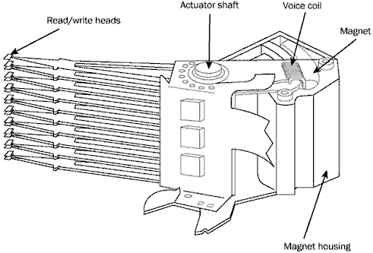
Device Management
Disk pack:

Slide 37
Device Management
Disk pack:
  An interesting question occurs about disk packs, is it more efficient to write a series of records on one surface of a disk and then the opposite surface of that disk, followed by the next disk, and the next one, and so on? Or is better to do fill the other surface of each surface of each disk, then the next track, then the next?

Slide 38
Device Management
Disk pack (Case 1):

Slide 39
Device Management
Disk pack (Case 2):

Slide 40
Device Management
Disk pack (Case 2):

Slide 41
Device Management
Disk pack (Case 2):

Slide 42
Device Management
Disk pack (Case 2):

Slide 43
Device Management
Disk pack (Case 2):

Slide 44
Device Management
Disk pack (Case 2):

Slide 45
Device Management
Disk pack (Case 2):

Slide 46
Device Management
Disk pack (Case 2):
C y l i n d e r

Slide 47
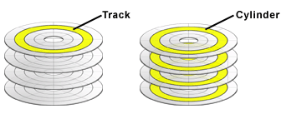
Device Management
Disk pack:
  It turns out it’s faster to fill the disks a track at a time (case 2), and this leads up to the concept of a virtual cylinder of data.

Slide 48
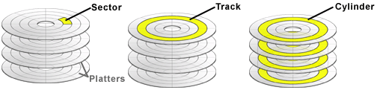
Device Management
Disk pack:
  So to access a record, the device manager needs; the cylinder number, the surface number, and the sector number.

Slide 49
Optical Disk Storage

Slide 50
Device Management
Optical Disk Storage:
  Because of advances in laser technology it is possible to store data optically rather than magnetically, and CDs and DVDs are examples of optical storage.
  Unlike magnetic disks, which typically consist of tracks as a series of concentric circles, optical disks are usually a single continuous spiral track.

Slide 51
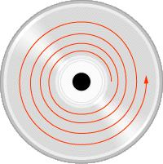
Device Management
Magnetic Disks Optical Disks

Slide 52
Device Management
Optical Disk Storage:

Slide 53
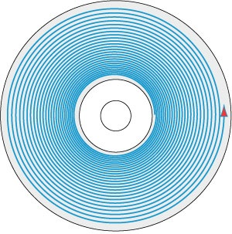
Device Management
Optical Disk Storage:

Slide 54
Device Management
Optical Disk Storage:
  Another significant difference between magnetic and optical disks is that magnetic disks spin at a constant speed, so the tracks on other outer rings of magnetic disks have to have larger sectors, and those tracks nearer the centre have small tracks.
  Optical disks can change the speed to reading, so the sector size is the same in the outside or inside.

Slide 55
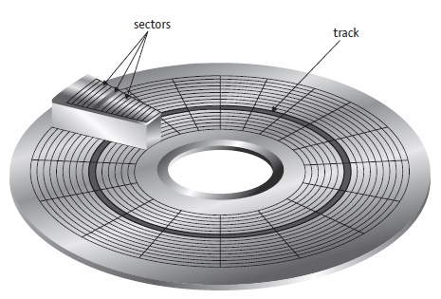
Device Management
Optical Disk Storage:

Slide 56
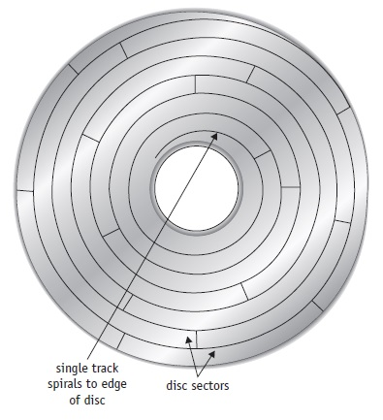
Device Management
Optical Disk Storage:

Slide 57
Device Management
Optical Disk Storage:
  Another significant difference between magnetic and optical disks is that magnetic disks spin at a constant speed, so the tracks on other outer rings of magnetic disks have to have larger sectors, and those tracks nearer the centre have small tracks.
  Optical disks can change the speed to reading, so the sector size is the same in the outside or inside.

Slide 58
Device Management
Optical Disk Storage:
  Three important performance measures are:
    Data Transfer Rate
    Average Access Time
    Cache Size

Slide 59
Device Management
Data Transfer Rate
  This measures the amount of data that can be read from the disk.
  It is typically measured in megabytes per second (MB/s).

Slide 60
Device Management
Average Access Time
  This measures how long (on average) it takes to move the disk head to a specific place on the disk.
  It is typically measured in milliseconds (ms).

Slide 61
Device Management
Cache Size
  When reading and writing to disk, sometimes the user will wish to re-read data they have just read, if so, having it in the cache saves reading it again.
  It is typically measured in kilobytes (KB).

Slide 62
Device Management
Optical Disk Storage:
  To write to an optical disk, a high intensity laser beam burns indentations in the disk called pits. The pits represent zeros (0s).
  The unburned flat areas are called lands, and represent ones (1s).

Slide 63
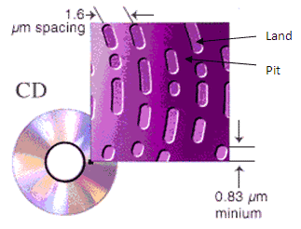
Device Management

Slide 64

Device Management

Slide 65
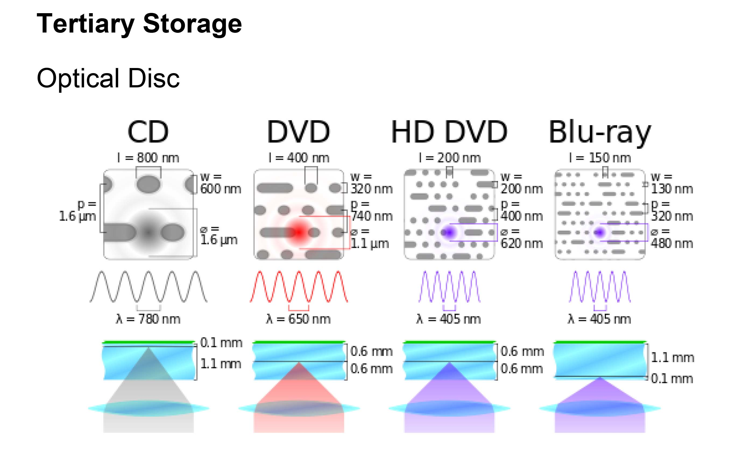
Device Management

Slide 66
Components of an I/O System

Slide 67
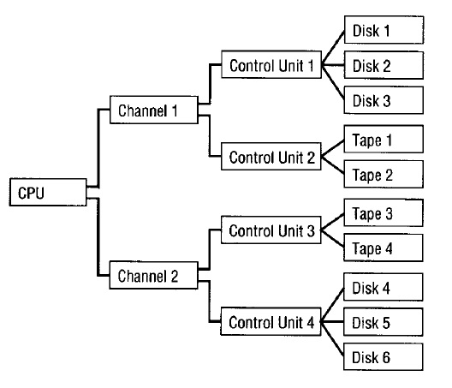
Device Management

Slide 68
Device Management
The CPU makes a lot of I/O requests.
The I/O channels work to co-ordinate the devices to synchronise the fast speed of the CPU with the slower speeds of the I/O devices.
The I/O control units are attached to several similar devices and control these devices based on instructions from the channel.

Slide 69
RAID
(Redundant Array of
Independent Disks)

Slide 70
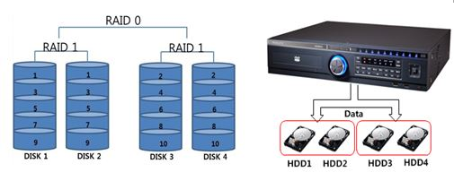
Device Management
RAID is a collection of physical disk drives that can be viewed as a single logical unit by the operating system.

Slide 71
Device Management
RAID works on the basis that several small-capacity disk drives are more efficient than a few large-capacity disk drives.
This is because by distributing the data among several smaller disks, the system can simultaneously access the requested data from the multiple drives, resulting in improved I/O performance.

Slide 72
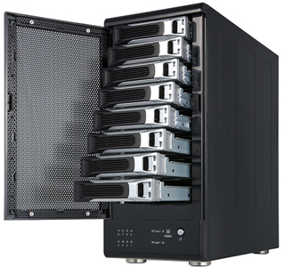
Device Management

Slide 73
Device Management
A RAID configuration could have five disk drives connected to a specialized controller.
The controller houses the software that coordinates the transfer of data from the disks in the array to a large-capacity disk connected to the I/O subsystem.
This configuration is viewed by the operating system as a single large capacity disk, so that no software changes are needed.

Slide 74
Device Management
A RAID configuration could have five disk drives connected to a specialized controller.
The controller houses the software that coordinates the transfer of data from the disks in the array to a large-capacity disk connected to the I/O subsystem.
This configuration is viewed by the operating system as a single large capacity disk, so that no software changes are needed.

Slide 75
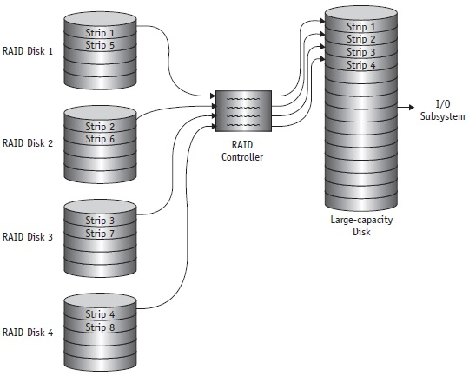
Device Management

Slide 76
Device Management
Data is divided into segments called strips, which are distributed across the disks in
the array.
A set of consecutive strips across disks is called a stripe and the whole process is called striping.
The previous figure shows how data strips are distributed in an array of four disks

Slide 77
Device Management (Summary)
Damian Gordon

Slide 78
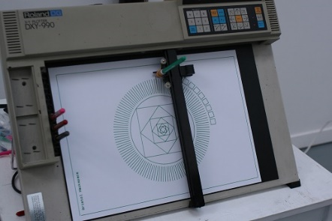

Device Management
There are three main types of devices:
  Dedicated Devices
  Shared Devices
  Virtual Devices

Slide 79
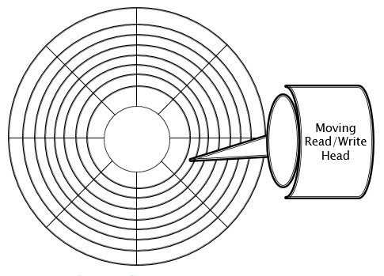
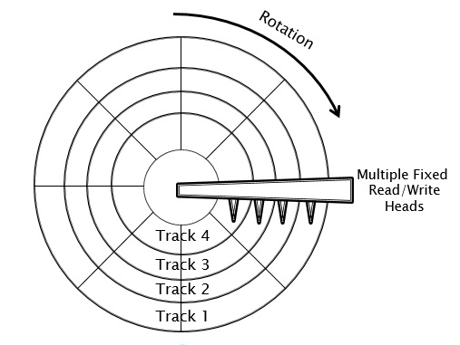
Device Management
We’ll look at two hard disk configurations:
  Mobile-Head Magnetic Disk Storage
  Fixed-Head Magnetic Disk Storage

Slide 80
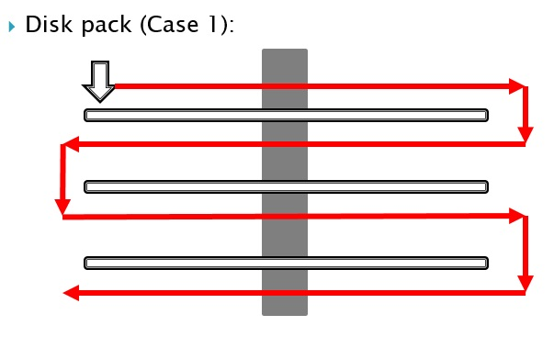
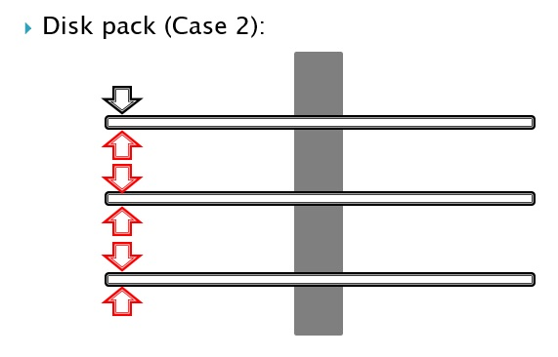
Device Management
Writing to disk:
  One surface at a time (Case 1)
  One track at a time (Case 2)

Slide 81
Device Management
Magnetic Disks Optical Disks

Slide 82
Device Management
Magnetic Disks Optical Disks

Slide 83
Device Management
Optical Disk Storage:
  Three important performance measures are:
    Data Transfer Rate - amount of data that can be read from the disk.
    Average Access Time - how long (on average) it takes to move the disk head to a specific place on the disk.
    Cache Size – measures re-read ability.

Slide 84
Device Management

Slide 85
Device Management

Slide 86
Thanks.

