Slide 1
Device Hacking
Damian Gordon

Slide 2
Device Hacking
Although it is difficult to exploit hardware, there is a lot of interest in device hacking as it gives so much more control over devices.
As the security of software becomes more robust, attackers are looking in other areas to control systems, and hardware and firmware are the new targets.

Slide 3
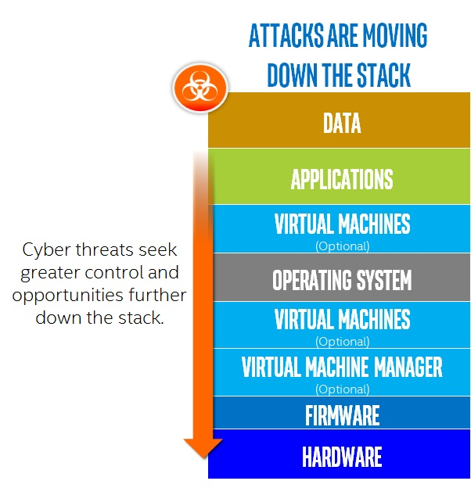
Device Hacking

Slide 4
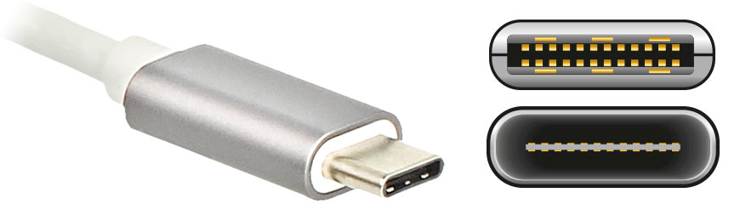
USB Hacking
Newer smartphones and laptops use a USB port for charging (USB-C port).
The EU would like a common charger for all devices, and think USB-C is the way to go:

Slide 5
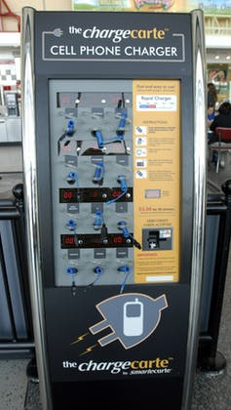
USB Hacking
The problem is that the port can take data and instructions as well as power, therefore, if I create a fake charging station, I can steal all the data off a phone, install malware, or do anything else I want with the phone.
So experts have identified 29 different types of USB attacks, and recommend never to use public chargers.

Slide 6
USB Hacking
Ran Yahalom of Ben-Gurion University showed the following kinds of USB attacks:
  Installation of infections, or other malicious software, that once connected, have access and take control of your computer or phone.
  Microcontrollers attacks, Microcontrollers (like an Arduino) can impersonate a USB peripheral and act like a keyboard or a mouse. Once you connect, it starts injecting key presses.
  Electrical attacks, creating an electrical component that looks like a flash drive, but conducts a power surge attack once connected, and, fry the entire computer or phone.

Slide 7
USB Hacking
There are also some commercial USB hacking devices:
  USBdriveby
  KeySweeper
  BadUSB

Slide 8
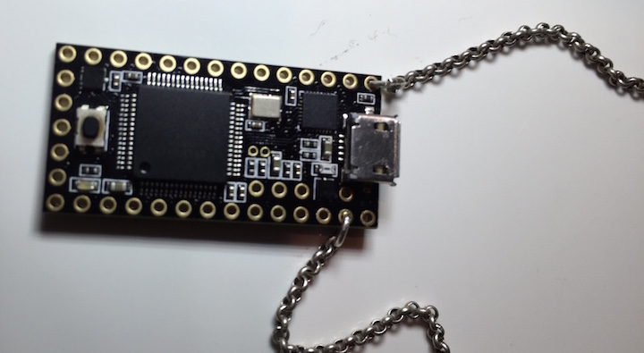
USB Hacking
USBdriveby: This USB stick is easily identified by the chain attached to it and contains a particularly nasty surprise inside. Once plugged into a PC, it begins to imitate your keyboard and uses keystrokes to disable firewalls, opens backdoors to allow remote control and tells network monitoring apps that everything is okay.

Slide 9
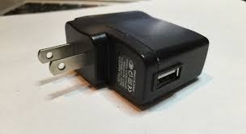
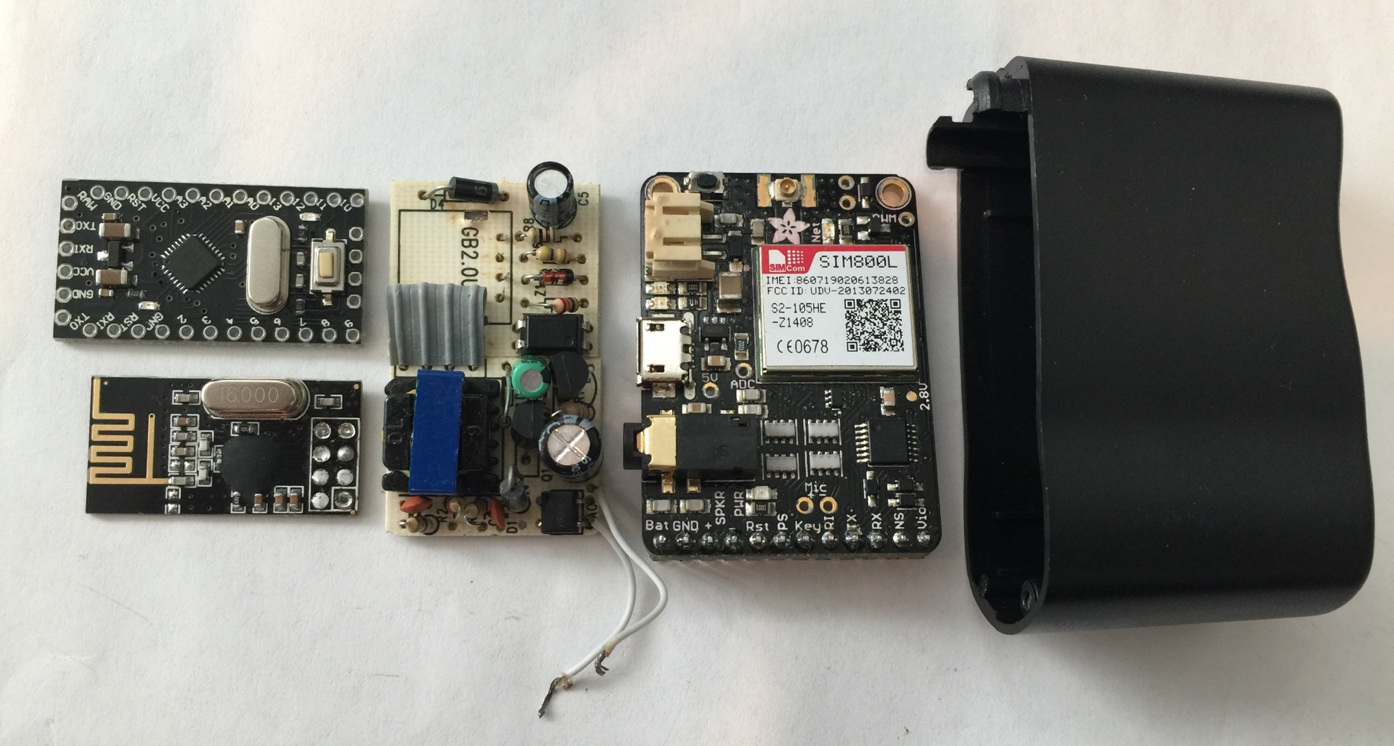
USB Hacking
KeySweeper: Disguised as a USB wall charger, the KeySweeper hack is a very well concealed device which uses wireless connections to identify and spy on local Microsoft wireless keyboards. And, by monitoring keystrokes, KeySweeper can quickly obtain login details and transmit these back to a remote location.

Slide 10
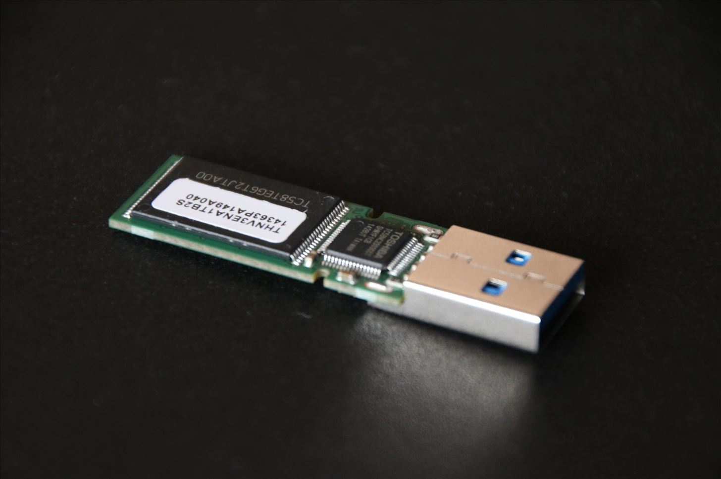
USB Hacking
BadUSB: A USB stick hack, BadUSB impersonates your keyboard to allow itself to reprogram firmware associated with your existing USB devices e.g. network cards can be reprogrammed to send users to sites containing malicious software which can soon infect your entire network.

Slide 11

Bluetooth Hacking
Bluetooth is a wireless technology standard for exchanging data between fixed and mobile devices over short distances.
It used short-wavelength UHF radio waves in the industrial, scientific and medical radio bands, from 2.400 to 2.485 GHz.
Bluetooth is managed by the Bluetooth Special Interest Group (SIG),

Slide 12

Bluetooth Hacking
BlueBorne is a generic term for several security vulnerabilities affecting electronic devices involving various Bluetooth implementations in Android, iOS, Linux and Windows.
BlueBorne scans for devices with Bluetooth enabled and once it finds them, can gain access in about 10 seconds. Once compromised, the device expands the reach of the attack, boosting the signal for the hacker and eliminating the need for the attack source to be within Bluetooth range of potential targets.

Slide 13
WiFi Hacking
WiFi Spoofing
A spoofing attack is one where a program successfully masquerades another by falsifying credentials.
So if you login to a public WiFi regularly, e.g. Starbucks, then if a hacker sets up a WiFi spot called Starbucks, your computer/phone may automatically connect. The hacker will be connected to your computer/phone.

Slide 14
WiFi Hacking
In 2017 Google’s Project Zero security team demonstrated a flaw in a very common wireless chip by the Broadcom (used in phones by Apple, Samsung and others) that leaves millions of mobile phones and other devices vulnerable to simple hacking by way of wireless networks.
One of the discovered holes was a “stack buffer overflow” hole that would allow an attacker to “execute arbitrary code on the WiFi Chip.
It has been mostly fixed, but there may be others.

Slide 15
Medical Device Hacking
One extremely worrying area is medical device hacking; where hackers target devices like insulin pumps, pacemakers and heart implants.
New Zeland computer security expert Barnaby Jack showed vulnerabilities in each of these.

Slide 16

Barnaby Jack
Born: 22nd November 1977
Died: 25th July 2013
Born in Auckland, New Zealand
A New Zealand hacker, programmer and computer security expert.
Demonstrated how to hack ATMs (his technique was called “Jackpotting”.
He also show how to hack various medical devices
In 2012 his testimony led the United States Food And Drug Administration to change regulations regarding wireless medical devices.

Slide 17

Medical Device Hacking
Hacking insulin pumps
In October 2011 Jack demonstrated the wireless hacking of insulin pumps. Interfacing with the pumps with a high-gain antenna, he obtained complete control of the pumps without any prior knowledge of their serial numbers, up to being able to cause the demonstration pump to repeatedly deliver its maximum dose of 25 units until its entire reservoir of 300 units was depleted, amounting to many times a lethal dose if delivered to a typical patient.

Slide 18
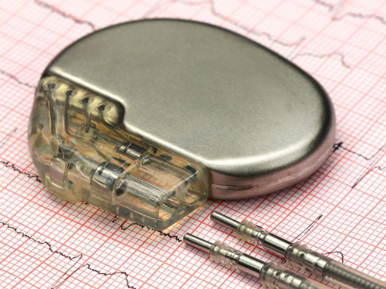
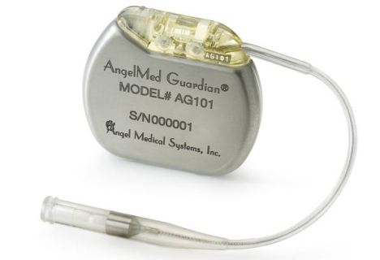
Medical Device Hacking
Hacking pacemakers and heart implants.
In 2012-2013 Jack demonstrated the wireless hacking of pacemakers and heart implants.
He developed software that allowed him to remotely send an electric shock to anyone wearing a pacemaker within a 50-foot radius.
He also developed software to control of heart implants.

Slide 19
Medical Device Hacking
The risk to medical devices grows as more and more become part of the internet of things (IoT), in which physical devices are embedded with technology to make them wirelessly accessible.
According to a report from the US Department of Health and Human Services' Office of the Inspector General, the US Food and Drug Administration is not doing enough to prevent medical devices being hacked (November 1, 2018).

Slide 20
Medical Device Hacking
Medical device company Abbott announced a voluntary recall of 465,000 pacemakers in 2017 due to a possible hacking threat. The FDA said the devices contained vulnerabilities that could allow access to a patient’s device using commercially available equipment. This access could be used to modify programming commands to the implanted pacemaker, which could result in patient harm from rapid battery depletion or administration of inappropriate pacing.

