Slide 1
Operating Systems Protections
Damian Gordon

Slide 2
System Protection
System protection is multifaceted, four protection methods include:
  Antivirus Software
  Firewalls
  Patch Management
  Authentication

Slide 3
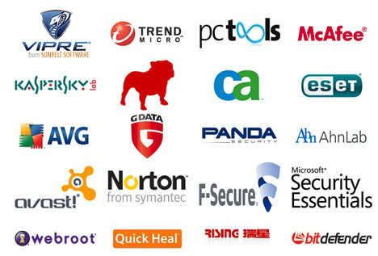
Antivirus Software
Antivirus Software is used to protect systems from attack by malicious software.

Slide 4
Antivirus Software
The software can be preventative, diagnostic, or a combination of both.
As new viruses are identified security vendors and government agencies provide information and updates about them.

Slide 5
Antivirus Software
Antivirus software is usually capable of repairing files infected by a virus, but it generally cannot repair the damage done by worms, Trojans, and blended approaches.
This is since viruses usually add code to an existing file, whereas worms, Trojans, and blended approaches usually fully replace files.

Slide 6
Antivirus Software
Examples of Antivirus software include:
  Bitdefender Antivirus Plus
  Kaspersky Anti-Virus
  Webroot SecureAnywhere AntiVirus
  Emsisoft Anti-Malware
  F-Secure Anti-Virus 2015
  Malwarebytes Anti-Exploit
  McAfee AntiVirus Plus
  Panda Antivirus Pro
  Trend Micro Antivirus+ Security
  VoodooSoft VoodooShield

Slide 7
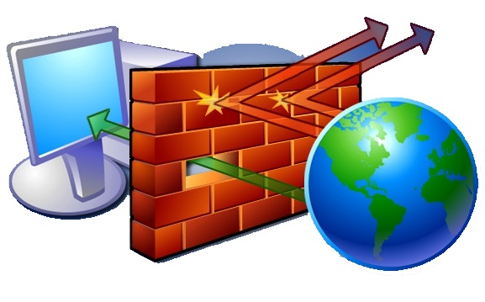
Firewalls
A firewall is a network security system that monitors and controls the incoming and outgoing network traffic based on predetermined security rules.

Slide 8
Firewalls
Network firewalls can be software programs running on general purpose hardware, or hardware-based firewall computer appliances, that filter traffic between two or more networks.
Firewall appliances may also offer other functionality to the internal network they protect such as acting as a DHCP or VPN server for that network.

Slide 9
Firewalls
Network firewalls can be software programs running on general purpose hardware, or hardware-based firewall computer appliances, that filter traffic between two or more networks.
Firewall appliances may also offer other functionality to the internal network they protect such as acting as a DHCP or VPN server for that network.

Slide 10
Firewalls
Firewalls typically:
  Log activities that access the internet
  Maintain access control based on the senders’ and receivers’ IP addresses
  Maintain access control based on the services being requested
  Hide the internal network from unauthorized users
  Verify that virus protection is installed and running
  Perform authentication based on the source of a request from the Internet

Slide 11
Firewalls
Firewalls use a combination of packet filtering and proxy servers.
  Packet Filtering means that the firewall reviews all of the header information of each packet coming into the computer and going out to make sure there is noting suspicious present.
  Proxy Servers sit in between the local computer and network, and intercept all requests to the local computer from the network, and verify them before passing them onto the local computer.

Slide 12
Firewalls
Examples of Firewalls include:
  Bullguard
  ZoneAlarm
  McAfee
  Norton
  AVG Anti-virus
  Bitdefender
  Avira
  Kaspersky Lab

Slide 13
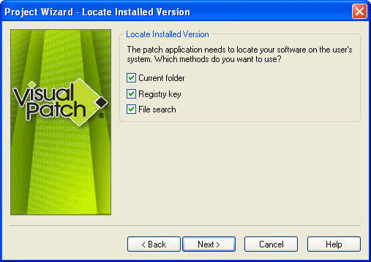
Patch Management
A patch is a piece of software that can be applied to an operating system (or any other software) to correct an issue with that software.

Slide 14
Patch Management
Most operating systems will have several patches after their initial release and usually update the version of the program when successfully installed.
Software patches can be found through the software developer's website, or are automatically downloaded after each system restart.

Slide 15
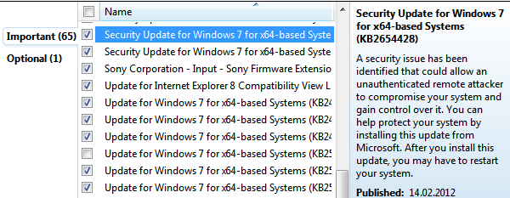
Patch Management
A security patch is a change applied to an operating system to correct a discovered vulnerability.
This corrective action will prevent successful exploitation and remove or mitigate a threat’s capability to exploit a specific vulnerability in that operating system.

Slide 16
Patch Management
Security patches are the primary method of fixing security vulnerabilities in operating systems.
Currently Microsoft releases its security patches once a month, and other operating systems and software projects have security teams dedicated to releasing the most reliable software patches as soon after a vulnerability announcement as possible.

Slide 17
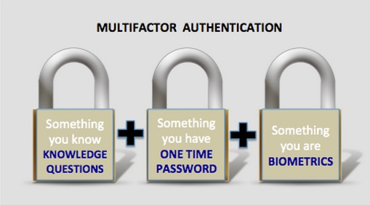
Authentication
Authentication is verification that an individual trying to access the system is authorised to do so.

Slide 18
Authentication
Let’s consider passwords, they should be:
  Easy to remember
  Hard to guess
  Changed often
  Never written down
  Never part of an automated login
Passwords are stored on the system in an encrypted format, so when you type in your password, it is encrypted using the same algorithm, and the two encryptions are compared to verify.

Slide 19
Authentication
Top 25 US Passwords in 2016
1. 123456 (Unchanged)
2. password (Unchanged)
3. 12345678 (Up 1)
4. qwerty (Up 1)
5. 12345 (Down 2)
6. 123456789 (Unchanged)
7. football (Up 3)
8. 1234 (Down 1)

Slide 20
Authentication
Top 25 US Passwords in 2016
9. 1234567 (Up 2)
10. baseball (Down 2)
11. welcome (New)
12. 1234567890 (New)
13. abc123 (Up 1)
14. 111111 (Up 1)
15. 1qaz2wsx (New)
16. dragon (Down 7)

Slide 21
Authentication
Top 25 US Passwords in 2016
17. master (Up 2)
18. monkey (Down 6)
19. letmein (Down 6)
20. login (New)
21. princess (New)
22. qwertyuiop (New)
23. solo (New)
24. passw0rd (New)
25. starwars (New)

Slide 22
Authentication
The longer the password, the better.
  A password of eight (8) letters, just using lowercase letters has 26⁸ (208,827,064,576) possible combinations.
  A password of ten (10) letters, just using lowercase letters has 26¹⁰ (141,167,100,000,000) possible combinations.
  A password of eight (8) letters, using all letters and numbers has 95⁸ (6,634,204,300,000,000) possible combinations.
  A password of ten (10) letters, using all letters and numbers has 95¹⁰ (59,873,694,000,000,000,000) possible combinations.

Slide 23
Authentication
Where are the passwords stored?
  On Windows:
    c:\windows\system32\config\SAM
  On Linux
    /etc/shadow
  On Unix and (some) Apple
    /etc/passwd

Slide 24
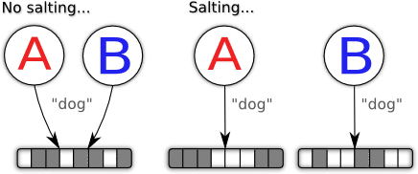
Authentication
Salting
Some operating systems (not Windows) make the passwords even harder to guess by adding in a few extra random bits into the encrypted password. So even if two people have the same password, they will be stored differently.

Slide 25
Authentication
Alternatives to passwords:
  CAPTCHAs
  reCAPTCHAs
  Smart Cards
  Biometrics

Slide 26

Authentication
CAPTCHAs
CAPTCHA ("Completely Automated Public Turing test to tell Computers and Humans Apart") is a type of challenge-response test.
The term was coined in 2003 by Luis von Ahn, Manuel Blum, Nicholas J. Hopper, and John Langford.
This form of CAPTCHA requires that the user type the letters of a distorted image, sometimes with the addition of an obscured sequence of letters or digits that appears on the screen

Slide 27

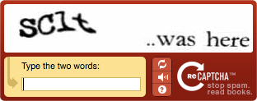
Authentication
reCAPTCHAs
The reCAPTCHA service supplies subscribing websites with images of words that are hard to read for optical character recognition (OCR) software.
The text is obscured with horizontal lines and warped.

Slide 28
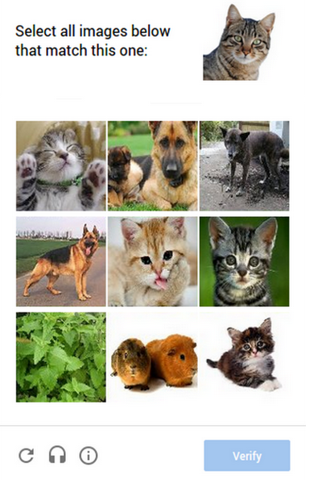
Authentication
Image reCAPTCHAs
In 2014, reCAPTCHA implemented another system in which users are asked to select one or more images from a selection of nine images.

Slide 29
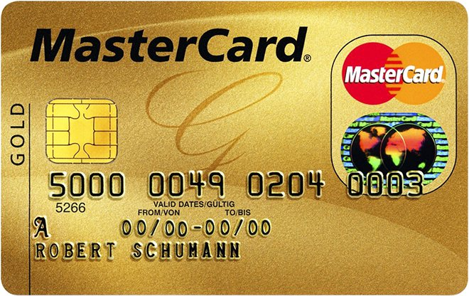
Authentication
Smart Cards
A smart card, chip card, or integrated circuit card (ICC) is any pocket-sized card that has embedded integrated circuits.
Smart cards can be either contact or contactless smart card. Smart cards can provide personal identification, authentication, data storage, and application processing.
Smart cards may provide strong security authentication for single sign-on (SSO) within large organizations.

Slide 30

Authentication
Biometrics
Biometrics authentication (or realistic authentication) is used as a form of identification and access control.
Examples include, but are not limited to fingerprint, palm veins, face recognition, DNA, palm print, hand geometry, iris recognition, retina and odour/scent.
Behavioral characteristics are related to the pattern of behavior of a person, including but not limited to typing rhythm, gait, and voice.

