Slide 1
Operating Systems Attacks
Damian Gordon

Slide 2
Intentional Attacks

Slide 3
Intentional Attacks
Denial-of-Service (DoS) Attack
Wiretapping
Viruses
Worms
Trojans

Slide 4
Denial-of-Service (DoS) Attack

Slide 5
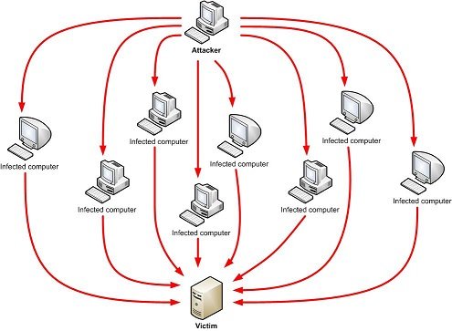
Denial-of-Service (DoS) Attack
Makes the “victim” computer unavailable to its users. Typically used on computers that act as Web Servers.

Slide 6
Denial-of-Service (DoS) Attack
Works by making the “victim” computer perform a task over and over again, thus preventing it from doing other jobs.
For example, if the computer is supposed to take orders from customers, and the first step is for the “victim” computer to identify itself to the customer computer, a DoS attack might keep making the “victim” computer identify itself and therefore unable to do other work.

Slide 7
Denial-of-Service (DoS) Attack
A Distributed Denial-of-Service (DDoS) is where the attack source is more than one, often thousands of, unique IP addresses.
It is like to a group of people crowding the entry door to a shop, and not letting legitimate customers enter into the shop or business, disrupting normal operations.

Slide 8
Denial-of-Service (DoS) Attack
How does it work?
There are a variety of approaches that can work, we’ll look at a HTTP POST DoS attack.

Slide 9
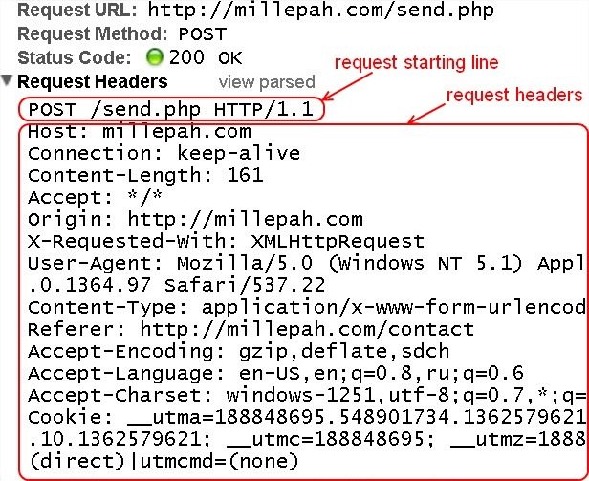
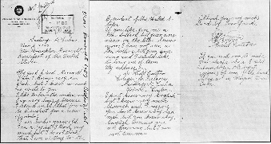
Denial-of-Service (DoS) Attack
HTTP
POST
Attack
How does it work?
There are a variety of approaches that can work, we’ll look at a HTTP POST DoS attack.
<HTTP Message>
HEAD
BODY

Slide 10
Denial-of-Service (DoS) Attack
HTTP
POST
Attack
A legitimate HTTP POST header, which includes a 'Content-Length' field to specify the size of the message body to follow. However, the attacker then proceeds to send the actual message body at an extremely slow rate (e.g. 1 byte/110 seconds).

Slide 11
Denial-of-Service (DoS) Attack
HTTP
POST
Attack
Due to the entire message being complete, the target server will attempt to obey the 'Content-Length' field in the header, and wait for the entire body of the message to be transmitted, which can take a very long time.

Slide 12
Denial-of-Service (DoS) Attack
HTTP
POST
Attack
The attacker establishes hundreds or even thousands of such connections, until all resources for incoming connections on the server (the victim) are used up, hence making any further (including legitimate) connections impossible until all data has been sent.

Slide 13
DoS Attack Case Study
Bollywood versus Anonymous

Slide 14
DoS Attack Case Study
Bollywood versus Anonymous
Bollywood is the nickname for the Hindi language film industry, based in Mumbai, the capital of Maharashtra in India. Bollywood is also one of the largest centres of film production in the world, and is more formally referred to as Hindi cinema.

Slide 15
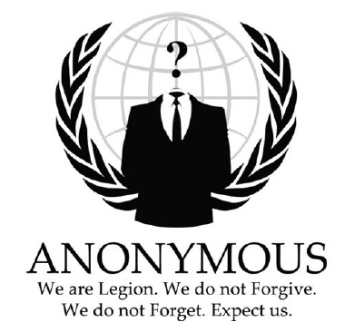
DoS Attack Case Study
Bollywood versus Anonymous
Anonymous are a loosely associated international network of activist and hacktivist groups. The group became known for a series of well-publicized publicity stunts and Denial-of-Service (DoS) attacks on government, religious, and corporate websites.

Slide 16
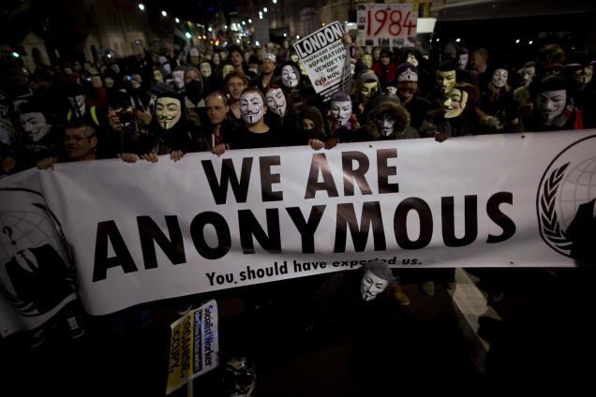
DoS Attack Case Study
Bollywood versus Anonymous
Anonymous are a loosely associated international network of activist and hacktivist groups. The group became known for a series of well-publicized publicity stunts and Denial-of-Service (DoS) attacks on government, religious, and corporate websites.

Slide 17
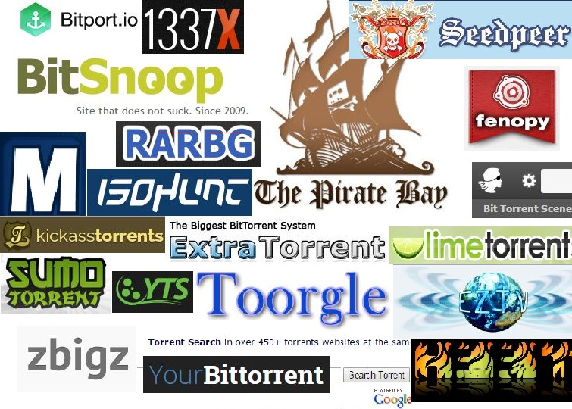
DoS Attack Case Study
Bollywood versus Anonymous
Bollywood was unhappy with the torrent sites:

Slide 18
DoS Attack Case Study
Bollywood versus Anonymous
In 2010, several Bollywood companies hired Aiplex Software to launch DDoS attacks on websites that did not respond to takedown notices.

Slide 19
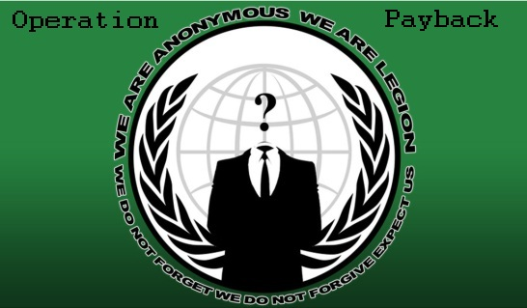
DoS Attack Case Study
Bollywood versus Anonymous
Piracy activists then created Operation Payback in September 2010 in retaliation

Slide 20
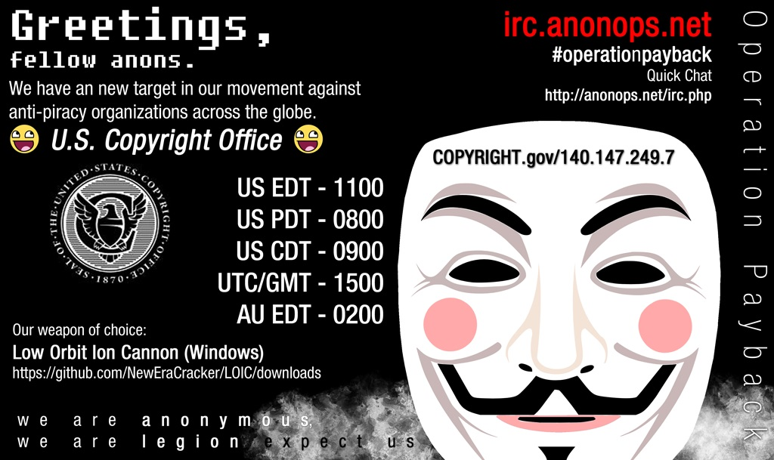

Slide 21
DoS Attack Case Study
Bollywood versus Anonymous
The original plan was to attack Aiplex Software directly, but upon finding some hours before the planned DDoS that another individual had taken down the firm's website on their own, Operation Payback moved to launching attacks against the websites of copyright stringent organisations Motion Picture Association of America (MPAA) and International Federation of the Phonographic Industry, giving the two websites a combined total downtime of 30 hours.

Slide 22
DoS Attack Case Study
Bollywood versus Anonymous
In the following two days, Operation Payback attacked a multitude of sites affiliated with the MPAA, the Recording Industry Association of America (RIAA), and British Phonographic Industry. Law firms such as ACS:Law, Davenport Lyons and Dunlap, Grubb & Weaver (of the US Copyright Group) were also attacked.

Slide 23
Wiretapping

Slide 24
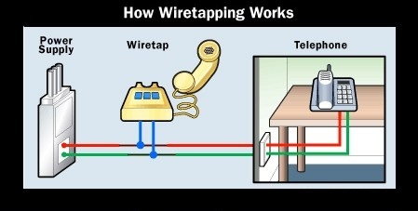
Wiretapping
Wiretapping has been around since the 1890s, it’s simply a matter of gaining access to the transmission media and using a device to intercept the signals.

Slide 25
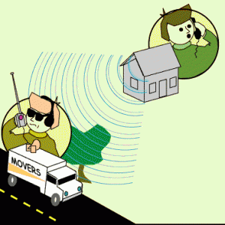
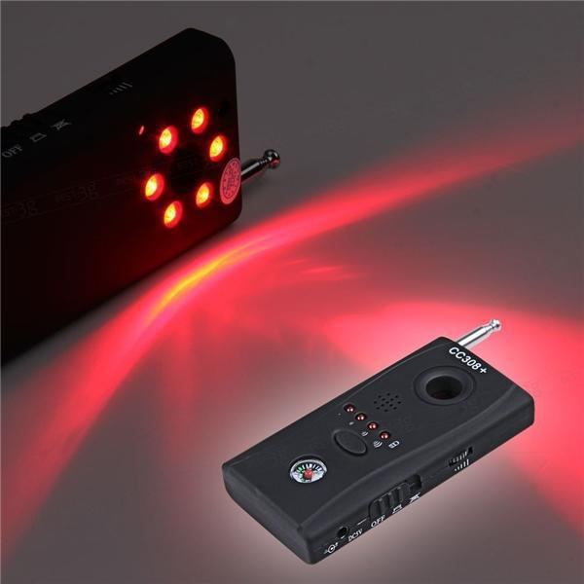
Wiretapping
Wireless wiretapping works in the exact same way, except that there is no need to have physical contact with the transmission media.
This is why we should encrypt wireless transmissions.

Slide 26
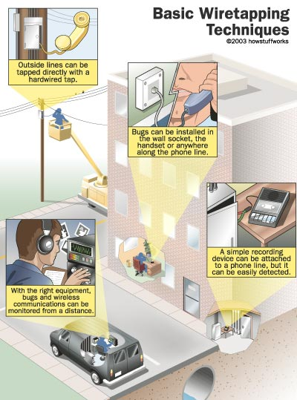
Wiretapping

Slide 27
Wiretapping
There are two forms of wiretapping:
Passive Wiretapping is where you are recording the data transmitted, but not interfering with it.
Active Wiretapping is where you are recording the data and also modifying it before it is sent onto the receiver.

Slide 28
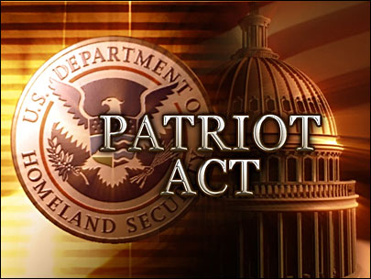
Wiretapping Case Study
USA Patriot Act
The USA PATRIOT Act
Title II: Enhanced Surveillance Procedures

Slide 29
Wiretapping Case Study
USA Patriot Act
The USA PATRIOT Act
Title II: Enhanced Surveillance Procedures
Section 209 made it easier for authorities to gain access to voicemail as they no longer must apply for a wiretap order, and instead just apply for a normal search warrant.
The FBI can secretly conduct a physical search or wiretap on U.S. citizens to obtain evidence of crime without proving probable cause, as the Fourth Amendment explicitly requires.

Slide 30
Wiretapping Case Study
What it doesn’t cover
USA Patriot Act
The USA PATRIOT Act
On February 9, 2016, the FBI asked Apple Inc. to create a new version of the phone's iOS operating system that could be installed and run in the phone's random access memory to disable certain security features that Apple refers to as "GovtOS“, the FBI had recovered an Apple iPhone 5C owned by the San Bernardino County, California government, that had been issued to its employee, Syed Rizwan Farook, one of the shooters involved in the December 2015 San Bernardino attack. The attack killed 14 people and seriously injured 22.

Slide 31
Wiretapping Case Study
What it doesn’t cover
USA Patriot Act
The USA PATRIOT Act
Apple declined due to its policy to never undermine the security features of its products. The FBI responded by successfully applying to a United States magistrate judge, Sherri Pym, to issue a court order, mandating Apple to create and provide the requested software. The order was not a subpoena, but rather was issued under the All Writs Act of 1789.

Slide 32
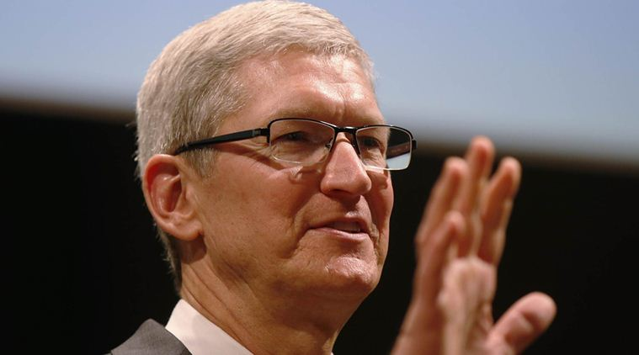
Wiretapping Case Study
What it doesn’t cover
USA Patriot Act
The USA PATRIOT Act
On February 16, 2016, Apple chief executive officer Tim Cook released an online statement to Apple customers, explaining the company's motives for opposing the court order. He also stated that while they respect the FBI, the request they made threatens data security by establishing a precedent that the U.S. government could use to force any technology company to create software that could undermine the security of its products.

Slide 33
Wiretapping Case Study
What it doesn’t cover
USA Patriot Act
The USA PATRIOT Act
On March 28, 2016, the FBI said it had unlocked the iPhone with the third party's help, and an anonymous official said that the hack's applications were limited; the Department of Justice vacated the case.

Slide 34
Wiretapping Case Study
What it doesn’t cover
USA Patriot Act
For more detail:
In September 2015, Apple released a white paper detailing the security measures in its iOS 9 operating system.
The iPhone 5C model can be protected by a four-digit PIN code. After more than ten incorrect attempts to unlock the phone with the wrong PIN, the contents of the phone will erase the AES encryption key that protects its stored data.
https://www.apple.com/business/docs/iOS_Security_Guide.pdf

Slide 35
Viruses

Slide 36
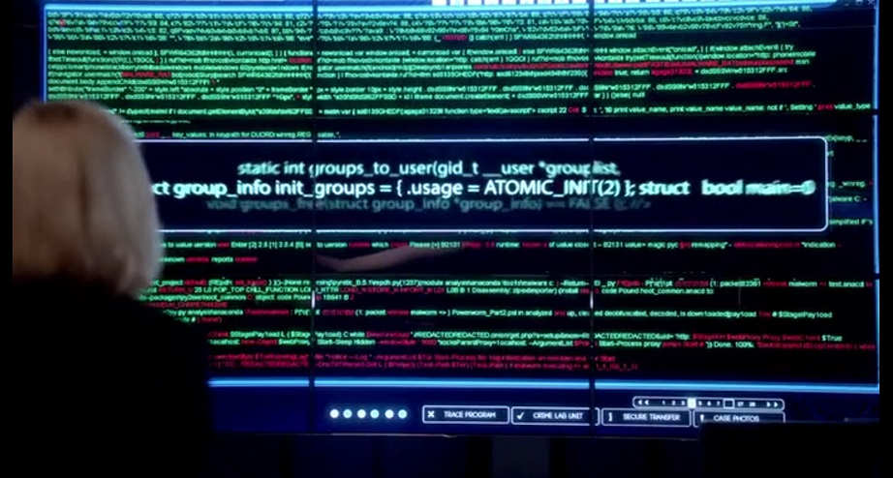
Viruses
A Computer Virus is a program that alters the way a computer works without permission of the user. It is typically self-executing and self-replicating.

Slide 37
Viruses
A Virus is typically written for a specific operating system, so a virus that works on Windows usually won’t work on Linux.
Virus writers exploit vulnerabilities in a specific operating systems.

Slide 38
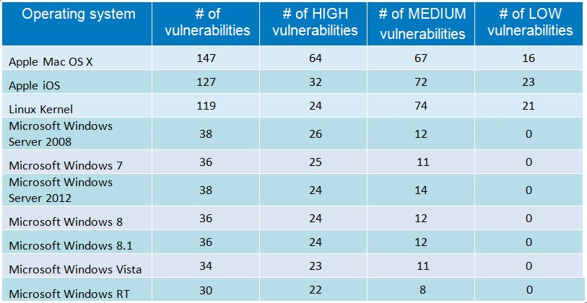
Viruses
Most vulnerable operating systems and applications in 2014

Slide 39
Viruses
Most vulnerable operating systems and applications in 2015

Slide 40
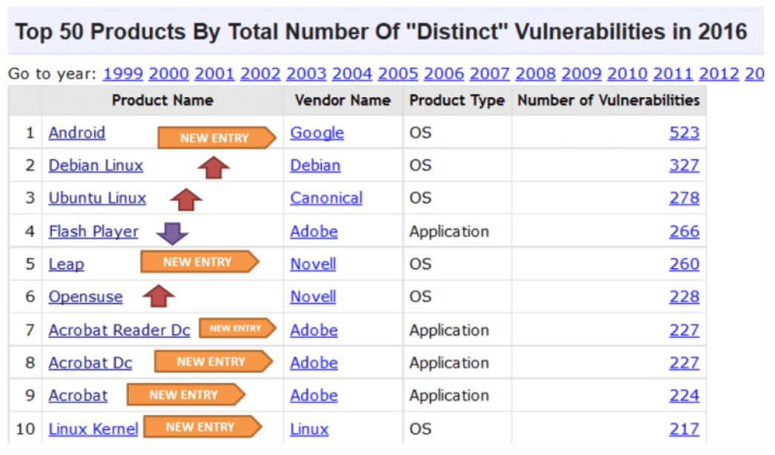
Viruses
Most vulnerable operating systems and applications in 2016

Slide 41
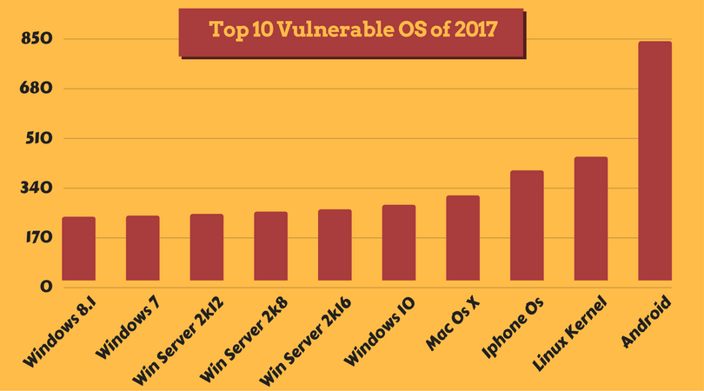
Viruses
Most vulnerable operating systems and applications in 2017

Slide 42
Types of Viruses
Boot Sector Virus
File Infector Virus
Macro Virus
Multipartite Virus
Polymorphic Virus

Slide 43
Types of Viruses
Boot Sector Virus: Infects the boot sector. There are two types of boot sector viruses:
Master Boot Record (MBR): A MBR can contain code that locates and invokes its volume record.
Volume Boot Record (VBR): A VBR can contain code that loads and invokes the operating system.

Slide 44
Types of Viruses
File Infector Virus: Perhaps the most common type of virus, the file infector takes root in a host file. This type of virus may end up deleting the file that was originally infected, or it may rewrite it or replace it with something else.
Usually infects .COM and .EXE files.

Slide 45
Types of Viruses
Macro Virus: This is a virus that can be hidden in data files, like Word documents and Spreadsheets.
Disable macros on files that you don’t trust.

Slide 46
Types of Viruses
Multipartite Virus: A virus of this type may spread in multiple ways, and it may take different actions on an infected computer depending on variables, such as the operating system installed or the existence of certain files.
Can infect boot sector and files.

Slide 47
Types of Viruses
Polymorphic Virus: A polymorphic Virus can mutate over time or after every contaminated file and changes the code that is used to deliver the payload.

Slide 48
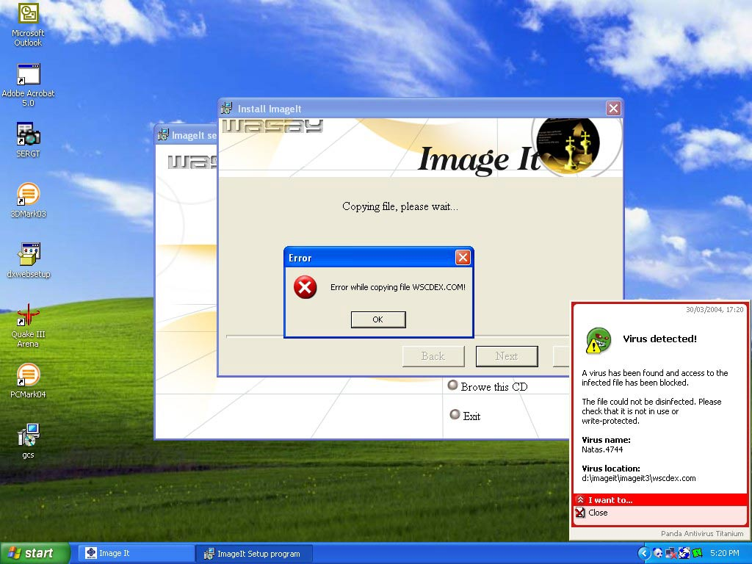
Virus Case Study
Natas Virus
The Natas Virus

Slide 49
Virus Case Study
Natas Virus
The Natas Virus
Natas is a memory-resident stealth virus which is highly polymorphic, that affects master boot records, boot sectors of diskettes, files .COM and also .exe programs.

Slide 50
Virus Case Study
Natas Virus
The Natas Virus
Natas (Satan spelled backwards) is a computer virus written by James Gentile, a then 18-year-old hacker from San Diego, California who went by the alias of "Little Loc" and later "Priest".
The virus was made for a Mexican politician who wanted to win the Mexican elections by affecting all the Mexican Federal Electoral Institute (IFE) computers with a floppy disk.

Slide 51
Virus Case Study
Natas Virus
The Natas Virus
The virus first appeared in Mexico City in May 1992, spread by a consultant using infected floppy disks. The virus became widespread in Mexico and the southwest United States.
The virus also made its way to the other side of the USA, infecting computers at the United States Secret Service knocking their network offline for approximately three days.

Slide 52
Virus Case Study
Natas Virus
The Natas Virus
When a file infected with Natas is executed, it becomes memory resident, taking up 5,664 bytes in memory and infects the master boot record and COMMAND.COM. The virus infects files when they are executed, opened or copied, appending its 4,746 bytes to .COM, .EXE and .OVL files.

Slide 53
Worms

Slide 54
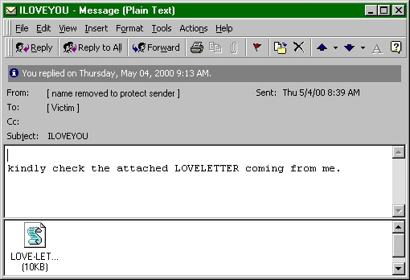
Worms
A computer worm is program that replicates itself in order to spread to other computers (often using a computer network). Unlike a computer virus, it does not need to attach itself to an existing program

Slide 55
Worms
Worms usually slow down processor time, and take up memory space, they also typically take up network bandwidth.
Some worms that have been created are designed only to spread, and do not attempt to change the systems they pass through. However, as the Morris worm and Mydoom showed, even these worms can cause major disruption by increasing network traffic.

Slide 56
Helpful Worms
Since the start of computer networks there have been attempts to create useful worms, for example, the Nachi family of worms tried to download and install patches from Microsoft's website to fix vulnerabilities in the host system—by exploiting those same vulnerabilities.

Slide 57
Helpful Worms
In practice, although this may have made these systems more secure, it generated considerable network traffic, rebooted the machine in the course of patching it, and did its work without the consent of the computer's owner.
Several worms, like XSS worms, have been written to research how worms spread. For example, the effects of changes in social activity or user behaviour.

Slide 58
Worm Case Study
“I love you” worm
The ILOVEYOU Worm

Slide 59
Worm Case Study
“I love you” worm
The ILOVEYOU Worm
ILOVEYOU, sometimes referred to as Love Letter, was a computer worm that attacked tens of millions of Windows personal computers on and after May 4th, 2000.
it started spreading as an email message with the subject line "ILOVEYOU" and the attachment "LOVE-LETTER-FOR-YOU.txt.vbs“

Slide 60
Worm Case Study
“I love you” worm
The ILOVEYOU Worm
The worm did damage on the local machine, overwriting random types of files (including Office files, image files, and audio files; however after overwriting MP3 files the virus would hide the file), and sent a copy of itself to all addresses in the Windows Address Book used by Microsoft Outlook.

Slide 61
Worm Case Study
“I love you” worm
The ILOVEYOU Worm
The worm originated in the Philippines, thereafter across the world, moving first to Hong Kong, then to Europe, and finally the United States, as employees began their workday that Friday morning. The outbreak was later estimated to have caused US $5.5-8.7 billion in damages worldwide, and estimated to cost the US $15 billion to remove the worm.

Slide 62
Trojans

Slide 63
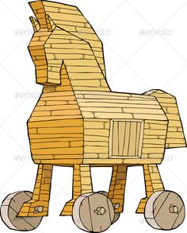
Trojans
A Trojan is a malicious program that misrepresents itself to appear useful, routine, or interesting in order to persuade a victim to install it.

Slide 64
Trojans
Trojans are generally spread by some form of social engineering, for example where a user is duped into executing an e-mail attachment disguised to be unsuspicious, (e.g., a routine form to be filled in), or by downloading.
Unlike computer viruses and worms, Trojans generally do not attempt to inject themselves into other files or otherwise propagate themselves.

Slide 65
Trojans
Types of things Trojans do:
Destructive Behaviour
Use of Resources, or Identity
Money, Theft, or Ransom
Data Theft
Spying, Surveillance, or Stalking

Slide 66
Trojans
Destructive Behaviour
Crashing the computer or device.
Modification or deletion of files.
Data corruption.
Formatting disks, destroying all contents.
Spread malware across the network.
Spy on user activities and access sensitive information.

Slide 67
Trojans
Use of Resources, or Identity
Use of the machine as part of a botnet (e.g. to perform automated spamming)
Using computer resources for mining cryptocurrencies
Using the infected computer as proxy for illegal activities and/or attacks on other computers.
Infecting other connected devices on the network.

Slide 68
Trojans
Money, Theft, or Ransom
Electronic money theft
Installing ransomware such as CryptoLocker

Slide 69
Trojans
Data Theft
Data theft, including for industrial espionage
User passwords or payment card information
User personally identifiable information
Trade secrets

Slide 70
Trojans
Spying, Surveillance, or Stalking
Keystroke logging
Watching the user's screen
Viewing the user's webcam
Controlling the computer system remotely

Slide 71
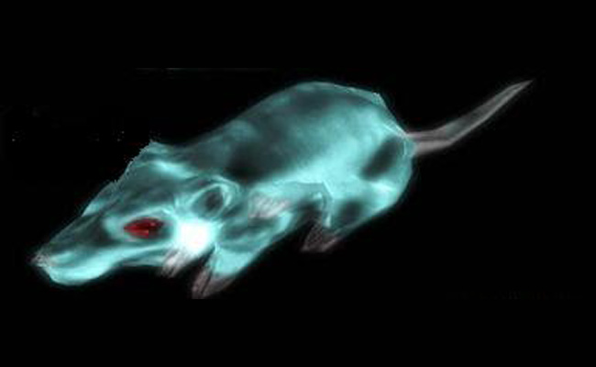
Trojan Case Study
Gh0st RAT
Trojan
The Gh0st RAT Trojan

Slide 72
Trojan Case Study
Gh0st RAT
Trojan
The Gh0st RAT Trojan
Gh0st RAT is a Trojan horse for the Windows platform that was used to hack into some of the most sensitive computer networks on Earth. It is a cyber spying computer program. The "Rat" part of the name refers to the software's ability to operate as a "Remote Administration Tool".

Slide 73
Trojan Case Study
Gh0st RAT
Trojan
The Gh0st RAT Trojan
It can:
Take full control of the remote screen.
Provide real time as well as offline keystroke logging.
Provide live feed of webcam, and microphone.
Download remote binaries on the infected remote host.
Take control of remote shutdown and reboot of host.
Disable infected computer remote keyboard input.
Enter into shell of remote infected host with full control.
Provide a list of all the active processes.

Slide 74
Trojan Case Study
Gh0st RAT
Trojan
The Gh0st RAT Trojan
Gh0st Rat was originally made by the C.Rufus Security Team in 2005. Just as with other well-featured “off-the-shelf” trojans like Poison Ivy, Hupigon and DarkComet it has been used by all sorts of people – from script kiddies to resourceful targeted attack actors.

Slide 75
Trojan Case Study
Gh0st RAT
Trojan
The Gh0st RAT Trojan
In less than two years (2007-2009) Gh0st Rat infiltrated at least 1,295 computers in 103 countries, including many belonging to embassies, foreign ministries and other government offices, as well as the Dalai Lama’s Tibetan exile centres in India, Brussels, London and New York.

Slide 76
Unintentional Attacks

Slide 77
Unintentional Attacks
An unintentional attack is any breach of security that was not as a result of a planned intrusion.
For example, if two processes are updating the same record and it results in an incomplete modification of the record, that is an unintentional attack.

Slide 78
Unintentional Attacks
The Year 2000 problem (aka the Millennium bug, or the Y2K bug) was caused by programmers who reduced the four-digit year to two digits.
This made the year 2000 indistinguishable from 1900.

Slide 79
Unintentional Attacks
Unintentional Denial-of-Service
When Michael Jackson died in 2009, websites such as Google and Twitter slowed down or even crashed. Many sites' servers thought the requests were from a virus or spyware trying to cause a denial-of-service attack, warning users that their queries looked like "automated requests from a computer virus or spyware application".

