Slide 1
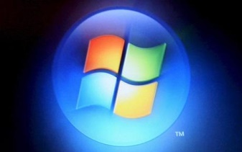
A History of Windows
Damian Gordon

Slide 2
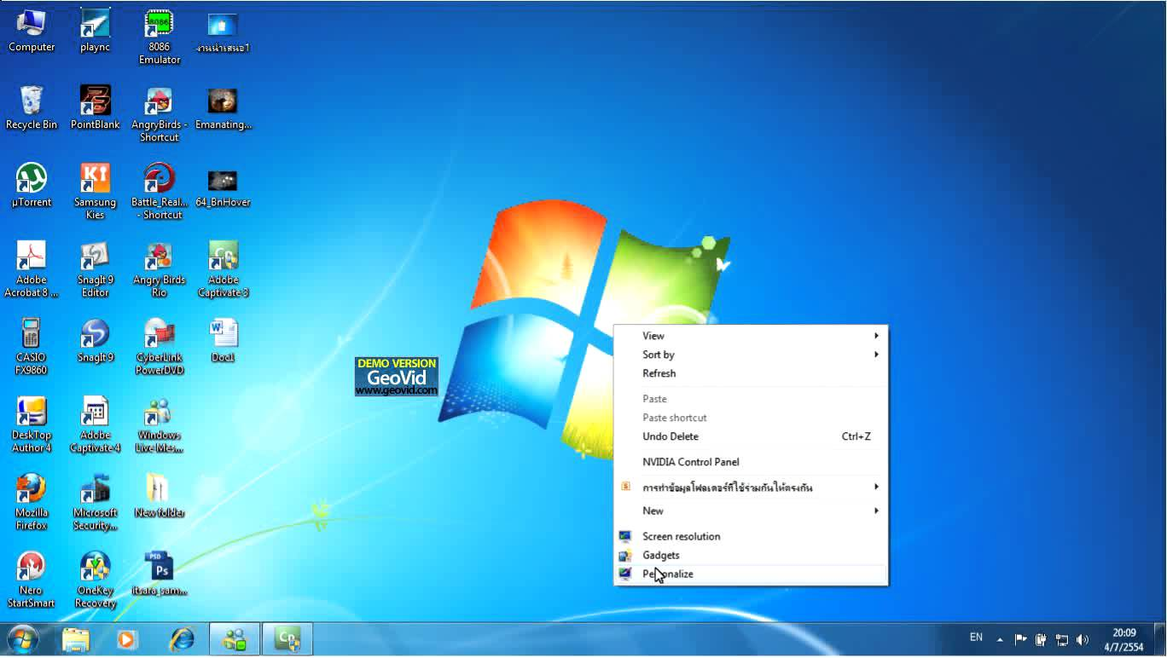

Slide 3
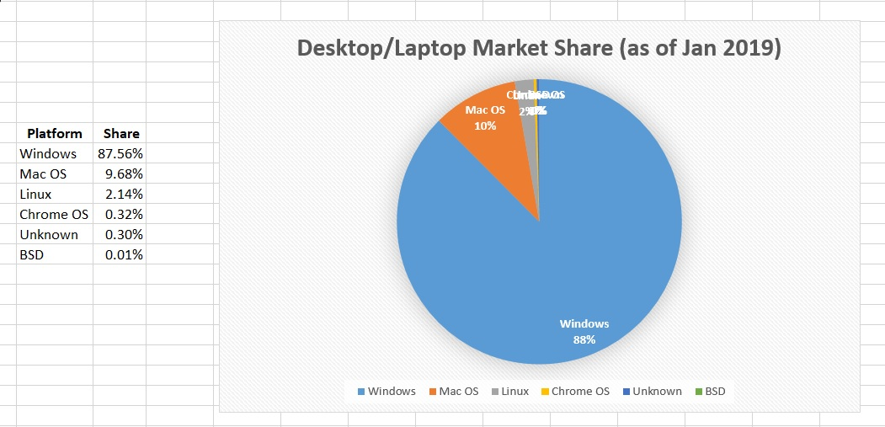
Desktop market share (31/1/2019)
Full Details here

Slide 4
Desktop market share (31/1/2019)
87.5%
Share
Full Details here

Slide 5
Timeline of Windows
1985
Win 1
1990
Win 3
1995
Win 95
2000
Win 2000
2001
Win XP
2009
Win 7
2015
Win 10
1981
MS-DOS
1987
Win 2
1993
Win NT
1998
Win 98
2000
Win ME
2007
Win Vista
2012
Win 8

Slide 6
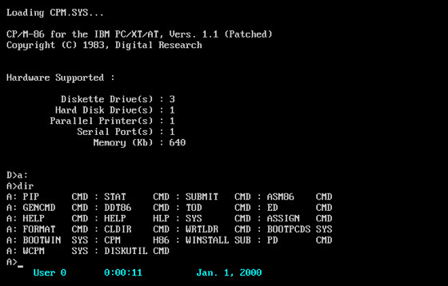
MS-DOS
August
1981
Microsoft Disk Operating System
Command-line interface (CLI)
Microsoft bought an existing operating system from Seattle Computer Products (86-DOS), for $75,000 in 1981.

Slide 7
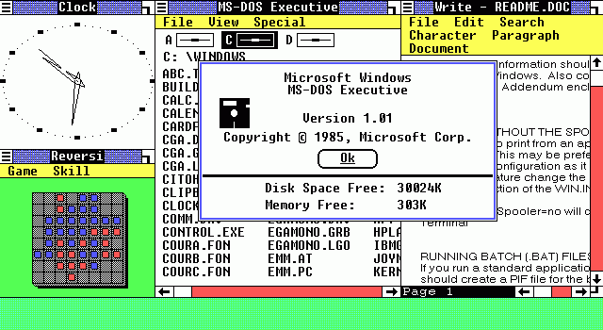
Windows 1.0
20th
November
1985
16-bit multi-tasking shell on top of an existing MS-DOS installation
Limited multi-tasking
The development of Windows began after Bill Gates saw a demonstration of VisiCorp's Visi On.

Slide 8
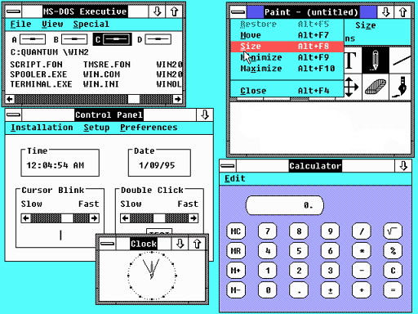
Windows 2.0
9th
December 1987
Allows application windows to overlap
First version to integrate the control panel
On March 17, 1988, Apple filed a lawsuit against Microsoft and HP, accusing them of copying the Macintosh System.
Apple lost.

Slide 9
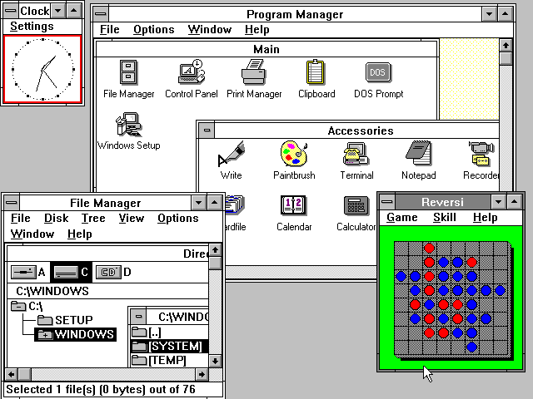
Windows 3.0
22nd
May
1990
Protected/Enhanced mode to run Windows applications with reduced memory issues
Better memory management
Developed based on work by David Weise and Murray Sargent in 1989.

Slide 10
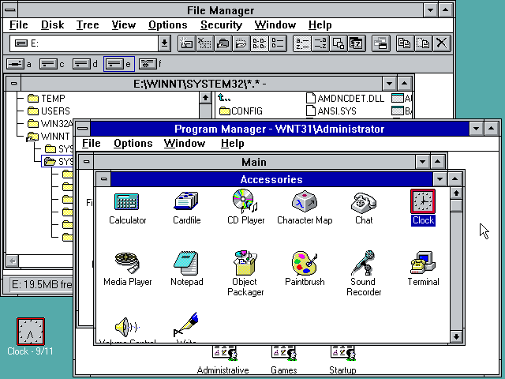
Windows NT
27th
July
1993
Portability to multiple processor architectures, as well as higher security and stability
Designed from scratch (“Unix killer”)
Bill Gates hired David Cutler from DEC to design Windows NT.
(WNT = VMS)

Slide 11
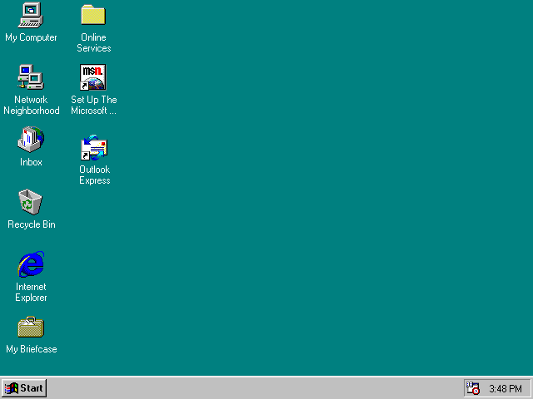
Windows 95
24th
August
1995
Chicago
Introduced the taskbar, the 'Start' button, and the way the user navigates
Moved to multitasked 32-bit architecture
Windows 95 included support for 255-character mixed-case long filenames.

Slide 12
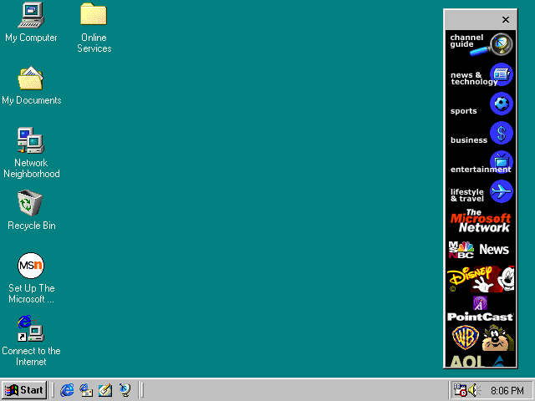
Windows 98
25th
June
1998
Memphis
Improved power management, network management, and USB support
Added Standby and Hibernate modes
Introduced the Windows Driver Model (WDM) to manage device drivers.

Slide 13
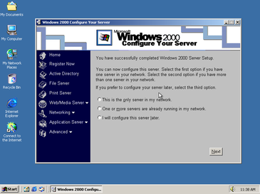
Windows 2000
17th
February
2000
Jim Allchin didn't like codenames
Added NTFS (New Technology File System) 3.0, the Microsoft Management Console (MMC), and the Encrypting File System (EFS)
Also Active Directory
A number of new assistive technologies to support for people with disabilities were introduced.

Slide 14
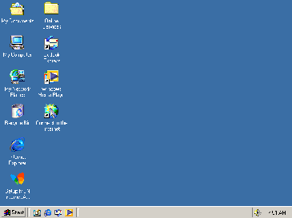
Windows ME
14th
September
2000
Millennium
Introduced a System Restore feature, and improved digital media and networking tools
Restricted access to real mode MS-DOS
Criticized for speed and stability issues, a PC World article dubbed Windows ME the "Mistake Edition“
(Very short shelf-life)

Slide 15
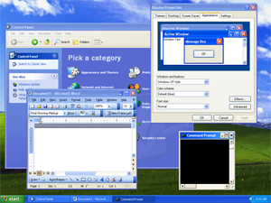
Windows XP
25th
October
2001
Neptune
Improved taskbar and ‘Start’ menu, better networking features
Newly improved user interface
The first version of Windows to use product activation in an effort to reduce software piracy.

Slide 16
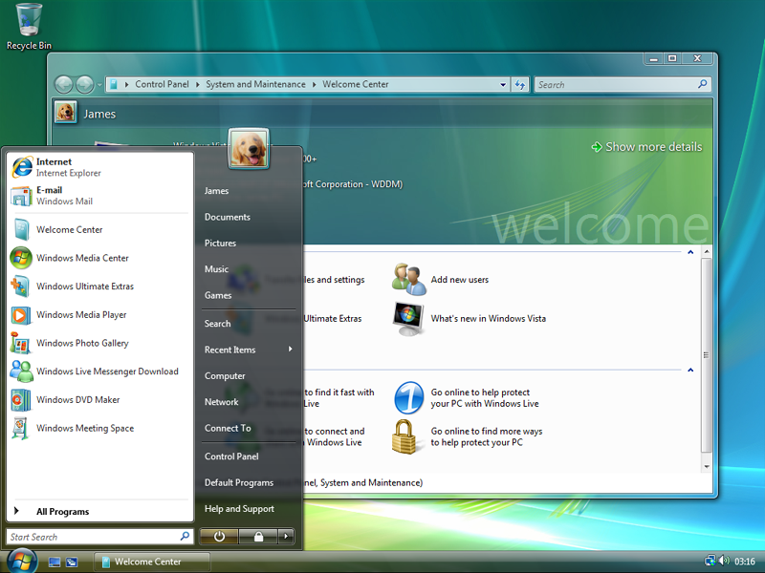
Windows Vista
30th
January
2007
Longhorn
Introduced Windows Search, Windows Aero, Windows Sidebar, Shadow Copy
Integrated Speech Recognition
Criticisms of Vista
- high system requirements
- more restrictive licensing
- new digital rights management
- lack of compatibility with some pre-Vista hardware and software

Slide 17
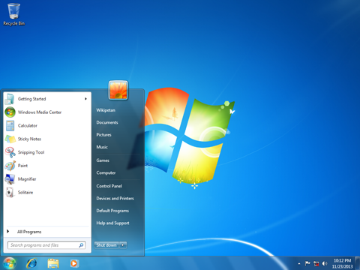
Windows 7
22nd
October
2009
Blackcomb
Support for virtual hard disks, better multi-core processors performance, and kernel
Improved touch and handwriting recognition
Intended to address criticisms faced by Windows Vista, such as performance improvements

Slide 18
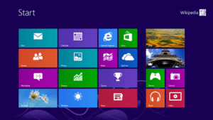
Windows 8
26th
October
2012
Jupiter
Heavier integration with online services from Microsoft and others (Skydrive, Xbox)
Faster startup through UEFI integration
User interface focused on tablets users, including a touch-optimized shell using the "Metro" design language, and a new 'Start' screen
(No ‘Start button)

Slide 19
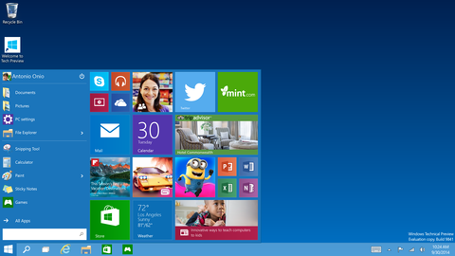
Windows 10
29th
July
2015
Threshold
Return of ‘Start’ button, a virtual desktop system, integration with Windows Phone
Device dependent interface
Incorporates Microsoft's intelligent personal assistant Cortana

Slide 20
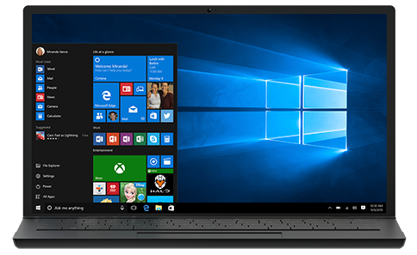
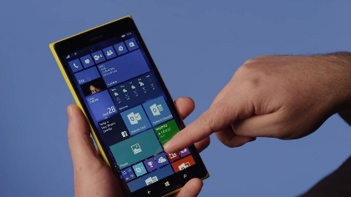
Windows 10.5
13th
November
2018
Redstone
Changes to File Explorer tool
Window Security improvements
Added Network Support
Lots more features for Windows on phones

