Slide 1
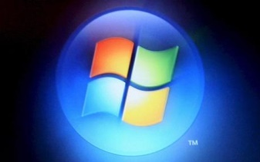
Hacking Windows
Damian Gordon

Slide 2
Hacking Windows
Most Windows vulnerabilities are well-known, and variations of vulnerabilities that have been around for a very long time.
Thus if patches are applied correctly many Windows attacks are preventable, but Security Management is prevalent in a lot of organisations.

Slide 3
Hacking Windows
If you can connect to a Windows computer, you can usually extract a lot of information, particularly if the system has been set up with the default configurations.

Slide 4
Hacking Windows
What sort of tools does Windows provide that can be used to discover system information?

Slide 5
nbtstat
Displays protocol statistics and current TCP/IP connections using NBT (NetBIOS over TCP/IP)

Slide 6
nbtstat
Displays protocol statistics and current TCP/IP connections using NBT (NetBIOS over TCP/IP)
network
Network I/O
network

Slide 7
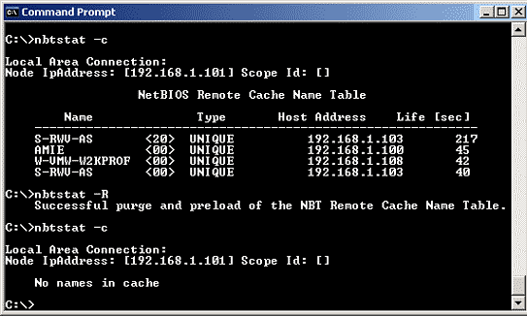
nbtstat

Slide 8
netstat
Displays network statistics and current TCP.

Slide 9
netstat
Displays network statistics and current TCP.
network

Slide 10
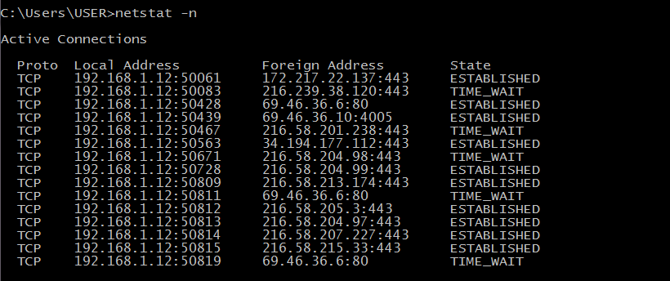
netstat

Slide 11
MBSA
Microsoft Baseline Security Analyzer
https://www.microsoft.com/en-IE/download/details.aspx?id=19892
Test for missing patches and basic Windows security settings.

Slide 12
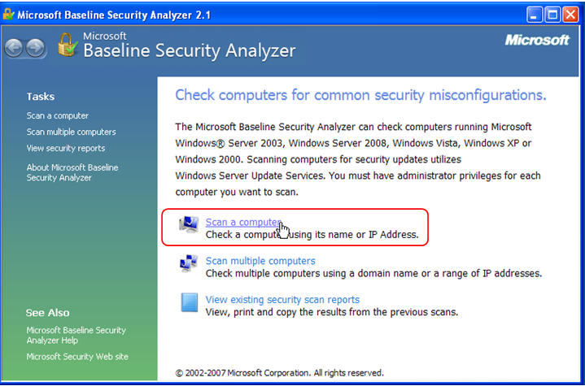
MBSA

Slide 13
Non-Free Tools
GFI LanGuard
Nexpose
Metasploit Framework and Metasploit Pro
NetScanTools Pro
SoftPerfect Network Scanner
TCPView
Winfo

Slide 14
Gathering Information
1. Run a scan for open ports, use something like NetScanTools Pro.

Slide 15
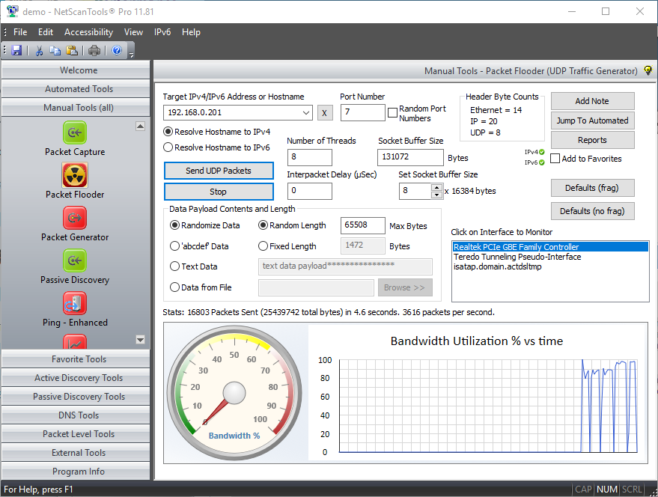

Slide 16
Gathering Information
2. Scan for shares, and versions of the Server Message Block, using LanGuard.

Slide 17
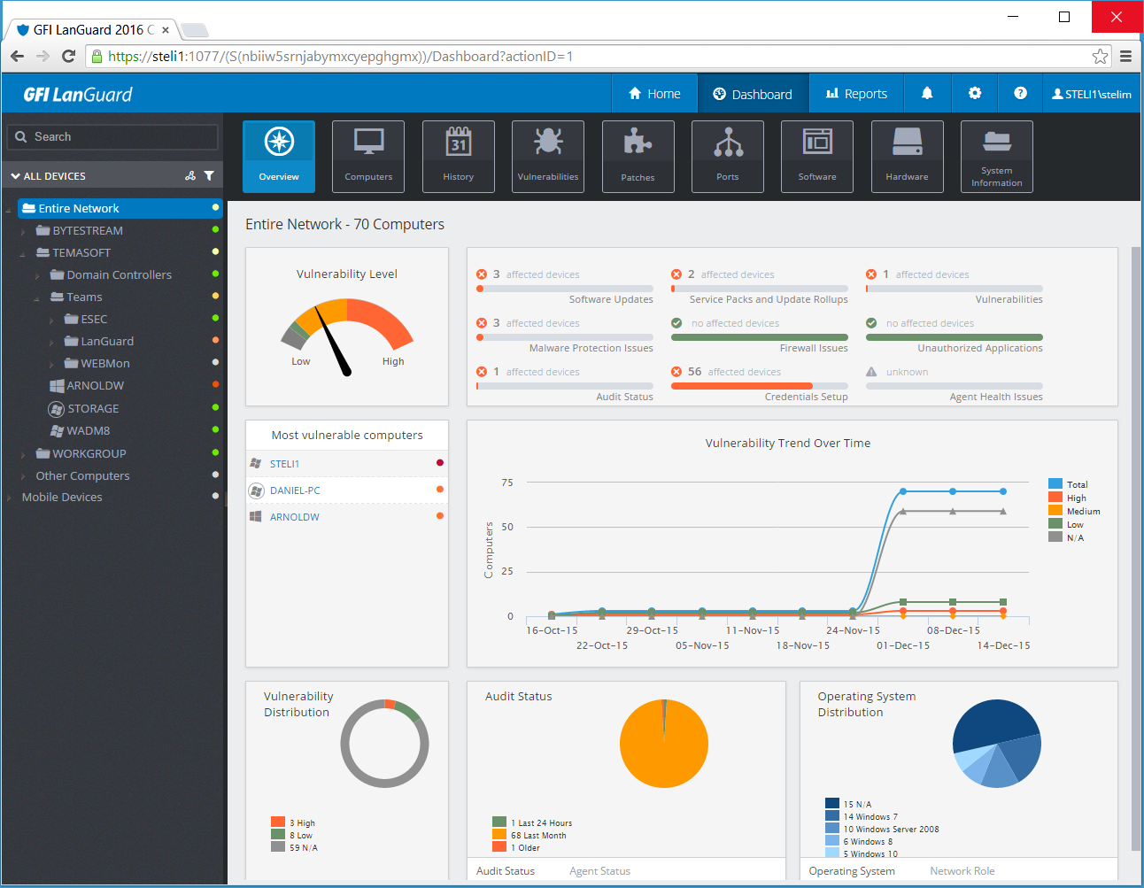

Slide 18
How to stop scanning
Make sure the network firewall is up and running, and running Internet Information Services (IIS)
Have personal firewalls on each machine, and consider blocking ports, such as RPC (port 135) and NetBIOS (ports 137, 138, 139, 445)
Disable any unnecessary services

Slide 19
Misconfigured Shares
Windows allows you to easily share folders or devices
Share can be misconfigured, allowing users, malware, and external attackers to access information (once there are in the network)
LanGuard has a Share Finder Tool to search for shares

Slide 20
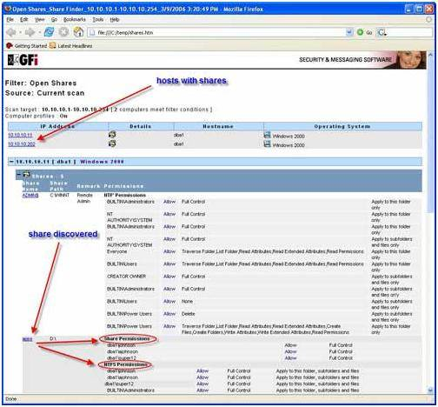

Slide 21
Windows 10 Security
Windows 10 is a very secure system
Patch management is much improved
BitLocker and full-disc encryption are also improved
Lots of tools in Windows Defender
Improved User Authentication

