Slide 1
DOS Commands
Damian Gordon

Slide 2
dir
List all the files in the current folder.

Slide 3
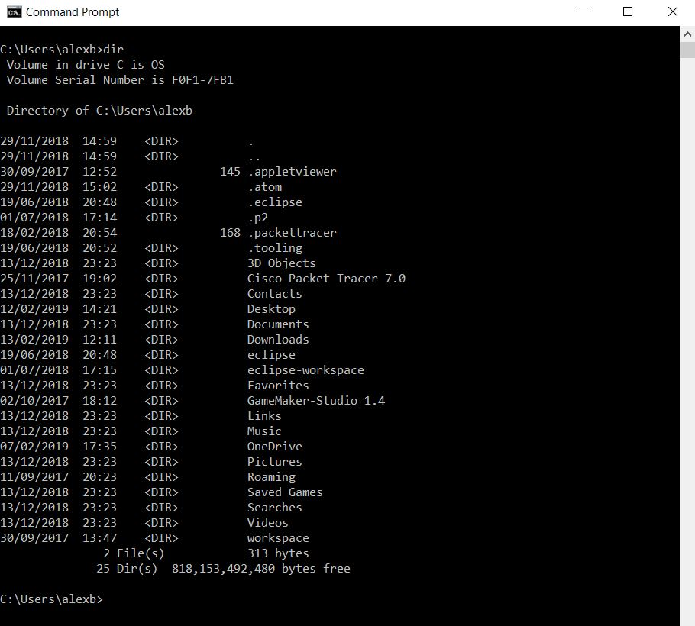
dir

Slide 4
help
List all the possible DOS commands, and explain what they do.

Slide 5
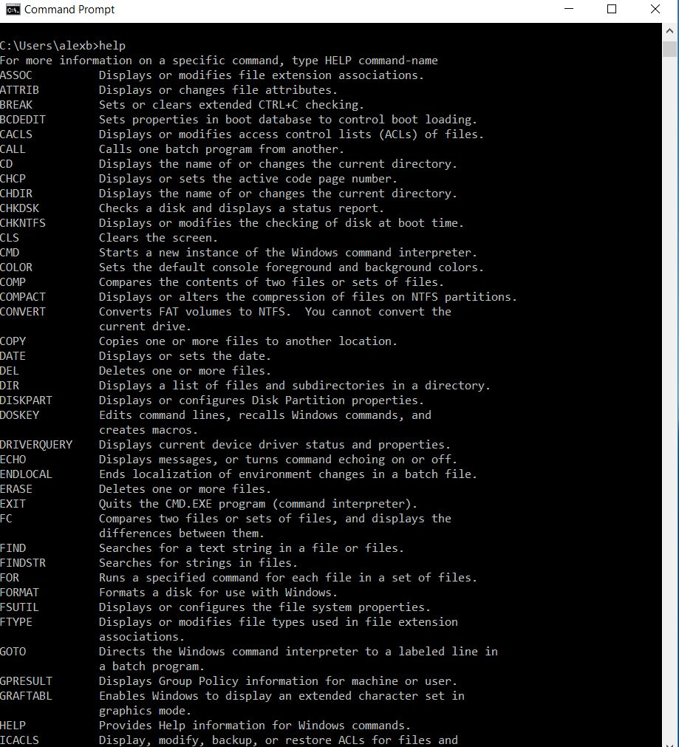
help

Slide 6
cls
Clear the screen.

Slide 7
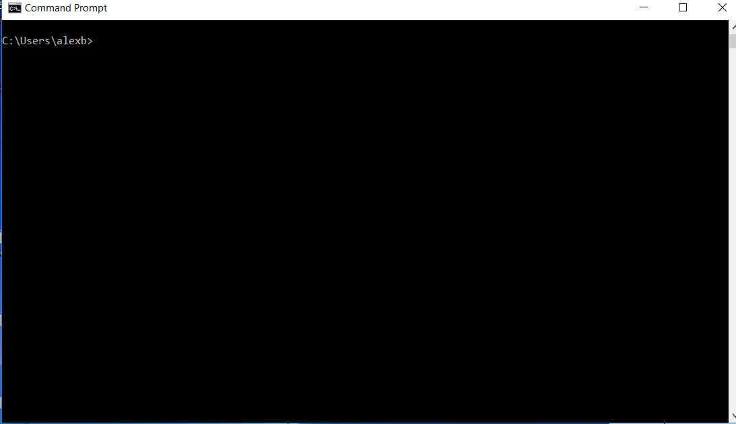
cls

Slide 8
echo hello world
Print out whatever arguments come after the ‘echo’ command.

Slide 9
path
List all the directories that DOS will search through to locate a command executable.

Slide 10
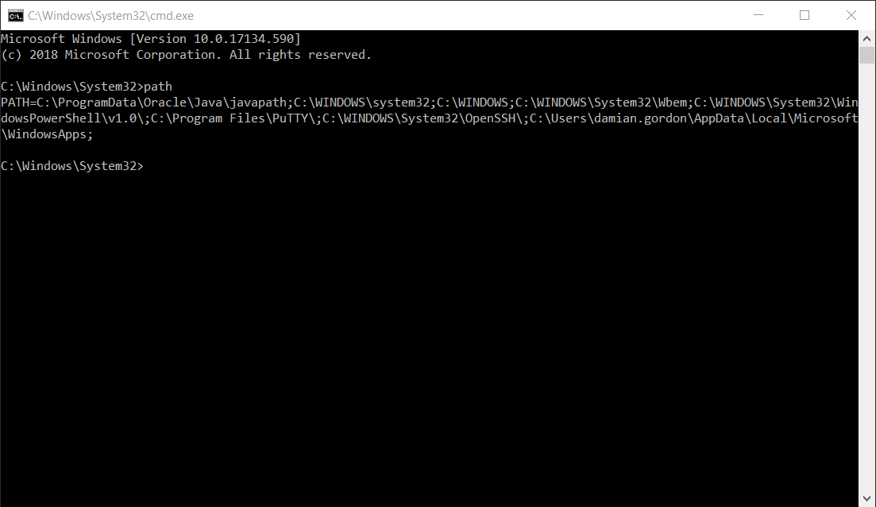
path

Slide 11
cd ..
Change directory to one level higher up in the hierarchy structure.

Slide 12
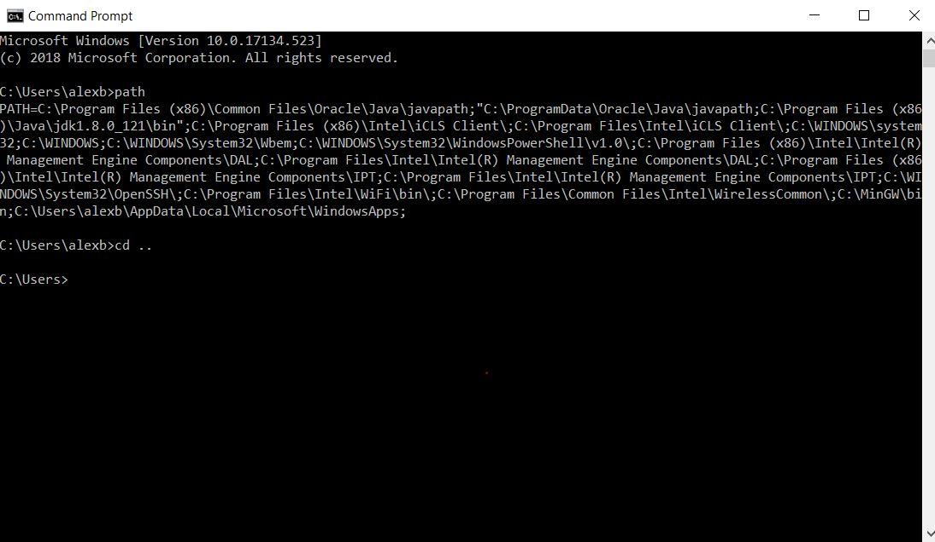
cd ..

Slide 13
tree
Print out a graphical representation of all the folders in the system.

Slide 14
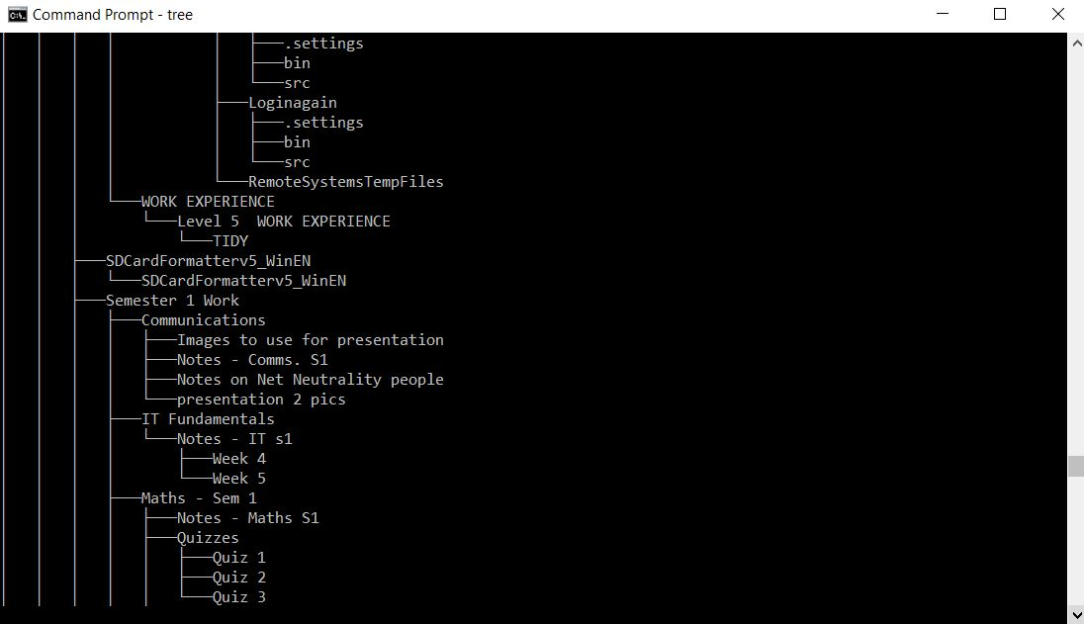
tree

Slide 15
MORE ON PATH

Slide 16
path
List all the directories that DOS will search through to locate a command executable.

Slide 17
path

Slide 18
path
echo %PATH%

Slide 19
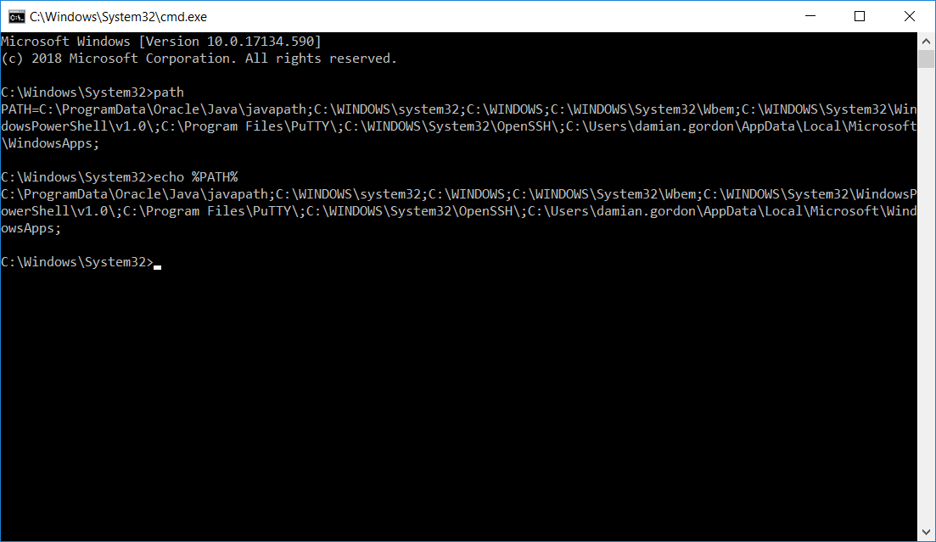
path

Slide 20
path
>set path = %path%;C:\Users\Dieter\AppData\Local\Programs\Python\Pytjon36-32

Slide 21
path
>set path = %path%;C:\Users\Dieter\AppData\Local\Programs\Python\Pytjon36-32
SET will add the new directory to the PATH as long as the current DOS window is open.

Slide 22
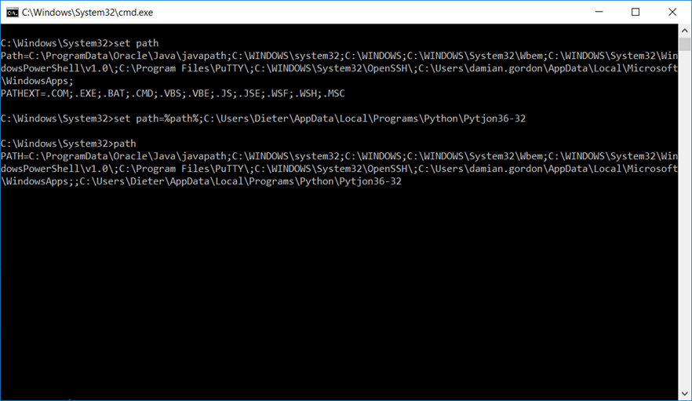
path

Slide 23
path
>setx path = %path%;C:\Users\Dieter\AppData\Local\Programs\Python\Pytjon36-32

Slide 24
path
>setx path = %path%;C:\Users\Dieter\AppData\Local\Programs\Python\Pytjon36-32
SETX will add the new directory to the PATH as long as the current DOS window is open.

Slide 25
HACKING COMMANDS

Slide 26
Hacking Commands
doskey /history
Display command history.

Slide 27
Hacking Commands
ipconfig && mspaint
Run two commands together (&&).

Slide 28
Hacking Commands
driverquery
See all the drivers installed on your computer.

Slide 29
Hacking Commands
ipconfig | clip
Send the command’s output to the clipboard.

Slide 30
Hacking Commands
sfc /scannow
Run a system file checker tool that scans Windows system files and looks for problems.

