Slide 1
Fetch-Decode-Execute Cycle and the von Neumann Architecture
Damian Gordon

Slide 2
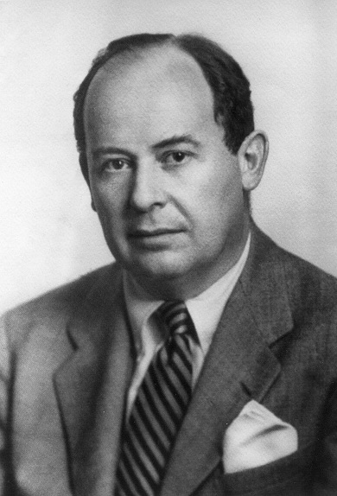
John von Neumann
Born: December 28, 1903
Died: February 8, 1957
Born in Budapest, Austria-Hungary
A mathematician who made major contributions to set theory, functional analysis, quantum mechanics, ergodic theory, continuous geometry, economics and game theory, computer science, numerical analysis, hydrodynamics and statistics.

Slide 3
von Neumann Architecture
Most computer architectures conform to the so-called von Neuman Architecture. This means that they execute programs by accessing both instructions and data on the same storage device.
The computer performs the following sequence of steps;

Slide 4
Fetch-Decode-Execute Cycle
Fetch the next instruction from memory at the address in the program counter
Decode the instruction using the control unit
Increment the Program Counter
The control unit commands the rest of the computer to execute the instruction
Go to step 1

Slide 5
Fetch-Decode-Execute Cycle
This is the Fetch-Decode-Execute (FDE) cycle. These computers are known as Stored-Program Computers since the separation of storage from the processing unit is implicit in this model.

