Slide 1
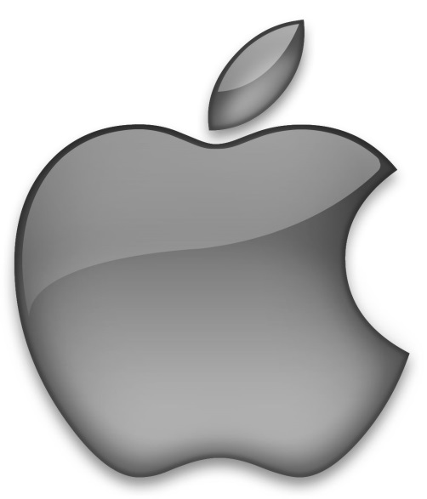
Mac OS By Team 9
Josh Brownlow,
Kevin Furlong,
David Long,
Fahid Othman,
Seamus E. Timmons,

Slide 2
Table of contents:
Introduction: 3
Bio’s 4
Timeline of Mac OS: 8
Mac OS Architecture 9
Early Systems: 10
System 7.6 / Mac OS: 13
Mas OS X Cheetah: 16
Mac OS X Yosemite: 19
Conclusion: 22
Questions: 23

Slide 3
Introduction
We’re going to talk about the Mac OS
From the early years of the Systems,
To the current day Mac OS X

Slide 4
Steve Wozniak
Born: August 11, 1950 (age 64)
San Jose, California, USA
Developed the Apple 1 computer
Co-founder of Apple

Slide 5
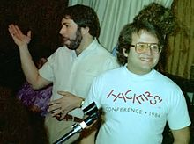
Andy Hertzfeld
Born: April 6, 1953(age 61)
Born in Philadelphia, Pennsylvania, USA
Worked for apple from 1979-1984
Was a primary software architect of the Macs origional system software
His buisiness card at Apple listed his title as “Software Wizard”

Slide 6
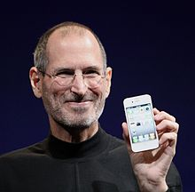
Steve Jobs
February 24, 1955 - October 5, 2011
Born in San Francisco, California, USA
Co-founder, Chairman and CEO of Apple
Awarded the National Medal of Technology in 1985

Slide 7
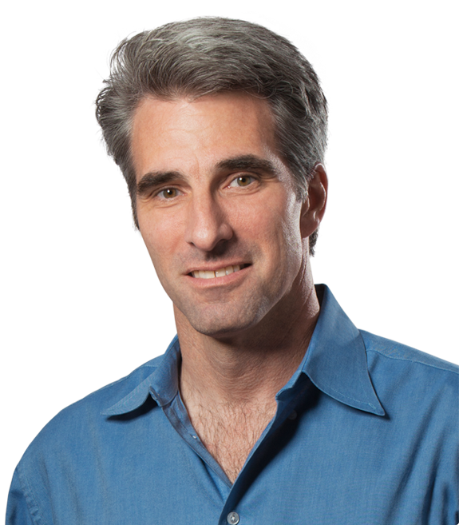
Craig Federighi
Born 1970(age 44-45)
Worked at NeXT, then Apple, then worked for Ariba for several years.
Returned to apple in 2009 as SVP of Software Engineering

Slide 8
Timeline of Mac OS
1997
Sys 7.6
First Mac OS
1984
Sys 1
1986
Sys 3
1987
Sys 5
1991
Sys 7
1999
Mac OS 9
1985
Sys 2
1987
Sys 4
1988
Sys 6
1997
Mac OS 8
2001
Mac OS X
2001
OS X v10.0
2002
OS X v10.2
2005
OS X v10.4
2009
OS X v10.6
2012
OS X v10.8
2014
OS X v10.10
2001
OS X v10.1
2003
OS X v10.3
2007
OS X v10.5
2011
OS X v10.7
2013
OS X v10.9

Slide 9
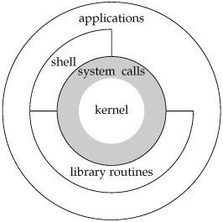
Mac OS Architecture

Slide 10
Systems 1and 2, Jan 1984/April 1985:
System 1
Graphic interface (no command lines).
No multitask due to limited RAM.
Finder (file manger).
System 2
Apple talk to connect systems.
Allowed use of multiple folders.

Slide 11
System 3 and 4, Jan 1986/Jan 1987:
System 3
System had to adapt to support new technologies
New graphics e.g. trash icon bulge
System 4
MAC SE (contained expansion slot).
Introduction of internal hard drives.

Slide 12
Systems 5 and 6, Oct 1987/April 1988:
System 5
MultiFinder enabled several programs to be run at the same time.
Only made available in the US, Canada and some European countries.
System 6
1.44mb superdrive
Macintosh portable provided support for the first laptop features.

Slide 13
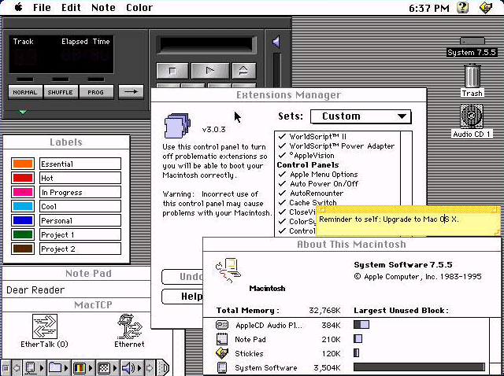
System 7.6
Jan
1997
Harmony
introduced several features that were also included in Mac OS 8,
It was the first
Apple system
Named mac OS
Also it had been completely revamped from previous versions

Slide 14
System Requirement's
 | 3400/180 | 3400/200 | 3400/240
Apple Part # | M3553
Processor | 603ev
CPU Speed | 180 MHz | 200 MHz | 240 MHz
Built-in RAM(MiB) | 16
Maximum RAM (MiB) | 144
Hard drive (GB) | 1.3 | 2 | 3
Removable drives | Floppy drive (CD optional) | Floppy + CD
Display | 12.1" color, active matrix
Resolution | 800×600/32K
Networking | Modem, Infrared, Ethernet (optional) | Modem, Infrared, Ethernet

Slide 15
What was new to Mac OS
Revamped Extensions Manager
Native PowerPC code for Power Macs
Improved internet tools and utilities
More-stable Finder with increased memory allocation
In this version, the PowerTalk feature from 7.5 was removed due to poor application
Mac OS 7.6.1 finally ported the 68k exception handling routines to PowerPC

Slide 16
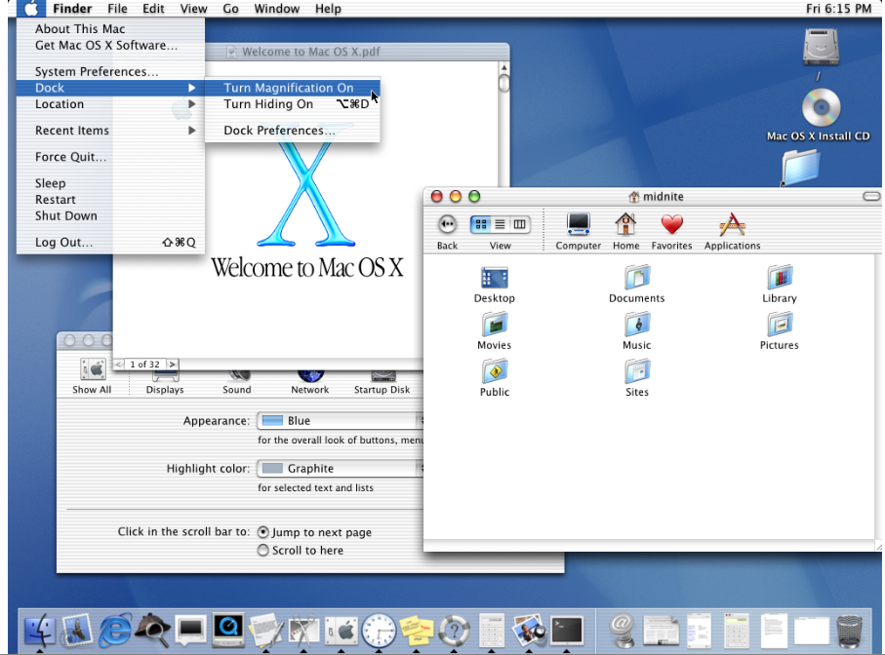
Mac OS X 10.0 “Cheetah”
10.0 (build)4k78 March 24,01
Media: CD-Rom
Initial Price:$129(US)

Slide 17
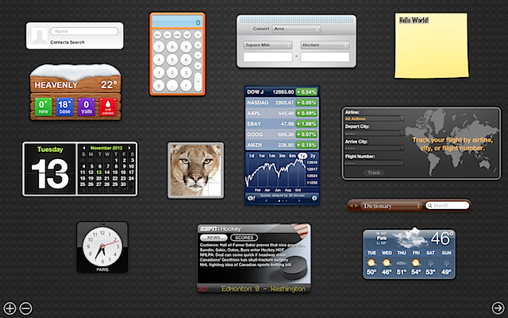
Features:
Dock,
Mach 3.0,
Terminal,
Mail - email client,
Address Book,
TextEdit,
PDF Support,
Aqua UI,
AppleScript,
Sherlock,
Protected memory,

Slide 18
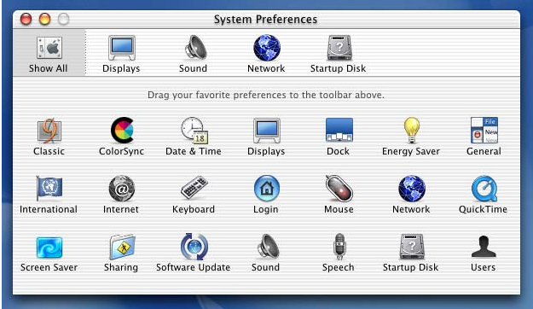
System requirements:
Supported computers:
Power Macintosh G3 & B&W,
G4, Cube,
iMac,
PowerBook G3,G4,
iBook,
RAM: 128 MB,
Hard Drive:
1,500 MB.

Slide 19
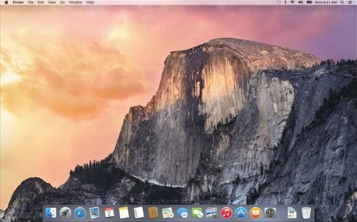
The New Age: Mac OS X Yosemite:
Loads of new or updated features;
Allows for more integration between Apple products.
Latest Mac OS
Allows for making calls and passing documents between hardware
(I phones, I mac’s,
Laptops)

Slide 20
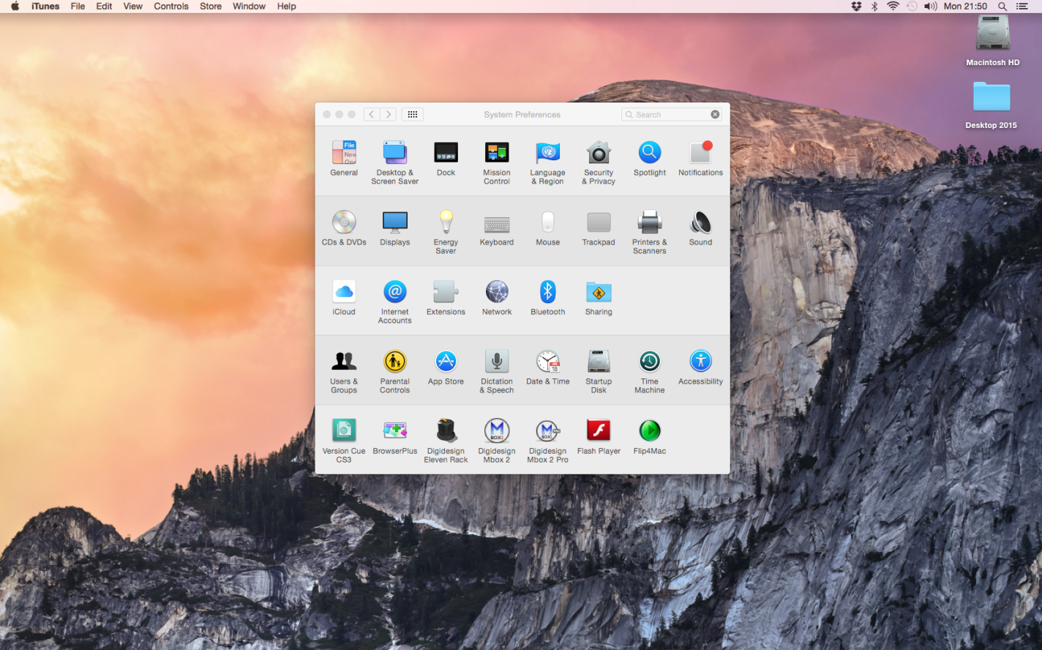
General Specs!
OS X v10.6.8 or later
2GB of memory
8GB of available storage

Slide 21
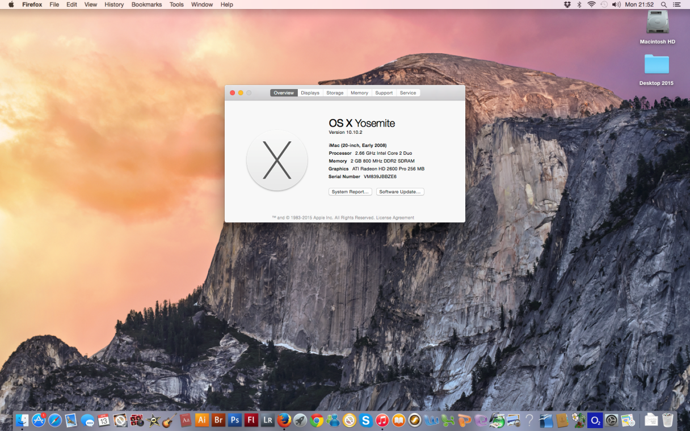
System Requirements:
Needs an iMac (Mid 2007 or newer)
Standard 1gb- 4gb memory,
2.4GHz Intel Core 2 Duo,
4MB shared cache.

Slide 22
Conclusion:
Mac OS has come along way and it shows.
Even though it has come up in leaps and bounds they are still in Microsofts shadow.
The only constant utility on the system is finder, which has lasted for 30 years.

Slide 23
Any Questions?

