Slide 1
Be Operating System
Aine Newsome, Eoin Smyth, Mark Keogh,
Chloe Doyle, Henry Ballinger McFarlane
“Dare to Be(OS) Average”

Slide 2
Contents
Jean-Louis Gassée Biography | 3
1980s: Apple Computer | 4-5
1991 - 2002: Be Incorporated | 6-7
2002 - Present: After Be Inc. | 8-9
BeOs | 10-15
The Media OS (Video) | 16
BeOS Architecture diagram | 17
Desktop | 18-19
The After Years | 20-23
Conclusion | 24

Slide 3
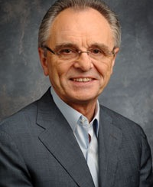
Jean-Louis Gassée
Born: March 1944 in Paris, France, 71 Years Old
Lives in San Fransico, California
Bachelor's Degree from Université Paris-Sud, Paris XI
Master’s of Science Degree from Université de la Sorbonne - Université de Paris.
Master’s of Science Degree in Mathematics and Physics from Orsay University.

Slide 4
Jean-Louis Gassée
1980s: Apple Computer
Worked at Apple from 1981 - 1990
Became head of Apple France
Appointed to head of Macintosh Development
Steve Jobs’ old position
Anti-licensing Mac OS
1988 - Head of Apple's advanced product development and worldwide marketing

Slide 5
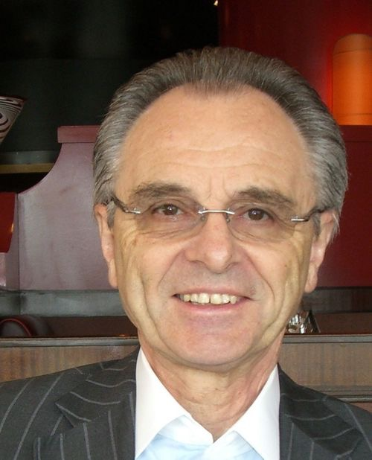
Jean-Louis Gassée
1980s: Apple Computer
February 1987, Jean-Louis Gassée released his book: “The Third Apple: Personal Computers & the Cultural Revolution”
Included a collection of non-technical essays on the advent, possibilities, and limitations of personal computers.

Slide 6
Jean-Louis Gassée
1991–2002: Be Incorporated
Started a new venture, Be Inc.
Steve Sakoman left Apple with Jean-Louis
Built a new OS, optimised for multiple CPUs and multithreaded applications
Became known as BeOS
Written for the BeBox

Slide 7
Jean-Louis Gassée
1991–2002: Be Incorporated
1996, Apple made a bid of $125 million to buy Be
Later, rasied to $200 million
Be’s worth was $80 million
Gassée held out for $275 million
Apple bailed on the bid
Move to “Plan B”, port to x86 platform

Slide 8
Jean-Louis Gassée
2002–present: After Be, Inc.
Be’s focus shift to BeIA proved unsuccessful
Be forced to lay-off most of its staff in 2001
Assets and remaining employees bought out by Palm, Inc. for $11 million
Gassée stayed through the transition, but left in Jan 2002

Slide 9
Jean-Louis Gassée
2002–present: After Be, Inc.
Gassée served as president and CEO of Computer Access Technology Corporation (CATC)
Left within a year
General partner at Allegis Capital, still in position
November 2004, became chairman of PalmSource, Inc.

Slide 10
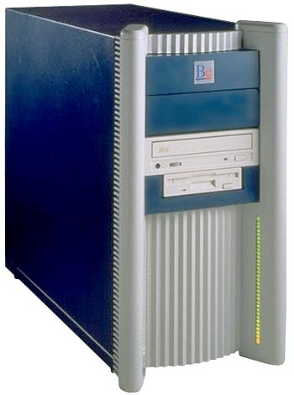
BeOS
1991, First versions of BeOS created for BeBox
Be’s own dual-processor machine
Later developments ported to run on Macintosh
Power Computing & Motorola signed deals to ship OS with their hardware

Slide 11
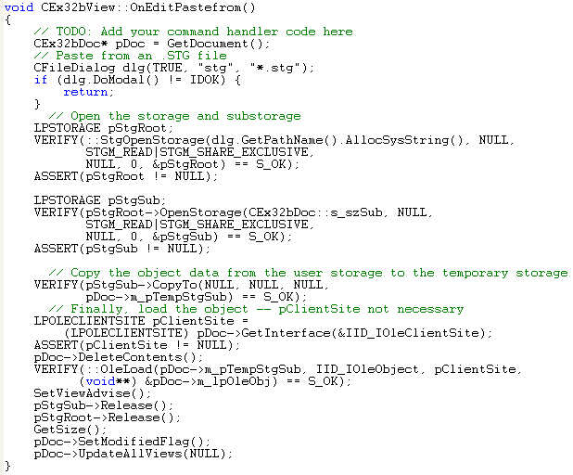
BeOS
Built for digital media work
Utilise modern hardware, like symmetric multiprocessing
Clarity and a clean, uncluttered design
API written in C++

Slide 12
BeOS
First versions ran on AT&T’s Hobbit Processor
Ported to PowerPC in January 1996
Release 3 - 1998
Ran on Intel powered machines
Release 5.1 - 2001

Slide 13
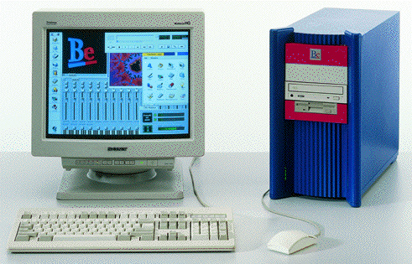
BeOS
BeBox production stopped as a result
Around 2000 units sold in total
Focus shifted entirely to BeOS
BeOS had many features that Apple sought
Unsuccessful bids by Apple

Slide 14
BeOS
With Intel’s assistance, ported to x86 platform
Several thousand programs available
BeOS also used as an embedded OS in multimedia production systems
Unsuccessful in getting top-tier OEMs to bundle OS with their hardware

Slide 15
BeOS
Focus shift at the end of 1999
Desktop OS became open-source
Focus on BeIA, OS targeted to internet appliances
Several employees lost due to disagreements with strategy

Slide 17
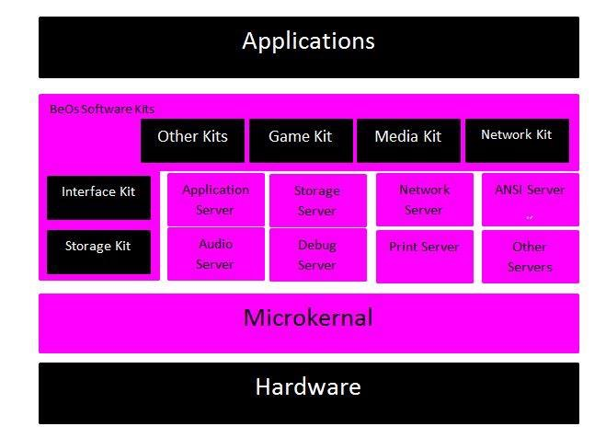
Diagram

Slide 18
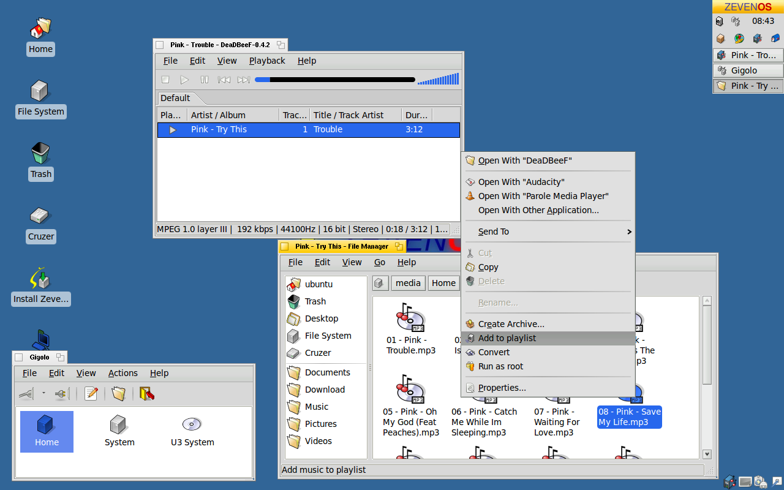
BeOs Desktop

Slide 19
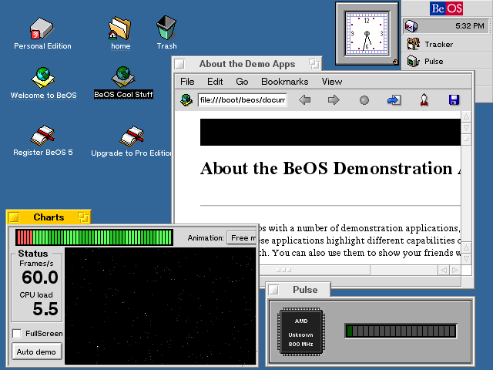

Slide 20
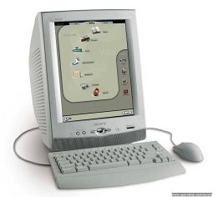
BeIA
Focus of Be in place of the BeOS
Offer simple access to Internet Applications
Sony product called the eVilla based on BeIA
January - August 2001
Cost $499

Slide 21
HAIKU
The official successor to BeOS
OpenBeOS(changed to Haiku in 2004).
Tracker and Deskbar the only parts of the original BeOS code
Application support from BeOS R5
R1/Alpha 4.1, released November 14th, 2012

Slide 22
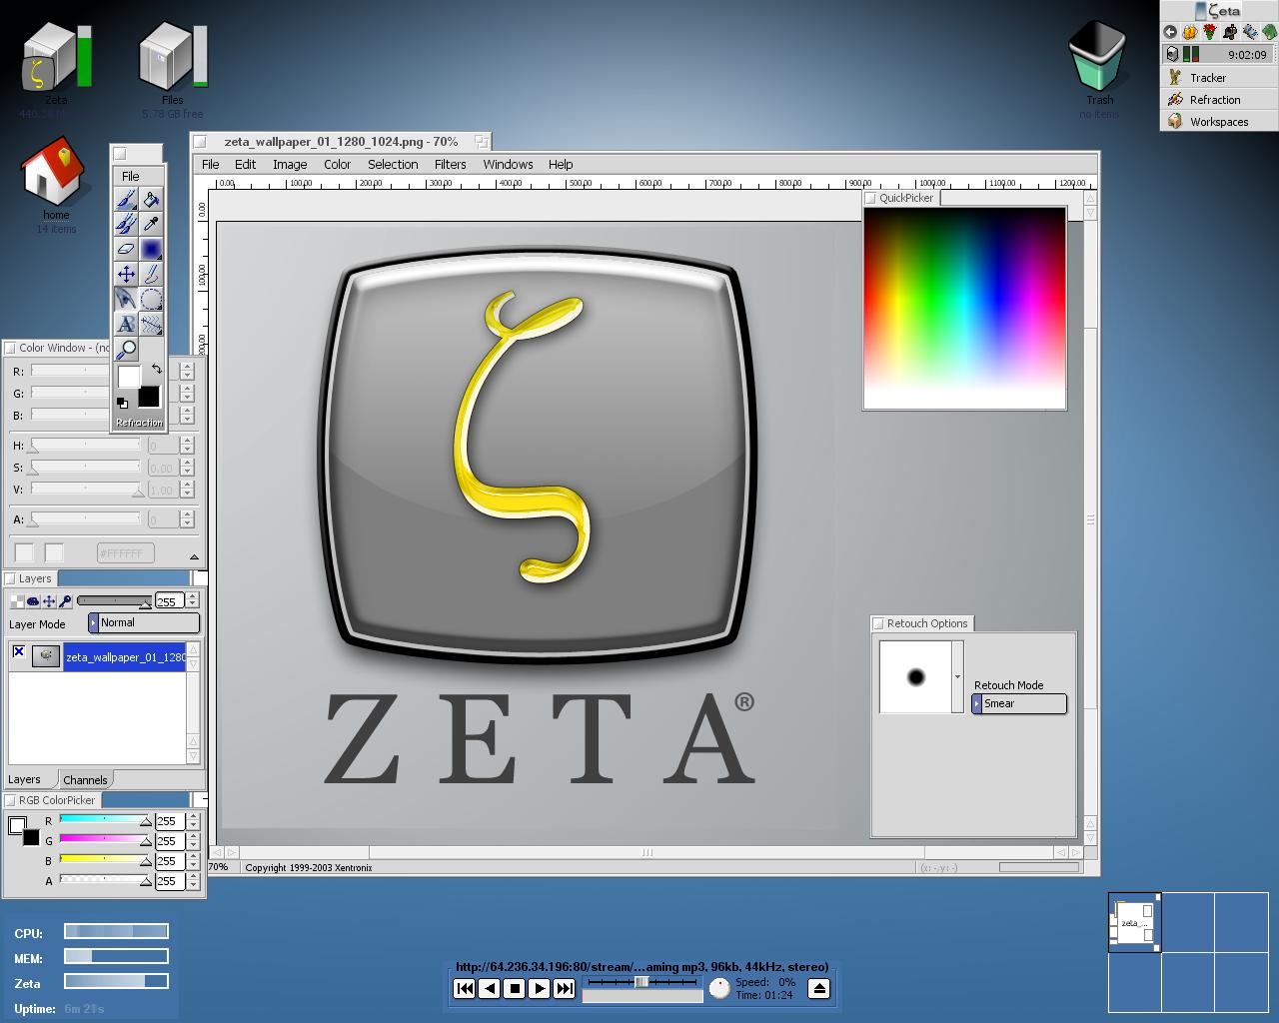
Zeta
Developed by yellowTAB
Later distributed by magnussoft
Based on the BeOS source code
Legal issues surrounding permissions
Discontinued April 2007

Slide 23
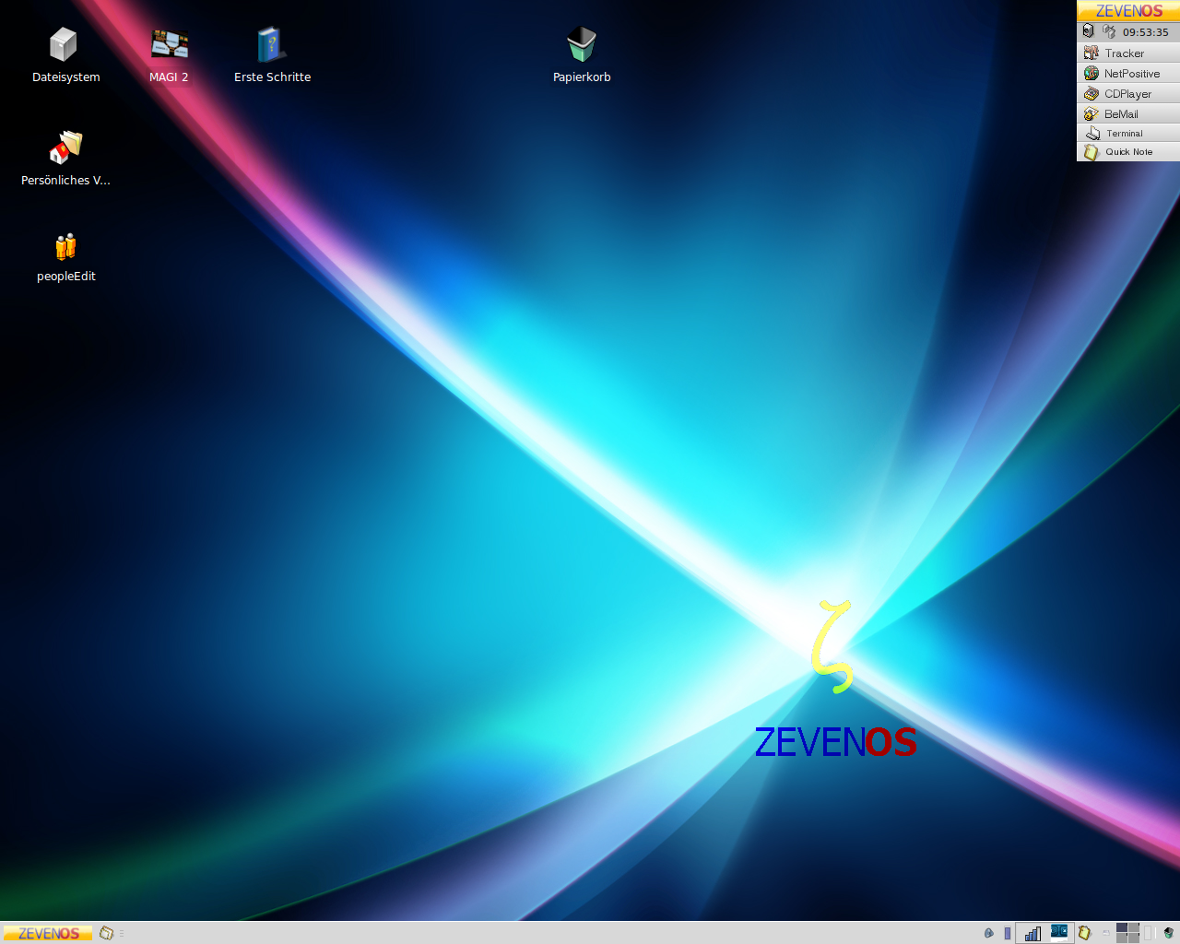
ZevenOS
Linux-based distribution
GUI heavily inspired by BeOS and Zeta
Open source
Current Version: ZevenOS 6.0 - Goodbye Edition

Slide 24
Conclusion
BeOS first version introduced in 1991
Designed to run on BeBox
Final version released in 2001
Jean-Louis Gassée founder of Be, Inc.
BeOS designed to be a media OS
Modern versions created by enthusiasts

