Slide 2
Group members
Byron Farrell
Zhimian Wu
Mingjun Gao
Calvin Ho
Olamide Olukenle

Slide 3
Table of contents
Information about Ubuntu’s designer
How he helped start Ubuntu
Why he started Ubuntu
His contribution to Ubuntu
What is he doing now

Slide 4
Mark Shuttleworth
Born in: South Africa
Date of birth: 18 September 1973 (age 44)
Education: Bachelors Degree in Finance and Information Systems

Slide 5
Early Years
1990 – Participated in the development of Debian
2001 – Formed Shuttleworth Foundation

Slide 6
Why he started Ubuntu
Open Source Software Idealist

Slide 7
Contribution to Ubuntu
2004 – founded Ubuntu development through Canonical LTD
2005 – Made 10 million investment into the Ubuntu Foundation

Slide 8
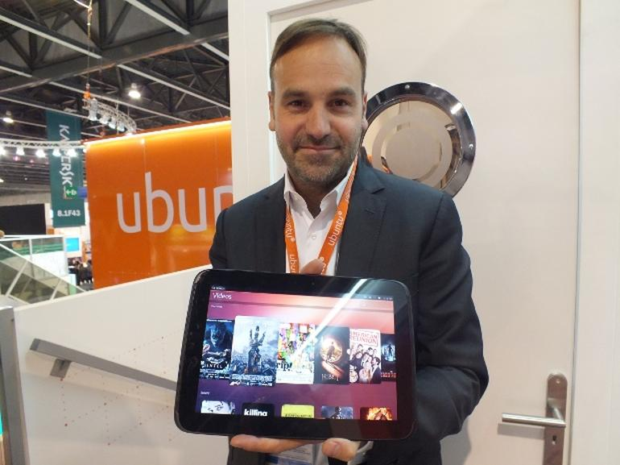
What is he doing now

Slide 9
Ubuntu’s operating System Architecture

Slide 10
Table of contents
Elements of an operating system
Kernel
Shell
Linux Shell edition
File system
Desktop of Ubuntu

Slide 11
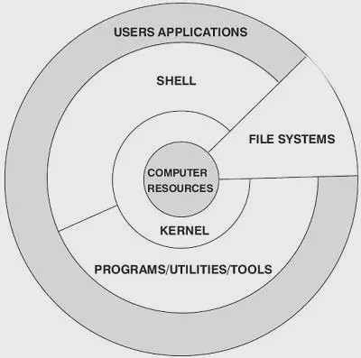
Linux (Operating System) has four important parts:
Kernel
Shell
File system
Users application
Kernel, shell and file system combine together to form a whole operating system, they make the users can running programs、managing files and using this operating system.

Slide 12
Kernel
Kernel is the core of an operating system, just like a heart of a human.
It has many kinds of basic functions, it takes charge of manage system process、computer’s memory、driver software、files and Internet system.
A kernel decide the system's performance and stability

Slide 13
Shell
Shell is the desktop of the system for users, it provides an interface for users to have interactive operation with kernel.
Shell get the users’ commands and send them into kernel to execute the commands.

Slide 14
Linux Shell edition
Bourne Shell: developing by Bell Labs.
BASH: is GNU’s Bourne Again Shell, most kinds of Linux distribution use this shell.
Korn Shell: is the later version of Bourne Shell, most of the content is compatible with Bourne Shell.
C Shell: SUN company's Shell, BSD version.

Slide 15
File System
File system is used to store files on disk or other storage device.
Linux can support many kinds of file system which is popular now, such as EXT2、EXT3、FAT、FAT32、VFAT and ISO9660.

Slide 16
Desktop of Linux Ubuntu

Slide 17
This icon is used to call a search bar from your computer, it can help users open files or applications on this computer, it can help users to save their time.

Slide 18
Table of contents
Advantages of Linux Ubuntu
Disadvantages of Linux Ubuntu
Conclusion

Slide 19
Advantages of Linux Ubuntu
1.Ubuntu is one of the most secured operating system and defines the highest level of security as compared other operating system.
2.Ubuntu is an open source OS.
3.Ubuntu is most popular Linux operating system.
4.It is more steady as compared to other operating systems.
5.Most of the software in Ubuntu are pre-installed to enhance users’ experience.
6.It is available free of cost.

Slide 20
Disadvantages of Linux Ubuntu
1.Ubuntu is very conventional to new technologies. You can instead go for Fedora Distro.
2.There is a little hardware support for Ubuntu OS. Some of the users complain that it becomes difficult to configure modem to start work on internet.
3.It is not possible to play the modern games in Ubuntu OS. It shows the poor graphics quality and need have to use simulators to do so that harms the graphics quality.

Slide 21
4.Though Linux (Ubuntu) has number of free applications and software available on net, but most of the applications are not found for Linux use.
5.Ubuntu is not capable of playing MP3 files by default.
6.The forum support for Ubuntu is really very poor. It takes weeks and even months to get our query solved.
7.The installation of Ubuntu is one of the major problems. It does not come installed in modern PCs. One needs to install it by himself.

Slide 22
8.The drivers support is also absence in most of the cases as compared other operating system.
9.And finally one more major drawback of Ubuntu is that a user switching from Windows or MAC will not like using experience on Ubuntu and will have difficulty in operating the OS.

Slide 23
Conclusion

