Slide 1
Temple Operating System
Niall Glynn, Davis Oplucans

Slide 2
Table of Contents
Biography
Features
Previous OS
Desktop Images

Slide 3
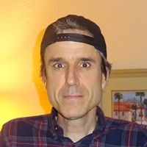
Biography
Temple OS was created by Terrence Andrew Davis

Slide 4
Biography
Born in America , Aged 46
Terry Davis is a schizophrenic programmer that has spent 10 years building an operating system to talk to God.
Although some consider him to be crazy, his body of work is largely thought to be very impressive.

Slide 5
Biography
Davis is a former atheist who believes that he can "talk with God" and that God told him the operating system he built was God's third temple.
Davis started developing templeos in 2003 after he suffered a series of “manic” episodes which left him in hospital for mental health issues.

Slide 6
Biography
Davis is youtube vlogger and regurlarly uploads videos of himself showing off his operating system.
https://www.youtube.com/watch?v=A_hzz2XSAaI This is a video where he gives a tour of his operating system

Slide 7
Biography
Davis gathered experience working with operating systems throughout his life.
When he was 20 he worked on ticketmasters VAX operating system in VAX’s assembly language while he was still in school

Slide 8
Features
The operating system was coded in a language developed by Davis in C/C++ that he called "HolyC".
According to Davis, God told him to create an operating system with 16 colors display, 640x480, and a single audio voice.

Slide 9
Features
Features include such as:
640x480 16 colour vga graphics
Keyboard and mouse support
Graphics
2D/3D graphics library
Real time differential equation solver
PC speaker support
Music Composing tool
Many games, demos and documentaries

Slide 10
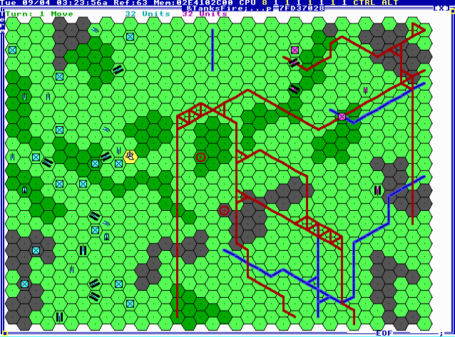
Picture of a Tank War Game on TempleOS

Slide 11
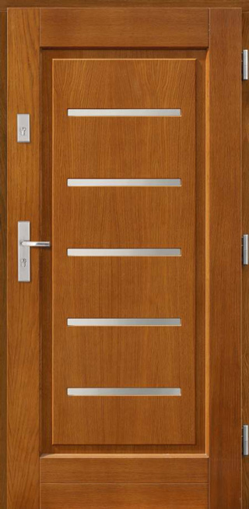
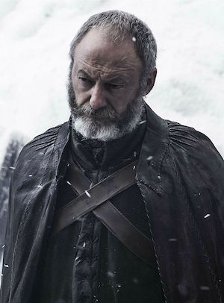
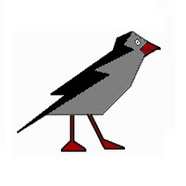
TempleOS had different names in the past such as
TPMOS (Terry’s Protected Mode OS)
HOPPY
Doors
Davos
J
LoseThos
SparrowOS

Slide 12
Terry’s Protected Mode OS
Simple Multitasking and barely a Malloc
Resurrection
Used FreeDOS to launch it
Visual Studios to edit files
Used TASM to ccompile and test

Slide 13
HOPPY
Started a company H.A.R.E
Used C/C++ for scripting
GOD spoke to him to stick with 640x480 16 colour
Wrote a JIT/AOT compiler
In a a years time he had his own working compiler and assembler

Slide 14
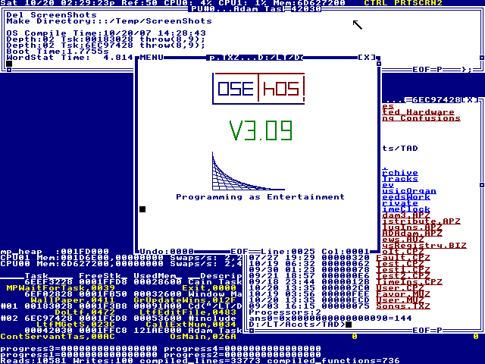
LoseThos

Slide 15
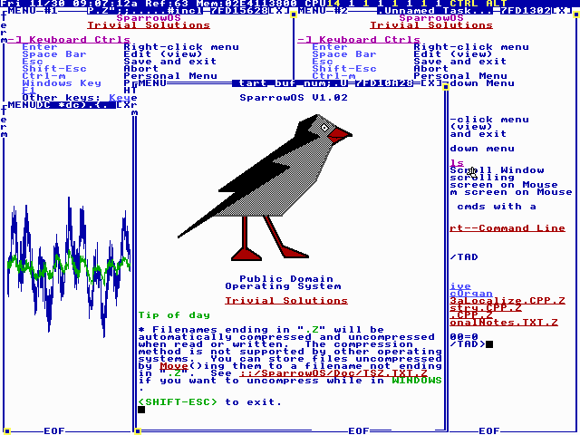
SparrowOS

Slide 16
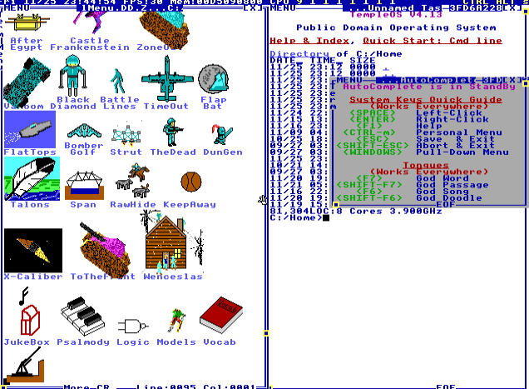
TempleOS Personal Menu

Slide 17
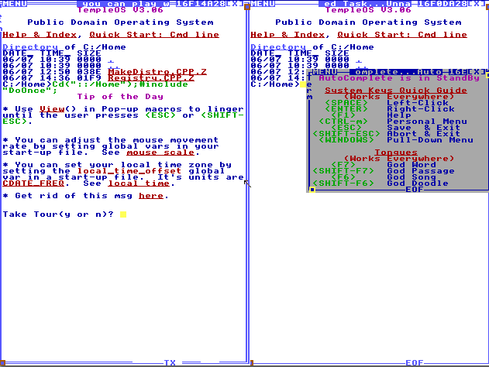

Slide 18
Conclusion
In conclusion we can say that despite having various personal problems and mental health issues, Terry Davis has published a body of work that is original and very impressive. Fair play to him.

Slide 19
THE END

