Slide 1
Tails
Lauren Byrne, Ross Phelan, Gary Kelly,
Brendan Foody, Sharon O’Malley, Ryan McGrane
C16452764, C16445344, C16380531, C16369976, C16469614, C16419862

Slide 2
Contents Page
What is Tails?
How does it work?
Who developed Tails?
Features
Advantages
Disadvantages
Snowden

Slide 3
What is Tails?
Released on the 23rd June 2009
Stands for The Amnesic Incognito Live System
Tails OS is based on providing security, anonymity and privacy
Free OS
Referred to as “a computer in a box”

Slide 4
How does it work?
Lives on a portable and discreet USB
Independent of computer’s own OS
Built-in applications include:
Instant client messaging
Office suite
Email
Image and sound editor
Web browser

Slide 5
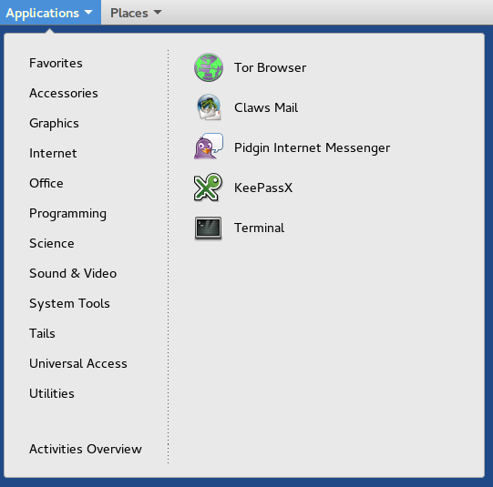
Applications menu

Slide 6
Tails helps you to:
Use the Internet anonymously and avoids censorship
Leave no trace on the computer you are using unless you ask it explicitly
Tails comes with a selection of tools to encrypt your files, emails and instant messaging

Slide 7
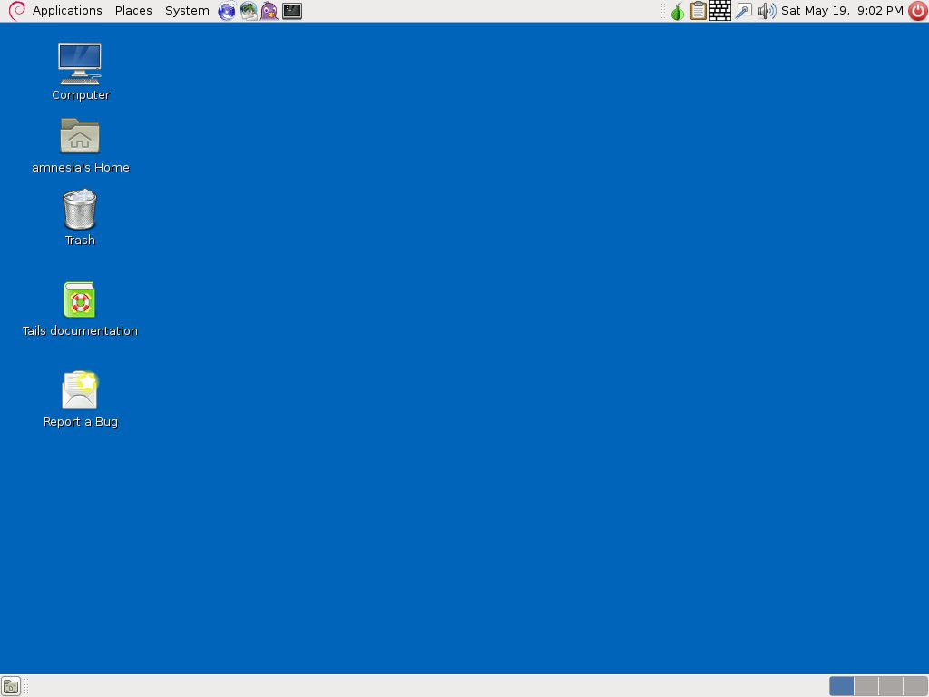

Slide 8
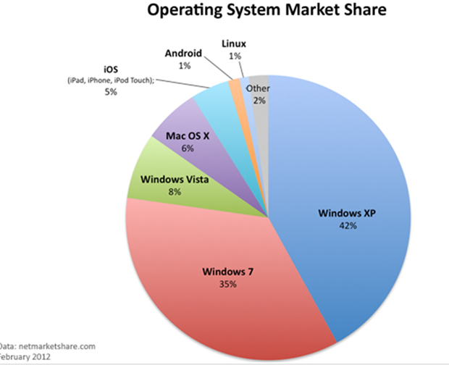

Slide 9
Who developed Tails?
It is unknown who originally developed Tails OS
The development of Tails is continuously being furthered by its code which allows the public to identify and fix problems and bugs

Slide 11
“The masters of today’s internet… really want our lives to be more and more transparent online, and this is only for their own benefit”
-The Tails Development Team

Slide 12
Tor Network
Tor is a secure browser that protects against network surveillance which threatens personal freedom and user privacy
Tails forces all connections to go through the Tor network

Slide 13
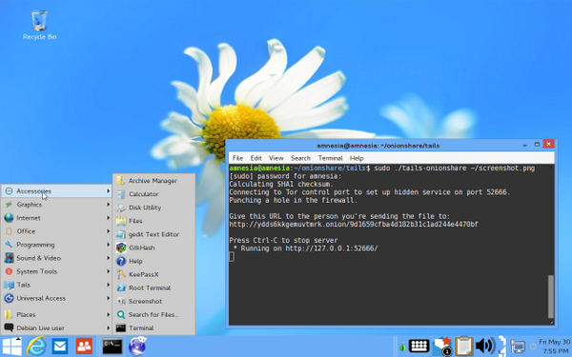
Feature of Tails
Includes a “Windows Camouflage” mode to make it look more like Windows 8

Slide 14
Advantages of Tails
Routes all traffic through Tor
It comes with built in applications
Protects your instant messages with a tool that provides encryption

Slide 15
Allows users to browse anonymously
Doesn’t save files locally
Can be used for whistleblowing

Slide 16
Disadvantages of Tails
Can’t save files locally (disadvantage IF using for everyday use)
Inconvenient OS for everyday use as users likely need to use their identity for web services (e.g. social media)
Using Tor to load websites is slow

Slide 17
Who uses Tails?
Journalists and their sources
Whistleblowers e.g. Edward Snowden
Government Agents
Victims of stalking
Privacy conscious citizens

Slide 18
Edward Snowden
One of the most associated public figures with Tails is Edward Snowden

Slide 19
Who is he?
Former American CIA employee
Leaked classified information without authorisation regarding the NSA
Currently resides in Russia after being charged with violating two counts of the Espionage Act.

Slide 20
How he used Tails?
Snowden used Tails along with his documentary team when communicating with each other (Citizenfour)
Tails makes it impossible for anyone to perform any forensics on the computer as it does not save files locally
Virtually immune to harmful software

Slide 21
How do we know Tails is safe?
Some of the Snowden leaks showed the NSA complaining about Tails OS
It’s open source code so it can be inspected by anyone

Slide 22
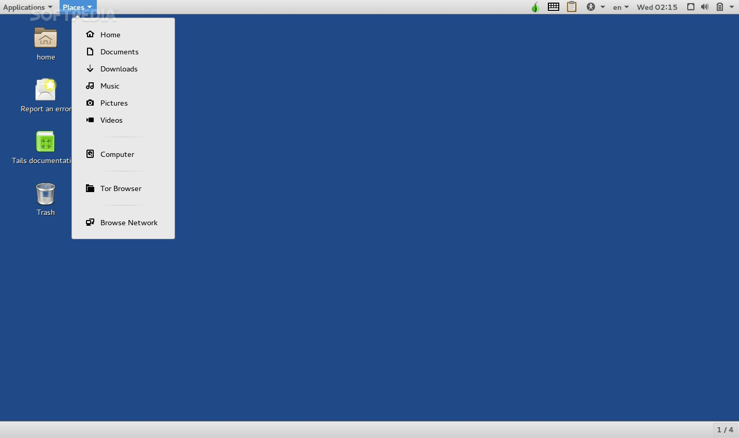
Versions of Tails
Tails 2.0
GNOME Shell
Changes to desktop environment
Debian 8

Slide 23
The Future Of Tails
Tails 3.0 is currently in beta
This version will be based on Debian 9
3.0 will include security
upgrades and some quality
of life changes

Slide 24
Conclusion slide
The End

Slide 25
References
https://tails.boum.org/about/index.en.html
http://www.techrepublic.com/article/getting-started-with-tails-the-encrypted-leave-no-trace-operating-system/
https://www.wired.com/2014/04/tails/
http://www.pcworld.com/article/3026721/linux/the-ultra-secure-os-beloved-by-edward-snowden-gets-a-major-upgrade.html

