Slide 1
Fionn MacNamara - C16753791
Kieran Ennis - C16767215
Michael Alder - C16743219
Sarah-Louise Stapleton - C16334391

Slide 2
Aleksey Bragin
IRC-nickname: “fireball”
Lives in Moscow, Russia
Current project coordinator
Wide-coverage developer focusing on the kernel, boot loader, drivers, and most other aspects of development

Slide 3
Precursor to ReactOS
In 1996 the ‘FreeWin95’ project was started by a group of open-source developers.
The goal was to implement an operating system that would be a “clone” of Windows 95.
Unfortunately, as can happen with ambitious projects, progress stalled in discussions of the design of the system, and never recovered.

Slide 4
Beginnings of ReactOS
At the end of 1997, the project members, led by coordinator Jason Filby, joined together to revive the project.
New project sought to emulate the functionality of Windows NT. To be achieved by creating a new NT kernel and basic drivers.
‘ReactOS’ was coined in IRC from the group's dissatisfaction with – and reaction to – Microsoft's monopolistic position.
In February 1998, ReactOS began.

Slide 5
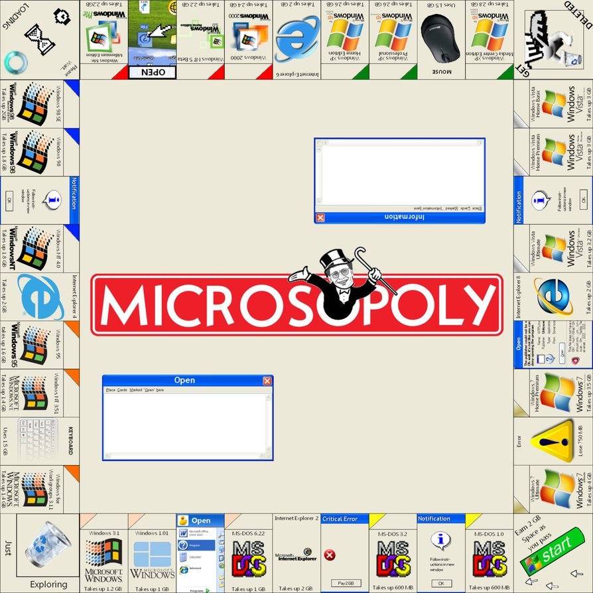

Slide 6
ReactOS Development
The core of the OS is written entirely in C and Assembly.
Some C++ is used for included programs.
Aiming for full kernel compatibility with Windows NT v5.2 (Windows Server 2003).
Targeting newer Versions of Windows as development matures.

Slide 7
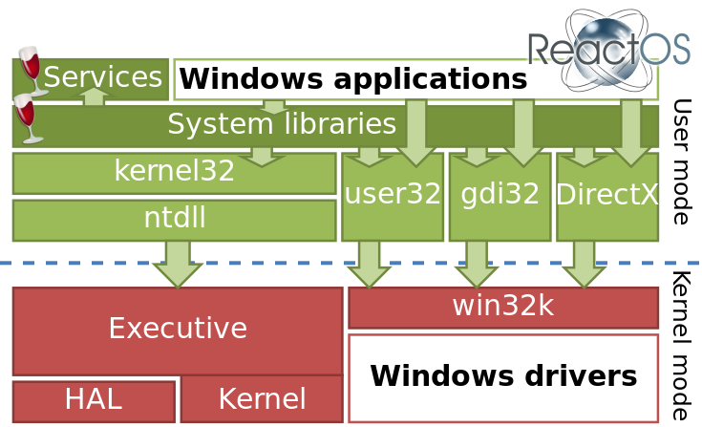

Slide 8
Wine
Open Source implementation of the Windows API
Allows unmodified Windows programs to run on Unix-like/based OS’ such as Linux and Solaris
Close collaboration, with ReactOS dependant on Wine for user mode DLLs (dynamic-link library)
Architectural differences arise from Wine primarily targeting the Linux platform, so some DLLs may not work w/ ReactOS without specific changes

Slide 9
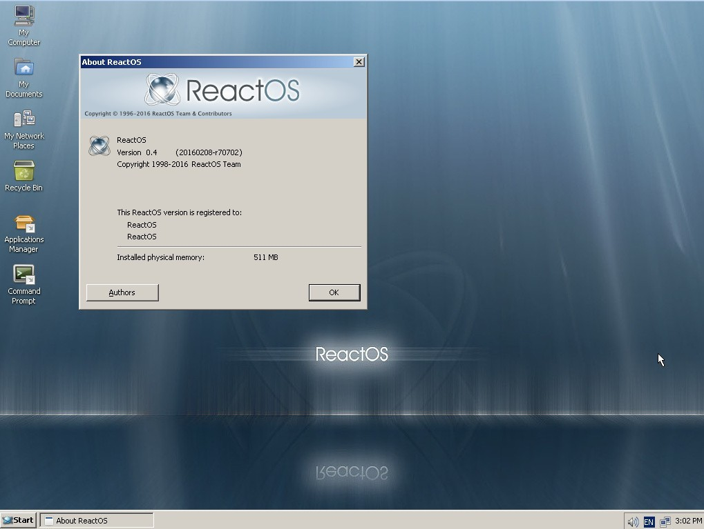

Slide 10
ReactOS today
Lightweight!
500 MB disk space
96 MB RAM
9,000,000+ lines of code
Compatible with many Windows programs
Install to system or try with a LiveCD
Open source and free!

Slide 12
Release History
0.3.15 - USB support, AHCI support, new memory manager
0.4.0 - ext2/NTFS support, new file explorer shell
0.4.1 - Btrfs support, USB bug fixes, improved shell
0.4.2 - Bug fixes, .NET Framework 2.0/4.0 support
0.4.3 - Improved ‘winsock’ support, bug fixes
0.4.4 - Initial printer support, font/layout fixes

Slide 13
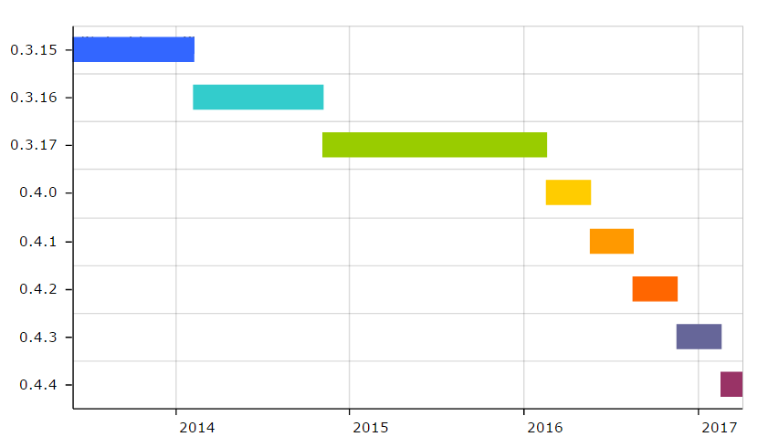
Release History

Slide 14
Release History
Massive reduction in the time between newer releases

Slide 15
Conclusions
Free, open source, community project
Compatible with many Windows-native 3rd party software
Ongoing development
Ready to install today

Slide 16
References
ReactOS, (-), Gallery/News, www.reactos.org, Date Accessed: March 2017
e-CHIP (2013), “Open source Windows”, echip.com.vn/windows-nguon-mo-a20130307001220481-c1107.html, Date Accessed: March 2017
Edublogs (2012), Microsoft Monopoly, files.campus.edublogs.org/blog.nus.edu.sg/dist/e/2019/files/2012/04/Microsoft_Monopoly_by_jubjub449.png-127i7in.jpg, Date Accessed: March 2017
‘hbelusca’, Word 2010 support Part 6: New progress, www.reactos.org/blogs/word-2010-support-part-6-new-progress, Date Accessed: April 2017
Wikipedia (-), ReactOS,en.wikipedia.org/wiki/ReactOS, Date Accessed: March 2017
ReactOS, (-), Welcome to the ReactOS Development Wiki, www.reactos.org/wiki/Welcome_to_the_ReactOS_Development_Wiki, Date Accessed: March 2017

