Slide 1

A History of ReactOS
Aron O’Neill C16466214
Carlos Gonzalez C16337921
Conor Maher C16337921
Magdalena Nowak D16123579

Slide 2


Slide 3
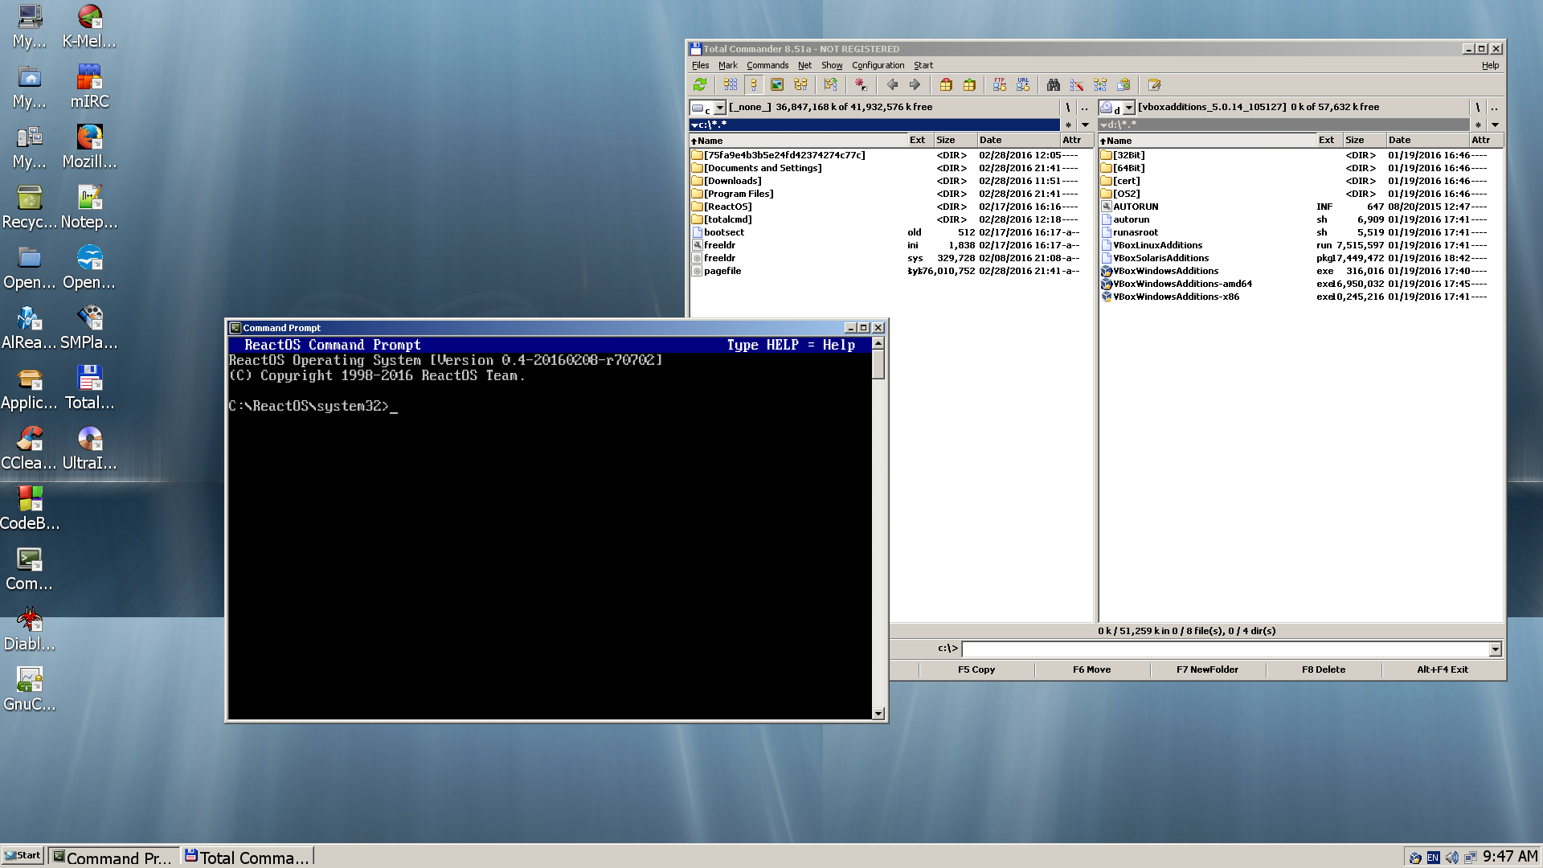

Slide 4

The Prehistory of ReactOS
1996:
  Free-Win 1995 was created
  Programmers + Software Developers
  Intended to copy Windows 95
  NO RESULTS

Slide 5

The History of ReactOS
Late 1997 :
  Given the name ReactOS
  Jason Fiby – Project Coordinator
  Tried to emulate Windows NT
  Less Discussion & More coding

Slide 6

The History of ReactOS
1998:
  Very slow Progress
  Few participants knew core coding
  React became more complete
  React stood for their dissatisfaction with Microsoft and Windows NT
  Increased number of participants

Slide 7
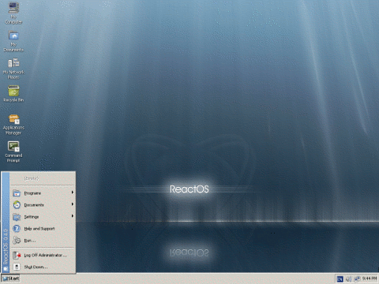
Version: 0.1.x Series
0.1.0 was released on February, 1998
requires 500MB of HDD space & 96MB of RAM

Slide 8
Version: 0.2.x Series
0.2.0 was released on January 25, 2004
First release to include ReactOS Explorer

Slide 9
Version: 0.3.0
0.3.0 was released on August 27, 2006
This release's main feature is the networking ability

Slide 10
Version: 0.3.13
0.3.13 was released on March 22, 2011
Many improvements in the memory manager.

Slide 11
Version: 0.3.15
0.3.15 was released on 30 May 2013
Preliminary support for USB mice, keyboards, and storage

Slide 12
Version: 0.4.0 Series
0.4.0 was released on 16 February 2016
Main features are SerialATA, USB, Sound and Theme support

Slide 13
Version: 0.4.3
0.4.3 was released on 16 November 2016
Main feature is Wireless Networking

Slide 14
Thank you ☺

