Slide 1
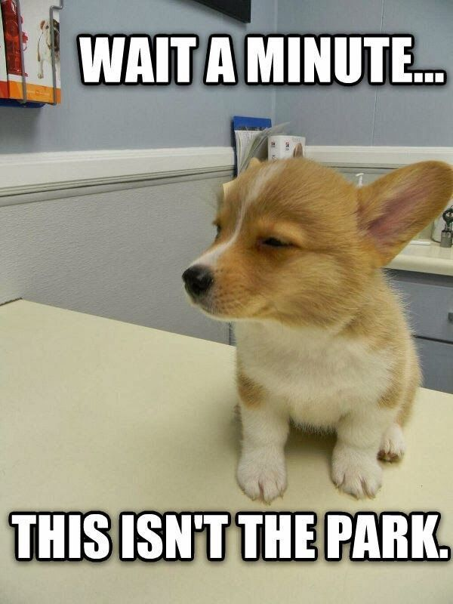

Puppy Linux
The DIT Crowd
Enda Keane (C16497656), Eileen Rattigan (C16339313), William Carey (C16315253), Adam Ryan (C16302271) & Rebecca Dillion (C16736885)

Slide 2
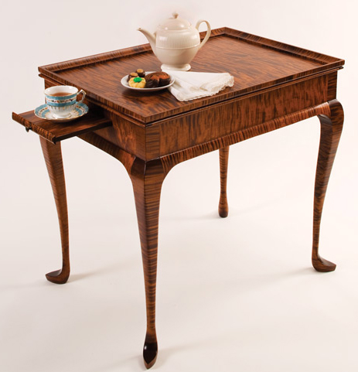

Table Of Contents
Intro
Rescue Disk
Desktop
Puppy Architecture
The Creator of Puppy Linux Biography
Conclusion
References
Notes:
kk

Slide 3
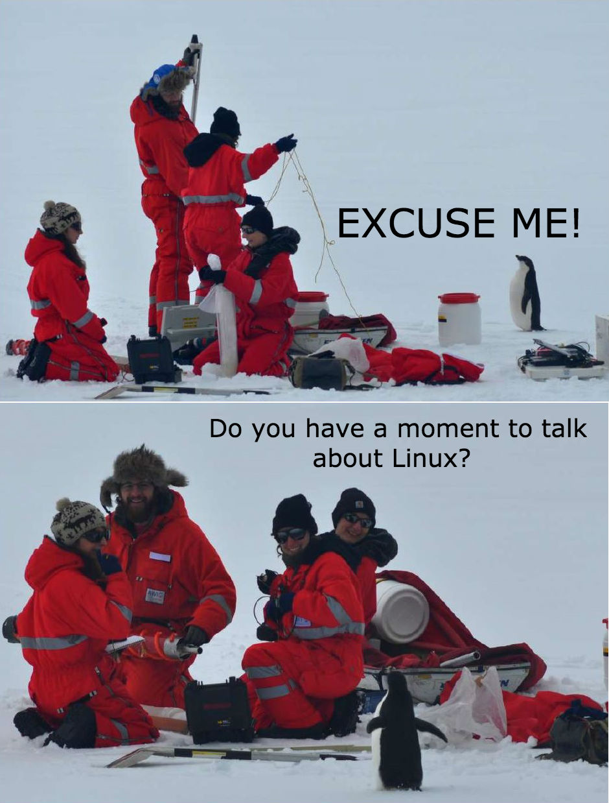
Intro
Created by Barry Kauler
Released 18 June 2003
Compact size
Rescue disk
Notes:
Penguin penguin penguin Quack!

Slide 4


Rescue Disk

Slide 5
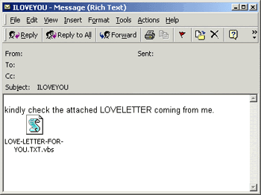

Rescue Disk Cont.
Placed on a USB, CD or DVD
Main uses:
Rescuing files
Combating malware in the OS

Slide 6

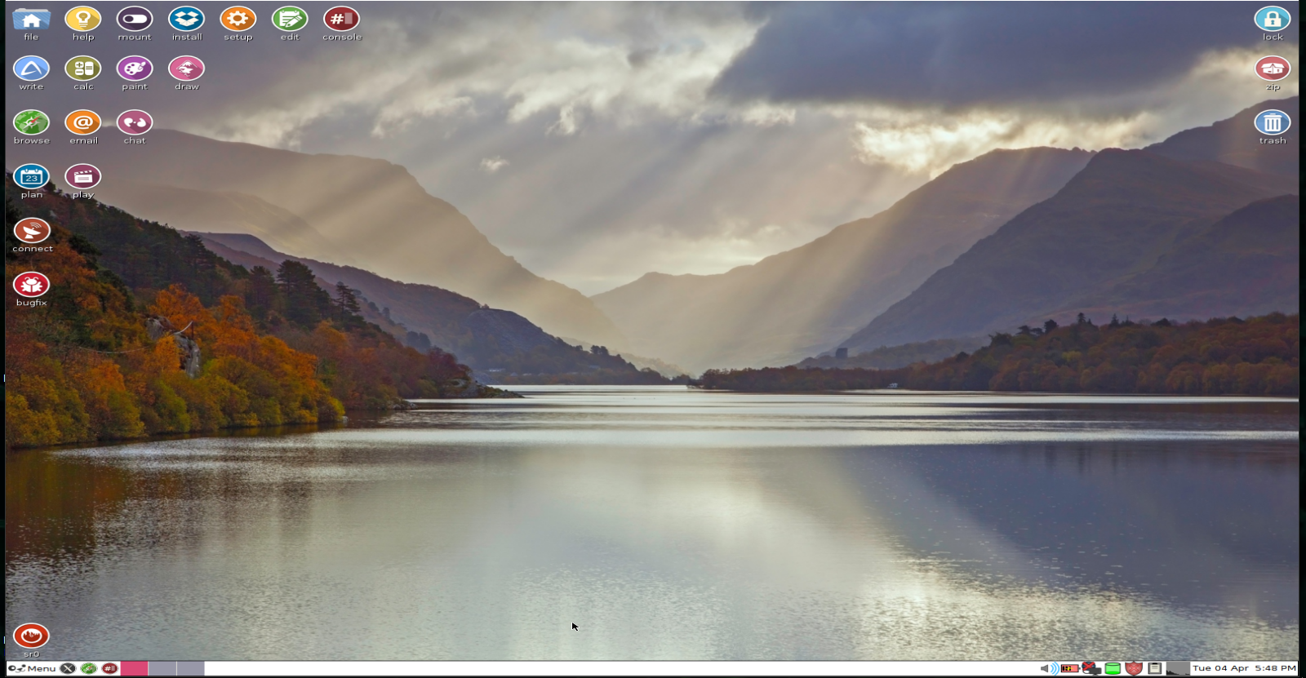
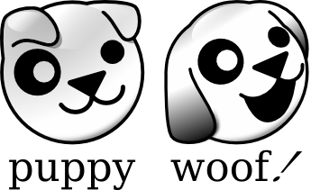

Desktop
Free Stuff!
Notes:
Enda: Thanks for the desktop pics
William: Enda do you want slide 24 picture “Who awesome You’re awesome” pic
Enda: Where would i put it? :o

Slide 7
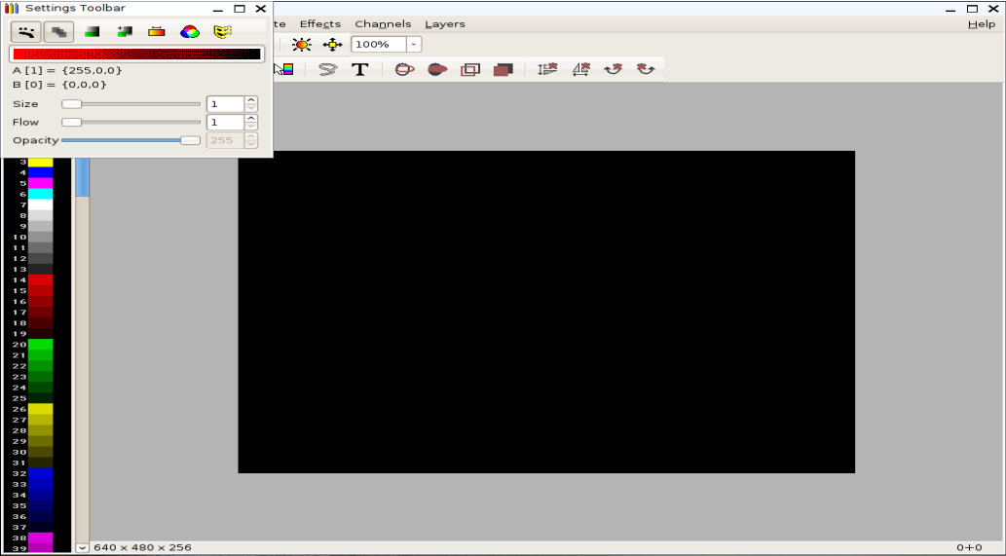
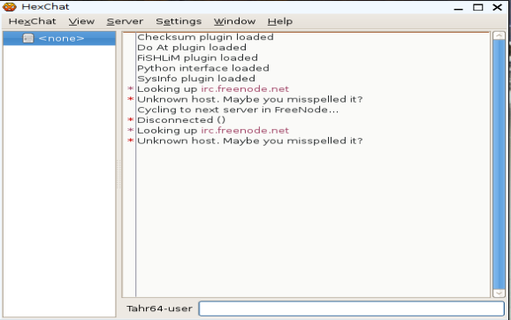
Desktop Cont.
Notes:
Better layout
Enda: Thanks for the desktop pics

Slide 8
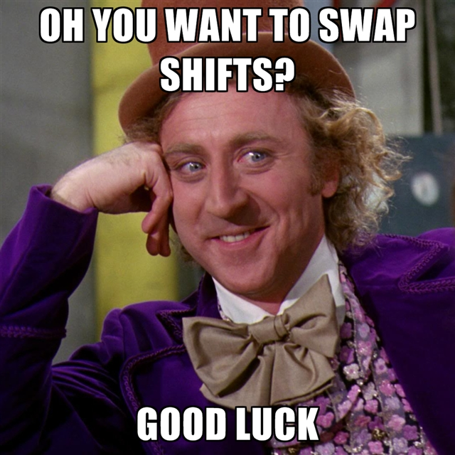
Time for a change

Slide 9
Puppy Architecture
Barry Kauler’s obsession with puppies...
iso file burnt to a CD or DVD at boot up

Slide 10
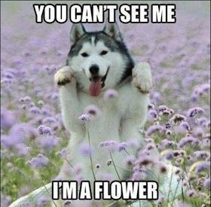
Puppy Architecture
Barry Kauler’s obsession with puppies...
iso file burnt to a CD or DVD at boot up

Slide 11

Puppy Architecture
The mission statement of puppy linux:

Slide 12
Puppy Architecture
user friendly with simple installation process.
It requires only 1.1 Mb
works on a PC with any size of RAM size due to “deamon”.

Slide 13

Hang in there puppy we are nearly done

Slide 14
Now onto the genius himself, Barry Kauler

Slide 15
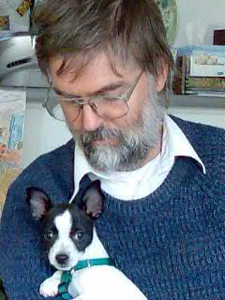
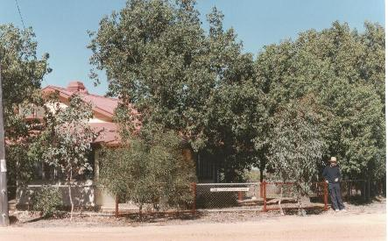
The Creator of Puppy Linux Biography
Barry Kauler - Born 18th of January 1950.
Lived in Perenjori. And Perth
Barry and his daughter’s puppy, Vincent
Barry’s house in Perenjori, where he lived for 12 years

Slide 16


Barry Kauler (Cont’d)
Quirky Linux logo
Created Puppy linux in 2003
Passed main control to the community
2013, created fork called Quirky Linux
Puppy Linux logo

Slide 17


Barry Kauler Fun Facts
Online avatar - a dog
Degrees in Electronic Engineering.
Lectured in Universities and TAFE(Technical and Further Education) colleges.
The TAFE logo
Barry’s online avatar
Notes:
Converted this into a better format.

Slide 18
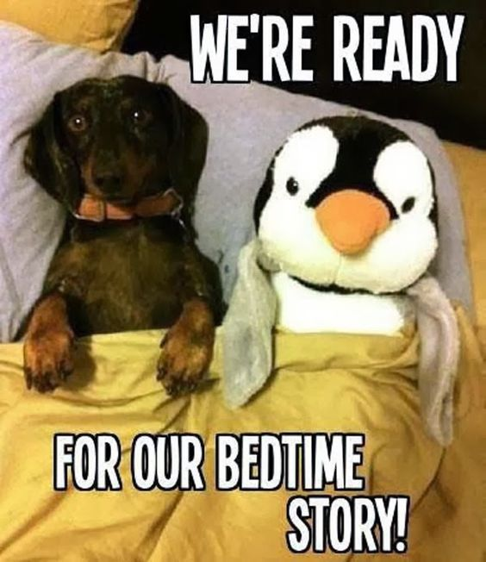
Conclusion

Slide 19
References-Images
.
Puppy Meme [Internet]. Pinterest. 2017 [cited 17 March 2017]. Available from: https://www.pinterest.com/explore/puppy-meme/
. Editor’s Letter- Week of May 8, 2015 - Nonbinary Review [Internet]. Nonbinary Review. 2017 [cited 15 March 2017]. Available from: http://nonbinaryreview.com/letter-from-the-editor/editors-letter-week-of-may-8-2015/
Linuxinsider.com. 2017 [cited 27 March 2017]. Available from: http://www.linuxinsider.com/images/rw963653/puppy-linux.jpg/
. Study in Australia – iae Edu Net Melbourne » TAFE NSW [Internet]. Studyinaus.com. 2017 [cited 25 April 2017]. Available from: http://www.studyinaus.com/tafe-nsw.html

Slide 20
References-Images
Download latest Puppy Linux release [Internet]. Puppylinux.org. 2017 [cited 13 March 2017]. Available from: http://puppylinux.org/main/Download%20Latest%20Release.htm
. Lighthouse Pup Architecture: The Layered File System [Internet]. Lhpup.org. 2017 [cited 15 March 2017]. Available from: http://www.lhpup.org/sfs/Architecture.htm

Slide 21
References-information
.
Kauler B. Barry Kauler [Internet]. Barryk.org. 2017 [cited 25 March 2017]. Available from: http://barryk.org/bkauler/
1. PuppyLinux: Software Index [Internet]. Puppylinux.org. 2017 [cited 10 March 2017]. Available from: http://puppylinux.org/wikka/SoftwareIndex
2. PuppyLinux: PuppySchool [Internet]. Puppylinux.org. 2017 [cited 15 March 2017]. Available from: http://puppylinux.org/wikka/PuppySchool
howpuppyworks.html [Internet]. Barryk.org. 2017 [cited 3 April 2017]. Available from: http://barryk.org/puppylinux/development/howpuppyworks.html

Slide 22
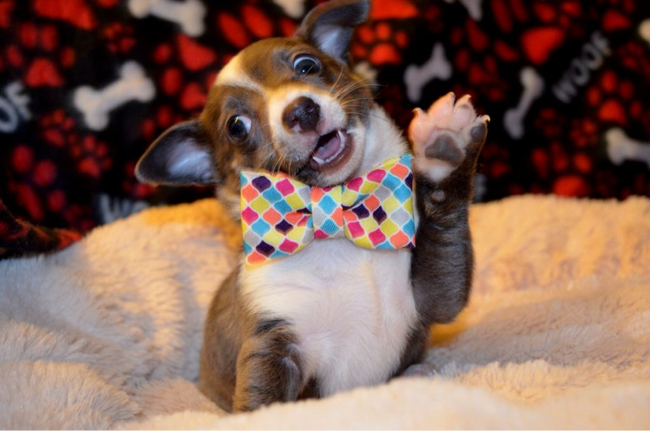
Goodbye my lovelies :)
Notes:
This one needs to be in the conclusion!!

