Slide 1
MorphOS
By Team Members
Team Members:
Cian Morar C16460726
Vasile Gancin C16394513
Tiarnán McGurk C16336861

Slide 2
Table of Contents
1. Introduction
2. History
3. Desktop
4. Ambient Features
5. Disk Formatting
6. Multi-threading
7. AmigaOS vs. MorphOS
8. Conclusion
9. Sources

Slide 3
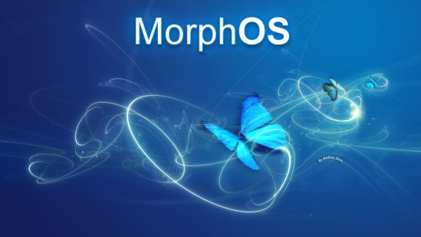
Introduction
Written in C
Initially released in August 2000
Available in 19 languages
“Inspired” by AmigaOS
Notes:
“inspired by amiga” - talk more about LATER

Slide 4
History
Originally built to run legacy applications
Accusations of developers not being payed
Ambient desktop released under GPL
Notes:
Legacy applications = applications that were written for an older OS or Hardware Platform
GPL = General Public Licence

Slide 5
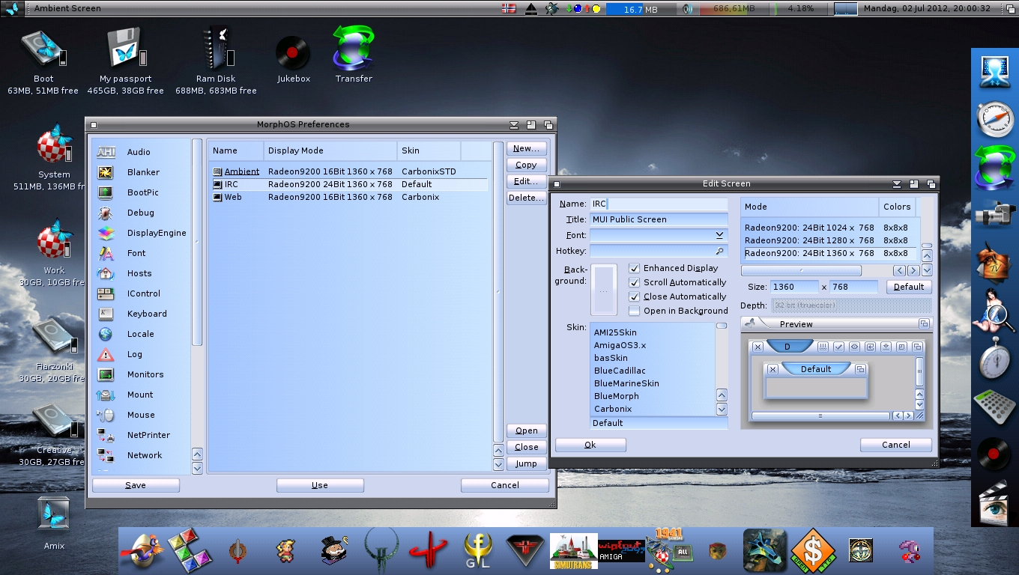

Slide 6
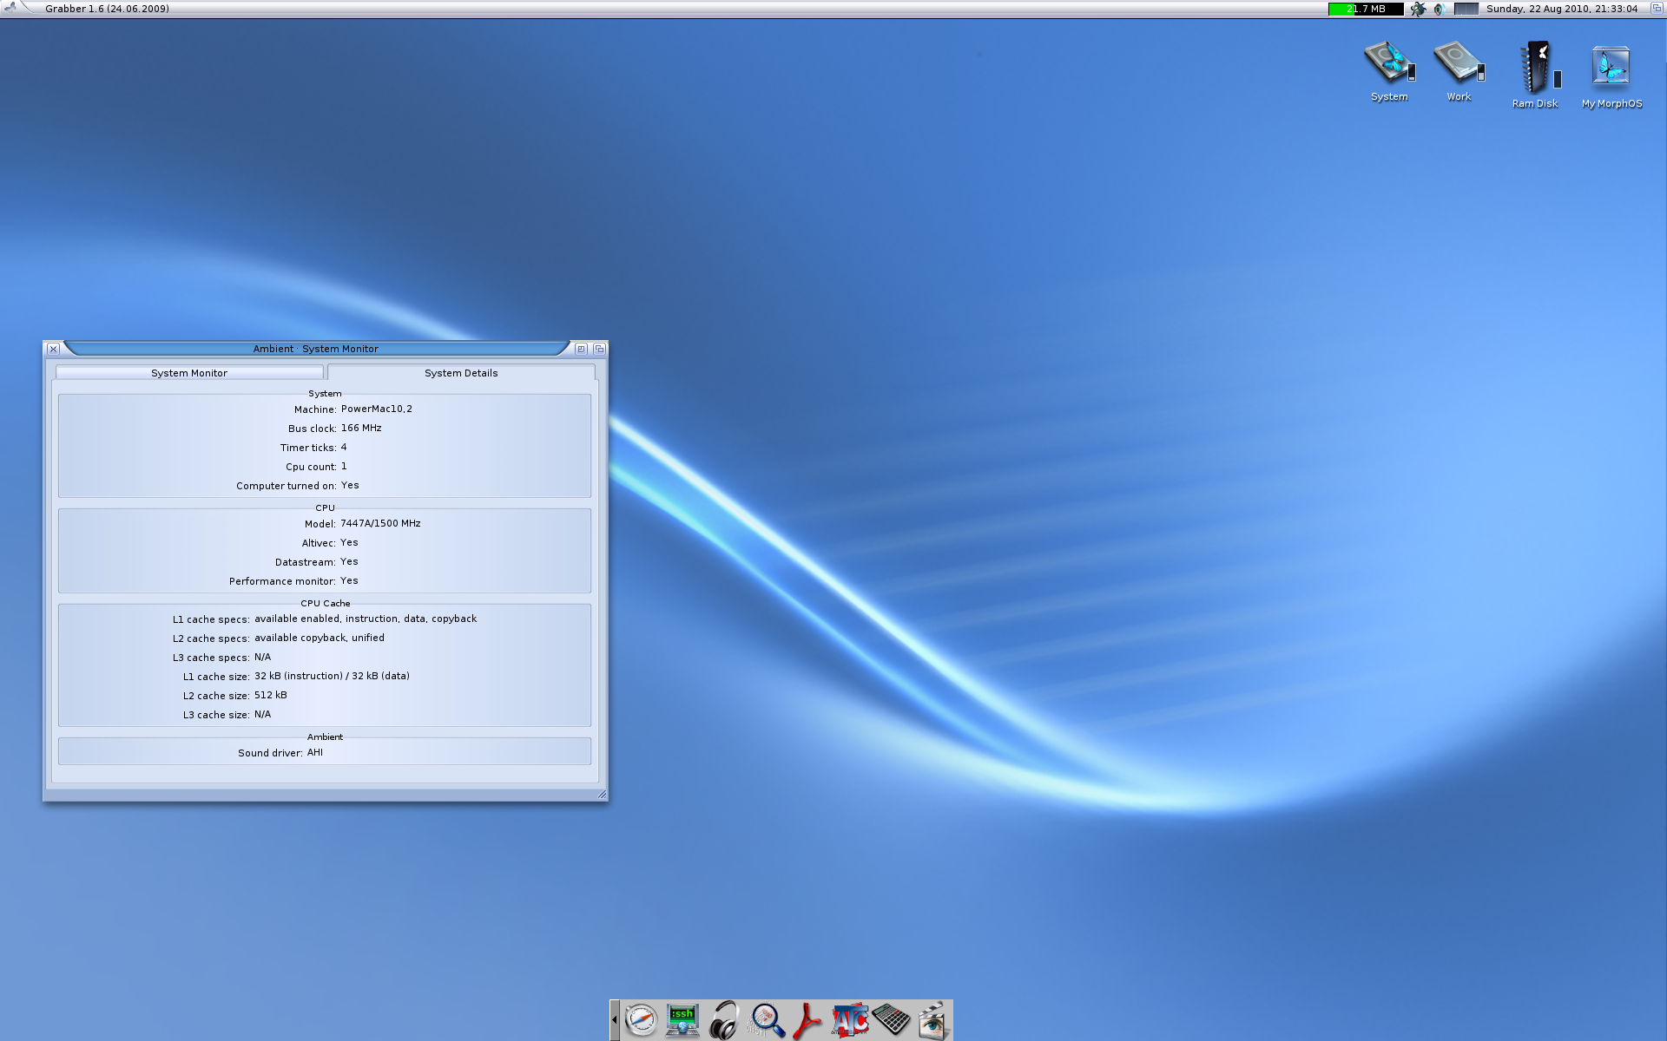
Desktop environment
Called “Ambient”
Developed for MorphOS in 2001
Written in C
Combination of both “Workbench and Directory Opus” worlds

Slide 7
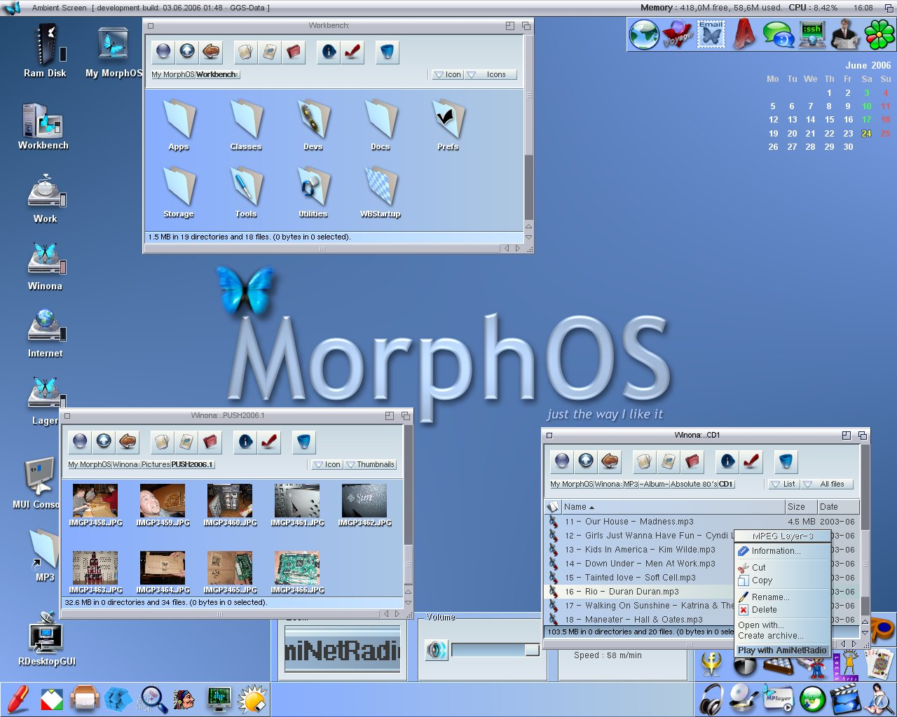
Ambient - Features
Localized for various languages
Takes advantage of hardware accelerated visual effects
MUI based desktop environment

Slide 8
Ambient - Features
Panels which act as program launchers
Built in functions such as disk formatting
Asynchronous multi-threaded design

Slide 9
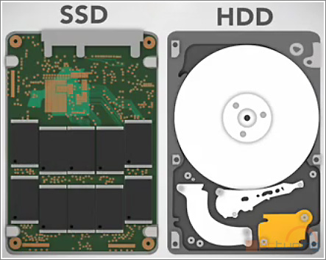
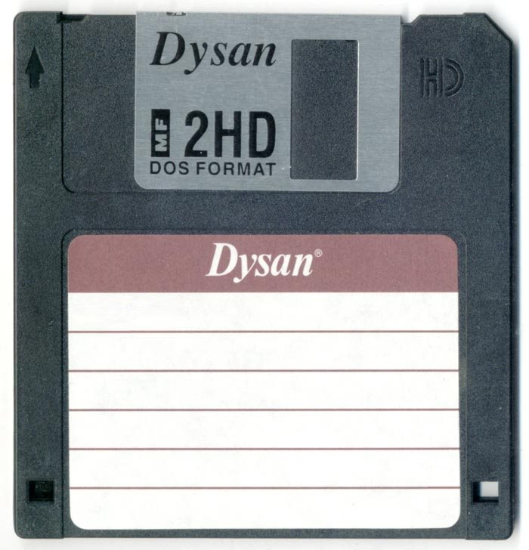
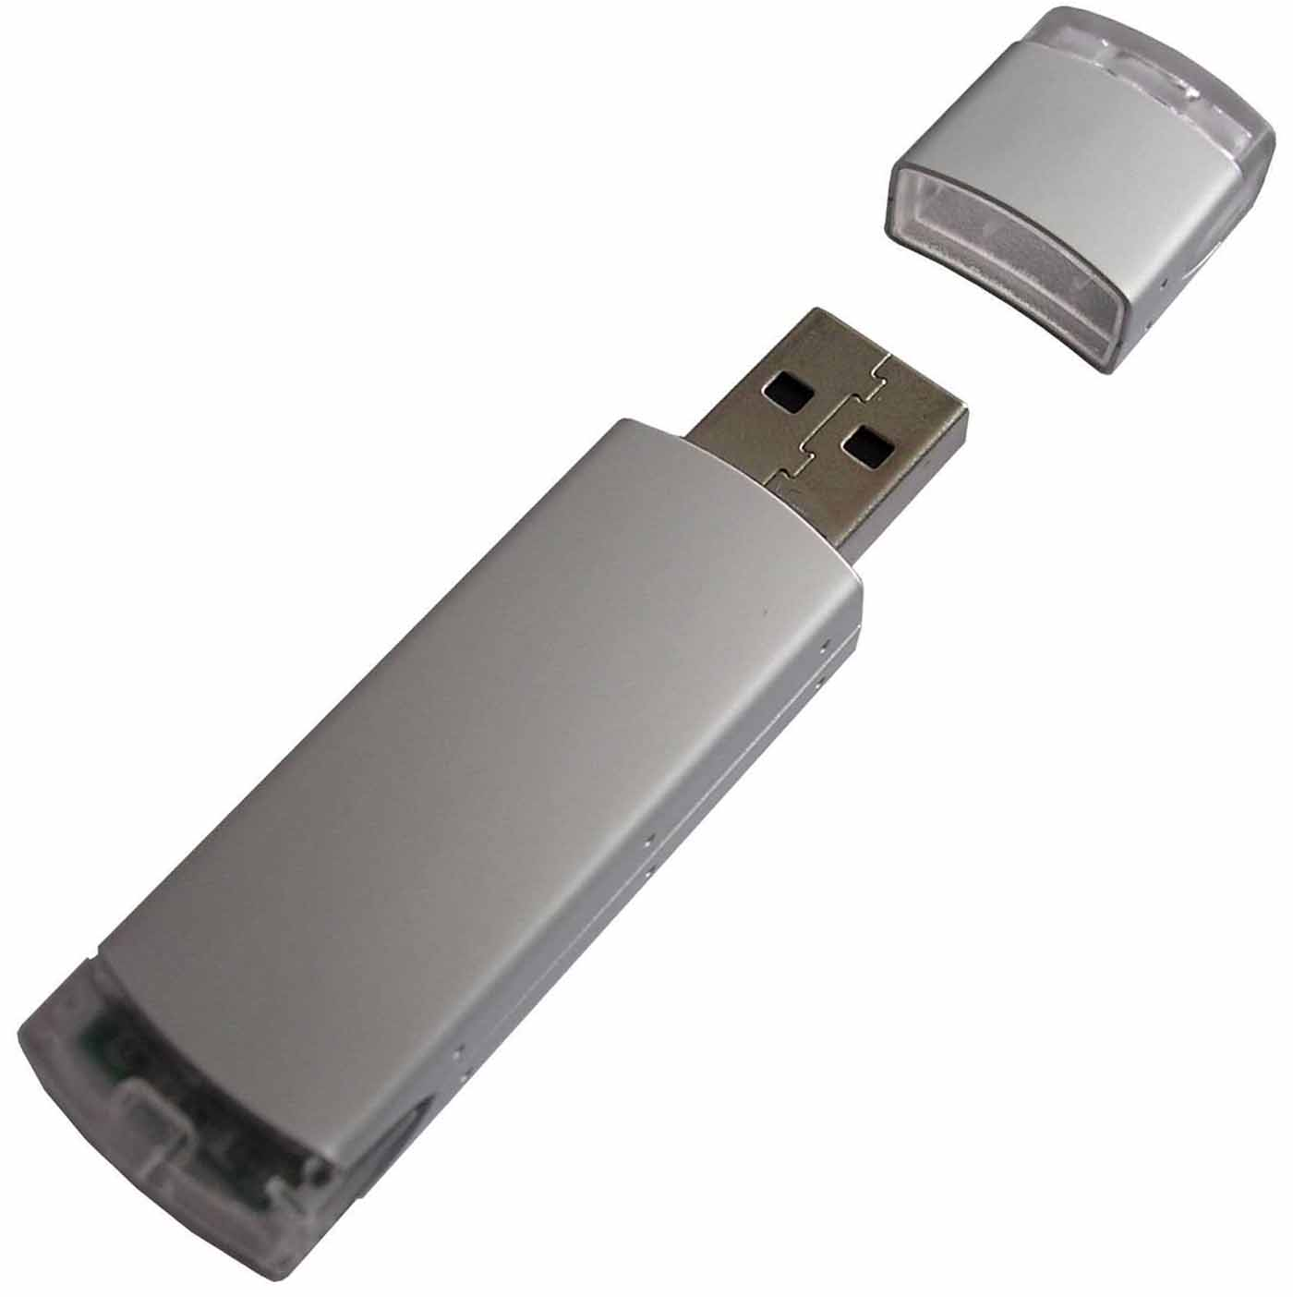
Disk Formatting
Preparing a data storage device for initial use
Such as a SSD, HDD, floppy disk or USB drive
May create one or more new file systems
Notes:
Disk formatting is the process of preparing a data storage device such as a hard disk drive, solid-state drive, floppy disk or USB flash drive for initial use. In some cases, the formatting operation may also create one or more new file systems.

Slide 10
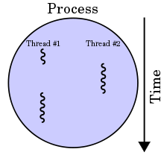
Multi-Threading Advantages
Responsiveness
Faster execution
Lower resource consumption
Notes:
Responsive - it is possible for the application to remain responsive to user input while executing tasks in the background
Faster execution - operate faster on computer systems that have multiple central processing units (CPUs) or one or more multi-core processors
Lower resource consumption - an application can serve multiple clients concurrently using fewer resources than it would need when using multiple process copies of itself

Slide 11
Multi-Threading Drawbacks
Synchronisation
Thread crashes a process
Difficult to debug, result is sometimes unpredictable
Potential deadlocks
Notes:
Synchronisation - programmer must avoid A race condition (the behavior of an electronic, software, or other system where the output is dependent on the sequence or timing of other uncontrollable events)
Thread crashes - an illegal operation (a command or instruction that specifies an operation that is unknown to the operating system or processor and that therefore can't be performed) performed by a thread disrupts the processing of all other threads in the application.

Slide 12
Grzegorz Kraszewski
Polish
Writes a lot of the software for MorphOS
Graduated from Bialystok University of
Technology in 1998
Wrote an e-book on programming for MorphOS

Slide 13
Oliver Wagner
Swiss
One of the lead software developers of
MorphOS
Sadly passed away last year at age 45 due to cancer

Slide 14
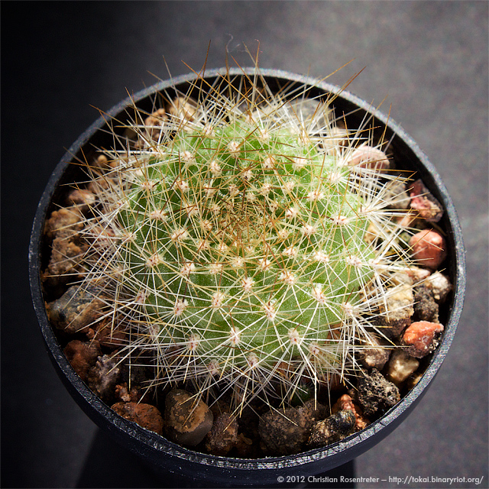
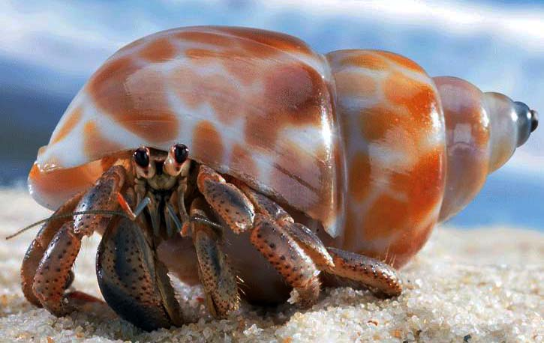
Christian Rostentreter
Created a lot of the games for MorphOS
Makes digital art and photos.
He grows cacti and rare plants, and keeps hermit crabs as pets.

Slide 15
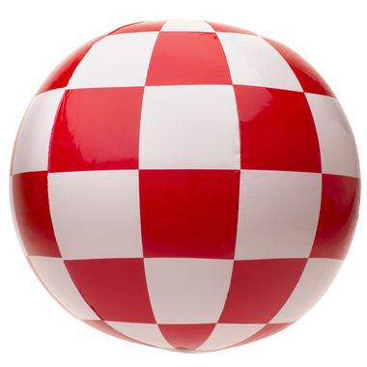
AmigaOS
Built by people who ported Freespace and Shogo from Linux to AmigaOS
MorphOS was built by those behind Amiga expansions
Notes:
oth are currently limited to 32-bit mode when running on 64-bit processors. Both are currently limited to running single-threaded on one core, even on multi-threaded/multicore processors.
AmigaOS4.x was built by the people who ported Freespace and Shogo from linux to AmigaOS, with much help from Olaf Barthell and many others.
MorphOS was built by the programmers behind the finest Amiga expansions (Blizzard, Cyberstorm), RTG subsystem (Cybergraphics), and kernel extensions (PowerUP), amongst many others.
AmigaOS has support for some more recent graphics cards than MorphOS, and has some features (eg Paula audio chip wrapper/emulator) that MorphOS does not.
AmigaOS runs on more 'new' hardware than MorphOS (custom hardware, v expensive sadly), MorphOS supports a vast range of commonly available Apple (PowerPC only) hardware which is easily obtainable, replaceable, and affordable.
When running on the same hardware MorphOS outperforms AmigaOS in most (all?) areas, however AmigaOS doubtless has some features that MorphOS lacks.

Slide 16
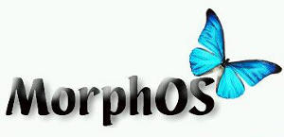
AmigaOS vs MorphOS
AmigaOS has support for some more recent GPU’s
AmigaOS runs on newer hardware (custom)
More apps and programs on AmigaOS
Notes:
oth are currently limited to 32-bit mode when running on 64-bit processors. Both are currently limited to running single-threaded on one core, even on multi-threaded/multicore processors.
AmigaOS4.x was built by the people who ported Freespace and Shogo from linux to AmigaOS, with much help from Olaf Barthell and many others.
MorphOS was built by the programmers behind the finest Amiga expansions (Blizzard, Cyberstorm), RTG subsystem (Cybergraphics), and kernel extensions (PowerUP), amongst many others.
AmigaOS has support for some more recent graphics cards than MorphOS, and has some features (eg Paula audio chip wrapper/emulator) that MorphOS does not.
AmigaOS runs on more 'new' hardware than MorphOS (custom hardware, v expensive sadly), MorphOS supports a vast range of commonly available Apple (PowerPC only) hardware which is easily obtainable, replaceable, and affordable.
When running on the same hardware MorphOS outperforms AmigaOS in most (all?) areas, however AmigaOS doubtless has some features that MorphOS lacks.

Slide 17
AmigaOS vs MorphOS
Both limited to 32-bit mode
Limited on running single-threaded on one core
even on multi-threaded multi core processors
Notes:
oth are currently limited to 32-bit mode when running on 64-bit processors. Both are currently limited to running single-threaded on one core, even on multi-threaded/multicore processors.
AmigaOS4.x was built by the people who ported Freespace and Shogo from linux to AmigaOS, with much help from Olaf Barthell and many others.
MorphOS was built by the programmers behind the finest Amiga expansions (Blizzard, Cyberstorm), RTG subsystem (Cybergraphics), and kernel extensions (PowerUP), amongst many others.
AmigaOS has support for some more recent graphics cards than MorphOS, and has some features (eg Paula audio chip wrapper/emulator) that MorphOS does not.
AmigaOS runs on more 'new' hardware than MorphOS (custom hardware, v expensive sadly), MorphOS supports a vast range of commonly available Apple (PowerPC only) hardware which is easily obtainable, replaceable, and affordable.
When running on the same hardware MorphOS outperforms AmigaOS in most (all?) areas, however AmigaOS doubtless has some features that MorphOS lacks.

Slide 18
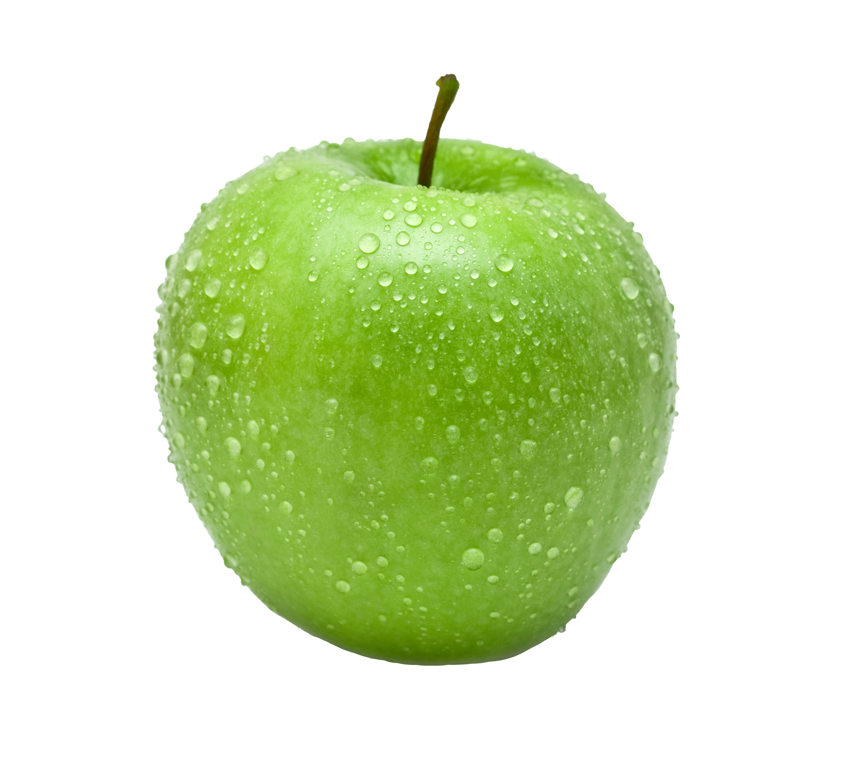
AmigaOS vs MorphOS
MorphOS supports a vast range of Apple hardware (easily obtainable, replaceable and affordable)
On same hardware MorphOS outperforms AmigaOS in most areas
OpenGL games are a bit faster due to faster graphics
More frequent updates
Notes:
oth are currently limited to 32-bit mode when running on 64-bit processors. Both are currently limited to running single-threaded on one core, even on multi-threaded/multicore processors.
AmigaOS4.x was built by the people who ported Freespace and Shogo from linux to AmigaOS, with much help from Olaf Barthell and many others.
MorphOS was built by the programmers behind the finest Amiga expansions (Blizzard, Cyberstorm), RTG subsystem (Cybergraphics), and kernel extensions (PowerUP), amongst many others.
AmigaOS has support for some more recent graphics cards than MorphOS, and has some features (eg Paula audio chip wrapper/emulator) that MorphOS does not.
AmigaOS runs on more 'new' hardware than MorphOS (custom hardware, v expensive sadly), MorphOS supports a vast range of commonly available Apple (PowerPC only) hardware which is easily obtainable, replaceable, and affordable.
When running on the same hardware MorphOS outperforms AmigaOS in most (all?) areas, however AmigaOS doubtless has some features that MorphOS lacks.

Slide 19
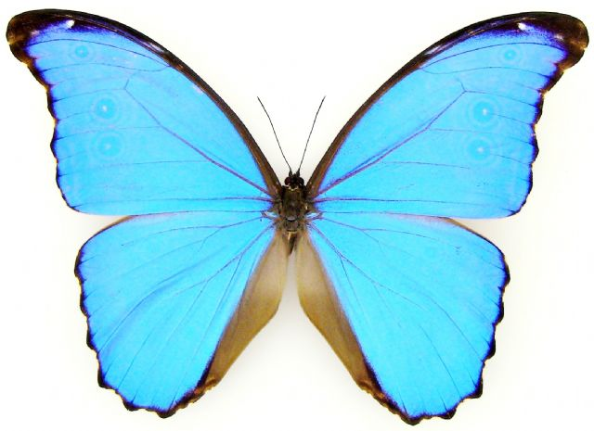
Conclusion
Lightweight, efficient, flexible OS
Designed by a wide range of people from all over the world
Continually updated
Notes:
continually updated giving it a very modern feel

Slide 20
Sources
Kraszewski, G. (2015) The Homepage, http://krashan.ppa.pl/, Date Accessed: March 2017
Kraszewski,G.(-) Table of Contents, http://krashan.ppa.pl/mph/ , Date Accessed: March 2017
Siegel, A. (2016) Oliver Wagner has passed away, https://morph.zone/modules/news/article_storyid_2295.html, Date Accessed: March 2017
Rosentreter,C (2014) Tokai’s software Dump, https://tokai.binaryriot.org/public/ ,Date Accessed: March 2017
Morph OS Development team,(2000)Info Page, http://www.morphos-team.net/intro ,Date Accessed: March 2017
Morph OS Development team,(2000) News, https://morph.zone/news/ ,Date Acessed: March 2017
Notes:
oth are currently limited to 32-bit mode when running on 64-bit processors. Both are currently limited to running single-threaded on one core, even on multi-threaded/multicore processors.
AmigaOS4.x was built by the people who ported Freespace and Shogo from linux to AmigaOS, with much help from Olaf Barthell and many others.
MorphOS was built by the programmers behind the finest Amiga expansions (Blizzard, Cyberstorm), RTG subsystem (Cybergraphics), and kernel extensions (PowerUP), amongst many others.
AmigaOS has support for some more recent graphics cards than MorphOS, and has some features (eg Paula audio chip wrapper/emulator) that MorphOS does not.
AmigaOS runs on more 'new' hardware than MorphOS (custom hardware, v expensive sadly), MorphOS supports a vast range of commonly available Apple (PowerPC only) hardware which is easily obtainable, replaceable, and affordable.
When running on the same hardware MorphOS outperforms AmigaOS in most (all?) areas, however AmigaOS doubtless has some features that MorphOS lacks.

