Slide 1
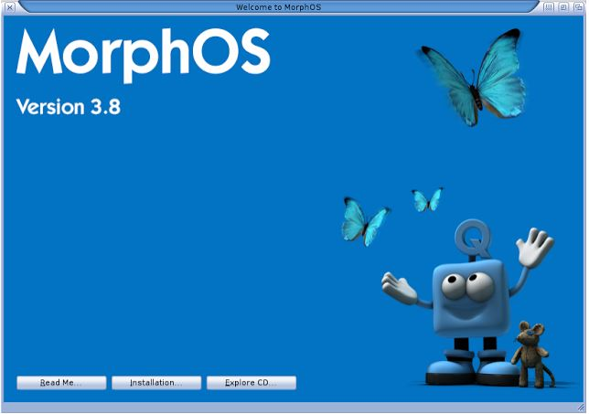
By Josh Lambert
C16362481,
Eoin Lambert,
C16362513,
Jack Byrne,
C16450832,
Mikey Keddy,
C16462516.
By Jack Byrne,
C16450832,
Josh Lambert, C16362481,
Eoin Lambert,
C16362513,
Mikey Keddy,
C16462516.
.

Slide 2
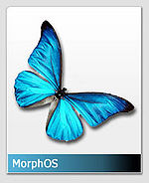
Table of Contents
Introduction
Facts
AmigaOS
History
Versions
Developers
Ambient
Uses
Conclusion
References

Slide 3
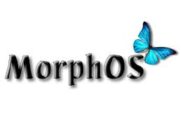
Introduction
MorphOS is an Amiga-like GUI based that was
first released in 2000.
MorphOS is a lightweight, highly efficient and flexible
desktop operating system. It includes primarily
Proprietary as well as open - source components.

Slide 4
Facts
It was first developed by the MorphOS development team, which included up to 20 core developers (approx).
MorphOS is written in C.
It costs €79 for a laptop or desktop licence and you can only use the MorphOS on the device you downloaded it on.
The unregistered version includes full functionality however it slows down every 30 minutes to 2 hours.
The logo is the Morpho butterfly, found in South America.

Slide 5
AmigaOS
MorphOS is based on AmigaOS and therefore it is a faster and a more “advanced” OS according to some.
AmigaOS is also written in C but it is also written in Assembly Language.
It was developed initially by Commodore International and then later by Hyperion Entertainment.

Slide 6
Ambient
Ambient is the MorphOS native desktop.
Ambient is a MUI-Based (Magical User Interface) desktop environment, becuase of its aesthetic features.
The project started in December 2001 when Pegasos came with its own operating system MorphOS.

Slide 7
Ambient
The Pegasos users were used to Amiga and so there was an effort to make a GUI that would be similar to Amiga, and this was why ambient was developed.
On the 22nd January 2005, Ambient was provided as an open source software, some of these sources are available on Sourceforge.

Slide 8
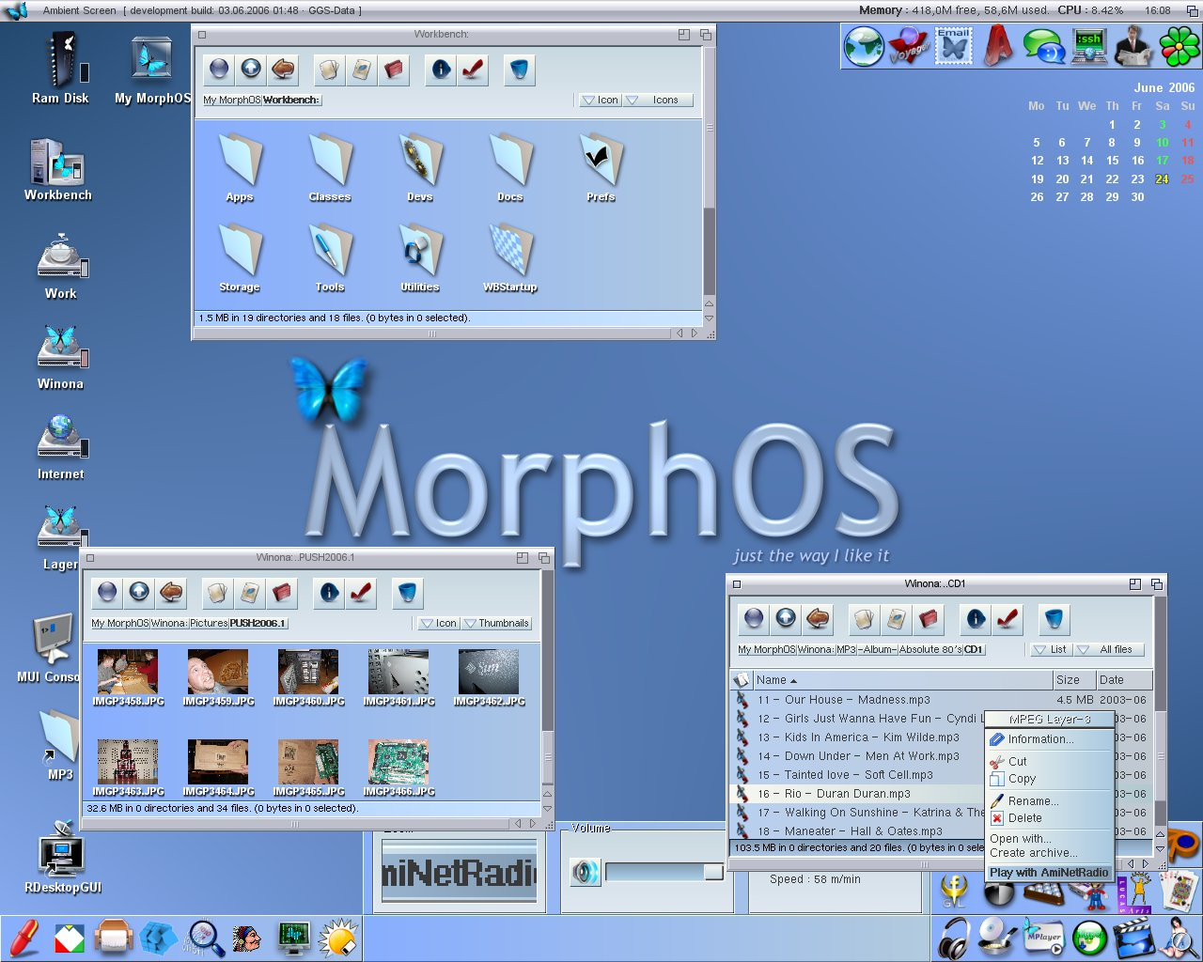

Slide 9
History
MorphOS was initially released on August the first 2000.
Its latest release was on the 19th June 2015.
There are a number of different versions of MorphOS.
It was built to run Legacy Applications.

Slide 10
History
Version 1 came out in 2002.
There were 8 versions of version 1, the last one being in mid 2005.
When version 2 came out in 2008, there were 7 versions of it.
In 2012, version 3 was introduced and there was 9 versions of this.
The latest version is version 3.9 introduced on 19th of june 2015.

Slide 11
Version 2.0
General improvements:
There were Various UI style fixes in applications
A new memory management was introduced
Ambient:
Improved file types so that each one can have its own default icon
It introduced Improved iconview and advanced lists
It also introduced a shortcut system and a finder tool to make searching quicker.
This version also improved Games, Utilities and 3D graphics.

Slide 12
Version 3.0
Ambient:
Made improvements for handling links
Improved launching apps so they didn’t crash when opening
Added support for multi-action operations
It also improved:
RAM filesystem
Touchpad input
Battery - added a battery sensor

Slide 13
Version 3.9
This is the latest version that came out in 2015.
This version came with improvements to both the ROM based components as well as changes to the disk-based components of MorphOS.
Such changes include bug fixes and improvement in the stability of MorphOS.

Slide 14
Founder/developers
We know that the core development team for MorphOS consisted of 20 core developers.
Some of the developers include Grzegorz Kraszewski, Mark Olsen and
Frank Mariak (responsible for the 3D graphics infrastructure).
Some developers also worked on AmigaOS and so it is no surprise that they are similar.

Slide 15
MorphOS what it’s used for?
Essentially MorphOS is an enhanced version of AmigaOS.
It finds its uses in the small and portable technology like the Mac mini and other small yet similar devices.
It only requires 140mb to be stored.
It was designed to support all CD Drives and DVD Drives that comply with the ATAPI standard.

Slide 16
Quark Kernel
This Kernel is used to run virtualized computers.
The Quark Kernel is a micro-kernel that consists of a ‘Box’.
This ‘Box’ consists of some of the main Processes that the system carries out.
These Processes include:
Memory Management
Process Management
Drivers

Slide 17

Conclusion

Slide 18
References
http://www.morphos.de/faq
http://library.morph.zone/What_is_Morph
http://www.operating-system.org/betriebssystem/_english/bs-amigaos.htm
http://www.webalice.it/fulvio.peruggi/public/Pegasos&MorphOS/Articles/06_MorphOS_TLOS/MorphOS_extended_en_frames.html

