Slide 1
N-1
Povilas Kubilius - C16370803
Michael Lenghel - C16434974
Aaron Sheehan - C16356021
Eamonn Keogh - C16757629
Matthew Martin - C16435796

Slide 2
Table of Contents
Slide: 3 | Introduction
Slide: 4 - 7 | Biography of OS Creators
Slide: 8 - 13 | OS Description
Slide: 14 - 19 | OS Kernel
Slide: 20-21 | Conclusion slides
Slide: 22 - 23 | Bibliography

Slide 3
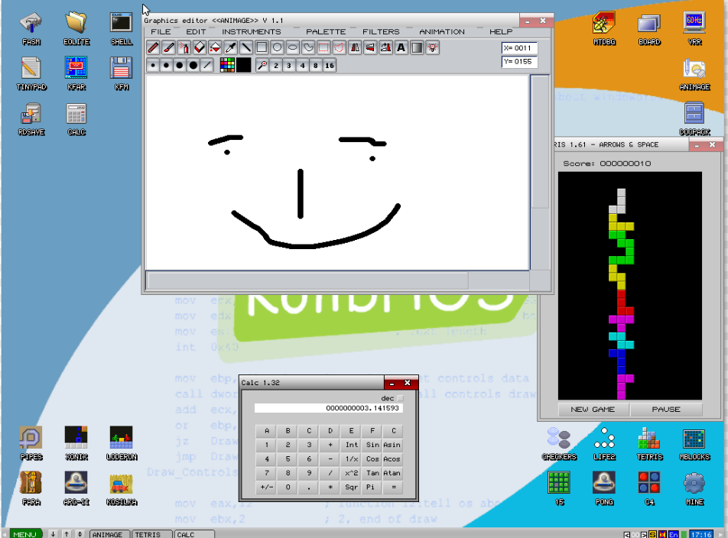

Slide 4
KolibriOS Project Team
Ville Turjanmaa - Process management, GUI
Jarek Pelczar - Quake, Doom, DOSbox ports
Mike Hibbett - Networking
Madis Kalme - Graphic functions
Tom Tollet - Floppy driver

Slide 5
KolibriOS Project Team

Slide 7
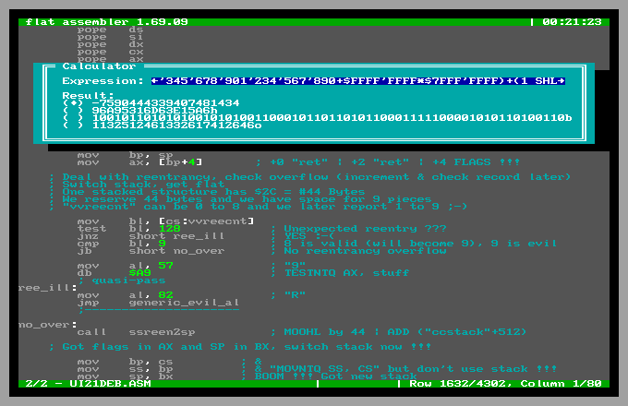
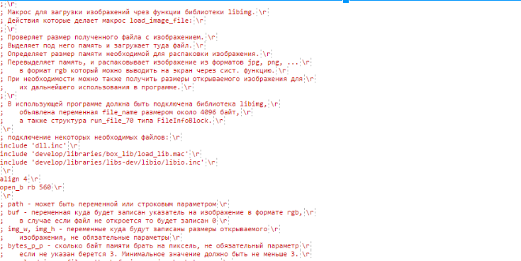
FASM x86 Assembler
1999, Polish university student Tomasz Grysztar
Open-source 80x86 assembler for DOS, Windows and Linux
Supports all 8086-80486/Pentium processor instructions (32/64bit)
Notes:
FASM assembler code

Slide 8
Why KolibriOS?

Slide 10
€100 euro PC = few seconds boot time
Kernel = FASM assembly
Fully open source

Slide 11
KolibriOS is less than
100 kilobytes!!

Slide 12
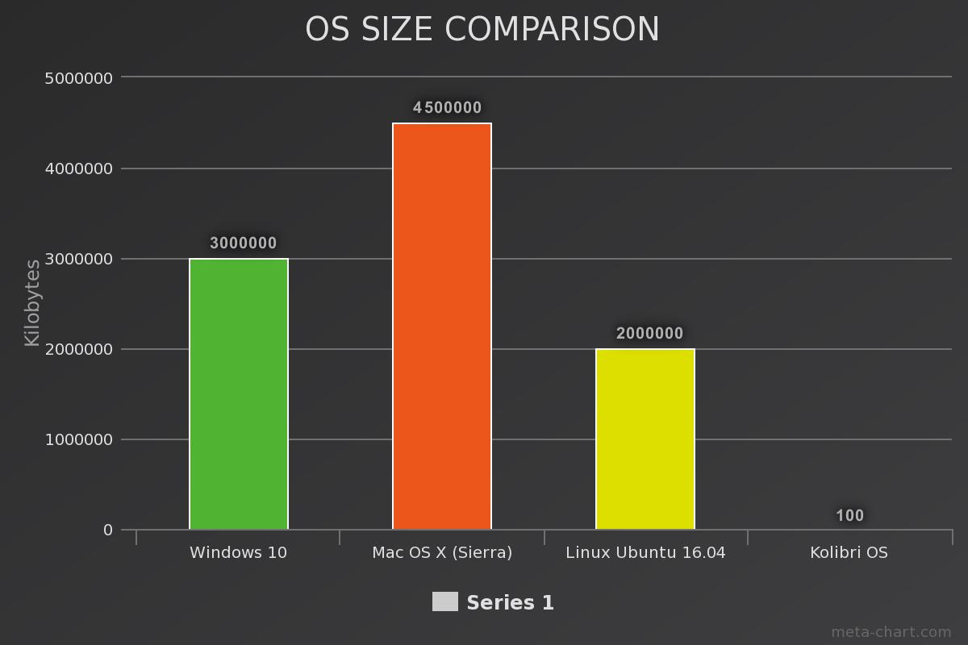
Goes Size Matters?

Slide 13
KolibriOS stored on DNA

Slide 14
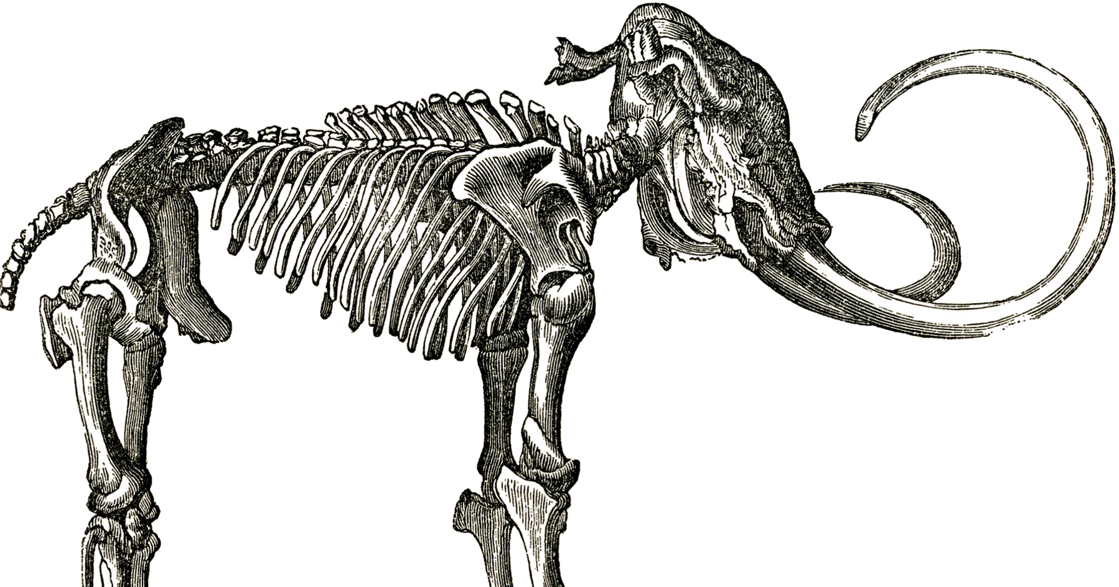
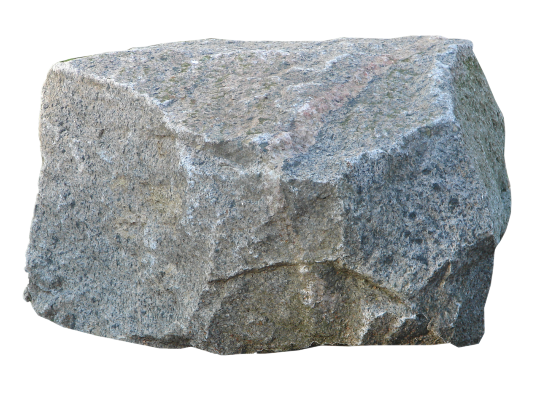
Monolithic -“formed of a single large block of stone”

Slide 15
KolibriOS Kernel
A monolithic kernel runs all the operating system instructions in the same address space, for speed.

Slide 16
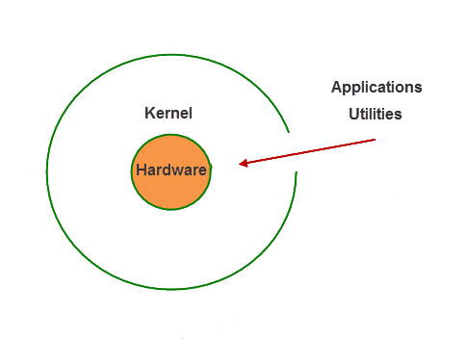
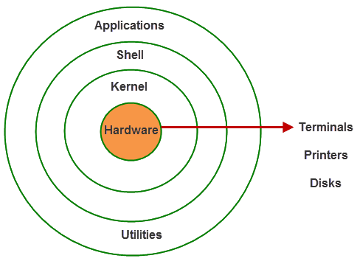
Typical Operating
System Architecture
KolibriOS
Architecture

Slide 17
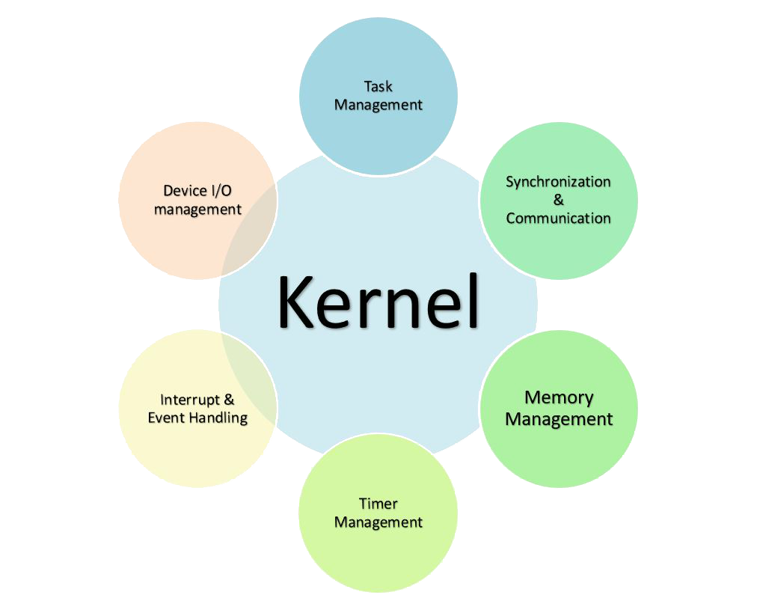

Slide 18
Monolithic Kernel
Consists of:
Device drivers
File system
Applications
Interprocess communication occurs in the kernel
Dynamically load and unload executables at runtime

Slide 19
Preemptive Kernel
Has the following behaviour:
Interrupts (IRQ) a given task on computer system
Does not require cooperation of task
Resumes the task at a later time
By referring back to the stack
Interrupted task has the potential to crash

Slide 20
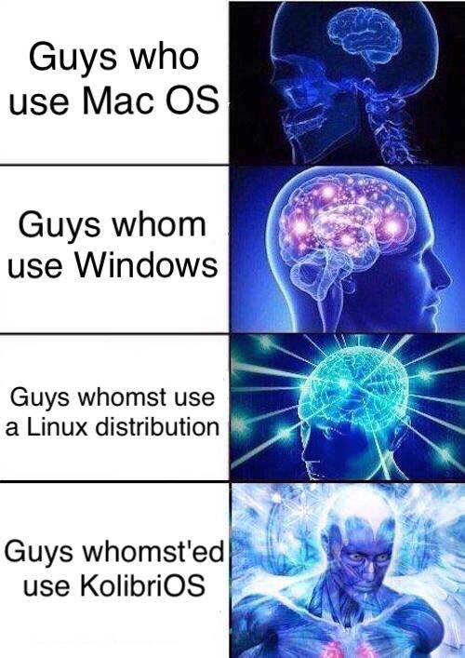

Slide 22
Bibliography
Image 1: Me
Cheetah image:
http://blog.aikidojournal.com/media/cheetah-running.jpg
Desktop image: https://gambaru.de/blog/wp-content/uploads/2011/01/20110120_KolibriOS_apps_1024x7681.png
DNAs: http://www.icone-png.com/png/51/51441.png

Slide 23
Bibliography
Monolithic Kernel:
https://en.wikipedia.org/wiki/Monolithic_kernel
Preemption in Computing:
https://en.wikipedia.org/wiki/Preemption_(computing)
Kernel:
https://en.wikipedia.org/wiki/Kernel_(operating_system)
FAT32:
https://staff.washington.edu/dittrich/misc/fatgen103.pdf
Detailed explanation of the architecture (its translated from russian):
https://translate.google.com/translate?sl=auto&tl=en&js=y&prev=_t&hl=ru&ie=UTF-8&u=http%3A%2F%2Fboard.kolibrios.org%2Fviewtopic.php%3Ff%3D35%26t%3D1179&edit-text=&act=url
Further explanation of architecture: https://translate.google.com/translate?sl=auto&tl=en&js=y&prev=_t&hl=ru&ie=UTF-8&u=http%3A%2F%2Fboard.kolibrios.org%2Fviewtopic.php%3Ff%3D35%26t%3D1179&edit-text=&act=url
FASM
https://flatassembler.net/

