Slide 1
We are DOS DIABLOS GROUP (THE DOS-SERS )
DOS-SERS Members:
STUDENT NAME STUDENT NUMBER
Iosif Dobos C16735789
Darren Byrne C16735211
Robert Dagger C16714909
Eddie O'Neill C16742511
David Kenny C16765119

Slide 2
DOS HISTORY
Created by THE DOS - SERS

Slide 3
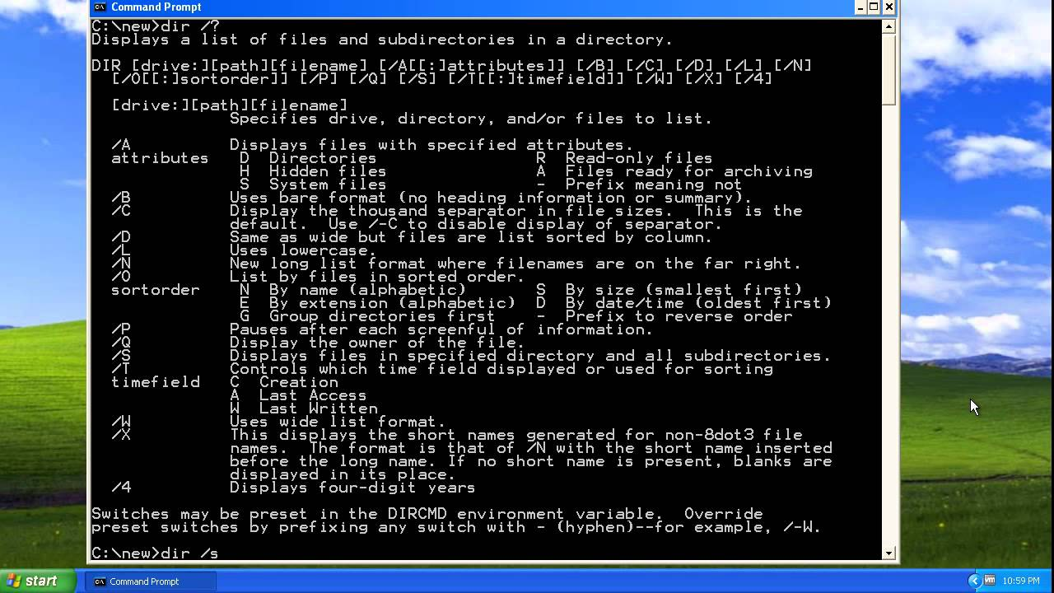

Slide 4
TabLe of contents
Title Page __________________________________________________________Stage 1
DOS History _________________________________________________________Stage 2
DOS Desktop________________________________________________________Stage 3
The Root of DOS Tim Patterson _______________________________________Stage 6
Tim Paterson ________________________________________________________Stage 7
DOS credited to Microsoft ___________________________________________Stage 10
MS-DOS Timeline ____________________________________________________Stage 11
History of DOS ______________________________________________________Stage 14
MS-DOS Diagram __________________________________________________Stage 15
MS-DOS Layer Structure ____________________________________________Stage 16
DOS Architecture ___________________________________________________Stage 19
DOS basic commands ______________________________________________Stage 20
DOS Acronyms ______________________________________________________Stage 26
Conclusion/The End _________________________________________________Stage 29
References__________________________________________________________Stage 30

Slide 5
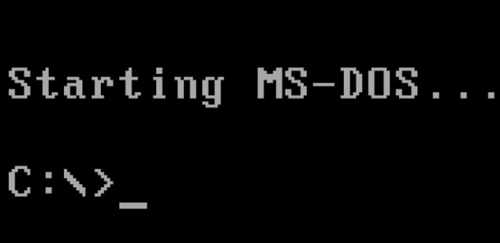

Slide 6
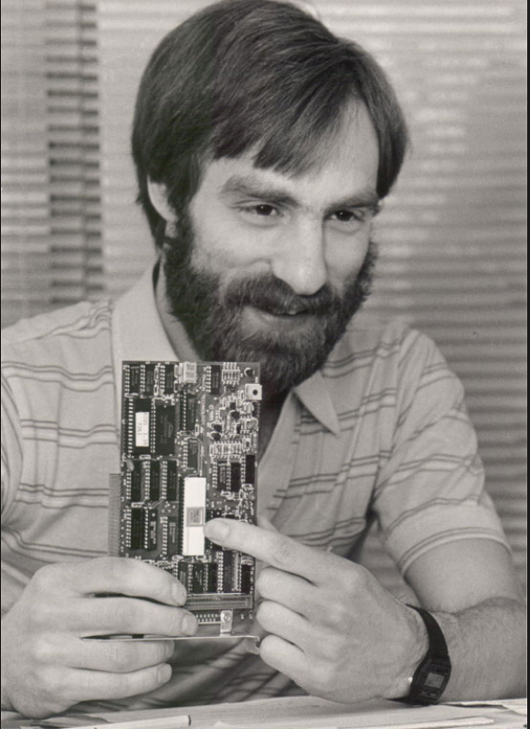
The Roots of DOS: Tim Paterson
Original author of DOS, MS-DOS, PC-DOS
Graduated from the University of Washington in 1978
Worked as an engineer in Seattle Computer Products
- designed an 8086nCPU card for S-100 Bus in May 1979
-Began designing DOS in 1980 after IBM had released their new 8086 microprocessor (16-bit)
Objectives in design DOS were to make it as simple to use as possible
Fast and efficient
Written in 8086 assembly language

Slide 7
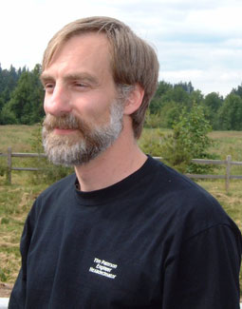
Tim Paterson
In college, Paterson wrote a multi-tasking operating system for the Z80 microprocessor as a term project. Therefore, Paterson had confidence in writing an OS for the 8086 computer.
Paterson spent roughly 2 months working on QDOS, “Quick and Dirty Operating System” which he developed between April and July , 1980.
QDOS 0.10 – launched in August 1980
86-DOS version 0.3 – released at the end of 1980
Sold non-exclusive rights to Microsoft to market 86-DOS
Released 86-DOS version 1.00 in April 1981
Similar to MS-DOS of today

Slide 8
Tim Paterson
Seattle Computer Products
Microsoft
Settled the license dispute by buying the license back from Seattle Computer Products for $975,000 in 1986
The total price for DOS ended up $1,050,000
Launched MS-DOS to its OEM in 1982
Stopped updating DOS in 1995 when Windows95 was released
( domestic version )

Slide 9
Tim Paterson
Seattle Computer Products
Microsoft
Paid $10,000 for the right to market 86-DOS
Paid $15,000 for each OEM customer in 1981
Bought DOS from Seattle Computer Products for $50,000
Plus a license to include DOS in their PCs in July 1981
Named DOS as MS-DOS
Microsoft kept improving and evolving MS-DOS over the past years
Microsoft integrated MS-DOS with its windows operating system in 1995

Slide 10
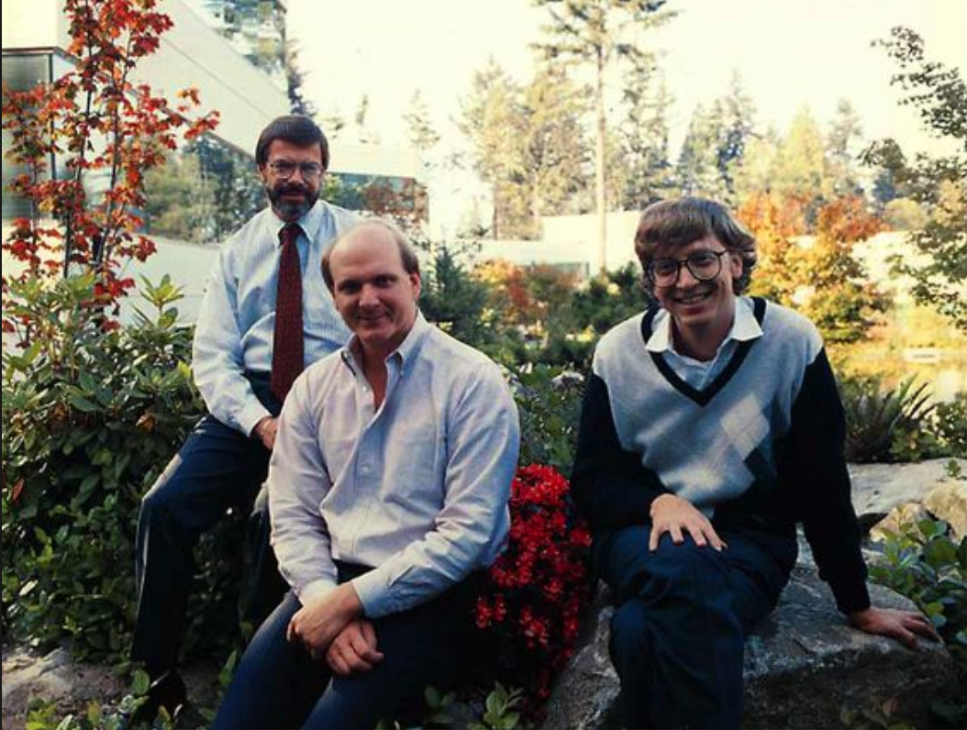
The DOS Operating System is credited to Microsoft
Bill Gates
Paul Allen
Steve Ballmer

Slide 11
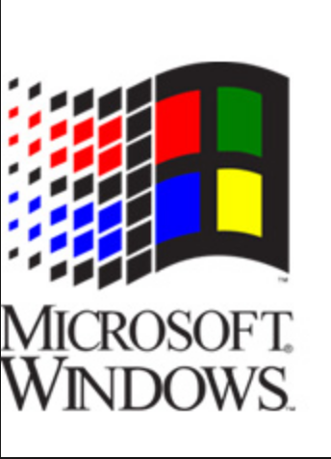
MS-DOS TIMELINE
The OS for IBM’s PC
The “Disk Operating System” or MS-DOS was based on QDOS, the “Quick and Dirty Operating System”
Written by Tim Patterson of Seattle Computer Products, for their prototype Intel 8086 based computer
Gates then talked IBM into letting Microsoft retain the rights, to market MS-DOS separate from the IBM PC project.
Bill Gates, Paul Allen and Steve Ballmer sealed the deal that made them billionaires and the huge corporation that Microsoft is today.

Slide 13
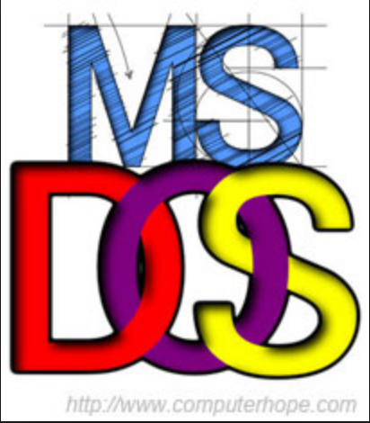
MS-DOS, PC-DOS or DOS
Developed to run single-user, stand-alone desktop computers
Typical early Operating Systems that managed jobs sequentially from a single user
Advantages : Simple operation with straight-forward user commands.
Disadvantages:
1. Lack of flexibility & limited ability to meet needs of programmers & experienced users.
2. Written for a single family of microprocessors (Intel family of chips: 8086, 8088, 80186 and 80286)
Notes:
Seattle Computer Products(SCP) was a hardware company, therefore it was willing to sell the non-exclusive right for Microsoft to market its 86-DOS at that time.

Slide 14
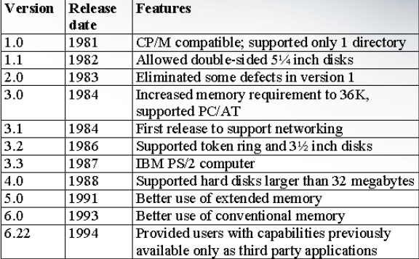
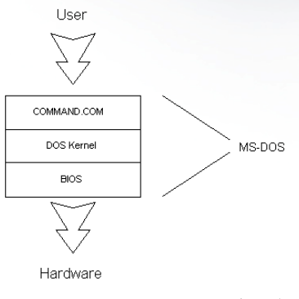
History of DOS

Slide 15
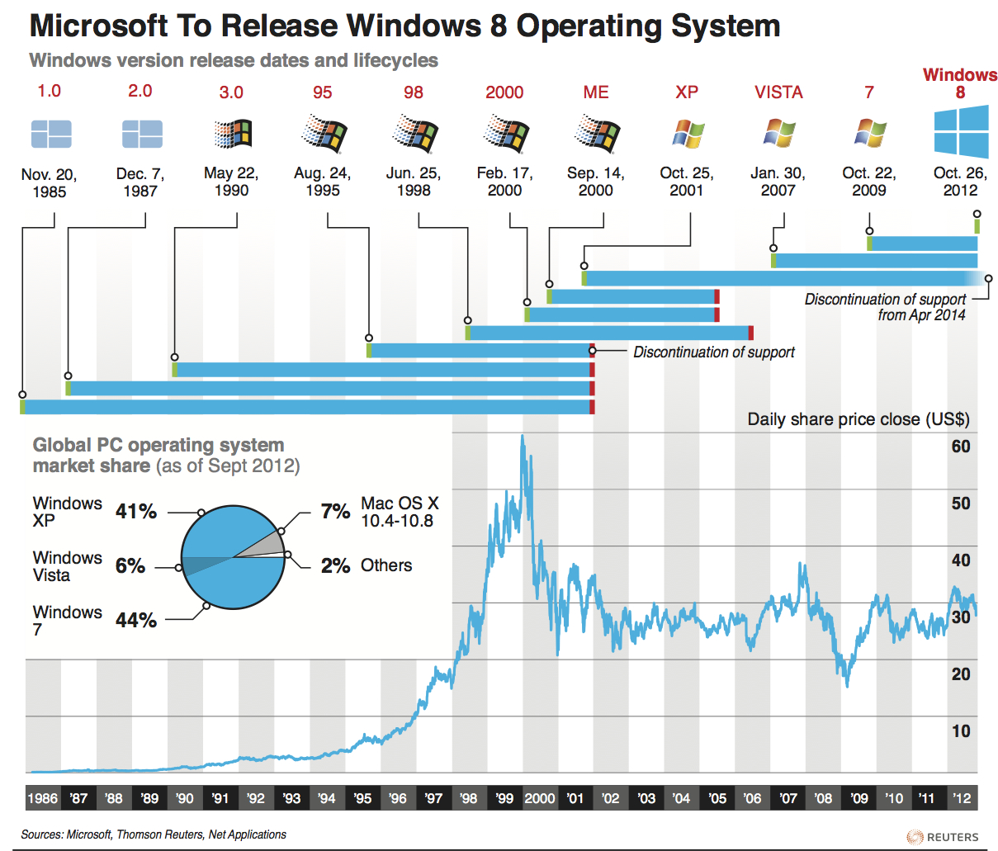
Windows Release date with their lifecycles

Slide 16
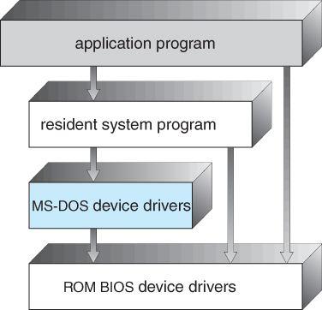
MS – DOS Layer Structure
Designed to accommodate single novice user in single-process environment
Standard I/O support including keyboard, monitor, printer & secondary storage unit
User commands are based on English words/phrases indicative of action to be performed
Commands are interpreted by command processor
Layered approach protects user from hardware

Slide 17
The Layers of DOS

Slide 18
The Layers of DOS

Slide 19
Architecture of DOS
DOS isn’t the name of a specific OS it’s an acronym for disk operated system
Written in assembly language
IBM & Microsoft DOS were designed to be compatible with
the new 16-bit 8086 in mind
Designed to use floppy disks as storage
FAT formatting
FAT12 “File Allocation Table 12” developed by Microsoft in 1980
FAT is similar to a linked list

Slide 21
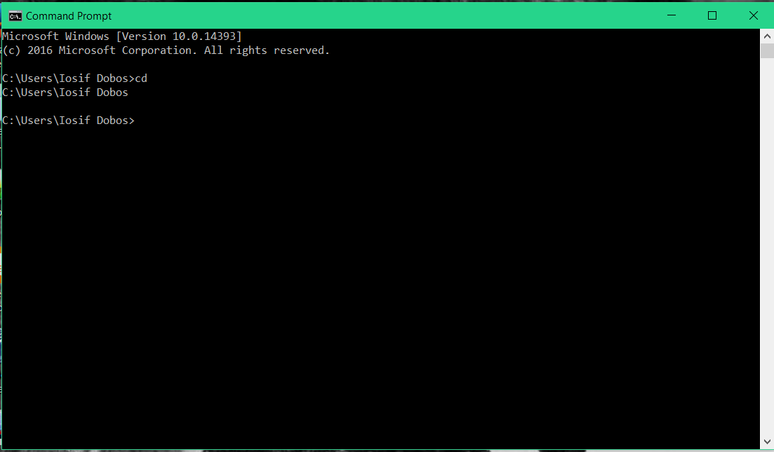
CD ( Change Directory ):
CD command is used to switch directory
Example: C:\users\user>
C:\users\user>cd:\ (enter)
C:\>cd D: (enter)
D:\>

Slide 22
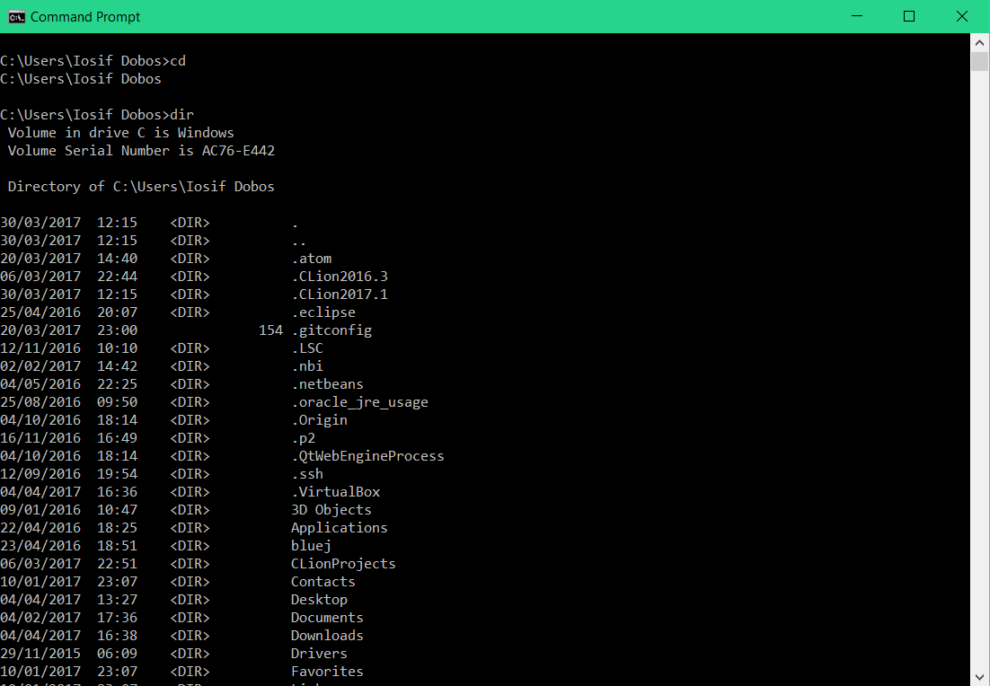
2. DIR: The dir command allows you to see the available files and directories in the current directory. By using this command, you find the last modification date and time, as well as the file size.
Example: C:\> dir (enter)

Slide 23
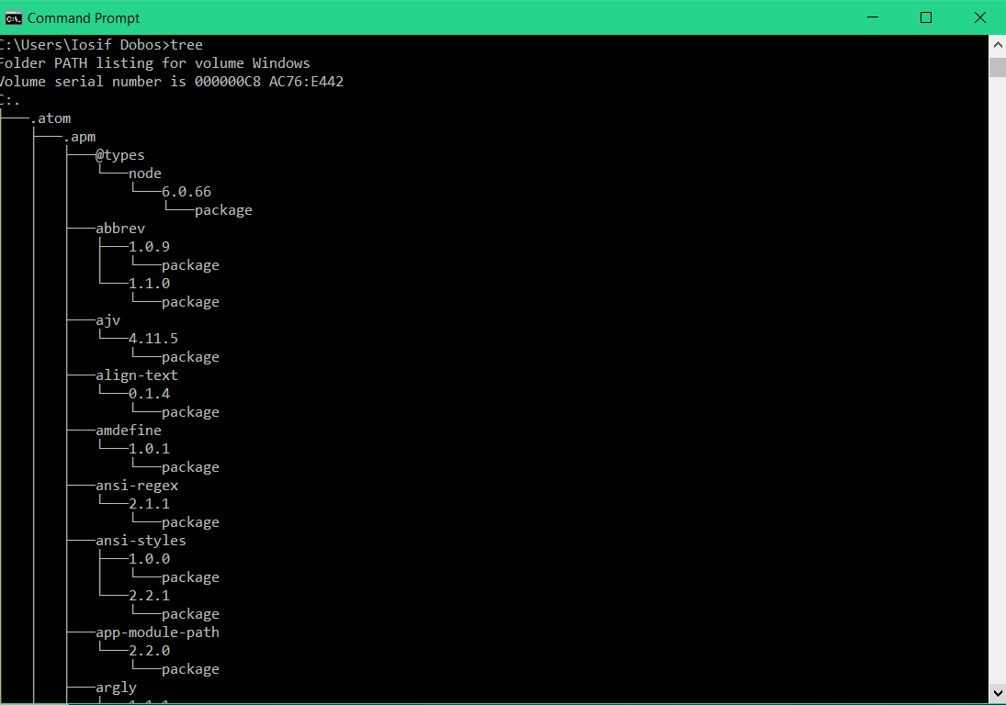
03. TREE: When we are creating a virtual spider web of directories & file etc. in computer, sometimes we forget/confuse to remember where the everything is. The TREE Command helps you to find the same. Tree command showing you a diagram of directories & subdirectories in your computer.
Example: C:\> tree (enter)

Slide 24
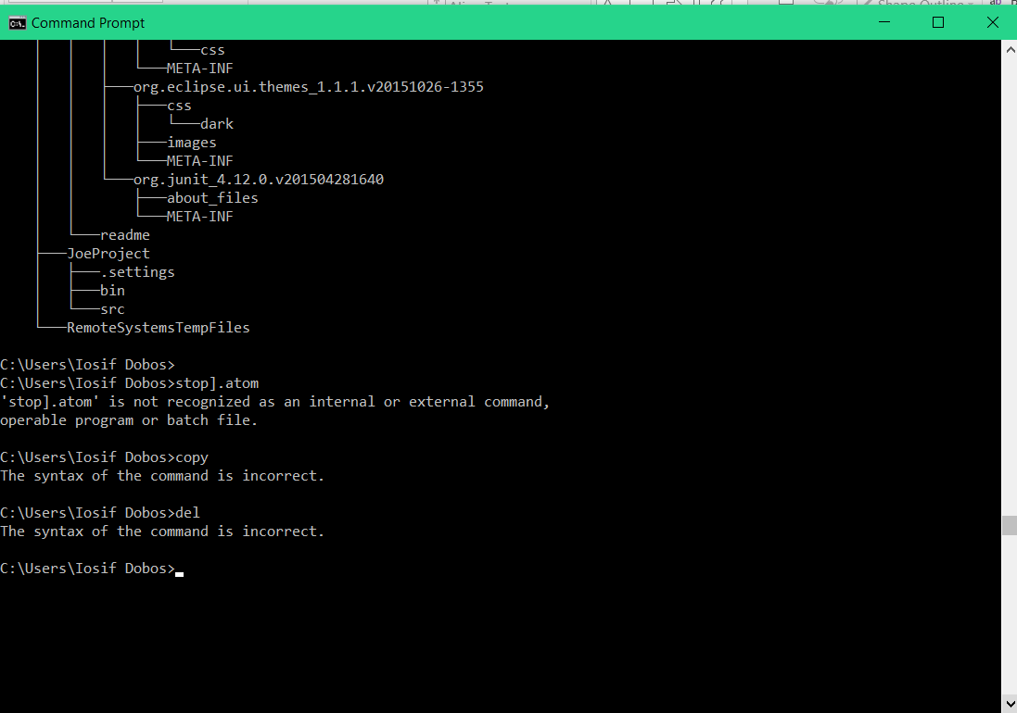
04. COPY: By using copy command, you can copy files to alternative locations.
Example: C:\> copy kolkata.txt d: (enter)
(Copy the document file “Kolkata.txt to
“d" drive)

Slide 25
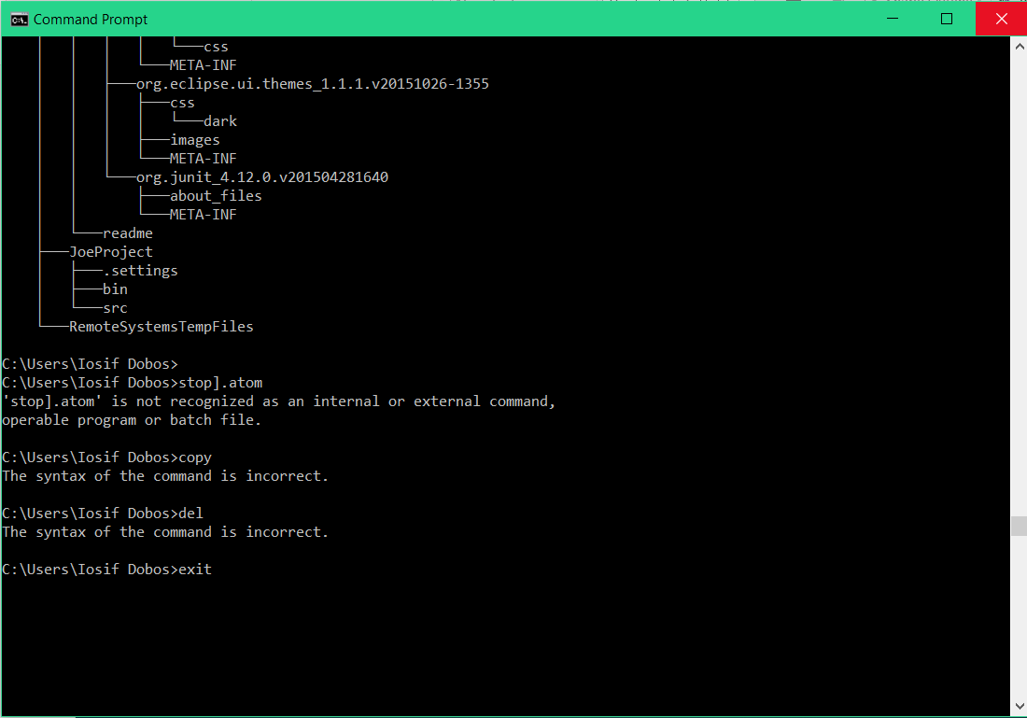
05. DEL: Del is used for delete the created file you want from computer.
Example: C:\> del Kolkata.txt (enter)
(Kolkata.txt will be deleted from "C"
drive when you used del command)

Slide 26
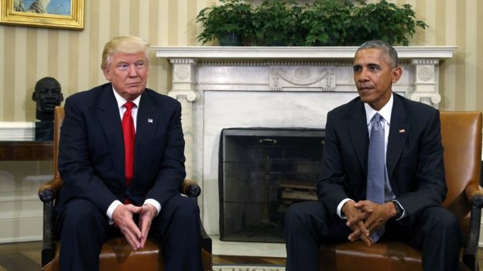
Donald Obama Swap

Slide 27
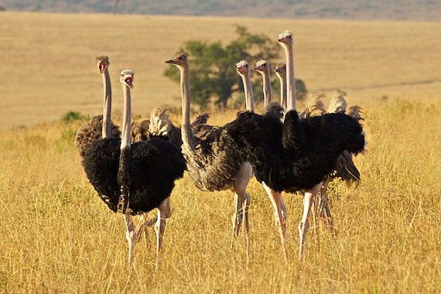
Do Ostriches Sit ?

Slide 28
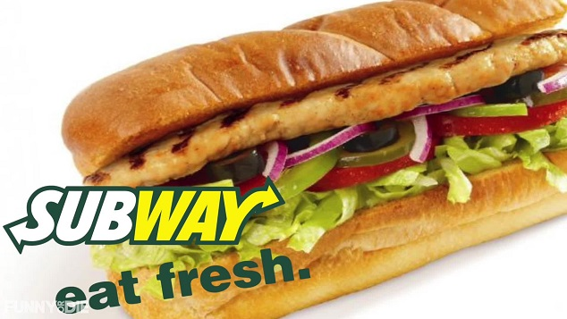
Daily Organic Subways

Slide 29
THE END OF
THANK YOU!!!

Slide 30
References
Tim Paterson, the Root of DOS from Softalk for the IBM Personal Computer March 1983
http://www.patersontech.com/dos/softalk.aspx
MS-DOS a brief introduction to history from
http://www.linfo.org/ms-dos.html
MS DOS layer structure from
https://www.cs.uic.edu/~jbell/CourseNotes/OperatingSystems/2_Structures.html

Slide 31
References
MS – DOS top 10 basic commands from
http://www.computerhope.com/dostop10.htm
MS-DOS, PC – DOS or DOS a brief introduction to history from
http://www.softpanorama.org/History/dos_history.shtml
MS – DOS, Images used for the presentation from
https://www.google.ie/search?q=ms+dos+pictures&espv=2&source=lnms&tbm=isch&sa=X&ved=0ahUKEwiv_KW54o_TAhULL8AKHZxYDygQ_AUIBigB&biw=1707&bih=816

