Slide 1
BSD
Berkeley Software Distribution (BSD)
A UNIX OPERATING SYSTEM
Daniel Orange C16703519 | Tatiana Zihindula C16339923 | Arthur Coll C16406984 | Sam Kealy C16317416 | Stephen Alger C16377163

Slide 2
WhERE Is BSD Used ?
* Primarily used on server environments.
Popular in Labs
High Level Systems.

Slide 3
BENEFITS OF BSD?
1. Ships the entire OS , not just the kernel
* listed under the BSD license unlike Linux.
2. Security Ranking
Free BSD has a complete built-in security manager
3. Supports a binary compatibility.
4. Multi Device Compatibility
- Smart toasters
- Smart phones

Slide 4
MAC and BSD
Mac is not a Unix Kernel
Mac is build onto an old BSD Kernel
Virtual Files and port management
Redistribution Tolerance

Slide 5
distributions of bsd
>> Best of the bunch:
1. FreeBSD
2. OpenBSD
3. NetBSD

Slide 6
freebsd
Advanced OS used to power servers, desktops, embedded platforms
Advanced networking, security and advanced features.
11 versions since release (1993)

Slide 7
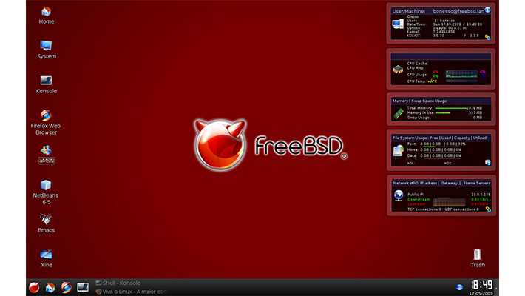

Slide 8
OPENbsd
Free multi-platform 4.4BSD-Based Unix kernel
OPENBSD foundation fund collection.
43 versions since release (1995)
Latest version 6.0 released 1st September 2016

Slide 9
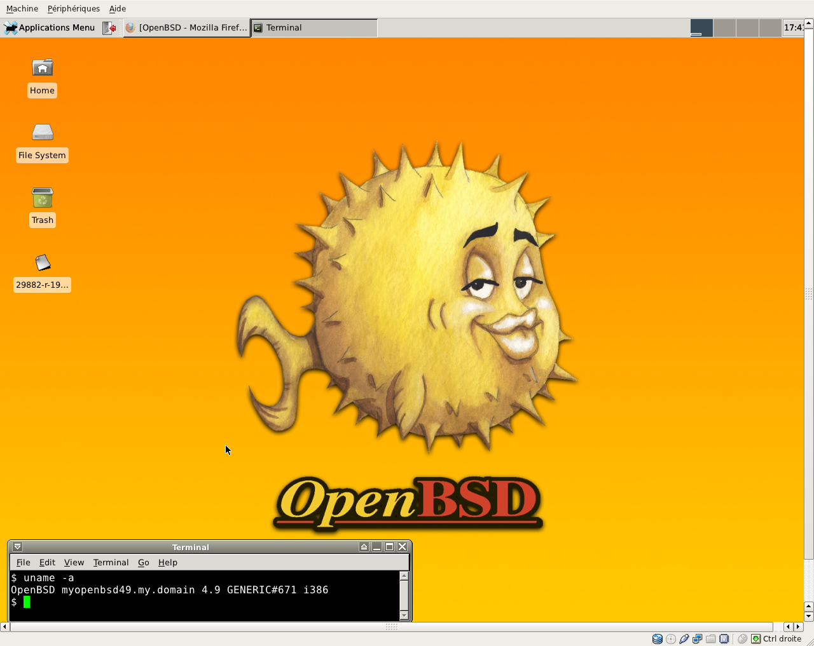

Slide 10
NETbsd
Also multi-platform(server, embedded, desktop..)
Clean and mostly used for labs and researches
Large international community
16 versions since release (1993)
Latest version 7.0 released in 2015

Slide 12
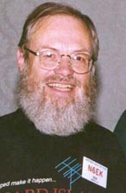
History of BSD
BSD’s source code was present in Early distributions of UNIX from Bells Labs.
Facilitated Researcher to modify it.
Professor Bob Fabry of Berkeley ordered a copy to be sent to this university.
Professor Bob Fabry

Slide 13
BSD File System - History
Shared an office at Berkeley with Bill Joy
Known for his arguably largest contribution to BSD’s file system.
Played a major role in developing Berkeley Fast File System.
Marshall Kirk McKusick

Slide 14
1BSD – BSD1.0
Along with the researcher Bill Joy, they created an improved text editor called ‘ex’.
On March 9th 1978 the first version of BSD was released, called 1BSD
Since 1BSD had no kernel it was seen as an extension of Unix rather than a standalone operating system.
Bill Joy

Slide 15
2BSD (early 1979)
Included :
Text editor vi
C shell
LAN Barkanet
3BSD (end 1979)
Text editor vi
C shell
PDP11 -
The computer
2BSD first ran on

Slide 16
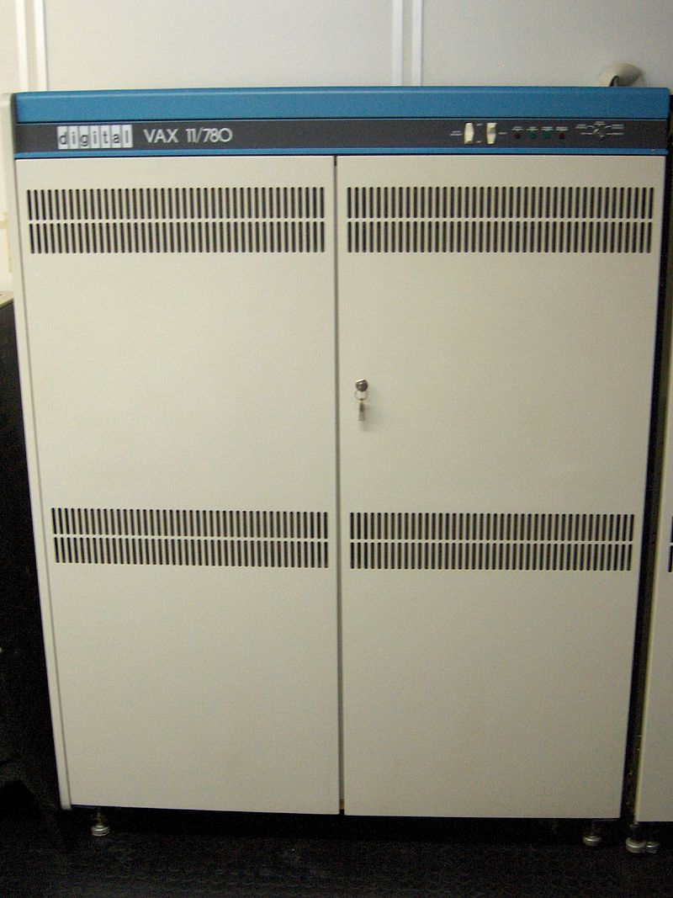
4BSD , 4.1BSD , 4.2BSD & 4.3BSD
4BSD (1980) included Job Control
4.1BSD (1981) included major kernel improvement
4.2BSD (1983) implemented Berkeley’s Fast File System and TCP/IP
4.3BSD (1983) changes to TCP/IP to meet the expansion of the internet
4BSD ran primarily on
The VAX 11/780

Slide 17
BSD Architecture
End users
User’s applications (GUI)
Shell (CLI)
Libraries
Kernel
Hardware

Slide 18
BSD Kernel
Core of BSD (yoke)
Memory management
Process Management
Device management
Network management
Kernel type: Modular (custom) != Monolithic

Slide 19
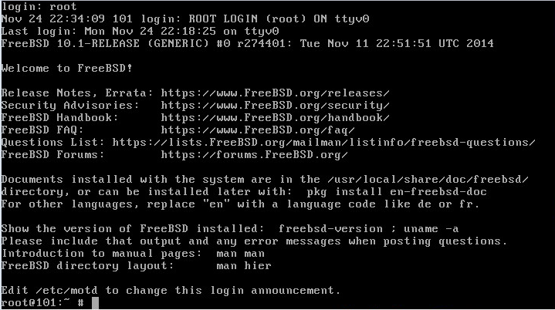

Slide 20
BSD Shell
Shell
tcsh (default root)
Bourne (User shell)
Supports other shell installations

Slide 21
Linux Commands Equivalent
Linux (Debian) | FreeBSD equivalent | Purpose
apt-get | pkg install | Install from remote repositories
dpkg –i package | pkg add package | Install local package
modprobe | kldload/ kldunload | Load/unload kernel modules
pwd | pwd | Shows current directory
ls | ls | List content of the current directory

Slide 22
Berkeley Fast File System (FFS)
New Revolution file system.
Performance gain + functionality
Released in 4BSD version. Was known as Berkeley FFS.
Features:
Reduced volume fragmentation
Large file transfer
Less file I/O overhead -> Faster performance.

Slide 23
SO WHY A WHOLE NEW FILE SYSTEM?
Simplicity was often emphasised over functionality in UNIX
Complaints about the functionality and performance limitations of the basic UNIX file system
UC Berkeley decided to address these issues in their fourth Software Distribution (4BSD).

Slide 24
BSD UNIX file system SUCCESSES:
The functionality and performance improvements
Change quickly adopted by the other UNIX vendors.
Nowadays, most standard UNIX file systems are based on the BSD (fast) file systems.
Used all over the world and adopted as the standard.

Slide 25
BSD UNIX file system- How does it work?
BSD file systems Divide the Volume into a number of equally sized cylinder groups.
Each cylinder group is a miniature file system – this modularity is crucial to the performance gains which this file system provides.
Each Cylinder group contains a Volume Descriptor (Super Block), Cylinder Group Descriptor, blocks of I-Nodes and Data Blocks

Slide 26
The Structure of the Cylinder Group:
BSD
Cylinder Groups
Super Block – Acts as Volume descriptor
Super Block
Cylinder Group Descriptor
Cylinder Group Summary
I-Nodes – Act as File Descriptors
I-Nodes
Data Blocks – Contain the File Contents
Data Blocks

Slide 27
CONCLUSION

