Slide 1
Alan Jones C16719689
Bryan Flood C16373571
Peter Hand C16769411
Mengqi He D15123660
Brendan O’Dowd C16476404
Chenxi Zhang C16434996
Roberto Leahy C16740185

Slide 2
CONTENTS
A biography of Andy Rubin.
Android Versions
The architecture of Android.
The Android GUI

Slide 3
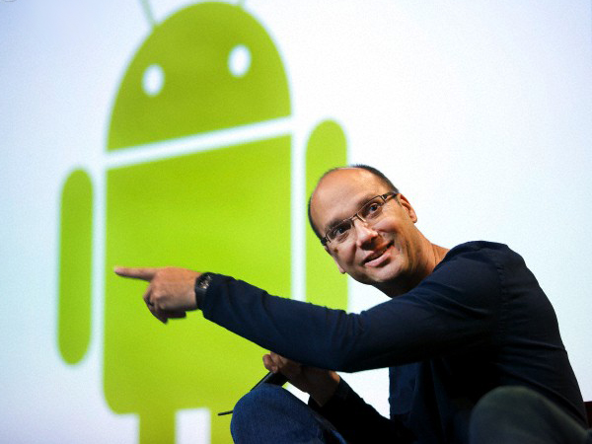
Creator of Android
Company founded by four people:
Andy Rubin
Rick Miner
Nick Sears
Chris White

Slide 4
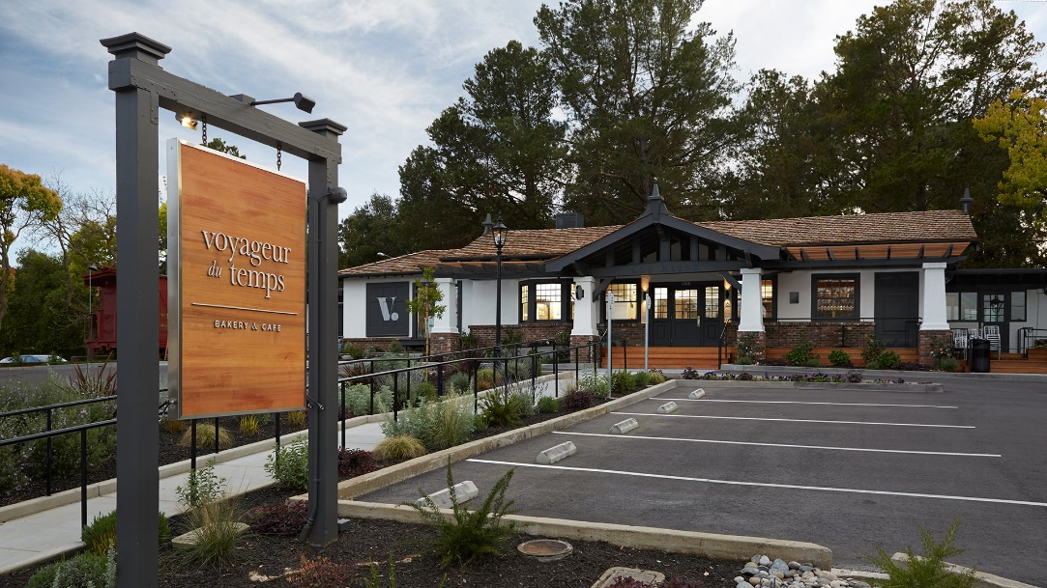
Andy Rubin
Born in 1963
Bachelors of Computer Science from Uticas College (81-86)
Various companies e.g. Carl Zeiss, Apple, MSN TV
Co-founder and Former CEO of Danger-Inc
Co-Founded Android in 2003
Runs a bakery in Los Altos with his wife, Rie.
Owns 17 patents

Slide 5
Andy Rubin - Google
In 2005 Android was acquired by Google
Senior Vice President of Mobile and Digital Content
2013 started management on robotics division.
Left in 2014

Slide 6
Andy Rubin - Present
Founded Playground Global 2014
PartnerRedpoint Ventures 2015
Incubator Companies

Slide 7
Donut
Quick Search Box
Without opening browser, search within phone and internet.
As powerful as you can imagine, searching your phones contact, maybe a suggestion of pizza takeaways near you, current weather, etc.
Big thing at that time.

Slide 8
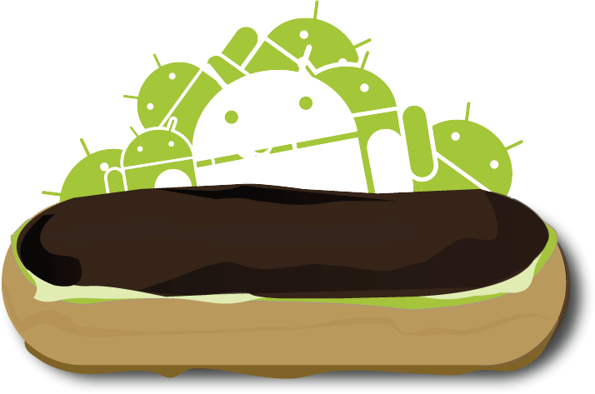
Eclair, Froyo and Gingerbread
Google Map Navigation
Act like In-car features, like GPS, 3D-view, voice guidance, traffic information all for free.
Home screen customization
Wallpaper, ringtones, etc. Also arrangement of apps and widgets, DIY the way you wanted.
Speech to text
Spoken words appear right on screen, it replaced the comma key button on the soft keyboard with microphone button

Slide 9
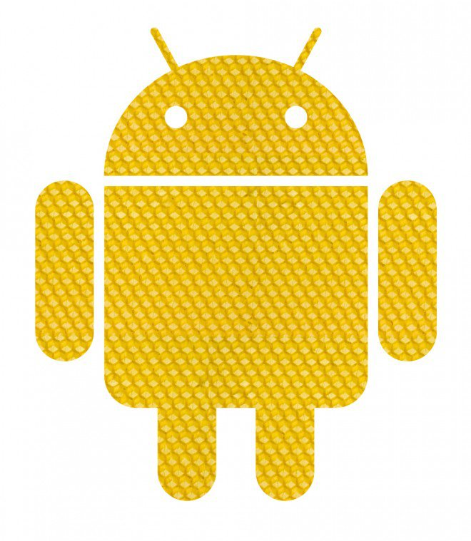
Honeycomb
Tablet friendly design
Larger layout pattern, enhanced experience of reading books, watching videos, exploring maps, etc.
System bar
New system bar replaced old physical home, back and menu button, it enabled on screen navigation controls on the Android device.
Quick Settings
Access essential information more easily, time, date, battery life and connection status all in one place.

Slide 10
Ice Cream Sandwich, Jelly Bean and KitKat
Custom home screen
App folders and favorites tray. Flexible and expand your widget to show more content or shrink to save space
Beam
Allow two phones instantly share content by NFC, simply by touching them. Share apps, videos, music, etc. Without an app or pair a phone.
Google Now
A new level of mobile assistance, get the information you need at just the right time.

Slide 11
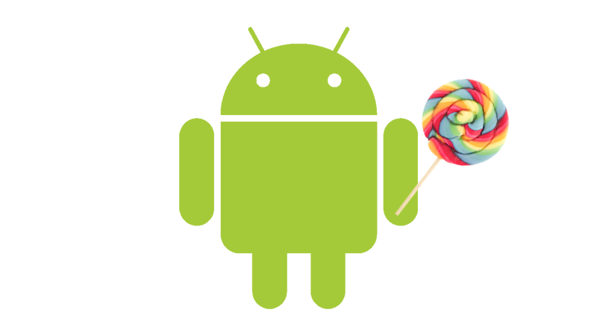
Lolipop
Material Design
Entire new looks and feel that make navigation easier. Unites classic principle of good design with innovation of what’s possible through technology.
Notifications
Notification appears to lock screen with segmented cards layout.

Slide 12
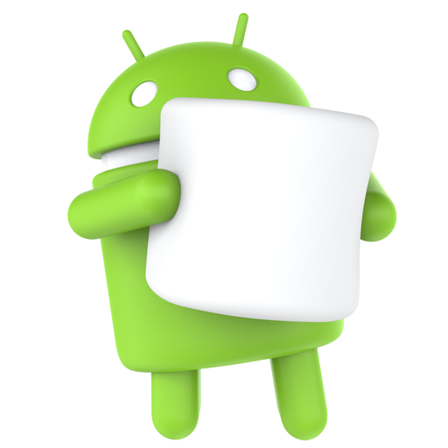
Marshmallow
Now on tap
Get assistance without leaving what you’re doing, whether in an app or on a website, just tap and hold home button.
Permissions
Define what you want to share with apps on your device, turn on/off anytime you want.
Battery
Optimize battery with Doze and App Standby

Slide 13
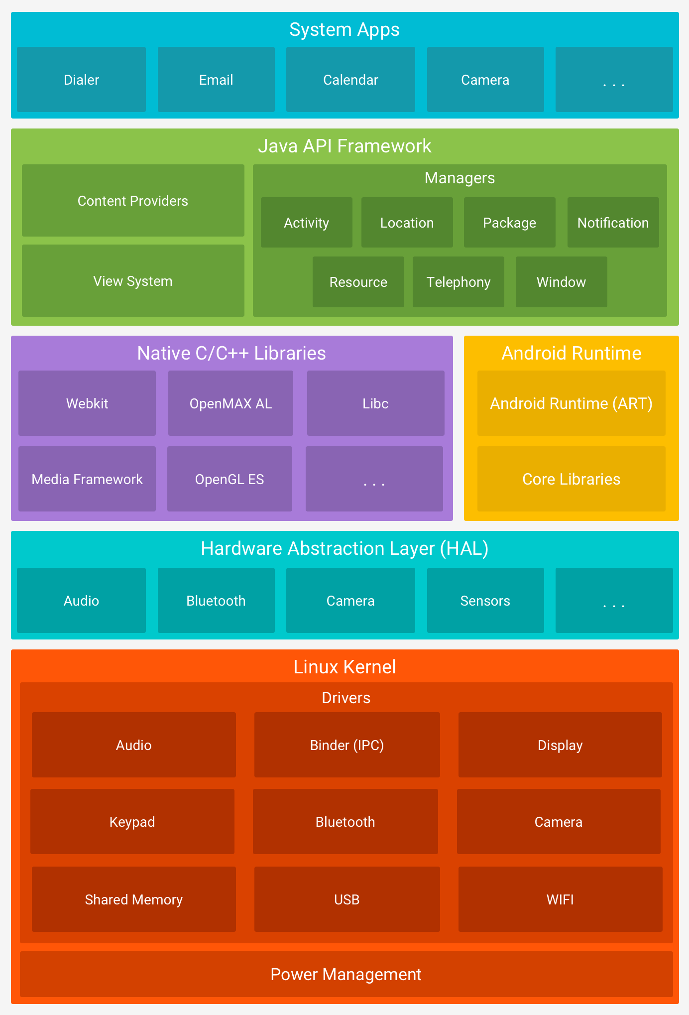
Android Architecture

Slide 14
Parts
Linux kernel
Hardware Abstraction Layer
Libraries
Android Run time
Application Framework
Applications

Slide 15
Linux Kernel
Android uses the Linux kernel which is the core of the OS
Its based off the Linux kernel 2.6
It has used a forked version of Linux Kernel since 2010 specifically for android

Slide 16
Why The Linux Kernel?
Free and lots of developers have experience with it
Allows android to be open source
Easier than creating a new kernel

Slide 17
Hardware Abstraction Layer
Acts as a intermediate between software and hardware
This allows the os to run on many devices with out the os kernel having to be changed
Allows for the use of java API calls instead of system calls

Slide 18
Hardware Abstraction Layer
Allows to communicate with the hardware specific device drivers
Complete abstraction and control over the device vendor
In short it means app developer don’t have to deal with communicating directly with the hardware

Slide 19
Libraries
Android contains several libraries that help speed up development
Native Libraries also allow developers to use existing libraries and make them work on many platforms

Slide 20
ART
This is the virtual machine that android uses to run Java based applications
It itself contains core libraries
It allows apps to run in their own instances

Slide 21
ART
Android Virtual Machine was originally Dalvik
ART provides a whole host of improvements such as
Better memory management
Compilation Ahead-of-time
Improved java performance

Slide 22
Application frameworks
Gives access to prebuilt functions to aid development
This ranges from resource and notification managers to accessing data from other applications

Slide 23
Applications
Apps written in Java and use Java Virtual Machine
Compiled into Java Byte Code at compile time
Each has their own instance
Installed using Android Package Kit (APK)from the Google Play Store, Amazon Appstore etc.
Examples include the YouTube app, Facebook messenger and many more

Slide 24
GUI
Graphical User Interface

Slide 25
Main Components
Home Screen
Lock Screen
Drop Down Menu
Apps Drawer

Slide 26
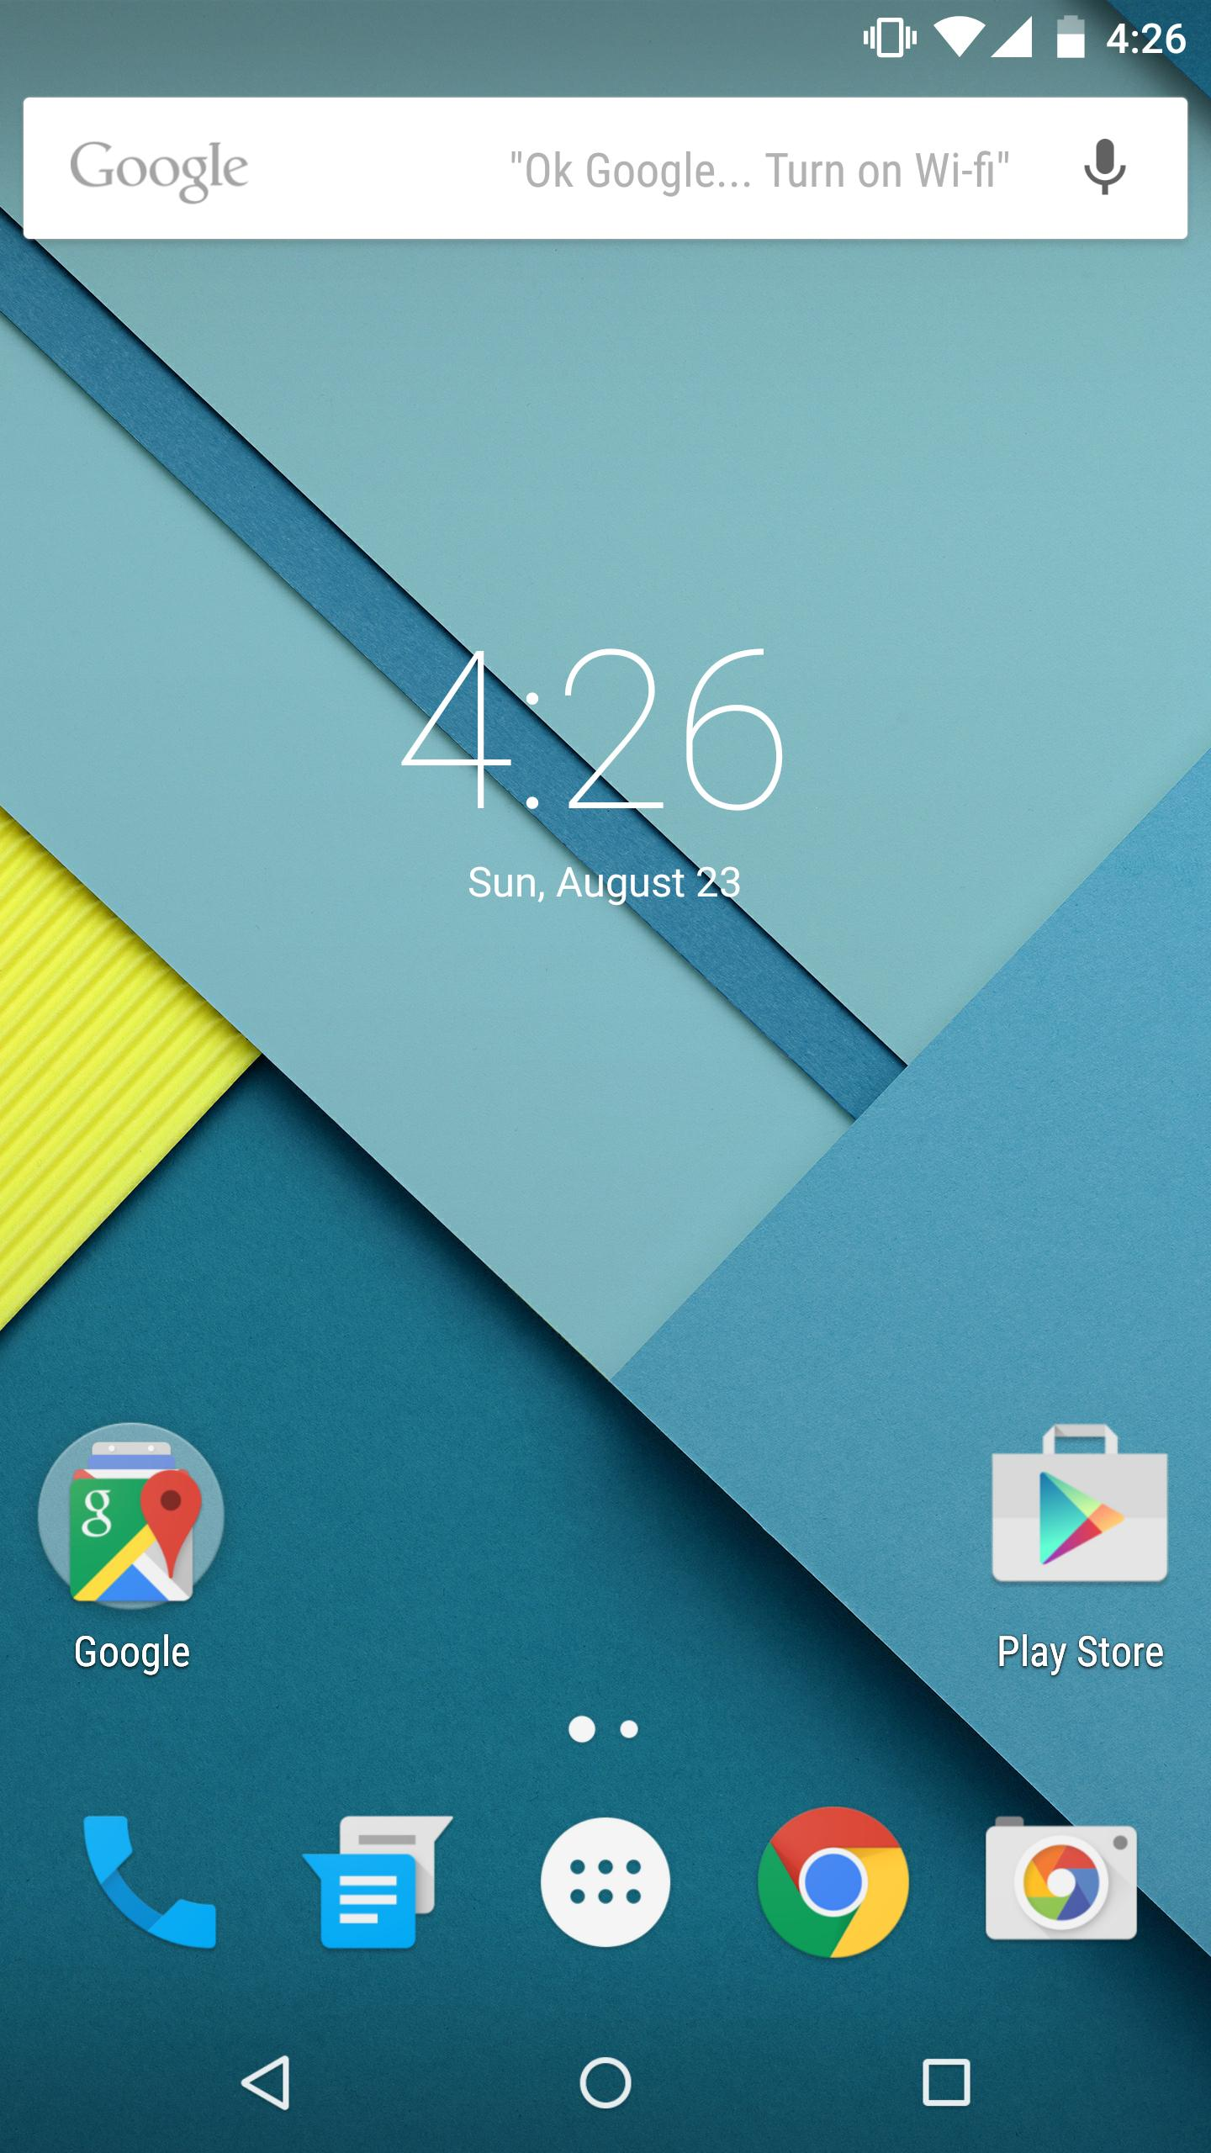
Home Screen
App Widgets dominate most of the home screen
Notification and Status Bar at the top
Apps Dock at the bottom
On screen buttons also at the bottom
Can group apps into folders on home screen
Swipe the screen right or left to access
different home screen pages

Slide 27
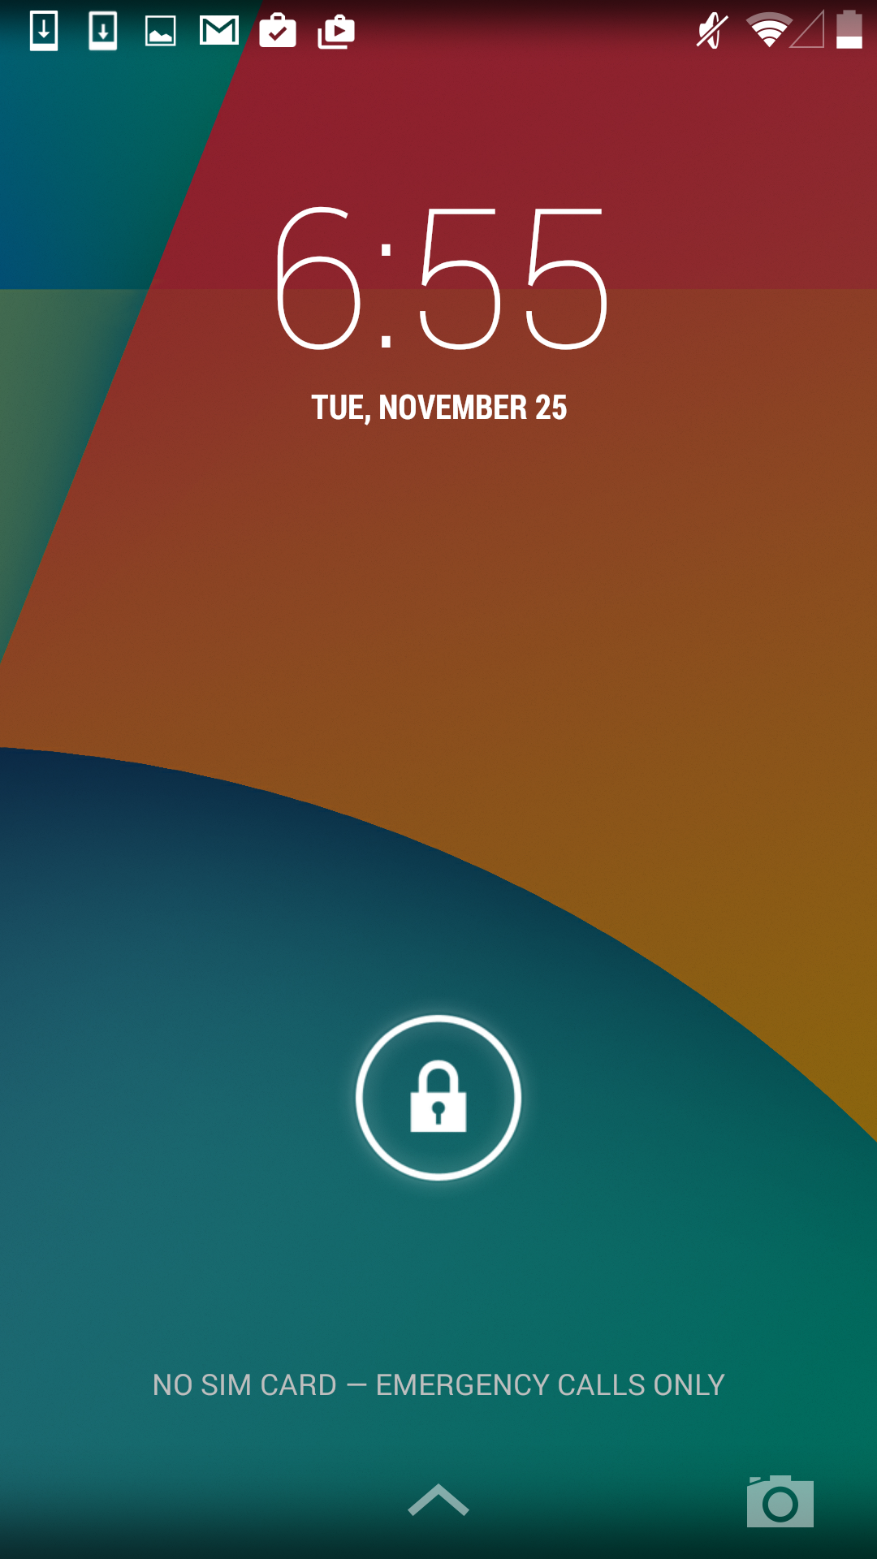
Lock Screen
Can set up specific wallpaper for lock screen
Multiple methods of lock screen password
protection (PIN, Pattern, Password)
Displays Time and other basic information
Notification bar and drop down menu
accessible from lock screen
Can control certain apps from
lock screen i.e Media Players

Slide 28
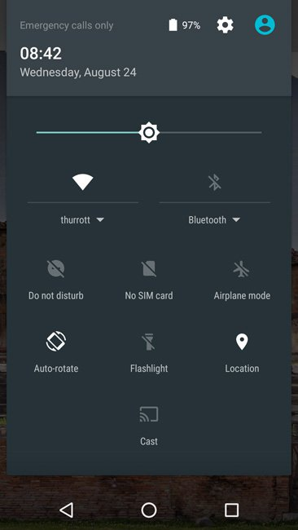
Drop Down Menu
Accessed by swiping down from the top
of the screen
Contains quick access to multiple settings options
Displays notifications from apps
Can customise what settings appear

Slide 29
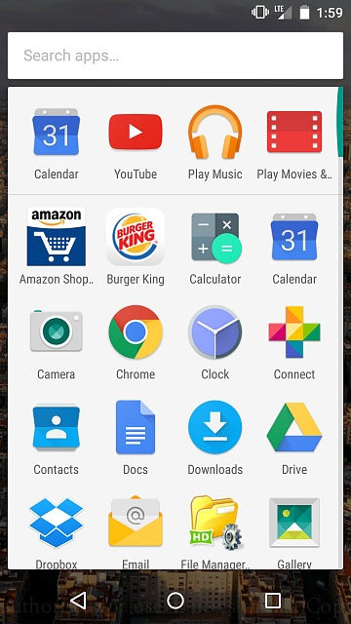
App Drawer
Place where all apps are located on the GUI
Apps can be dragged from the App Drawer
to the home screen to create a widget
Most used apps appear at the top
Can search for apps using the search bar

Slide 30
Thanks!

Slide 31
References
Android Word and os logo – Android
Andy Rubin Image https://vulcanpost.com/600635/andy-rubin-new-startup-take-on-apple-google/
Bakery - http://charactersf.com/projects/voyageur-du-temps
Google logo – google.com
PlayGround Global logo - https://www.crunchbase.com/organization/playground-global
Redpoint logo - http://streetfightmag.com/2015/09/28/redpoint-ventures-dharmaraj-there-will-be-many-different-craigslists/
Android Donut, Eclair- http://android.wikia.com/
Android Jellybean - https://www.howtogeek.com/120799/the-best-8-new-features-in-android-4.1-jelly-bean/
Android Honeycomb - http://www.intomobile.com/2010/12/06/android-3-0-honeycomb-tablet-optimized-ready-for-2011-launch/
Android Lollipop - http://www.crunchytricks.com/2014/10/get-android-lollipop-look-on-your-smartphone-with-these-5-apps.html
Andoid Marshmallow - http://android.wikia.com/
Android Architecture - https://developer.android.com/guide/platform/index.html
Desktop - http://www.clubic.com/smartphone/android/article-745031-1-nexus-6.html
Lockscreen http://www.tudocelular.com/windows/noticias/n69571/windows-10-mobile-redstone-atalho-camera.html
Drop Down menu - http://www.swedroid.se/recensioner/telefoner/vi-testar-motorola-moto-x-force-med-okrossbar-skarm/
App Drawer - http://forums.androidcentral.com/general-news-discussion/586191-new-marshmallow-app-drawer-terrible.html

