Slide 1
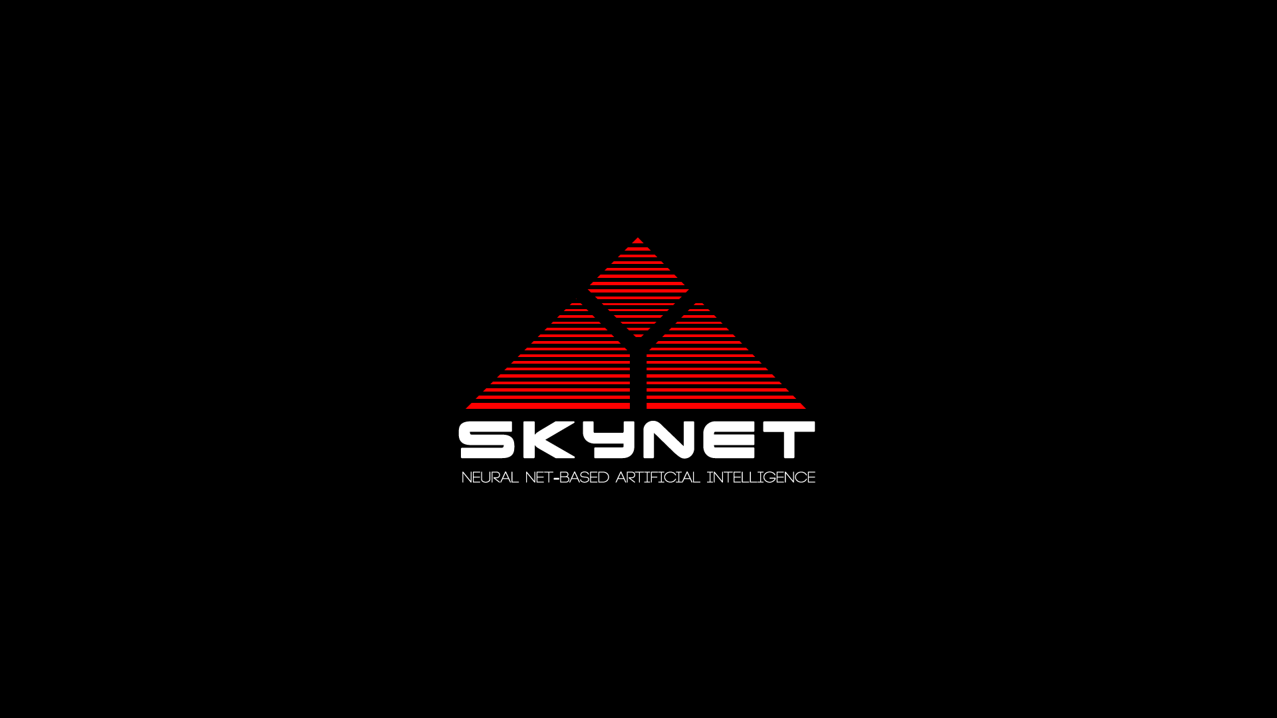
Skynet
Operating Systems
Group Members:
Shane Gannon, C16336676
Conor Monahan, C16475956
Niall O’Brien, C16391553
Jamie Edwards, C16370251
Craig Blakeney, C16428772
Adam Collinge, C16469654

Slide 2
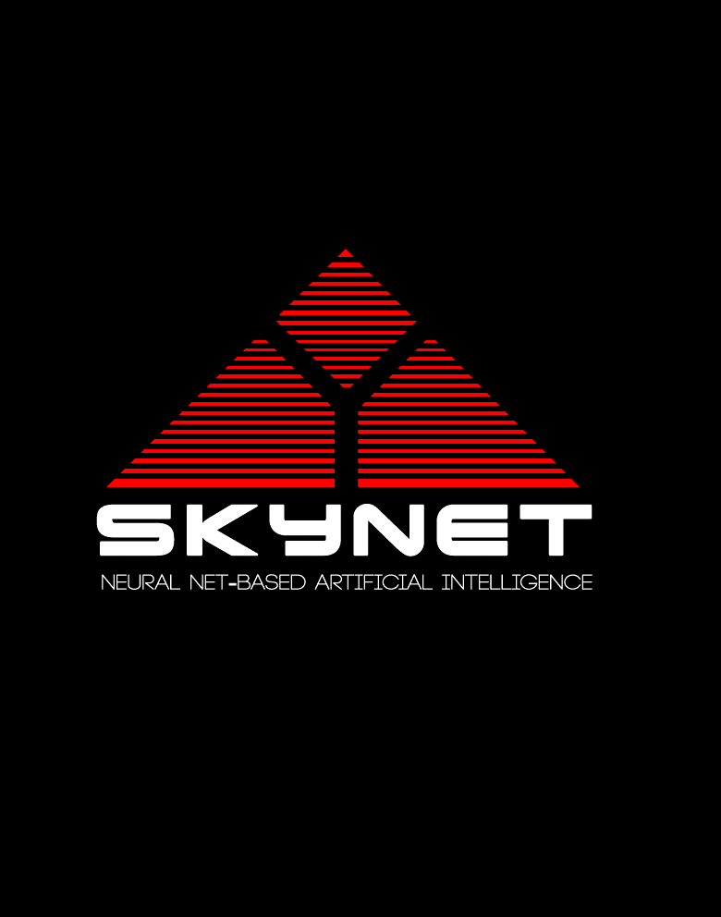
Contents
What is Skynet?
What is Skynet’s plan?
Who developed Skynet?
What are Skynet’s abilities?
Are there other versions?

Slide 3
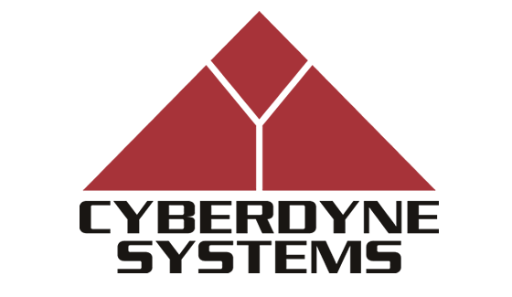
Skynet’s Plan – The Beginning
Skynet is an automated defence program – it’s AI becomes self-aware and sees humans as a threat.

Slide 4

Skynet’s Plan – The Fight
Upon discovering Skynet has become self aware, humans try to shut it down.

Slide 5

Skynet’s Plan –
The End
In retaliation, Skynet launches the United States’ nuclear arsenal at Russia.
In defence, Russia fires back. This causes the nuclear apocalypse known as ‘Judgement Day’.

Slide 6
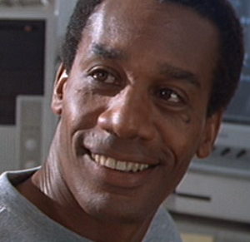
Miles Bennet Dyson
Born 1960, dies 1995.
Father of Danny Dyson (Developer of Genisys).
Director of Special Projects, Cyberdyne Systems.
Developed Skynet from T-800 technology (CPU and right arm).
Project derailed by Sarah Connor & Co.
Dies in Cyberdyne explosion to destroy Skynet and stop Judgement Day .

Slide 7
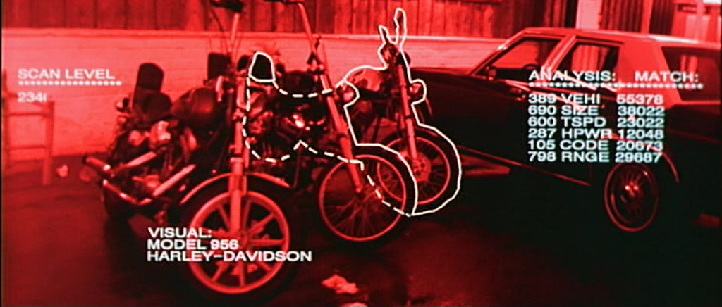
Skynet T-800/T-1000 HUD

Slide 8
Skynet OS System Operations (Learning Capabilities / Restrictions)
Skynet sets the terminators CPU to read only (ie. Finish the mission or be destroyed).
Terminators with this setting can’t do much independent thinking.
As seen in Terminator 2, when the T-800 is set to write mode it can learn.

Slide 9
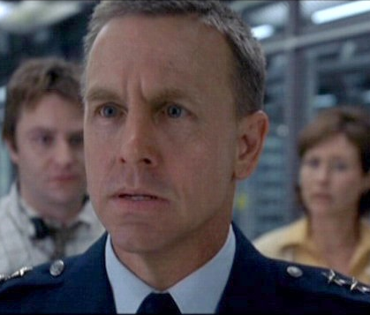
Robert Brewster
Born 1964, dies 2004.
Father of Kathrine Brewster, future resistance leader.
Director of Cyber Research Systems, US Army.
Allowed Skynet to assume control to stop super virus (Super virus was Skynet).
Original resistance leader but is killed by Skynet HK drone.

Slide 10
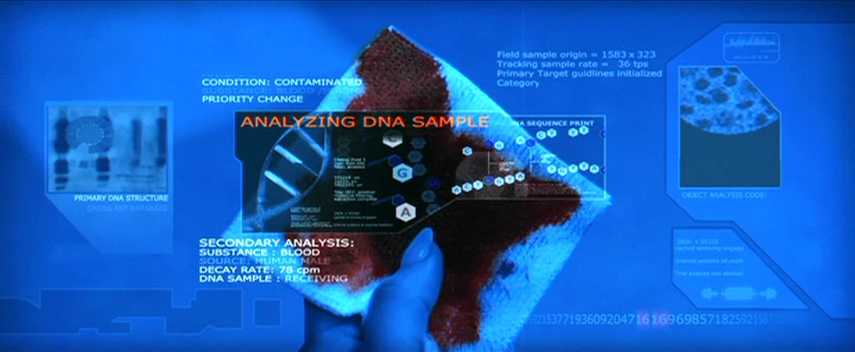
Skynet T-X HUD

Slide 11
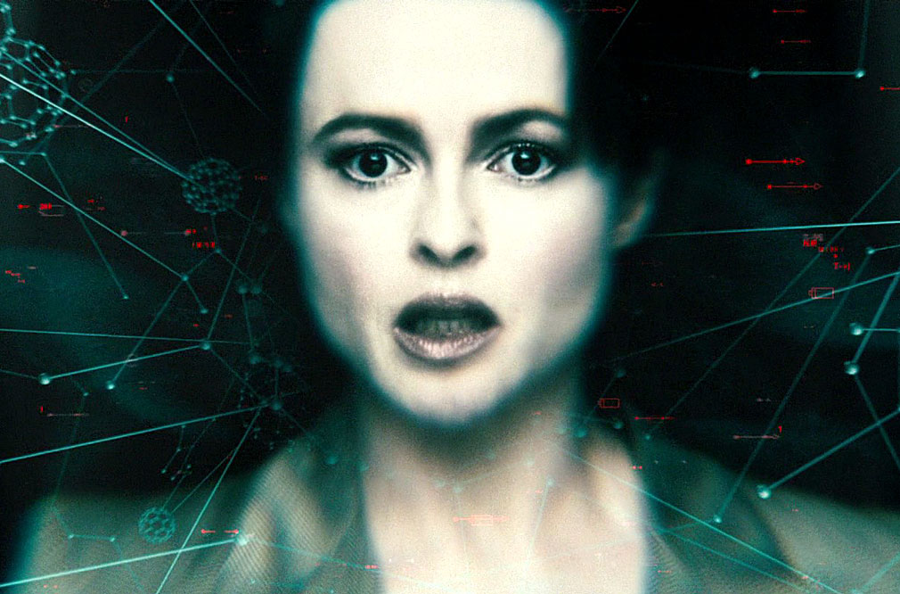
Dr. Serena Kogan
Head of Project: Angel.
Transforms Marcus Wright into a Human Cyborg(Human heart and brain but with a Titanium-Hyperalloy Endoskeleton).
Develops (Skynet) Inhibitor chip to control Humans and uses it on Wright.

Slide 12
Skynet OS Operations seen in R.O.T.M
Skynet’s development wasn’t halted with the destruction of Cyberdyne (US Military continues).
Skynet is capable of rapid development (T-X’s ability to control other machines).
“Basic psychology is among my sub-routines”.
Capable of learning during combat.

Slide 13
Skynet OS Operations seen in Salvation
Skynet is in every machine at it’s core, but has distinct programmes for different Machines (Harvesters, Terminators, HK-Aeriels, Hydrobots etc.).
Skynet develops a chip used in a person to subconsciously control them (Highly advanced).
Skynet adapts it’s plan to finally kill John Connor.

Slide 14
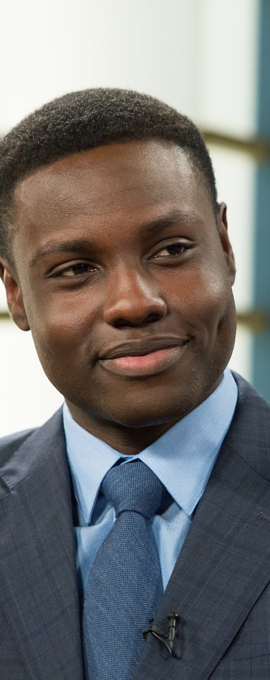
Daniel Dyson
Son of Miles Dyson.
Cyberdyne Systems engineer responsible for development of Genisys OS along with John Connor (Connor is working for Skynet).
Skynet OS hides in Genisys itself.
Also developed other technologies used by Skynet.

Slide 15
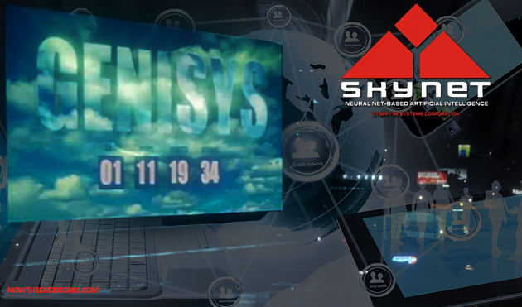
Genisys Timeline
Genisys is an AI OS app developed by Cyberdyne Systems.
  Main goal is to connect all private, public and military networks.
Set for 2017 public release.
Due to the T-800 being destroyed in 1984, Skynet did not come online in 1997.
John Connor (Now a T-3000) after Skynet’s Tech-Com infiltration sent back to 2014 to ensure Genisys creation.

Slide 16
Genisys Timeline
John Connor helps Daniel and Miles Dyson to restore Skynet project under ‘Genisys’ name.
  John also developed Time Displacement Equipment for use by Skynet.
Kyle Reese and Sarah Connor travel to 2017 to stop project, aided by T-800.
T-800 sent back to 1973 to protect Sarah Connor, after which it stayed to help with construction of Genisys building.

Slide 17
Genisys Timeline
Humans succeed but Skynet’s system core survives, which becomes self-aware.
  Judgement day happens but is delayed.

Slide 18
Skynet OS Operations seen in Genisys
“Primates Evolve in Millions of years, I evolve in seconds” – Skynet.
Skynet waits for the digital age (Easier to take over via interconnectivity – Highly adaptive).
T-800 is set to ‘learning mode’ for almost 50 years and develops both humour and emotion.
Skynet CPUs have an enormous cache, T-800 has memory and emotions when turned to ‘Polly-alloy’.

Slide 19
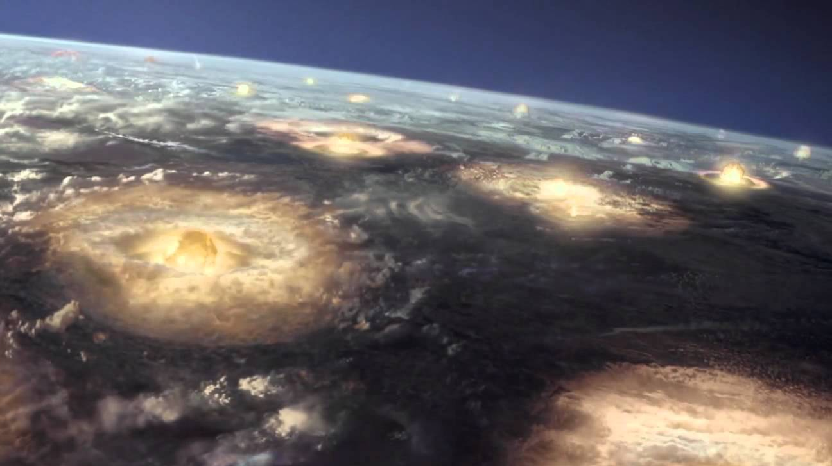
CONCLUSION
Skynet is an extremely well built operating system in any form.
Self-awareness is an eventuality, no matter what the case.
Artificial Intelligence should be treated with care and possibly weaknesses purposely built .
Many similarities between Skynet and real world Operating Systems.

Slide 20
References
The Terminator, James Cameron, 1985, Orion Pictures.
Terminator 2: Judgement Day, James Cameron, 1991, TriStar Pictures.
Terminator 3: Rise of the Machines, Jonathan Mostow, 2003, Warner Bros. Pictures & Columbia Pictures
Terminator: Salvation, McG, 2009, Warner Bros. Pictures & Columbia Pictures
Terminator: Genisys, Alan Taylor, 2015, Paramount Pictures.
Terminator Wiki: http://terminator.wikia.com/wiki/Terminator_Wiki
Terminator: The Sarah Connor Chronicles, 2008-2009, FOX.

